Slide 1
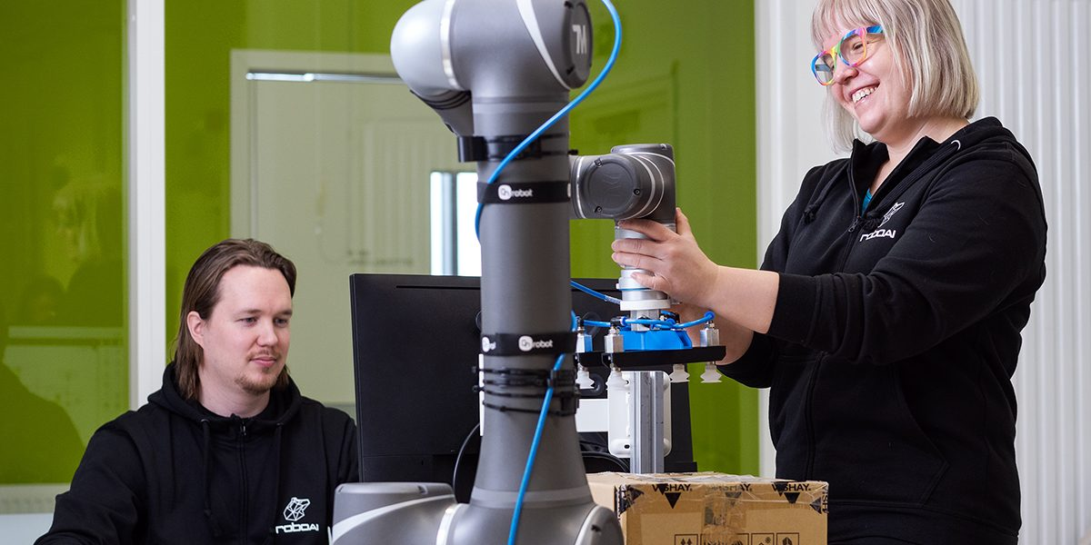
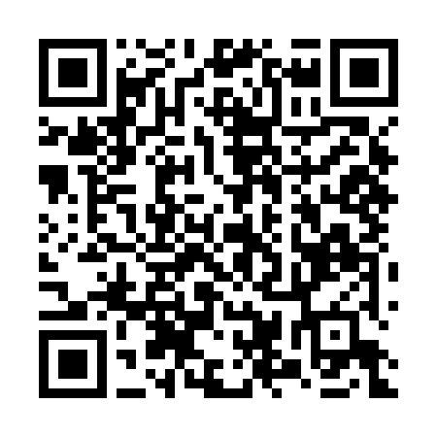



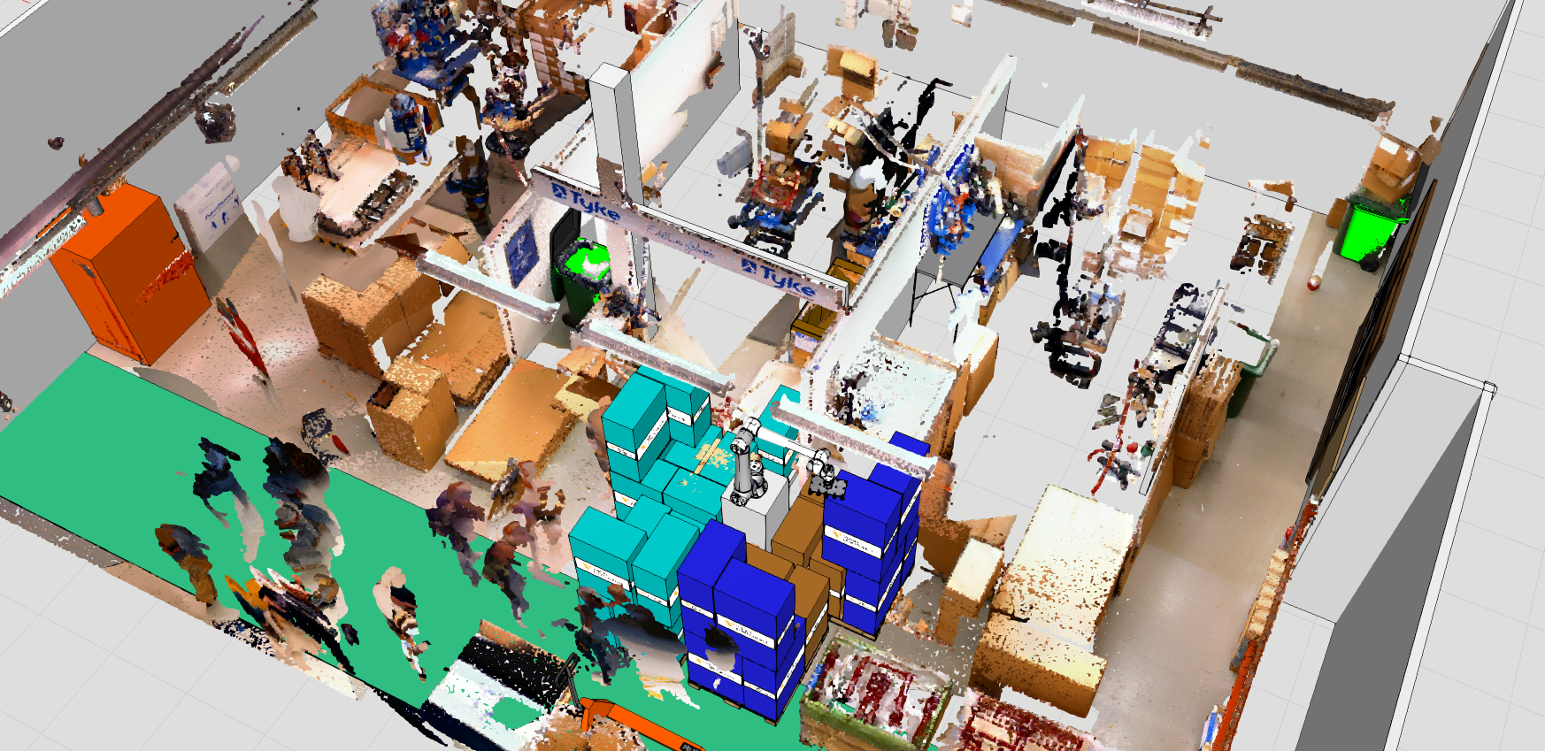
RoboAI Academy
Apply to study at the RoboAI Academy!
Hands-on learning through projects from companies. Topics cover robotics, AI, and programming. English sessions available March 24.
Website: www.roboai.fi/en/education-and-academies/roboai-academy/ Contact: Janika Tommiska
Apply for RoboAI Academy!

