Slide 1

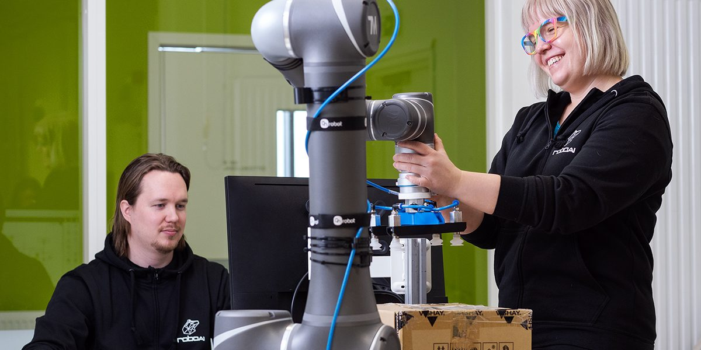

Apply to study at the RoboAI Academy!
Engineering studies starting autumn 2026
Applications open March 24 to April 12 for autumn 2026. Hands-on projects from companies. Selection in May.

