Slide 1
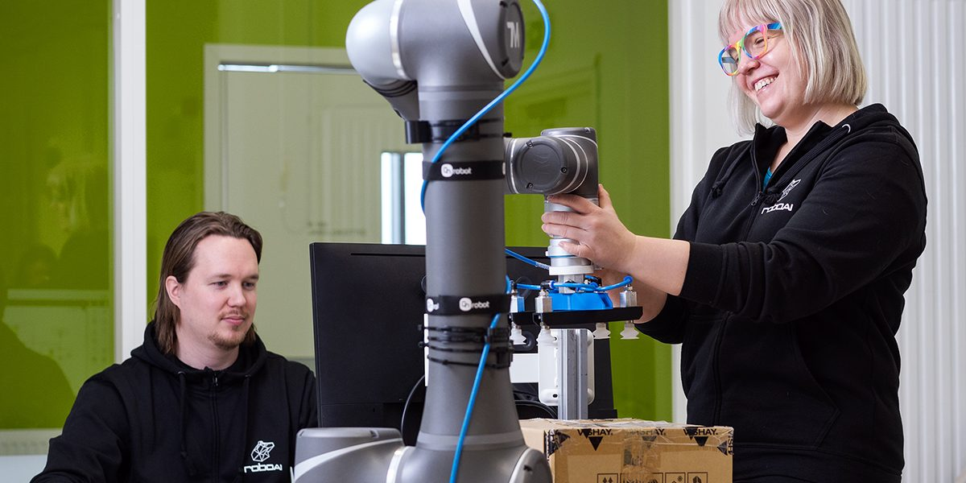


Study engineering in a hands-on way
Applications open March 24 to April 12 for autumn 2026 intake.
Apply to study at the RoboAI Academy!

