Slide 1
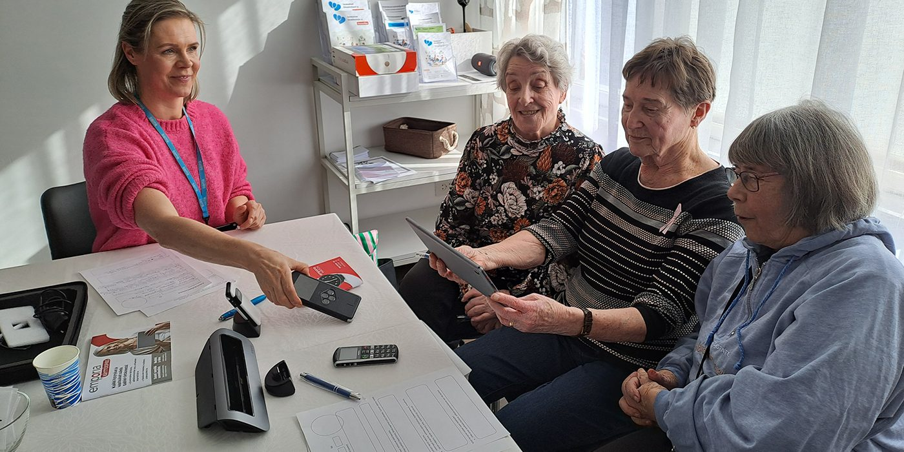
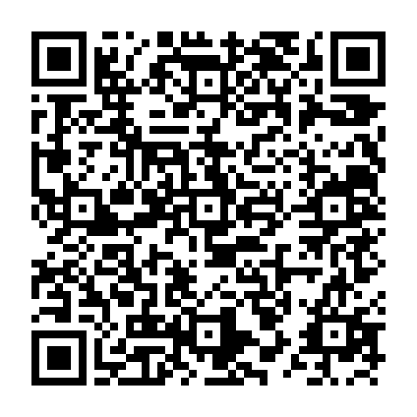



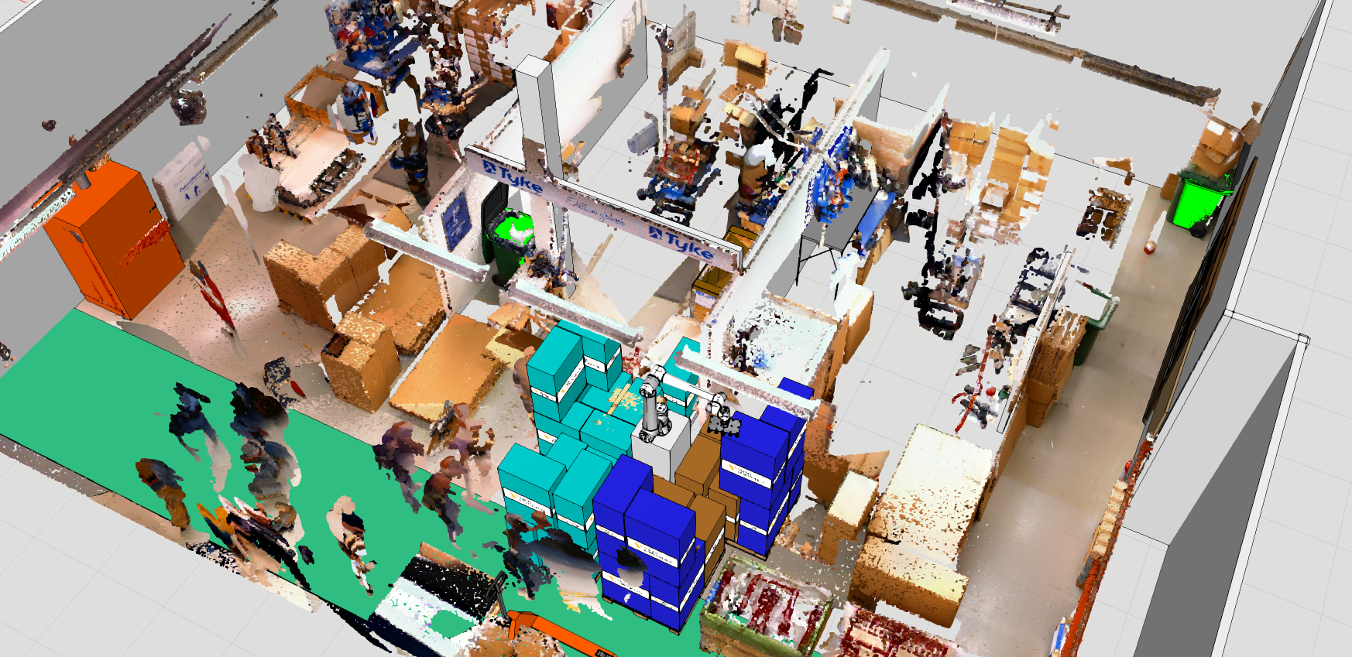
We Research
GeroTestbed model for age technologies
User-centred development ensures usability for older people. Specific needs must be considered during testing.
The IKI-project developed the GeroTestbed-model to support technology companies. It offers tools for safe product design. The model enables older people to participate in development.
More on this topic

