Slide 1
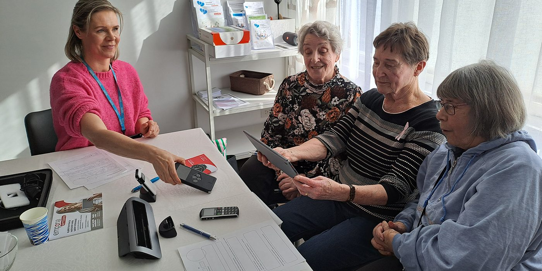
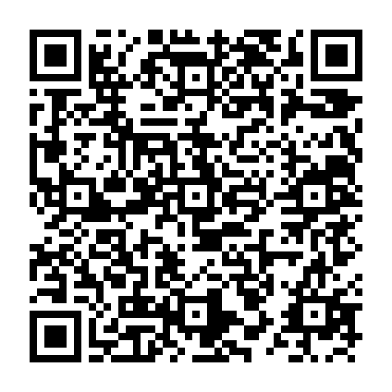



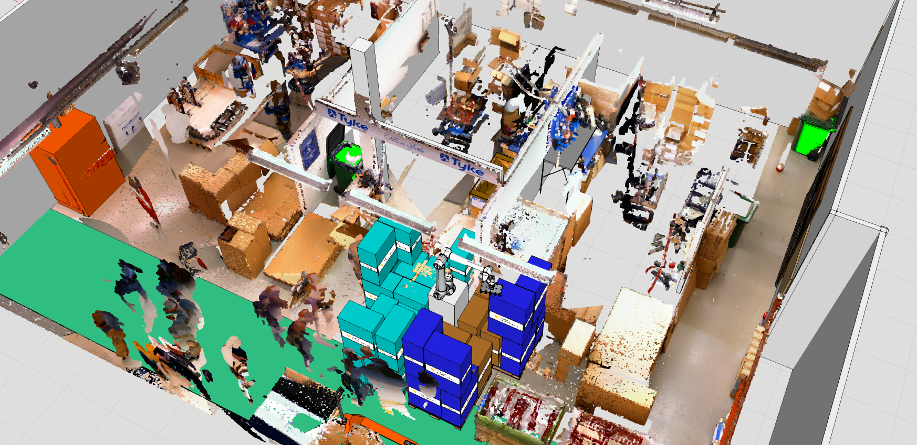
We Research
We Research: GeroTestbed-model supporting agetechnologies development
User-centred product development is key to ensuring usability of health and well-being technologies. Testing must occur at different stages on target groups. For older people, specific characteristics must be considered for safe user experience.
More on this topic: IKI project environment (24.4.2024), 10 tips for co-creation (blog 12/2024), GeroTestbed testbed video.
Read more

