Slide 1

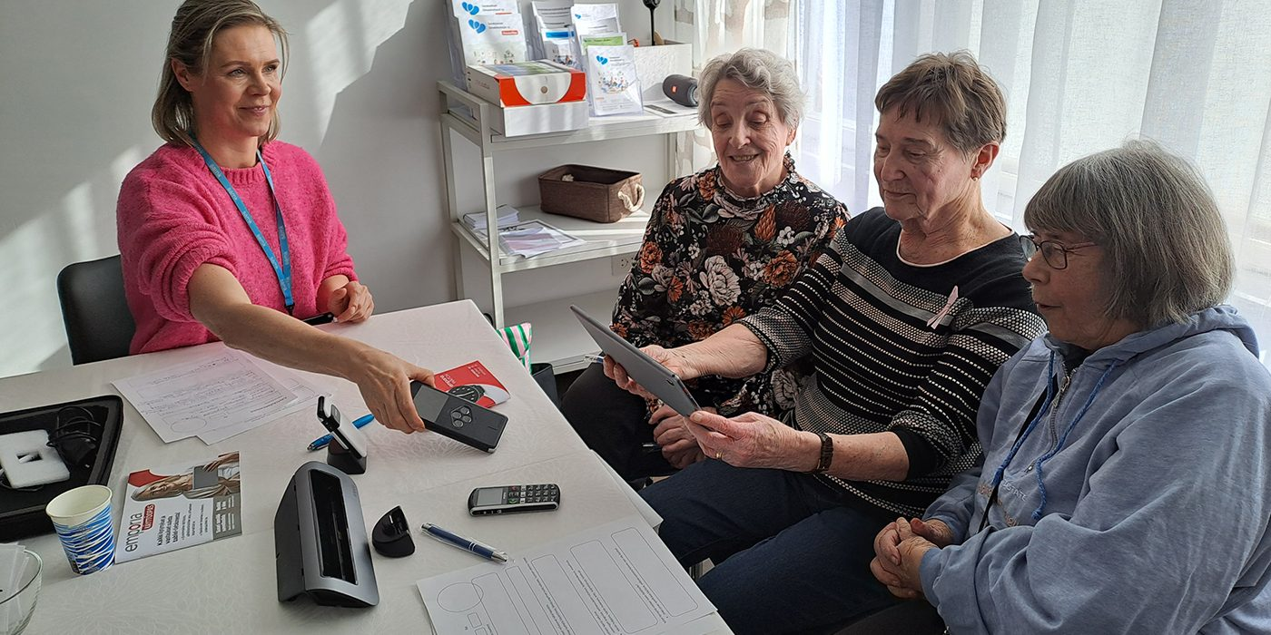

We Research: GeroTestbed-model supporting the development of agetechnologies
IKI project develops support services for ageing technologies
The IKI project aims to develop a GeroTestbed model for technology companies and service providers to ensure safe, user-centred products for older people.

