Slide 1
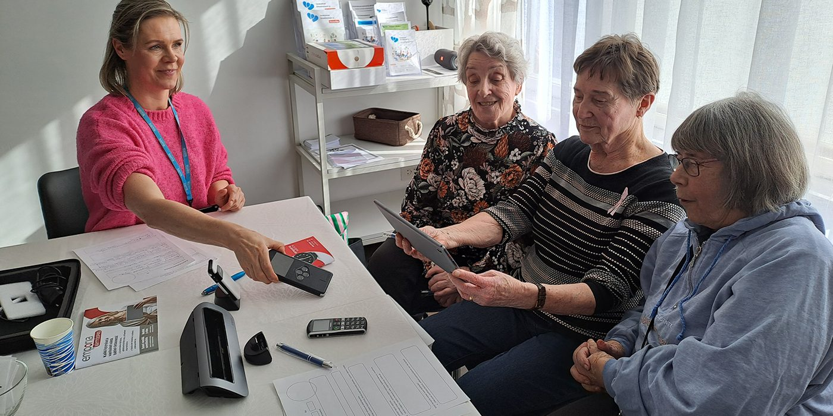

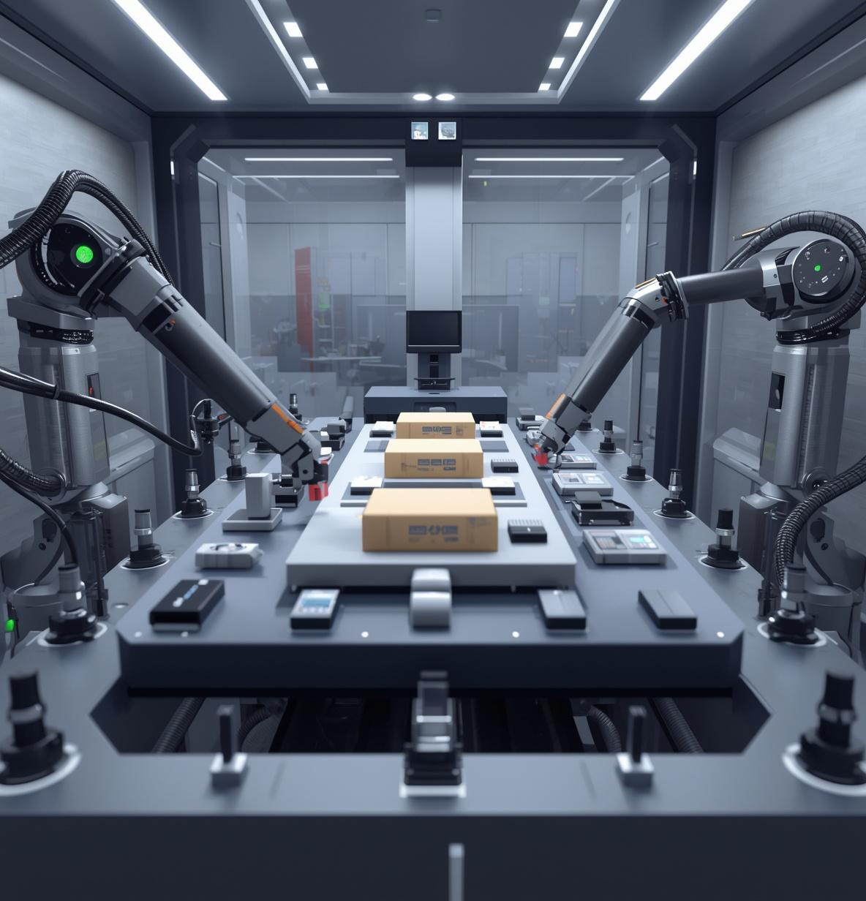
Ensuring usability and effectiveness for older users
Older people often face motor, cognitive and sensory barriers to using technology.
We Research: GeroTestbed-model supporting the development of agetechnologies

