Slide 1
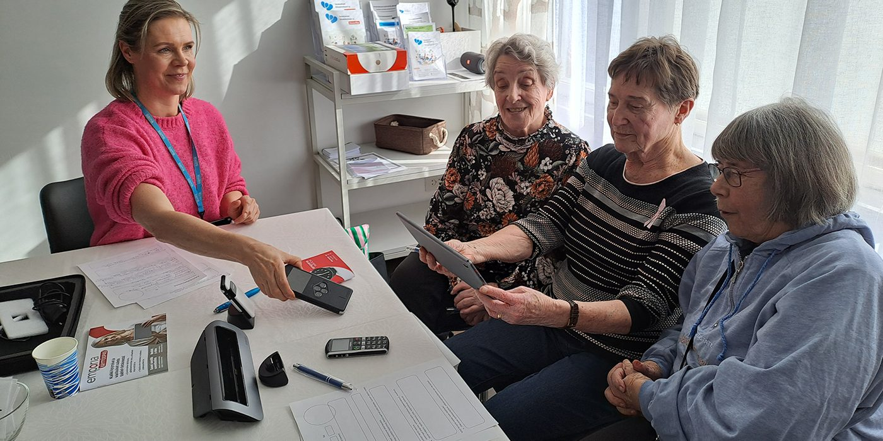
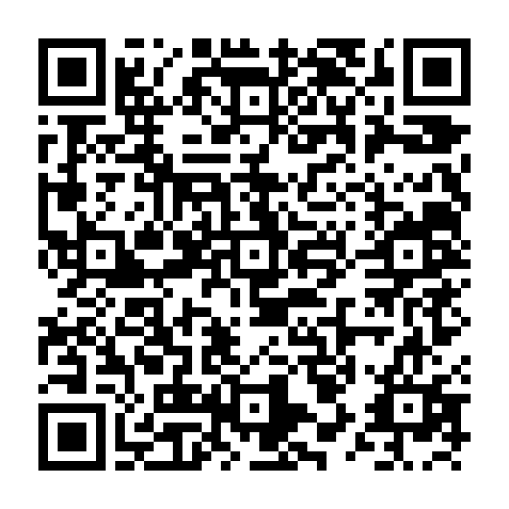



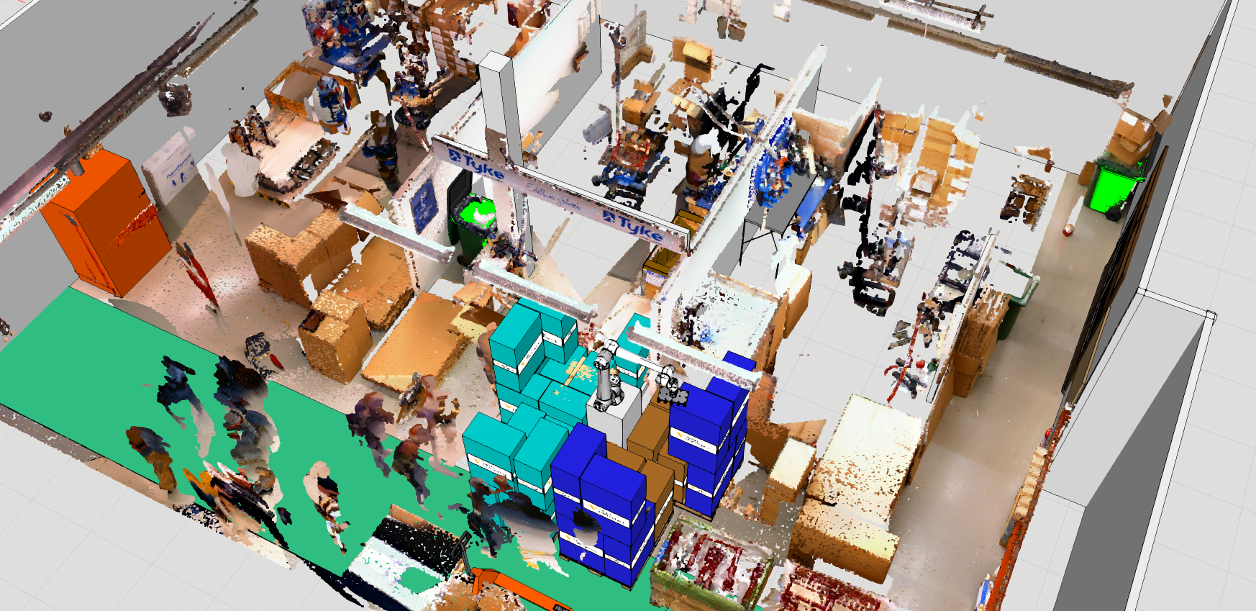
IKI Project
GeroTestbed-model for ageing technologies
User-centred product development is key to ensuring the usability of health and well-being technologies. Testing must consider specific characteristics of older people.
The model provides tools for companies to design user-centred products and supports service providers in technology use. Lessons enable older people and carers to participate safely in development.
More on this topic

