Slide 1

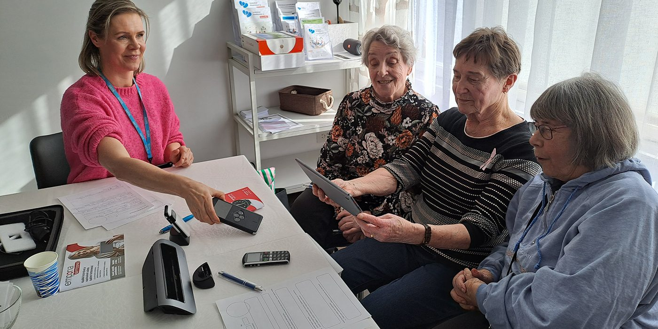

We Research: GeroTestbed-model supporting the development of agetechnologies
27.3.2025 Mervi Vähätalo
IKI project funded by EU and City of Pori created model for testing health technologies with older people.

