Slide 1
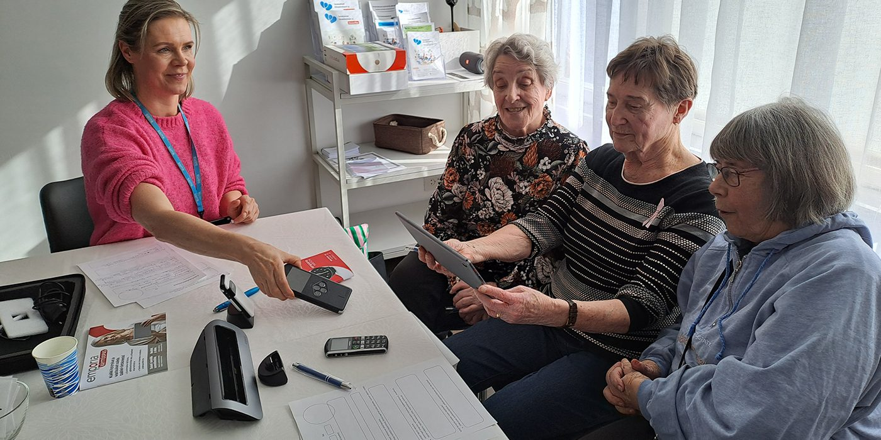

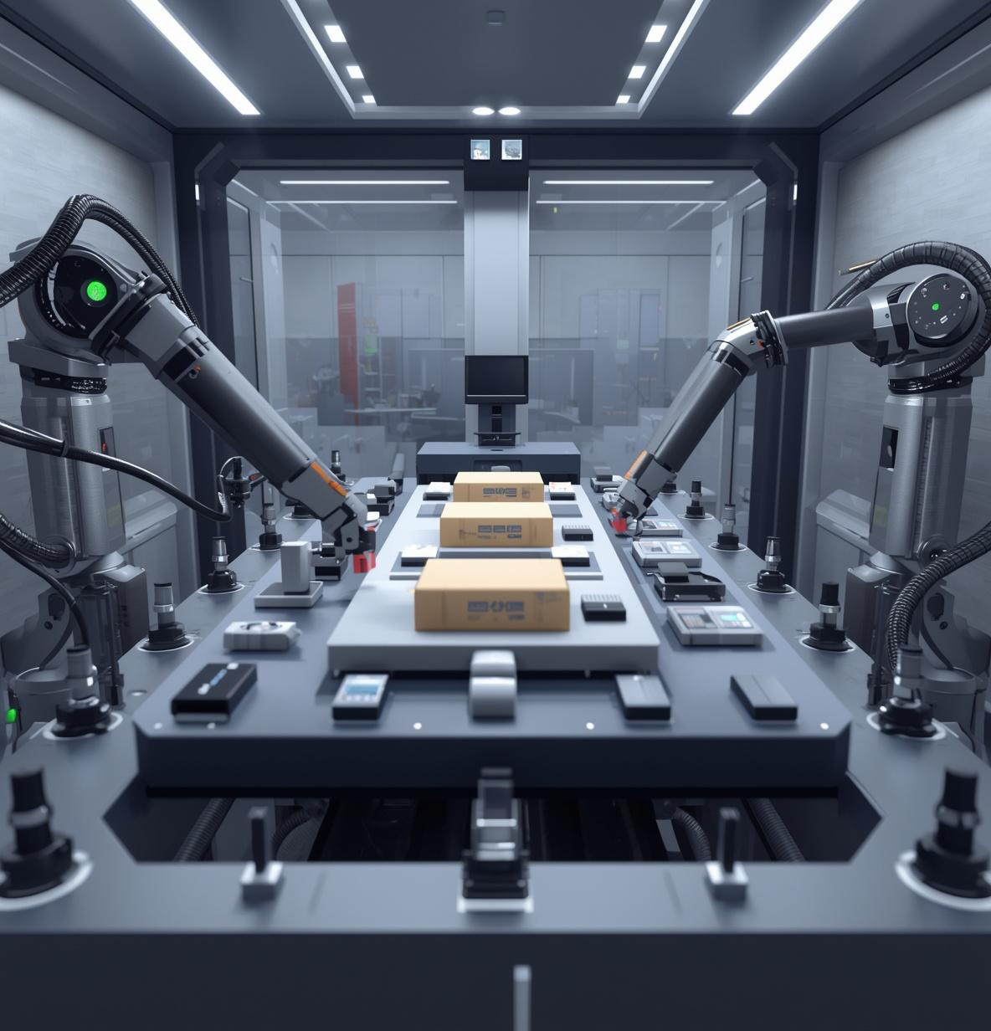
We Research
Many older people are enthusiastic and excited about the co-creation and use of technology!
We Research: GeroTestbed-model supporting the development of agetechnologies

