Slide 1
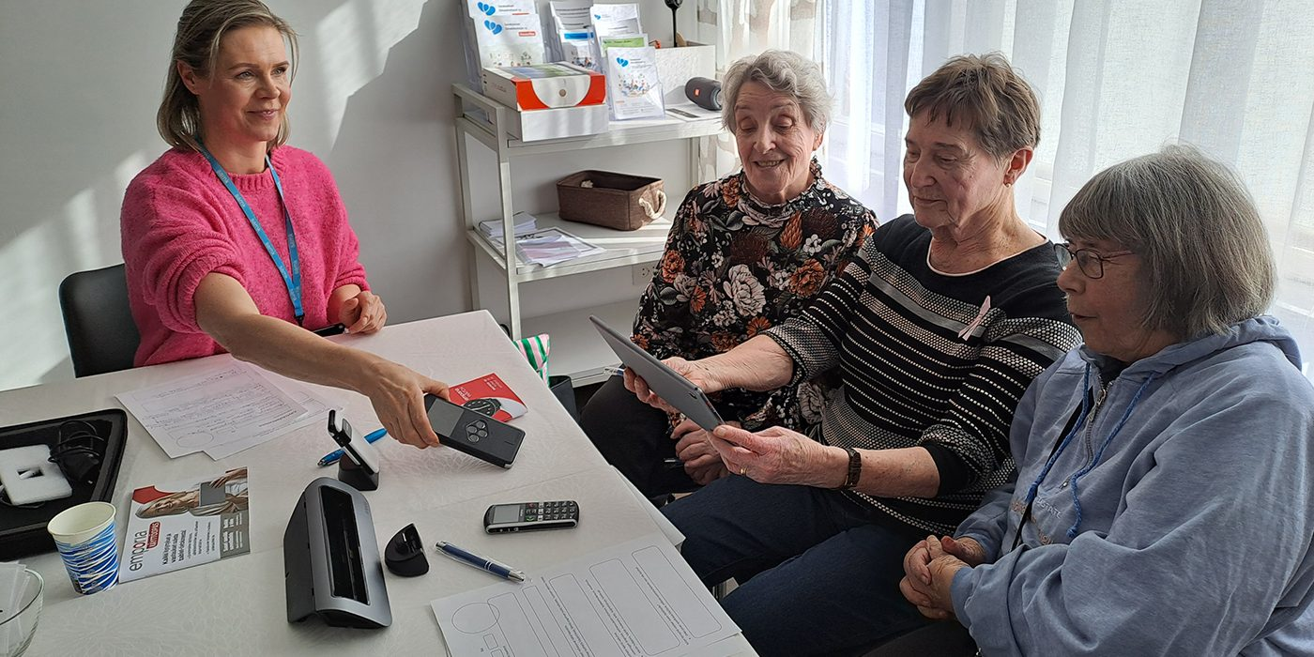
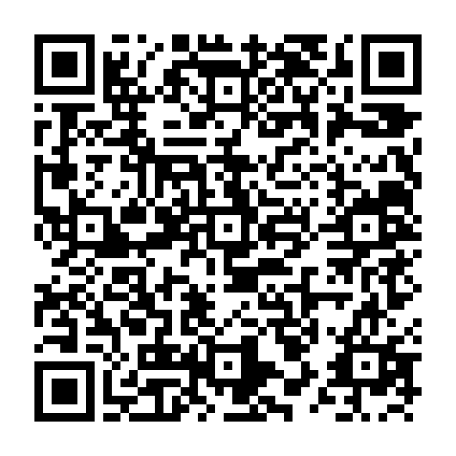



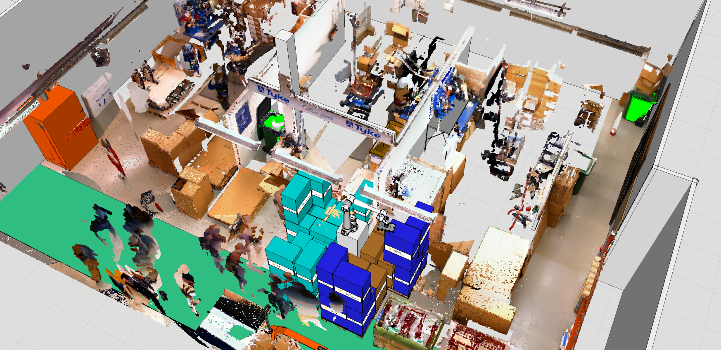
We Research
GeroTestbed model
User-centred product development is key to ensuring usability of health and well-being technologies for older people.
IKI project funded by EU and City of Pori created model providing testing and research services for technology development and digital services.
More on this topic

