Slide 1
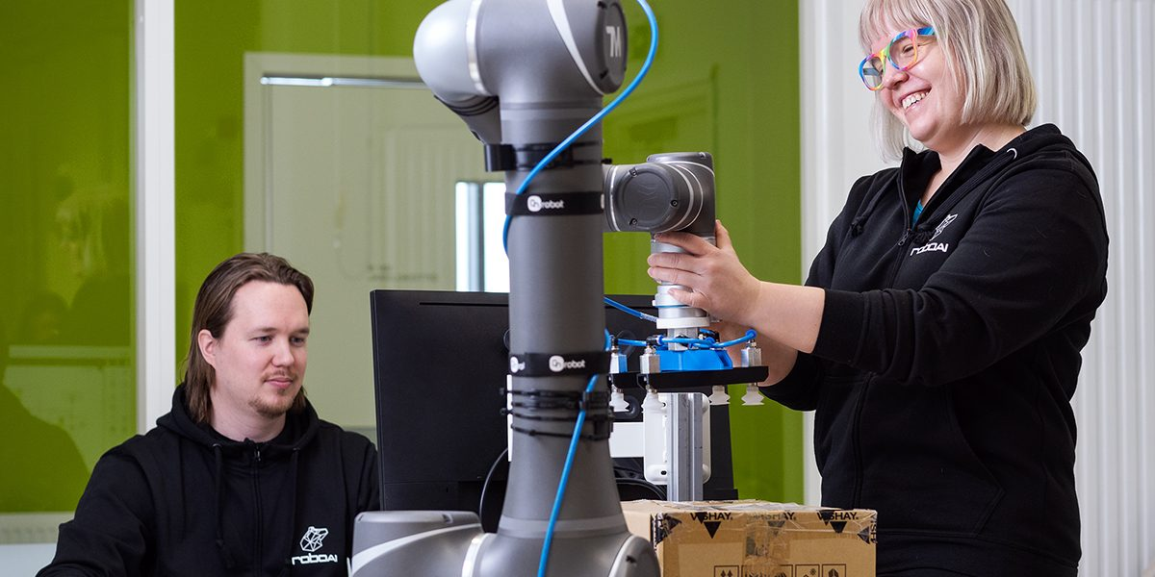

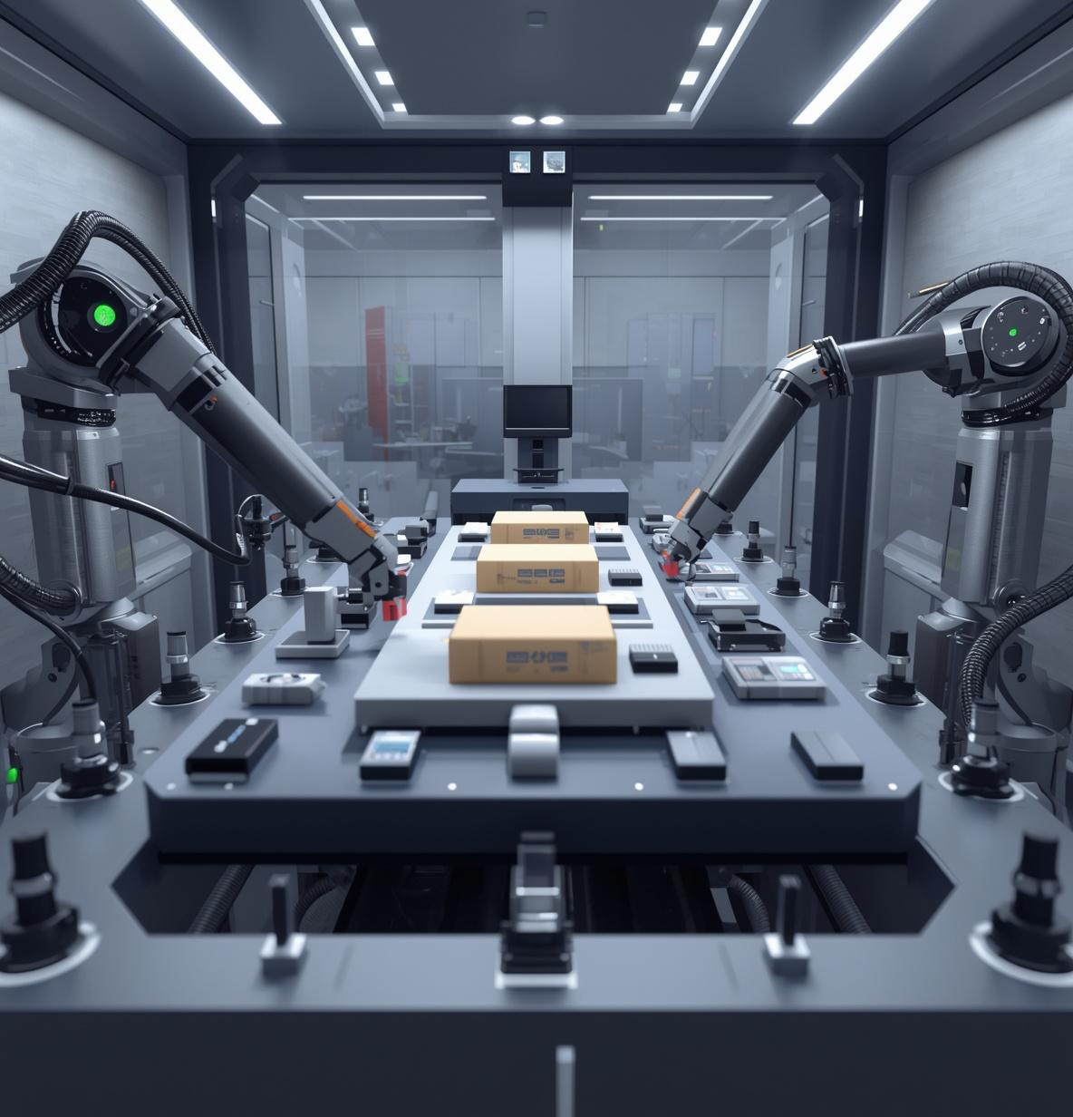
Hands-on learning through projects for engineering students
Learning happens through hands-on projects rather than traditional lectures with workable solutions meeting customer needs. Selections are made based on application and interviews in May. The academy fosters international collaboration with English as a primary language.
Apply to study at the RoboAI Academy!

