Slide 1
Analysing the Impact of Demographic and Lifestyle Factors on Student Performance
Xirui Li / Ruoyan Gong

Slide 2
CONTENTS
01
Summary
02
Exploratory Data Analysis
03
Hypothesis testing
04
Confidence Interval
05
Conclusion

Slide 3
1
Summary

Slide 4
1.1 Introduction
Student academic performance is influenced by multiple factors beyond classroom learning.
Demographic, family, and lifestyle aspects play crucial roles in shaping educational outcomes.
Understanding these factors helps educators and policymakers develop effective support systems.
Dataset: UCI Student Performance Dataset (Portuguese secondary education students).

Slide 5
1.2 Problem Statement
Student performance varies widely even within similar classroom environments.
Limited understanding of how demographic and lifestyle factors interact to influence academic outcomes.
Need to identify which factors most strongly correlate with high or low academic achievement.
Challenge: balancing complex, interrelated variables such as family background, study habits, and personal behaviors.

Slide 6
1.3 Goal
To analyze the impact of demographic, family, and lifestyle factors on students’ final grades.
To identify significant predictors of academic performance using data-driven analysis.
To provide actionable insights for improving educational support and student well-being.
Long-term goal: contribute to evidence-based educational policy and intervention strategies.

Slide 7
2
Exploratory Data Analysis

Slide 8
2.1 Dataset Overview
Source: UCI Student Performance dataset
658 observations, 32 variables
Represents secondary school students’ demographic, family, lifestyle, and academic data.
Target variable: Grade

Slide 9
2.2 Dataset Composition
18 categorical variables
13 numerical variables
Minimal missing values
Data types: 18 object, 13 int64, 1 float64.

Slide 10
2.3 Descriptive Highlights
Average age: 16.75 years.
Average final grade: 11.78.
Average study time: ~2 hours category, most students study 1–2 hours daily.
Most parents have moderate education.
Majority: Female (≈58%), Urban address, UK school code “GP”.
Family and school support present in ~60% of students.
Absences show wide variation, suggesting behavioral differences.

Slide 11
2.4 Missing Values Handling
address filled with mode
age filled with median
All missing values successfully imputed

Slide 12
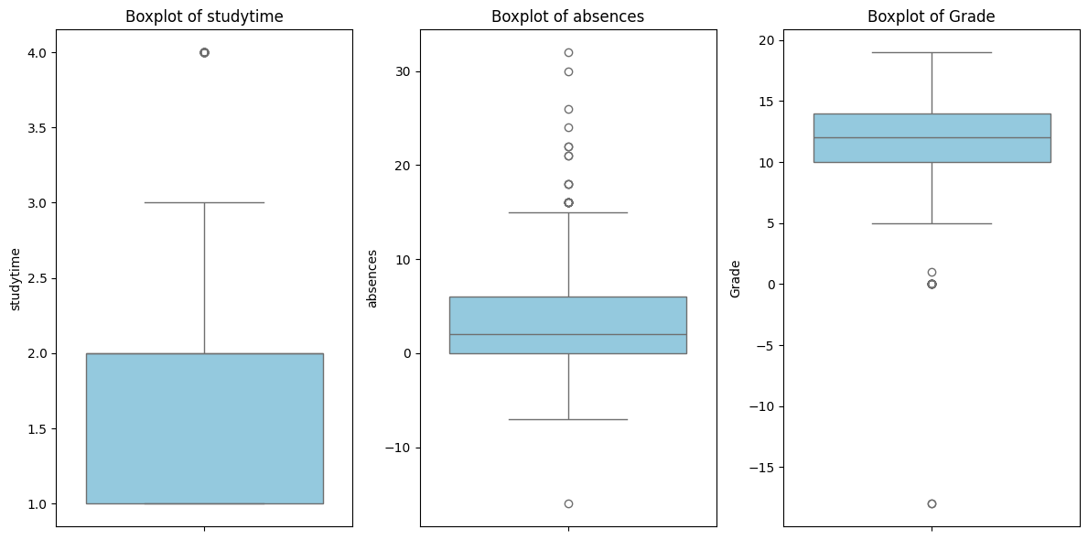
2.5 Outlier Treatment

Slide 13
2.5 Outlier Handling
Target columns: absences, studytime, Grade
Outliers detected using IQR method
Outliers replaced with median
Extreme values effectively mitigated

Slide 14
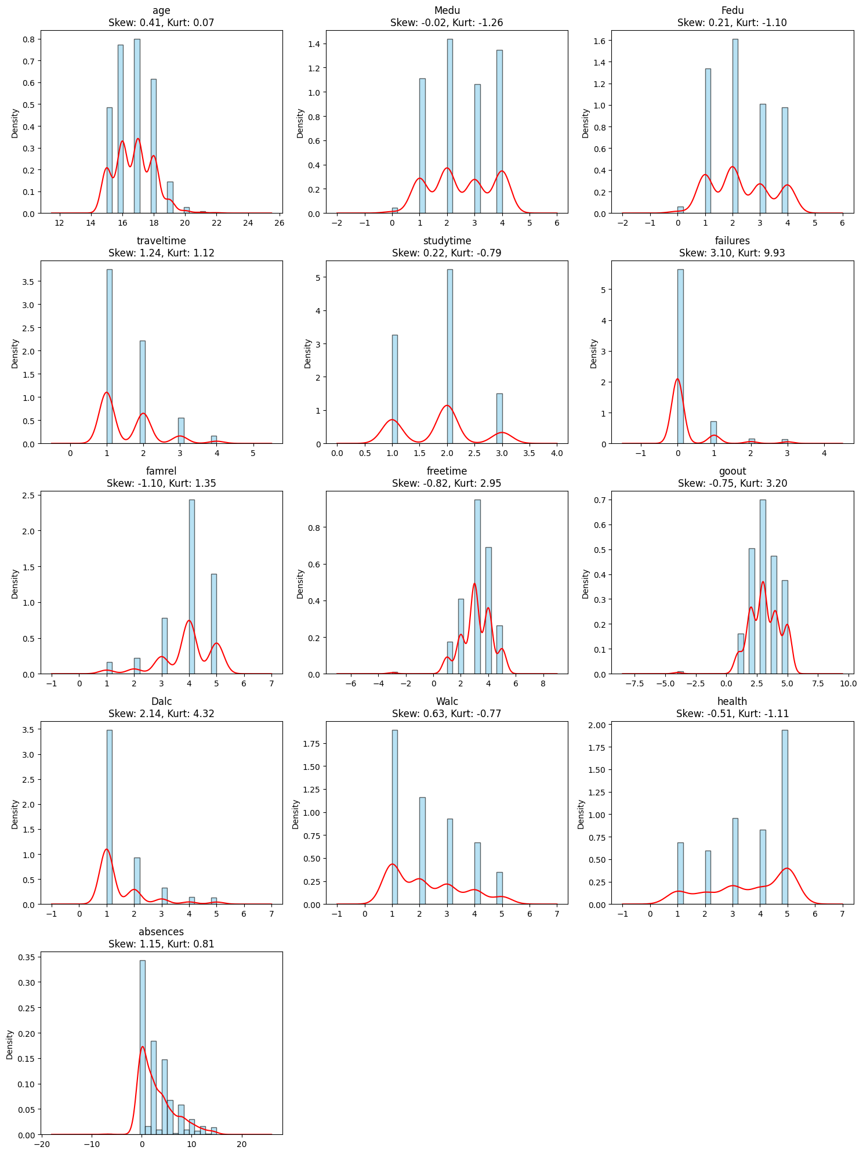
2.6 Skewness and Kurtosis of Numeric Variables

Slide 15
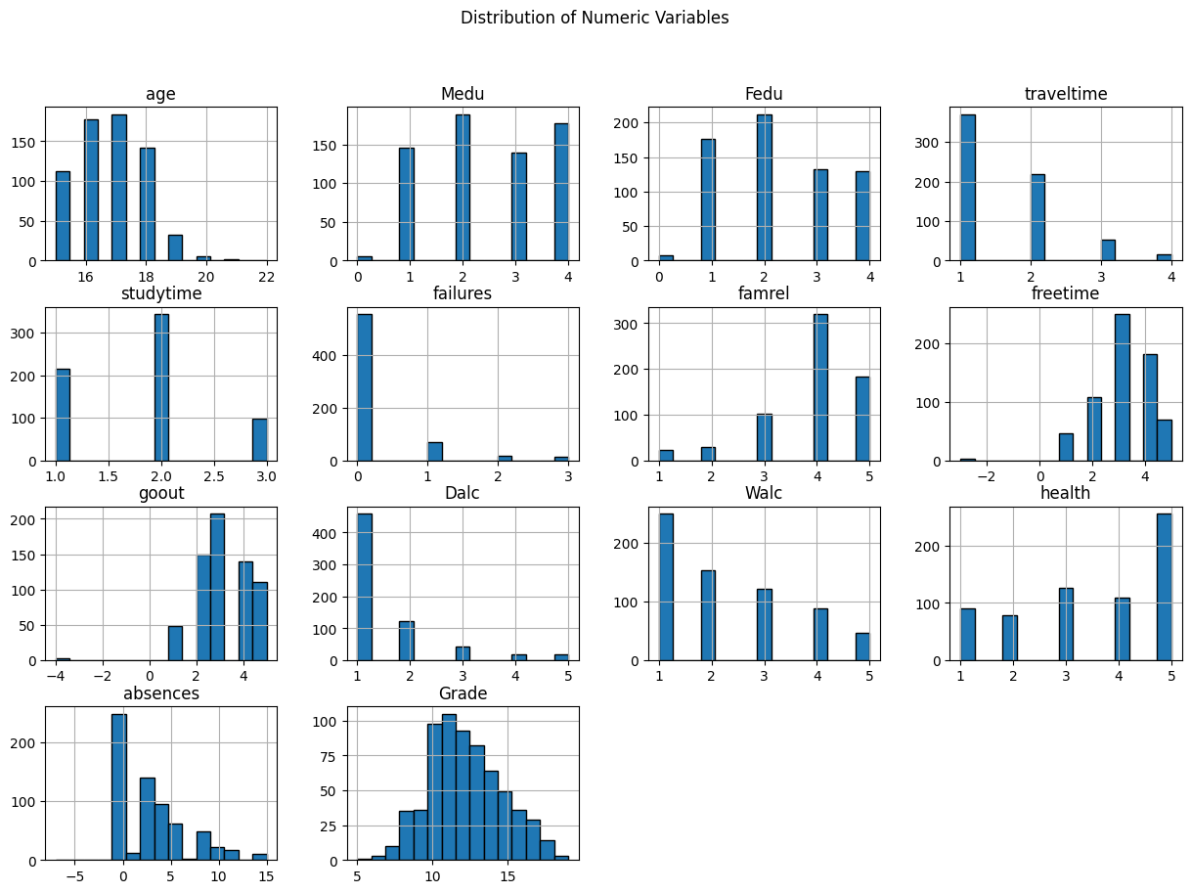
2.7 Univariate distribution

Slide 16
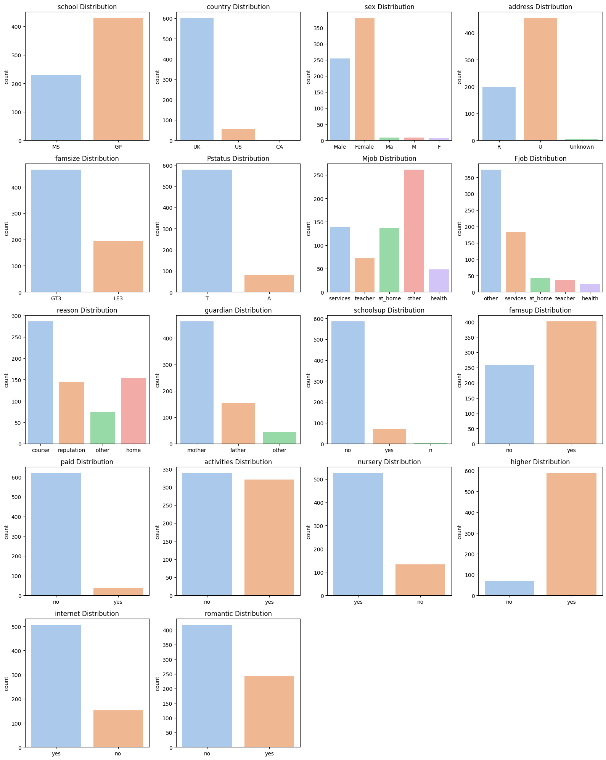
2.8 Frequency of categorical variables

Slide 17
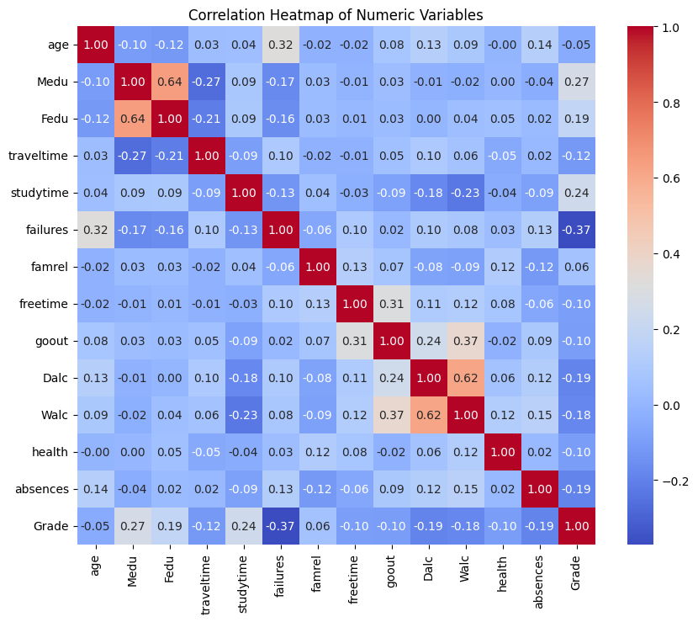
2.9 Correlation with Final Grade

Slide 18
3
Hypothesis testing

Slide 19
Hypothesis testing
H1. School effect on Grade
H0: Mean Grade is equal between GP and MS.
Test: Independent (Welch) t-test.
Result: Reject H0 — Grades differ between schools (t = 5.877, p < 0.001).
Interpretation: School context is associated with achievement (practical size reported via Cohen’s d).
H2. Study time relates to Grade
H0: Mean Grade is equal across studytime (1–4) levels.
Test: One-way ANOVA (or Kruskal–Wallis). Post-hoc with Tukey/Conover + FDR.
Expectation from EDA: Higher studytime → higher Grade.

Slide 20
Hypothesis testing
H3. Prior failures reduce Grade
H0: No association between failures and Grade.
Test: Spearman correlation (and linear trend in OLS as sensitivity).
Expectation: Negative correlation.
H4. Absences reduce Grade
H0: No association between absences and Grade.
Test: Spearman/Pearson depending on distribution.
Expectation: Negative correlation.
H5. Alcohol use is detrimental
H0: No association between Dalc/Walc and Grade.
Test: Spearman correlation; optional ANCOVA adjusting for age, studytime.
Expectation: Stronger for Walc (weekend) — negative association.

Slide 21
Hypothesis testing
H6. Parental education benefits Grade
H0: Mean Grade is equal across Medu/Fedu (0–4).
Test: ANOVA or Jonckheere–Terpstra for ordered trend.
Expectation: Positive monotonic trend with parental education.
H7. Commute time burdens Grade
H0: No association between traveltime and Grade.
Test: Spearman (ordinal).
Expectation: Small negative association.

Slide 22
4
Confidence Interval

Slide 23
4.1 Confidence Interval
Mean Grade: 12.19
95% CI: [11.99, 12.39] (ME ≈ ±0.20)
Takeaway: The school’s true average grade is tightly centered around 12.2, indicating consistent central performance.
Mean Absences: 3.06 days
95% CI: [2.79, 3.33] (ME ≈ ±0.27)
Takeaway: Typical absenteeism is low-to-moderate; variability is limited at the population level.

Slide 24
4.2 Confidence Interval
Pass Rate: 87.08%
95% CI: [84.52%, 89.64%] (ME ≈ ±2.56 pp)
Takeaway: Even the lower bound (>84%) reflects a high probability of passing across the school.
Higher-Education Aspiration: 89.36%
95% CI: [87.01%, 91.72%] (ME ≈ ±2.36 pp)
Takeaway: Aspirations are consistently high; the entire interval is well above 80%, suggesting strong college-going intent.

Slide 25
5
Conclusion

Slide 26
5. Conclusion
Key Findings
Studytime and Parental Education (Medu/Fedu) → Higher grades
Failures, Absences, Weekend Alcohol Use (Walc) → Lower grades
School differences exist but with moderate effect sizes
Commute time shows a weak negative trend
Statistical Insights
Significant associations confirmed by t-tests, ANOVA, and correlations
Effect sizes (Cohen’s d, η², r) show small–moderate practical impacts
95% CIs indicate consistent central performance and high reliability

Slide 27
Thanks!

