Slide 1
Homework Assignment #2:
Estimate File Space Usage

Slide 2
Outline
du
Opendir( )
Readdir()
Closedir()
lstat()
Homework Assignment #3

Slide 3
Outline
du
Opendir( )
Readdir()
Closedir()
lstat()
Homework Assignment #3

Slide 4
du
DESCRIPTION
  Command for estimate file space usage
  Summarize disk usage of the set of FILEs, recursively for directories
-a | --all | write counts for all files, not just directories
-b | --bytes | equivalent to '--apparent-size --block-size=1
-h | --human-readable | print sizes in human readable format (e.g., 1K 234M 2G)
-s | --summarize | display only a total for each argument
 | --help | display this help and exit
 | --version | output version information and exit
… | … | …

Slide 5
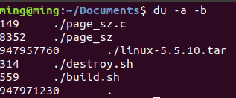
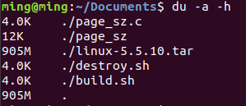
du
EXAMPLE

Slide 6
Outline
du
Opendir( )
Readdir()
Closedir()
lstat()
Homework Assignment #3

Slide 7
opendir( )
#include <dirent.h>
DIR *opendir(const char *name);
EX: DIR* pDir = opendir( “.” );
DESCRIPTION
  Opens a directory stream corresponding to the directory name, and returns a pointer to the directory stream. The stream is positioned at the first entry in the directory.
RETURN VALUE
  Return a pointer to the directory stream. On error, NULL is returned
Notes:
Include dirent.h
給他一個目錄的位置，他會回傳 directory stream 的 pointer ( type = DIR* )
這個 pointer 後續 readir 和 close 會使用到
假設找不到給定的目錄，會回傳NULL
例如，我給他一個點，代表我要開啟當前目錄

Slide 8
Outline
du
Opendir( )
Readdir()
Closedir()
lstat()
Homework Assignment #3

Slide 9
readdir()
#include <dirent.h>
struct dirent *readdir(DIR *dirp);
EX:
  struct dirent* pEntry = NULL;
  while ((pEntry = readdir(pDir)) != NULL) { … }
DESCRIPTION
  Returns a pointer to a dirent structure representing the next directory entry in the directory stream pointed to by dirp.
RETURN VALUE
  On success, readdir() returns a pointer to a dirent structure.
  If the end of the directory stream is reached or error, NULL is returned
Notes:
判斷Error 透過errno
Include dirent.h
透過剛才open 得到的 directory stream pointer ，給 readir
他會回傳這個目錄下的entry，data type 是一個 pointer 指向 dirent structure
假設這個目錄已經沒有其他entry ，就會回傳 NULL

Slide 10
dirent structure
struct dirent {
ino_t d_ino; /* Inode number */
off_t d_off; /* current position in the directory stream.*/
unsigned short d_reclen; /* Length of this record */
unsigned char d_type; /* Type of file; not supported by
all filesystem types */
char d_name[256]; /* Null-terminated filename */
};
Notes:
主要要看的只有紅色標記的，因為他是 standard ，其他項目要看ＯＳ是否support
這個 file 或是 directory 的 inode
他的檔案名稱

Slide 11
dirent structure (cont.)
The following macro constants for the value returned in d_type:
  DT_BLK This is a block device.
  DT_CHR This is a character device.
  DT_DIR This is a directory.
  DT_FIFO This is a named pipe (FIFO).
  DT_LNK This is a symbolic link.
  DT_REG This is a regular file.
  DT_SOCK This is a UNIX domain socket.
  DT_UNKNOWN The file type could not be determined.
Only Btrfs, ext2, ext3, and ext4 have full support for returning the file type in d_type.
Notes:
因為平台是 ext 檔案系統所以可以用
主要透過 這些constant 讓我們去知道，他是 檔案 還是 目錄

Slide 12
Outline
du
Opendir( )
Readdir()
Closedir()
lstat()
Homework Assignment #3

Slide 13
closedir()
#include <dirent.h>
int closedir(DIR *dirp);
EX: closedir(pDir);
DESCRIPTION
  Closes the directory stream associated with dirp. A successful call to closedir() also closes the underlying file descriptor associated with dirp.
RETURN VALUE
  Returns 0 on success. On error, -1 is returned
Notes:
當我們操作完畢的時候，要使用 closedir
帶入的值就是 我們 在open 那時得到的 directory stream pointer
假設有error ，會回傳 -1

Slide 14
Outline
du
Opendir( )
Readdir()
Closedir()
lstat()
Homework Assignment #3

Slide 15
lstat()
#include <sys/stat.h>
int lstat(const char *path, struct stat *buf);
EX: lstat(file_name,&buf);
DESCRIPTION
  Return information about a file. (in buf)
  No permissions are required on the file itself.
  Execute (search) permission is required on all of the directories in path that lead to the file.
  If path is a symbolic link, then the link itself is stat-ed, not the file that it refers to.
RETURN VALUE
  Returns 0 on success. On error, -1 is returned

Slide 16
stat structure
struct stat {
dev_t st_dev; /* ID of device containing file */
ino_t st_ino; /* inode number */
mode_t st_mode; /* protection */
nlink_t st_nlink; /* number of hard links */
uid_t st_uid; /* user ID of owner */
gid_t st_gid; /* group ID of owner */
dev_t st_rdev; /* device ID (if special file) */
off_t st_size; /* total size, in bytes */
blksize_t st_blksize; /* blocksize for file system I/O */
blkcnt_t st_blocks; /* number of 512B blocks allocated */
time_t st_atime; /* time of last access */
time_t st_mtime; /* time of last modification */
time_t st_ctime; /* time of last status change */
};

Slide 17
Outline
du
Opendir( )
Readdir()
Closedir()
lstat()
Homework Assignment #3

Slide 18
Flowchart
Example:
opendir( )
home
readdir( )
Movies
Downloads
test.pdf
Update total_size :
  Regular file
  Symbolic link file
  Directory file
≠ NULL
yes
no
MIB.mp4
memo.txt
hw3.c
opendir( )
/*Do something*/
…
closedir( )
Note : readdir() will return ‘ . ’ and ‘ .. ’, so skip them to avoid the loop.

Slide 19
Homework Assignment #2
Implement a simple program that does like du.
Show the total space usage in a given directory.
Only concern :
  Regular file
  Directory file
  Symbolic link file itself, not the linked file
Show every single size of the file.
Unit is byte.
If the user doesn’t give any argument, start at the current working directory by default.

Slide 20
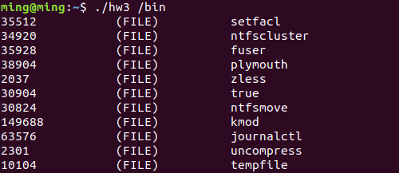
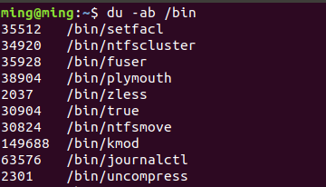
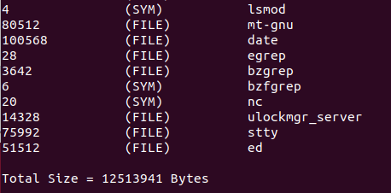
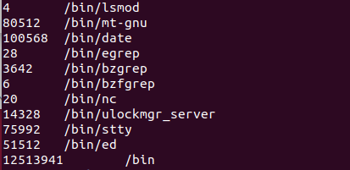
Homework Assignment #2
Ex1: show the total size of /bin
(unit: byte)
…
…
Your Program
Using du

Slide 21
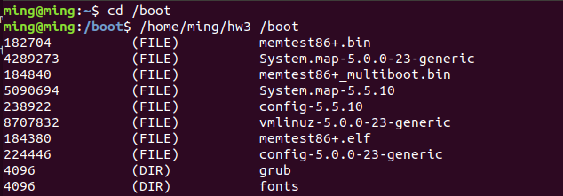
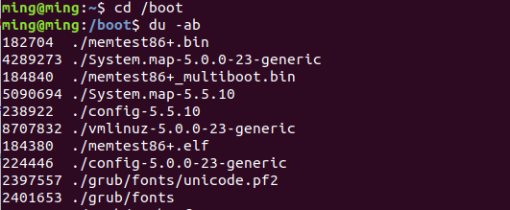
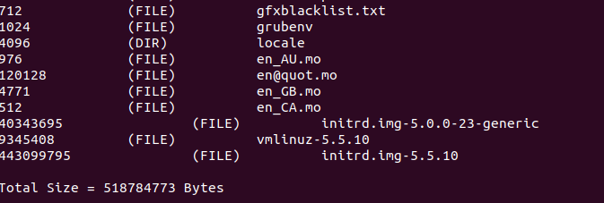
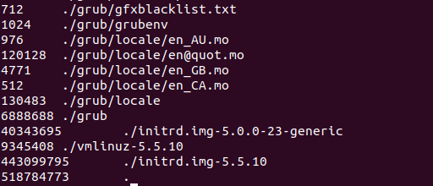
Homework Assignment #2
Ex2: show the total size of the current directory (/boot)
…
…
Your Program
Using du

Slide 22
Note
Please use Ubuntu 16 or later.
Make sure that all necessary header file are included.
Leave an appropriate comment.

Slide 23
Turn in
Deadline
2020/XX/XX 23:59:59
Upload to i-learning
File name
    Source code (e.g. HW3_7105056035.c)
    Word file (e.g. HW3_7105056035.docx)
If you don’t hand in your homework on time, your score will be deducted 10 points every day.

Slide 24
TA
Name: 陳治帆
Email: abc5572885@gmail.com
Title format: File System HW# - [your name]
Lab: OSNET(1001A)

Slide 25

Reference
Websites:
  http://man7.org/linux/man-pages/man3/opendir.3.html
  http://man7.org/linux/man-pages/man3/readdir.3.html
  http://man7.org/linux/man-pages/man3/closedir.3.html
  https://linux.die.net/man/2/lstat
  http://puremonkey2010.blogspot.com/2010/12/linux-du.html
Book:
  The Linux Programming Interface - A Linux and UNIX System Programming Handbook

Slide 26

ANY QUESTION?

