Slide 1

2020.12.10
Meeting

Slide 2
Bert for token classification

Slide 3
Example 1
Text : The United Kingdom has become the first Western nation to begin vaccinating its citizens with a Covid-19 shot outside of clinical trials -- a landmark moment in the coronavirus pandemic.

Slide 4
Result
I-org The
O United
O Kingdom
I-art has
B-tim become
B-gpe the
B-gpe first
B-org Western
B-geo nation
O to
O begin
B-geo vaccinating
B-eve its
I-org citizens
B-geo with
I-per a
I-eve Covid
I-art -
I-art 19
B-geo shot
B-geo outside
B-gpe of
B-nat clinical
B-nat trials
I-art -
I-tim -
B-tim a
B-tim landmark
B-tim moment
I-org in
I-per the
B-org coronavirus
O pandemic
I-per .

Slide 5
Result
I-org The
O United
O Kingdom
I-art has
B-tim become
B-gpe the
B-gpe first
B-org Western
B-geo nation
O to
O begin
B-geo vaccinating
B-eve its
I-org citizens
B-geo with
I-per a
I-eve Covid
I-art -
I-art 19
B-geo shot
B-geo outside
B-gpe of
B-nat clinical
B-nat trials
I-art -
I-tim -
B-tim a
B-tim landmark
B-tim moment
I-org in
I-per the
B-org coronavirus
O pandemic
I-per .

Slide 6
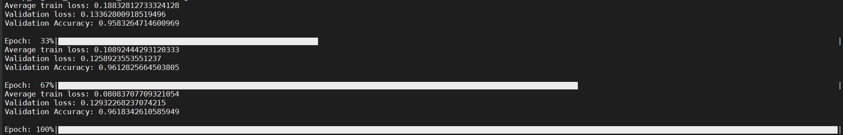
Conclusion
效果不好 但準確率卻很高?

Slide 7
Conclusion
結果不如預期
可能的問題 :
1. 訓練資料處理不當
2. Word Tag 沒有對起來
Solution : 可能要讀一下code 調整一下模型，或再找看看有沒有好一點的code

Slide 8
tdidf

Slide 9
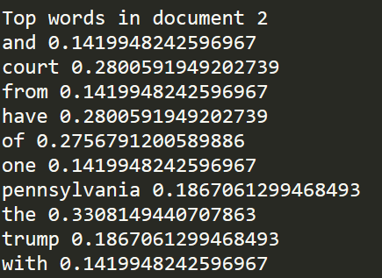
Code 1
Text: The repetitive and meritless legal challenges to the November 3 election results from President Donald Trump and his allies have sent one fundamental message: Millions of votes cast by their fellow Americans are worthless.Trump lawyers have argued for the widescale disenfranchisement of voters, including in Pennsylvania. So far, they have failed to convince the nation's courts.The Supreme Court rejected one of the cases from Pennsylvania Tuesday with a single sentence. That high court action came with no explanation, yet it reinforced a pattern of lower court judges spurning a series of baseless appeals.

