Slide 1

2020.12.10
Meeting

Slide 2
tdidf

Slide 3
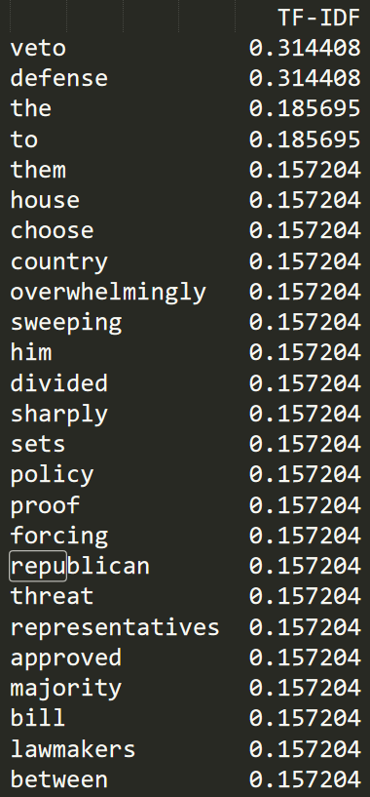
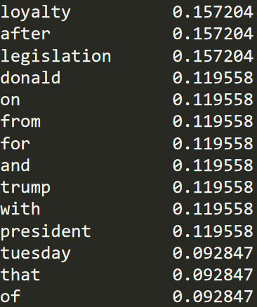
Code1:TfidfVectorizer
text1 = "The House of Representatives on Tuesday overwhelmingly approved a sweeping defense bill with a veto-proof majority after a veto threat from President Donald Trump sharply divided Republican lawmakers, forcing them to choose between loyalty to him and legislation that sets defense policy for the country."
text2 = "The repetitive and meritless legal challenges to the November 3 election results from President Donald Trump and his allies have sent one fundamental message: Millions of votes cast by their fellow Americans are worthless.Trump lawyers have argued for the widescale disenfranchisement of voters, including in Pennsylvania. So far, they have failed to convince the nation's courts.The Supreme Court rejected one of the cases from Pennsylvania Tuesday with a single sentence. That high court action came with no explanation, yet it reinforced a pattern of lower court judges spurning a series of baseless appeals."
text3 = "On the heels of major vaccine developments, Biden committed that his team will help get \"at least 100 million Covid vaccine shots into the arms of the American people in the first 100 days.\" It will be a massive undertaking, which he acknowledged Tuesday.\"This will be the most efficient mass vaccination plan in US history. I credit everyone who has gotten us to this point, but developing the vaccine is one herculean task,\" Biden said. \"Distributing it is another.\"This is on top of his pending nationwide 100-day mask mandate. "
Notes:
問題點 : Donald Trump 會被拆成兩個字

Slide 4
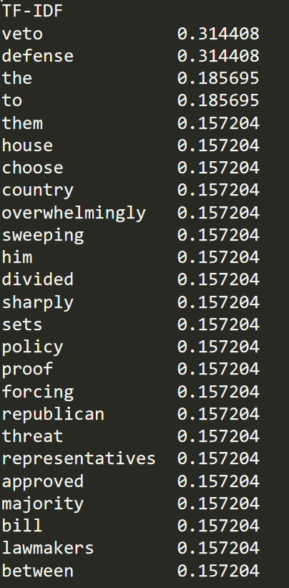
Code1
text1 = "The House of Representatives on Tuesday overwhelmingly approved a sweeping defense bill with a veto-proof majority after a veto threat from President Donald Trump sharply divided Republican lawmakers, forcing them to choose between loyalty to him and legislation that sets defense policy for the country."
text2 = "The repetitive and meritless legal challenges to the November 3 election results from President Donald Trump and his allies have sent one fundamental message: Millions of votes cast by their fellow Americans are worthless.Trump lawyers have argued for the widescale disenfranchisement of voters, including in Pennsylvania. So far, they have failed to convince the nation's courts.The Supreme Court rejected one of the cases from Pennsylvania Tuesday with a single sentence. That high court action came with no explanation, yet it reinforced a pattern of lower court judges spurning a series of baseless appeals."
text3 = "On the heels of major vaccine developments, Biden committed that his team will help get \"at least 100 million Covid vaccine shots into the arms of the American people in the first 100 days.\" It will be a massive undertaking, which he acknowledged Tuesday.\"This will be the most efficient mass vaccination plan in US history. I credit everyone who has gotten us to this point, but developing the vaccine is one herculean task,\" Biden said. \"Distributing it is another.\"This is on top of his pending nationwide 100-day mask mandate. "
Notes:
The to 這類冠詞TFIDF值還是很高，是否能用一個list記錄這些常遇見的介係詞冠詞，特別剔除他們不知道這個方法好不好?

Slide 5
TfidfVectorizer 的缺點
無法有效剔除 the , a , and
效果不佳 ，無法完全挑到我們要的重點

Slide 6
Code1
text1 = "The House of Representatives on Tuesday overwhelmingly approved a sweeping defense bill with a veto-proof majority after a veto threat from President Donald Trump sharply divided Republican lawmakers, forcing them to choose between loyalty to him and legislation that sets defense policy for the country."
text2 = "The repetitive and meritless legal challenges to the November 3 election results from President Donald Trump and his allies have sent one fundamental message: Millions of votes cast by their fellow Americans are worthless.Trump lawyers have argued for the widescale disenfranchisement of voters, including in Pennsylvania. So far, they have failed to convince the nation's courts.The Supreme Court rejected one of the cases from Pennsylvania Tuesday with a single sentence. That high court action came with no explanation, yet it reinforced a pattern of lower court judges spurning a series of baseless appeals."
text3 = "On the heels of major vaccine developments, Biden committed that his team will help get \"at least 100 million Covid vaccine shots into the arms of the American people in the first 100 days.\" It will be a massive undertaking, which he acknowledged Tuesday.\"This will be the most efficient mass vaccination plan in US history. I credit everyone who has gotten us to this point, but developing the vaccine is one herculean task,\" Biden said. \"Distributing it is another.\"This is on top of his pending nationwide 100-day mask mandate. "
Notes:
我會想要娶的答案

Slide 7
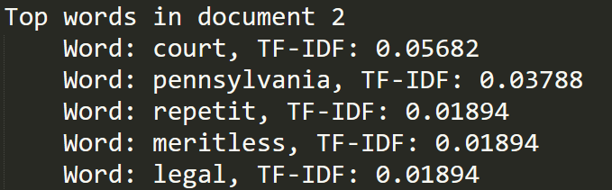
Code 2
Text: The repetitive and meritless legal challenges to the November 3 election results from President Donald Trump and his allies have sent one fundamental message: Millions of votes cast by their fellow Americans are worthless.Trump lawyers have argued for the widescale disenfranchisement of voters, including in Pennsylvania. So far, they have failed to convince the nation's courts.The Supreme Court rejected one of the cases from Pennsylvania Tuesday with a single sentence. That high court action came with no explanation, yet it reinforced a pattern of lower court judges spurning a series of baseless appeals.

Slide 8
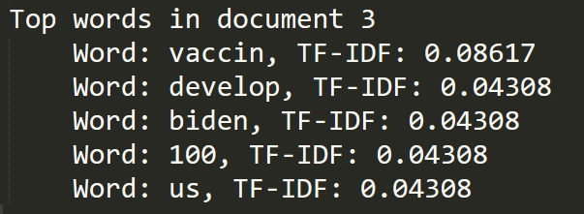
Code 2
Text: On the heels of major vaccine developments, Biden committed that his team will help get \"at least 100 million Covid vaccine shots into the arms of the American people in the first 100 days.\" It will be a massive undertaking, which he acknowledged Tuesday.\"This will be the most efficient mass vaccination plan in US history. I credit everyone who has gotten us to this point, but developing the vaccine is one herculean task,\" Biden said. \"Distributing it is another.\"This is on top of his pending nationwide 100-day mask mandate.

Slide 9
Code 2的優點及缺點
優點
能有效剔除the, a,and….
用詞幹提取，針對像是文章中的單複數或進行式型態的詞語，做統一歸納
效果不錯
缺點
因為過程中會進行詞幹提取(stem)，所以不一定能夠表達完整語義
Notes:
詞形還原（lemmatization），是把一個任何形式的語言詞彙還原為一般形式

Slide 10
Bert for token classification

Slide 11
Example 1
Text : The United Kingdom has become the first Western nation to begin vaccinating its citizens with a Covid-19 shot outside of clinical trials -- a landmark moment in the coronavirus pandemic.

Slide 12
Result
I-org The
O United
O Kingdom
I-art has
B-tim become
B-gpe the
B-gpe first
B-org Western
B-geo nation
O to
O begin
B-geo vaccinating
B-eve its
I-org citizens
B-geo with
I-per a
I-eve Covid
I-art -
I-art 19
B-geo shot
B-geo outside
B-gpe of
B-nat clinical
B-nat trials
I-art -
I-tim -
B-tim a
B-tim landmark
B-tim moment
I-org in
I-per the
B-org coronavirus
O pandemic
I-per .

Slide 13
Result
I-org The
O United
O Kingdom
I-art has
B-tim become
B-gpe the
B-gpe first
B-org Western
B-geo nation
O to
O begin
B-geo vaccinating
B-eve its
I-org citizens
B-geo with
I-per a
I-eve Covid
I-art -
I-art 19
B-geo shot
B-geo outside
B-gpe of
B-nat clinical
B-nat trials
I-art -
I-tim -
B-tim a
B-tim landmark
B-tim moment
I-org in
I-per the
B-org coronavirus
O pandemic
I-per .

Slide 14
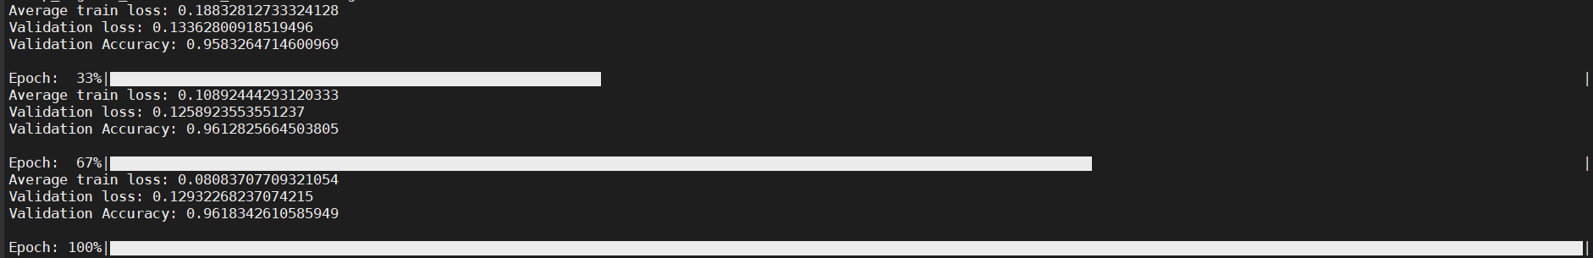
Conclusion
效果不好 但準確率卻很高?

Slide 15
Conclusion
結果不如預期
可能的問題 :
1. 訓練資料處理不當
2. Word Tag 沒有對起來
Solution : 可能要讀一下code 調整一下模型，或再找看看有沒有好一點的code

