Slide 1
analysis on customer reviews
INSIGHTS DISCOVERY AND SENTIMENT ANALYSIS
SUBMITTED By:
Minnikeswar Rao
Date 30th November 2022

Slide 2
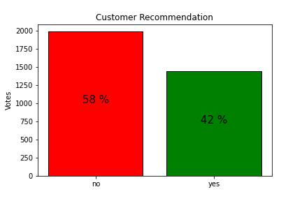
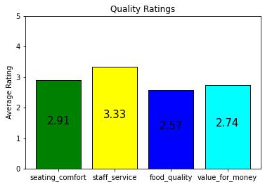
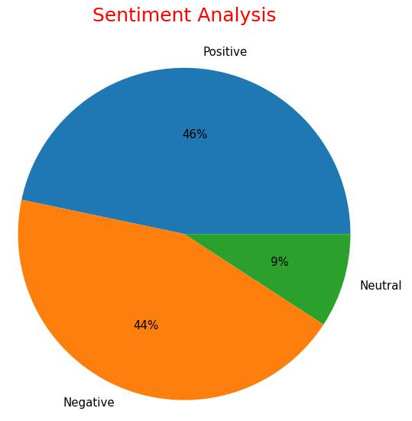
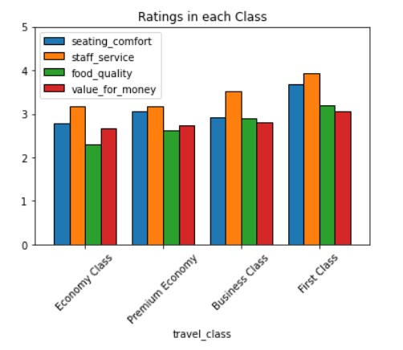
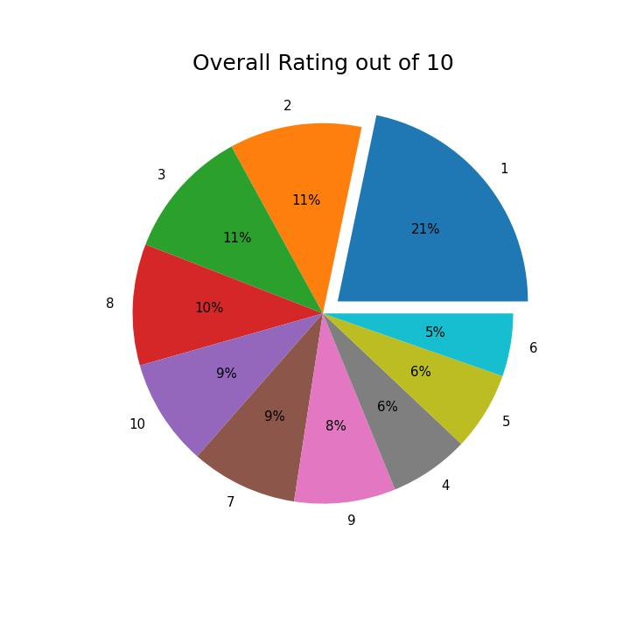
Conclusion :
It is observed that travelers of the Economy classes are expecting the Airline to improve its services in terms of food quality and seating comfort.
The sentiment analysis of the reviews shows as balanced customer experience with the Airline.
However the travelers of First class seem highly satisfied with the services provided.
Github

