Slide 1
analysis on customer Booking data
Finding the most contributing attributes
SUBMITTED By:
Minnikeswar Rao
Date 3rd December 2022

Slide 2
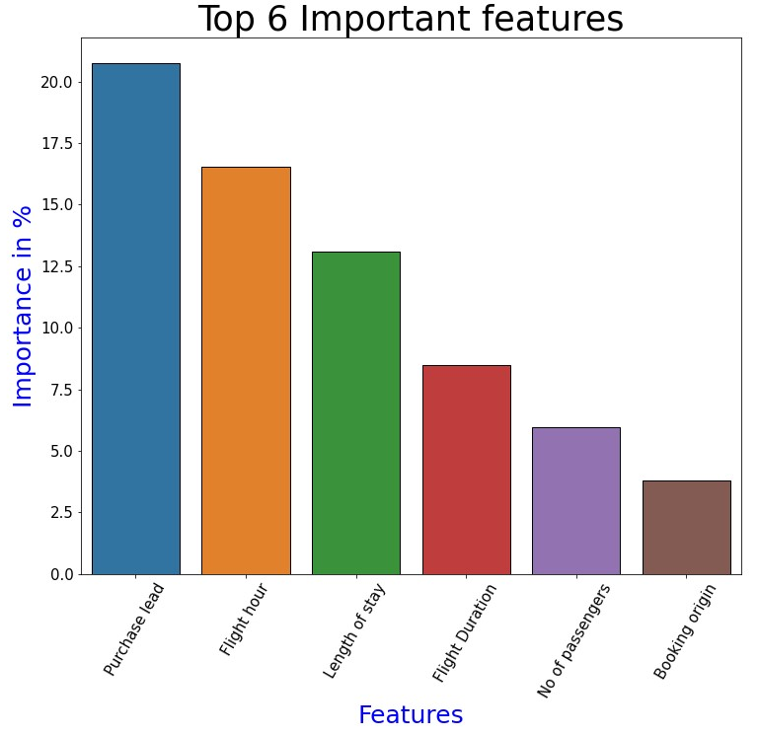
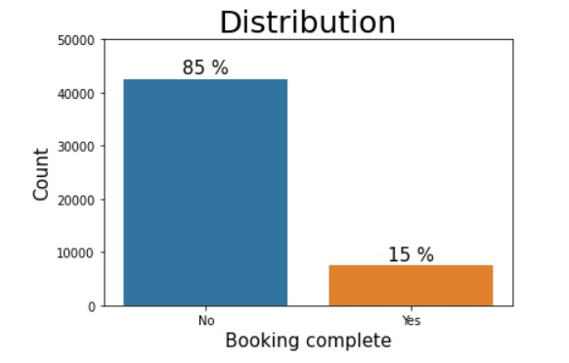
Summary:
The top 6 contributing features are Purchase lead time, Flight hour, Length of stay, Flight duration, No of passengers & Origin of booking.
In the Origin of booking locations like Malaysia, Australia played a major role.
The Accuracy of the model after 5 fold cross-validation is found to be around 70 %.
The reason for such a low cross-validation accuracy is non-uniform data distribution. For example target column has two values which are distributed into 85% and 15% respectively.

