Slide 1
Rural Banking by cloud Computing
By
MINNU JINSON
MCA –B
ROLL NO: 18

Slide 2
Relevance of project
As the advancement of technology has taken place with immense use of internet, mobile phones and online bill payments banking sector in India has a new facet altogether.
The cloud computing is one of the developing technology which is being use by all industrial domain in the IT field.
the concept of using cloud computing to develop a banking system for rural areas. It considers various factors such as lack of devices and amenities in rural areas and provides efficient functionality to fulfil those gaps. It uses the latest variations of cloud computing technology for filling in the various technological gaps in village

Slide 3
While business correspondents are currently used mainly for liability-based transactions such as deposits and payments related ones and contribute to 8-13% of total liability-based rural transactions, the proportion could well touch 25-30% in the next few years.
present, however, for most business correspondents in rural areas, this business is typically a side business. “They are either grocery shop farmers who are also members of a panchayat; and so, the compensation given to them by banks or corporate business correspondents is not their only source of income. Therefore it sees that the model can be sustainable even though the remuneration is relatively lower. It estimates that the n

Slide 4
description
people in the rural area interacting through online mode
Checking their saving account and take the loan through online mode
With help of cloud computing it is easy to handle the data and easy to access the data and it is flexible and efficient in banking sector

Slide 5
RRBs grant loan and advances to small farmers and agricultural laborers so that can start their own farming activities including purchase of land seed and manure.
➢ RRBs provide banking services at the doorsteps of the rural people particularly in those areas which are not served by any commercial bank. ➢ The RRBs charge a lower rate of interest and thus they reduce the cost of credit in the rural areas.
➢ RRBs provide loan and other financial assistance to entrepreneurs in villages suburban areas and small towns so that they become able to enlarge their business. ➢ Loans to artisans to encourage them for the production of artistic and related goods.
➢ Encourage the saving habit among the rural and semi-urban population

Slide 6
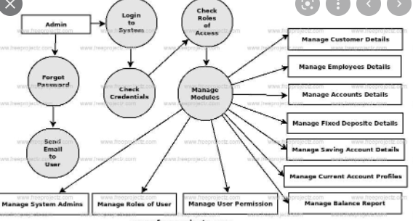
https://youtu.be/cKaHn3G3RZU

Slide 7
modules
Admin
Bank
customer

Slide 8
making people bank-conscious is only part- and the smaller pari—of the problem here. The real difficulty is how to make banking services available to the well-todo in the rural community.
The opening of branches by the large banks in the villages—even in the largest ones would not be a practical proposition for a very long lime to come.
devised for the injection of the hidden wealth in the countryside into the veins and arteries of the nation's financial system

Slide 9
Even by granting local loans with the maximum of security and making investments with the minimu m of risk, the Rural Banking Society would create in the villagers the necessary goodwill towards itself and its operations.
'Green Credit' to farmers against the new crop, the financing of small fruit-bottling plants in the hilly regions, fishtanning works at the seaside places, land reclamation and improvement projects in the purely agricultural districts could offer a suitable outlet for short-term, comparatively safe and potentially lucrative exploratory activities.

