Slide 1
README.md
2/4/2025
Asynchronous in JavaScript
Callbacks
A callback is a funtion passed as an argument to another function This technique allows a function to call another function
A callback function call run after another function has finished Normal function -
const display = (sum) => { console.log(`The result is : ${sum}`);
};
const calculate = (value1, value2) => { const sum = value1 + value2;
return sum;
};
const result = calculate(4, 5); display(result); // Output: The result is : 9
Using callback function as anonymous function
const display = (sum) => { console.log(`The result is : ${sum}`);
};
const calculate = (value1, value2, callback) => { const sum = value1 + value2;
// Use callback function
if (callback) callback(sum);
};
calculate(4, 5, display); // Output: The result is : 9
Using callback function as anonymous function differently
const calculate = (value1, value2, callback) => { const sum = value1 + value2;
// Calling anonymous callback function if (callback) callback(sum);
};

Slide 2
README.md
2/4/2025
calculate(4, 5, function (sum) { console.log(`The result is : ${sum}`);
}); // Output: The result is : 9
So, callback argument is pointing the following anonymous function
function (sum) {
console.log(`The result is : ${sum}`)
}
Using callback function as arrow function
const calculate = (value1, value2, callback) => { const sum = value1 + value2;
// Calling arrow function if (callback) callback(sum);
};
calculate(4, 5, (sum) => { console.log(`The result is : ${sum}`);
}); // Output: The result is : 9
So, callback argument is pointing the following arrow function
(sum) => {
console.log(`The result is : ${sum}`);
};
Callback example -
const paymentStatus = true; const mark = 80;
const enroll = (callback) => { console.log('Enrollment is processing...');
setTimeout(() => {
if (paymentStatus) callback();
else console.log('Enrollment process is failed');
}, 2000);
};
const progress = (callback) => { console.log('Course on progress...');

Slide 3
README.md
2/4/2025
setTimeout(() => {
if (mark >= 80) callback(); else
console.log(
'You could not achieve enough marks for getting the certificate'
);
}, 3000);
};
const getCertificate = () => { console.log('Preparing your certificate...');
setTimeout(() => {
console.log('Congratulation!!! You earn the certificate');
}, 2000);
};
enroll(() => { progress(getCertificate);
});
Outcome -
Enrollment is processing... (--- 2 seconds pause ---) Course on progress...
(--- 3 seconds pause ---) Preparing your certificate... (--- 2 seconds pause ---)
Congratulation!!! You earn the certificate
Tips:
Inside enroll function I need to point progress function which takes a parameter, so use arrow function and inside that function call another function
() => {
progress(getCertificate);
};
But getCertificate function doesn't take any parameter, so pass direct function name as callback function -

Slide 4
README.md
2/4/2025
progress(getCertificate);
Promise
The previous example creates callback hell
To get rid of it, need to use Promise feature of JavaScript
Promise is a constructor function
new Promise();
Takes a function inside the constructor function
// Using normal function new Promise(function () {});
// Or using arrow function new Promise(() => {});
That function takes two functions as a parameter named resolve & reject (convention)
// Using normal function
// Takes 'resolve' & 'reject' functions new Promise(function (resolve, reject) {});
// Or using arrow function
// Takes 'resolve' & 'reject' functions new Promise((resolve, reject) => {});
The concept is -
If Promise is completed or success, the Promise has been resolved or resolve function calls Else the Promise has been rejected or reject function calls
Promise definition -
const promise = new Promise((resolve, reject) => { setTimeout(() => {
if (status) resolve('Task 1');
else reject(new Error('Error message'));
});
});
Promise calls -

Slide 5
README.md
2/4/2025
promise
.then((res) => { console.log(res);
})
.catch((err) => { console.log(err.message);
});
Outcome if resolve -
Task 1
Outcome if reject -
Error message
Important notes:
If I use Promise, then it's an asynchronous function If use Promise, either resolve or reject.
Don't use console.log instead of resolve or reject
See the above mentioned Promise definition
Use console.log inside the function of then or catch
See the above mentioned Promise call
Same mentioned callback example using Promise
const paymentStatus = true; const mark = 90;
// Use 'Promise' so it's an asynchronous function const enroll = () => {
console.log('Enrollment is processing...');
// Either 'resolve' nor 'reject'. No console.log use in 'Promise' return new Promise((resolve, reject) => {
setTimeout(() => {
if (paymentStatus) resolve();
else reject(new Error('Enrollment process is failed'));
}, 2000);
});
};
const progress = () => { console.log('Course on progress...');
return new Promise((resolve, reject) => {

Slide 6
README.md
2/4/2025
setTimeout(() => {
if (mark >= 80) resolve(); else
reject(
new Error(
'You could not achieve enough marks for getting the certificate'
)
);
}, 3000);
});
};
const getCertificate = () => { console.log('Preparing your certificate...');
return new Promise((resolve) => { setTimeout(() => {
resolve('Congratulation!!! You earn the certificate');
}, 2000);
});
};
enroll()
.then(progress)
.then(getCertificate)
.then((res) => { console.log(res);
})
.catch((err) => { console.log(err.message);
});
Outcome -
Enrollment is processing... (--- 2 seconds pause ---) Course on progress...
(--- 3 seconds pause ---) Preparing your certificate... (--- 2 seconds pause ---)
Congratulation!!! You earn the certificate
Tips:
6 / 21

Slide 7
README.md
2/4/2025
From root Promise, start use then and catch
For others only use then
Inside a Promise, if resolve doesn't take any parameter then call like -
enroll().then(progress);
Basically pass next Promise in then
Inside a Promise, if resolve use any parameter then call like -
enroll().then((res) => { console.log(res);
});
Basically receive the parameter sent from resolve
Only one catch will catch all the reject's from all Promise
enroll()
.then(progress)
.then(getCertificate)
.then((res) => { console.log(res);
})
.catch((err) => { console.log(err.message);
});
Look at the next Promise example -
const promise1 = Promise.resolve('Promise 1 resolved'); const promise2 = new Promise((resolve, reject) => {
setTimeout(() => { resolve('Promise 2 resolved');
}, 2000);
});
promise1.then((res) => console.log(res)); promise2.then((res) => console.log(res));
Output -
Promise 1 resolved
Promise 2 resolved

Slide 8
README.md
2/4/2025
Instead of one by one call, I can use Promise.all
Pass all the Promise's in the form of an array
Receive all the resolved data in the form of an array too
Promise.all([promise1, promise2]).then((res) => console.log(res));
Outcome will be the same
If I want to process all the Promises but want to show output who resolved first, then use
Promise.race
Promise.race([promise1, promise2]).then((res) => console.log(res));
Outcome -
Promise 1 resolved
Async-Await
Use async so it's an asynchronous function Asynchronous function returns by default Promise
// Normal asynchronous function async function myFunction() {}
// Asynchronous arrow function const myFunction = async () => {};
I can only use await inside async function Same mentioned callback example using async
const paymentStatus = true; const mark = 90;
// Use 'Promise' so it's an asynchronous function const enroll = () => {
console.log('Enrollment is processing...');
// Either 'resolve' nor 'reject'. No console.log use return new Promise((resolve, reject) => {
setTimeout(() => {
if (paymentStatus) resolve();
else reject(new Error('Enrollment process is failed'));

Slide 9
README.md
2/4/2025
}, 2000);
});
};
const progress = () => { console.log('Course on progress...');
return new Promise((resolve, reject) => { setTimeout(() => {
if (mark >= 80) resolve(); else
reject(
new Error(
'You could not achieve enough marks for getting the certificate'
)
);
}, 3000);
});
};
const getCertificate = () => { console.log('Preparing your certificate...');
return new Promise((resolve) => { setTimeout(() => {
resolve('Congratulation!!! You earn the certificate');
}, 2000);
});
};
const course = async () => { try {
await enroll(); await progress();
const message = await getCertificate();
console.log(message);
} catch (err) { console.log(err.message);
}
};
course();
Outcome will be the same
Before use await, always use try-catch block for error handling
Synchronous Behavior
JavaScript works synchronously Doing a lot of work at the same time

Slide 10
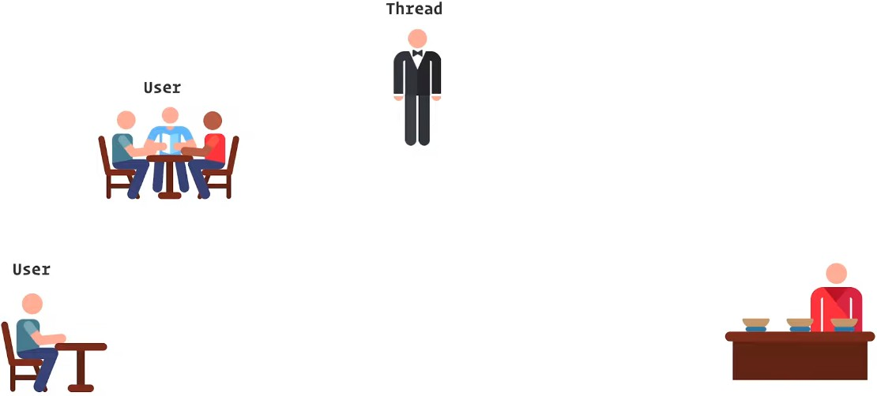

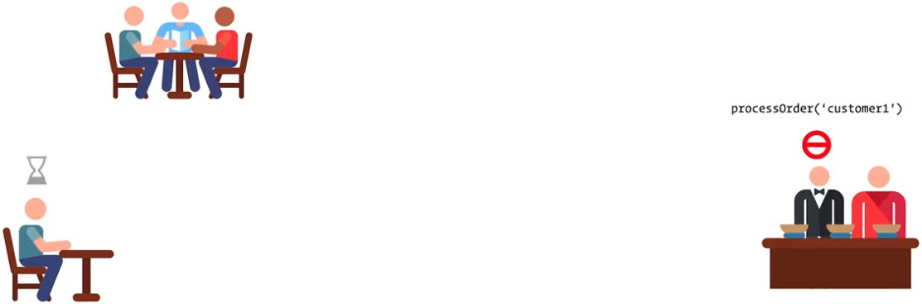
README.md
2/4/2025
So, JavaScript is a single-thread language For example:
In a restaurent scenario, one waiter and two customers are present So, I can indicate the waiter as Thread and the customers as User
Takes order from customer 1
Move to the kitchen and wait until the food is ready to serve
10 / 21

Slide 11

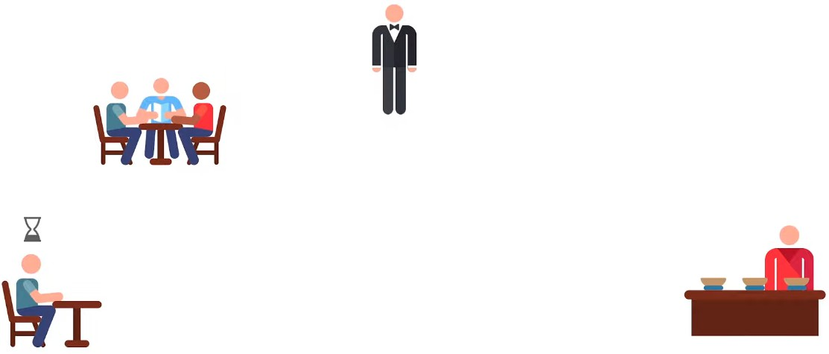

README.md
2/4/2025
When the food become ready, serve the food to the customer
Now, he becomes free
After that, moves to customer 2
Take the order and move to kitchen and wait until the food is ready

Slide 12
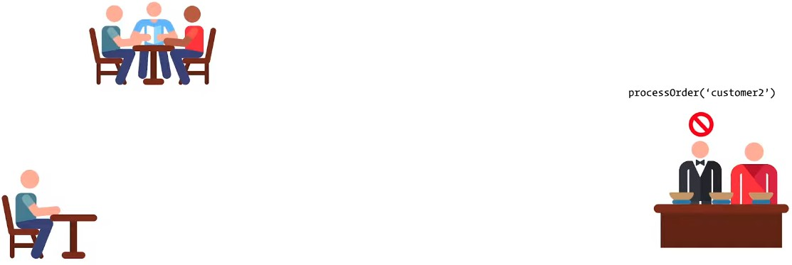


README.md
2/4/2025
Serve the food to customer 2
After that, he become free
This behavior is called Synchronous Blocking Behavior
In JavaScript implementation of Synchronous Blocking Behavior -
// Printing the log
const log = (anything) => { console.log(anything);

Slide 13
README.md
2/4/2025
};
let customer = 'Customer 1';
const processOrder = (customer) => {
log(`Move to kitchen and wait until the food is ready for ${customer}`);
let currentTime = new Date().getTime();
while (currentTime + 3000 >= new Date().getTime()) {}
log(`The food is ready and served to the ${customer}`);
};
log(`Take order from ${customer}`); processOrder(customer);
log(`Complete the order for ${customer}`);
customer = 'customer 2';
log(`Take order from ${customer}`); processOrder(customer);
log(`Complete the order for ${customer}`);
Outcome -
Take order from Customer 1
Move to kitchen and wait until the food is ready for Customer 1
(--- 3 seconds pause ---)
The food is ready and served to the Customer 1 Complete the order for Customer 1
Take order from customer 2
Move to kitchen and wait until the food is ready for customer 2
(--- 3 seconds pause ---)
The food is ready and served to the customer 2 Complete the order for customer 2
Asynchronous Behavior
Same functionality in JavaScript implementation of Asynchronous Behavior
// Printing the log
const log = (anything) => { console.log(anything);
};

Slide 14
README.md
2/4/2025
let customer = 'Customer 1';
const processOrder = (customer, orderTime) => {
log(`Move to kitchen and describe the order to chief for ${customer}`);
// Asynchronous function setTimeout(() => {
log(`The food is ready and served to the ${customer}`);
}, orderTime);
log(
`Complete the order for ${customer} and ${customer} needs to wait
${orderTime} seconds`
);
};
log(`Take order from ${customer}`); processOrder(customer, 5000);
log(`Waiter is free for taking next order from any customer`);
customer = 'customer 2';
log(`Take order from ${customer}`); processOrder(customer, 3000);
log(`Waiter is free for taking next order from any customer`);
Outcome -
Take order from Customer 1
Move to kitchen and describe the order to chief for Customer 1
Complete the order for Customer 1 and Customer 1 needs to wait | 5000 | seconds
Waiter is free for taking next order from any customer
Take order from customer 2
Move to kitchen and describe the order to chief for customer 2
Complete the order for customer 2 and customer 2 needs to wait | 3000 | seconds
Waiter is free for taking next order from any customer (--- 3 seconds pause ---) The food is ready and served to the customer 2 (--- 2 seconds pause ---) The food is ready and served to the Customer 1
Now, Asynchronous Behavior implementation using JavaScript callback feature
// Printing the log
const log = (anything) => {

Slide 15
README.md
2/4/2025
console.log(anything);
};
const processOrder = (customer, orderTime, callback) => {
log(`Move to kitchen and describe the order to chief for ${customer}`);
// Asynchronous function setTimeout(() => {
log(`The food is ready and served to the ${customer}`);
}, orderTime);
log(
`Complete the order for ${customer} and ${customer} needs to wait
${orderTime} seconds`
);
callback();
};
const takeOrder = (customer, callback) => { log(`Take order from ${customer}`); callback();
};
const waiterFree = () => {
log(`Waiter is free for taking next order from any customer`);
};
// First callback pattern let customer = 'Customer 1'; takeOrder(customer, () => {
processOrder(customer, 5000, () => { waiterFree();
});
});
// Second callback pattern customer = 'customer 2'; takeOrder(customer, () => {
processOrder(customer, 3000, () => { waiterFree();
});
});
Outcome -
Take order from Customer 1
Move to kitchen and describe the order to chief for Customer 1
Complete the order for Customer 1 and Customer 1 needs to wait 5000 seconds Waiter is free for taking next order from any customer
Take order from customer 2
Move to kitchen and describe the order to chief for customer 2

Slide 16
README.md 2/4/2025
Complete the order for customer 2 and customer 2 needs to wait 3000 seconds Waiter is free for taking next order from any customer
(--- 3 seconds pause ---)
The food is ready and served to the customer 2 (--- 2 seconds pause ---)
The food is ready and served to the Customer 1
Another way to use callback pattern
let customer = 'Customer 1'; takeOrder(customer, () => {
processOrder(customer, 5000, () => { waiterFree();
customer = 'customer 2'; takeOrder(customer, () => {
processOrder(customer, 3000, () => { waiterFree();
});
});
});
});
Output will be the same
Problem is the above example is creating callback hell
Promise
The syntax of Promise -
const meeting = new Promise((resolve, reject) => { if (!hasMeeting) {
const meetingDetails = {
name: 'An JavaScript Interview Session', duration: '2 hours',
time: '10:30 PM',
};
resolve(meetingDetails);
} else {
reject(new Error('A meeting has already scheduled'));
}
});

Slide 17
README.md
2/4/2025
If only resolve is present in a Promise, then write like -
const promise = Promise.resolve(123); promise.then((res) => {
console.log(res); // Output: 123
});
Or -
Promise.resolve(123).then((res) => { console.log(res); // Output: 123
});
If only reject is present in a Promise, then write like -
const promise = Promise.reject(new Error('fail')); promise.catch((err) => {
console.log(err.message); // Output: fail
});
Or -
Promise.reject(new Error('fail')).catch((err) => { console.log(err.message); // Output: fail
});
Creating a Promise -
const hasMeeting = false;
const meeting = new Promise((resolve, reject) => { if (!hasMeeting) {
const meetingDetails = {
name: 'An JavaScript Interview Session', duration: '2 hours',
time: '10:30 PM',
};
resolve(meetingDetails);
} else {
reject(new Error('A meeting has already scheduled'));
}

Slide 18
README.md
2/4/2025
});
meeting
.then((res) => { console.log(JSON.stringify(res));
})
.catch((err) => { console.log(err.message);
});
If Promise is completed, the Promise has been Resolved
{"name":"An JavaScript Interview session","duration":"2 hours","time":"10:30 PM"}
Else the Promise has been Rejected
A meeting has already scheduled
Multiple then use -
const hasMeeting = false;
const meeting = new Promise((resolve, reject) => { if (!hasMeeting) {
const meetingDetails = {
name: 'An JavaScript Interview Session', duration: '2 hours',
time: '10:30 PM',
};
resolve(meetingDetails);
} else {
reject(new Error('A meeting has already scheduled'));
}
});
const addToCalender = (meeting) => {
const calender = `I have a meeting titled ${meeting.name} at
${meeting.time}`;
// No need to 'reject' a 'Promise'. So, use direct 'resolve' return Promise.resolve(calender);
};
meeting
.then(addToCalender)

Slide 19
README.md
2/4/2025
.then((res) => { console.log(res);
})
.catch((err) => { console.log(err.message);
});
If Promise is completed, the Promise has been Resolved
I have a meeting titled An JavaScript Interview Session at 10:30 PM
Else the Promise has been Rejected
A meeting has already scheduled
I can receive any error messages using catch block
Run all the Promise's at a time and receive result at last in the same time
Async Await
Example-01
Same Promise example completed using async function
const hasMeeting = false;
const meeting = new Promise((resolve, reject) => { if (!hasMeeting) {
const meetingDetails = {
name: 'An JavaScript Interview Session', duration: '2 hours',
time: '10:30 PM',
};
resolve(meetingDetails);
} else {
reject(new Error('A meeting has already scheduled'));
}
});
const addToCalender = (meeting) => {
const calender = `I have a meeting titled ${meeting.name} at
${meeting.time}`;
// No need to 'reject' a 'Promise'. So, use direct 'resolve' return Promise.resolve(calender);
};

Slide 20
README.md
2/4/2025
const meetingSchecule = async () => { try {
const meetingDetails = await meeting;
const calender = await addToCalender(meetingDetails); console.log(calender);
} catch (err) { console.log(err.message);
}
};
meetingSchecule();
Outcome will be the same
So, to make sure best performance, I need to use asynchronous approach
To ignore blocking behavior, I need to use asynchronous approach as much as possible
Example-02
Reshape your code using async & await
const delay = (duration) =>
new Promise((resolve) => setTimeout(resolve, duration));
const log = (anything) => { console.log(anything);
};
const processOrder = async (customer, orderTime) => {
log(`Move to kitchen and describe the order to chief for ${customer}`);
// Asynchronous function await delay(orderTime);
log(`The food is ready and served to the ${customer}`); log(
`Complete the order for ${customer} and ${customer} needs to wait
${orderTime} seconds`
);
};
const takeOrder = async (customer) => { log(`Take order from ${customer}`); return customer;
};
const waiterFree = () => {
log(`Waiter is free for taking next order from any customer`);
};
20 / 21

Slide 21
README.md
2/4/2025
// Async-await model
const serveCustomer = async (customer, orderTime) => { await takeOrder(customer);
await processOrder(customer, orderTime); waiterFree();
};
// Serve Customer 1 serveCustomer('Customer 1', 5000);
// Serve Customer 2 serveCustomer('Customer 2', 3000);
Output:
Take order from Customer 1 Take order from Customer 2
Move to kitchen and describe the order to chief for Customer 1 Move to kitchen and describe the order to chief for Customer 2
( --- pause for 3 seconds --- )
The food is ready and served to the Customer 2
Complete the order for Customer 2 and Customer 2 needs to wait 3000 seconds Waiter is free for taking next order from any customer
( --- pause for 2 seconds --- )
The food is ready and served to the Customer 1
Complete the order for Customer 1 and Customer 1 needs to wait 5000 seconds Waiter is free for taking next order from any customer
21 / 21

