Slide 1
HELPCONNECT
Team 6
Date: 12.02.2026

Slide 2
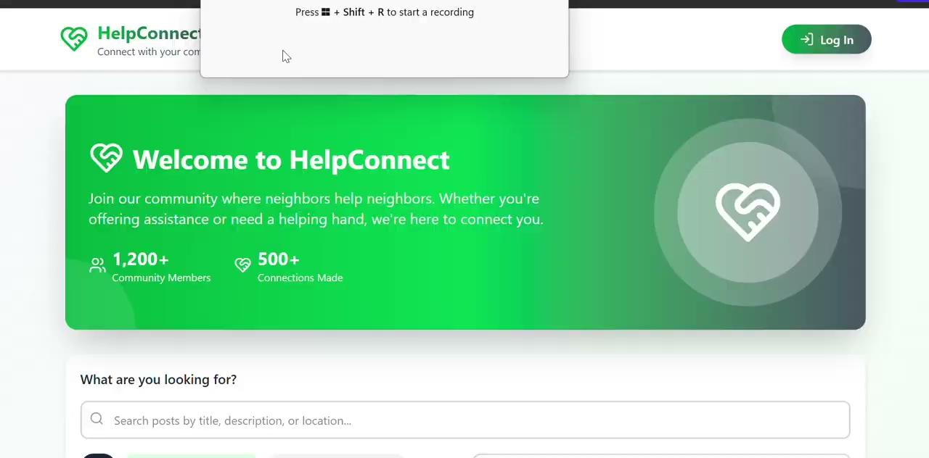
Sprint 1 Recap
Brief presentation of the prototype from Sprint 1

Slide 3
Front-End progress
Almost finished implementation of the UI
Key components created
Responsiveness and UX improvements
Routing/navigation
Forms implemented (e.g., registration, login, creating posts, message )
Admin dashboard base with post and user management

Slide 4
Sprint 2 Goals
Main objective for Sprint 2
  Get front-end mostly finished
  Get back-end endpoints finished
AI implementation
  Chatbot for asking questions

Slide 5
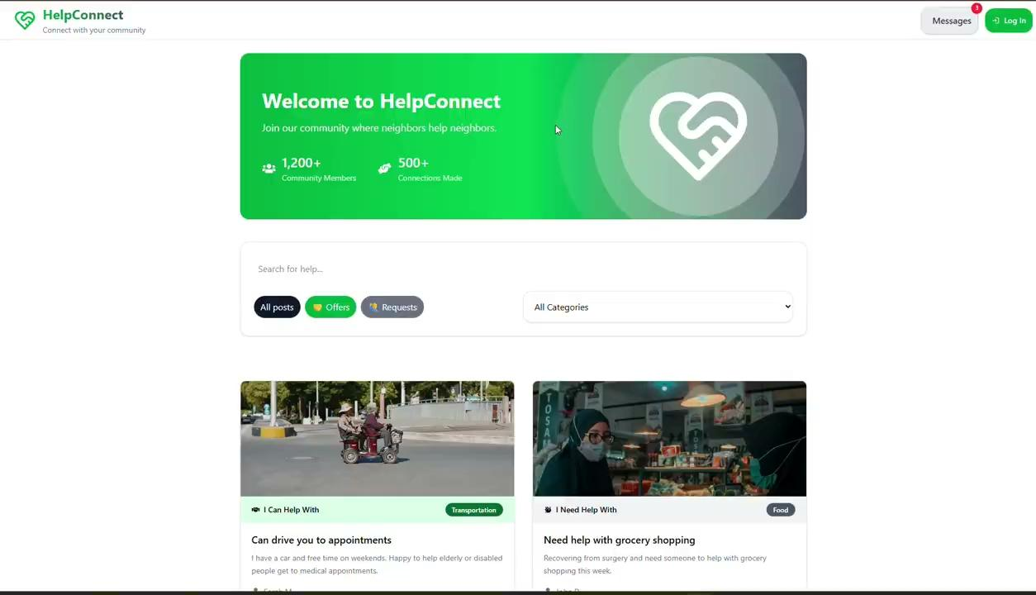
Hero + posts browses + message

Slide 6
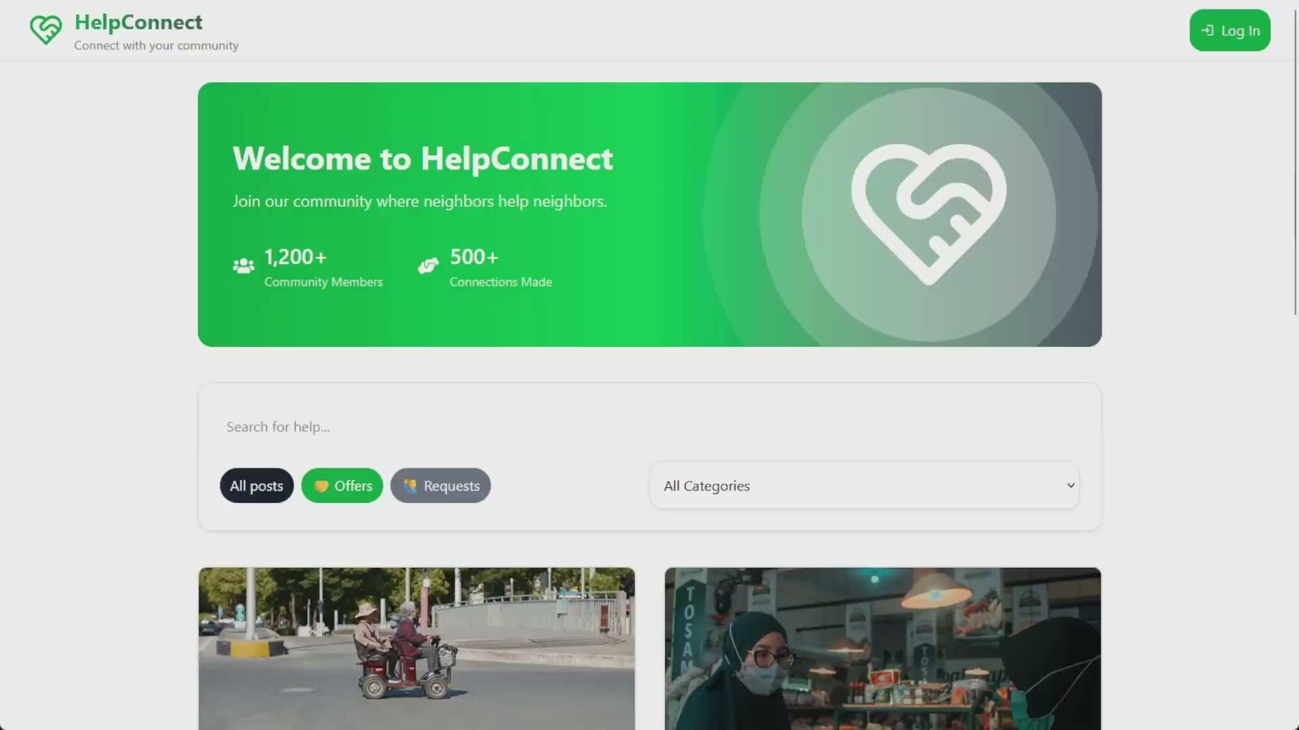
Main Page

Slide 7
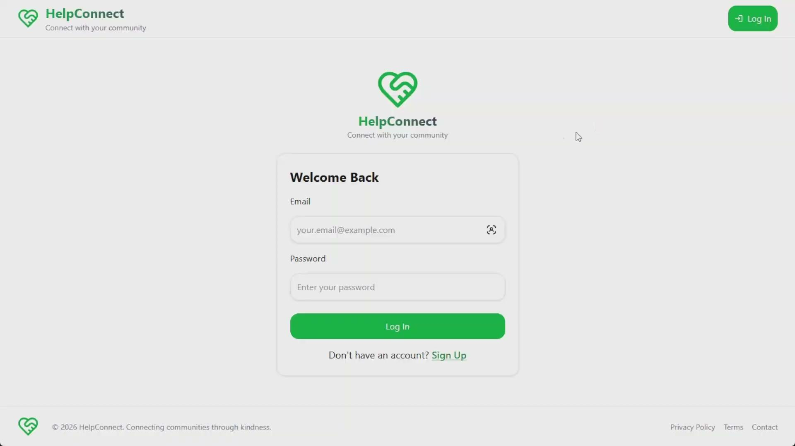
Login and Registration

Slide 8

Admin Dashboard

Slide 9
Backend-Progress
API endpoints created:
Authentication:
- POST /auth/register
Register a new user with validated credentials
- POST /auth/login
Authenticate user and return JWT token
-🔒 GET /auth/userinfo
Get authenticated user information
-🔒 PUT /auth/edit
Edit user information
-🔒 PUT /auth/change-password
Edit user password
-🔒 DELETE /auth/delete
Delete user information
Posts:
- GET /posts
Get all posts
- GET /posts/user/:userId
Get info about all posts of a user
- GET /posts/:postId
Get info about single post by ID
-🔒 POST /posts
Create a new post
-🔒 PUT /posts/:postId
Edit user post
-🔒 DELETE /posts/:postId
Delete user post

Slide 10
Backend-Progress
API endpoints created:
Profile:
- GET /users/profile/:id
Get profile data from a specific user id
- 🔒 PUT /users/profile/edit
Edit profile data of logged in user

Slide 11
Backend-Progress
Database schema change or persistence added
User Schema:
firstName
lastName
email
password
dateOfBirth
phone
location,
avatar, description,
socialLinks, isPublic
Post Schema:
user - connected with UserId
type - offer/request
title
description
category
location - City/municipality
budget - Optional
image - Optional
validation,
filtering,
sorting,
pagination

Slide 12
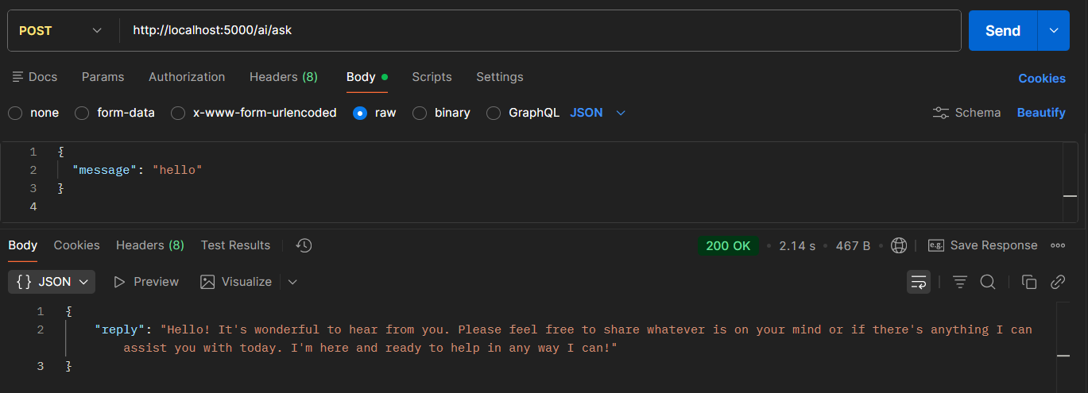
Backend-Progress
AI/LLM integration details
- GET /ai/ask - Communicate with AI

Slide 13
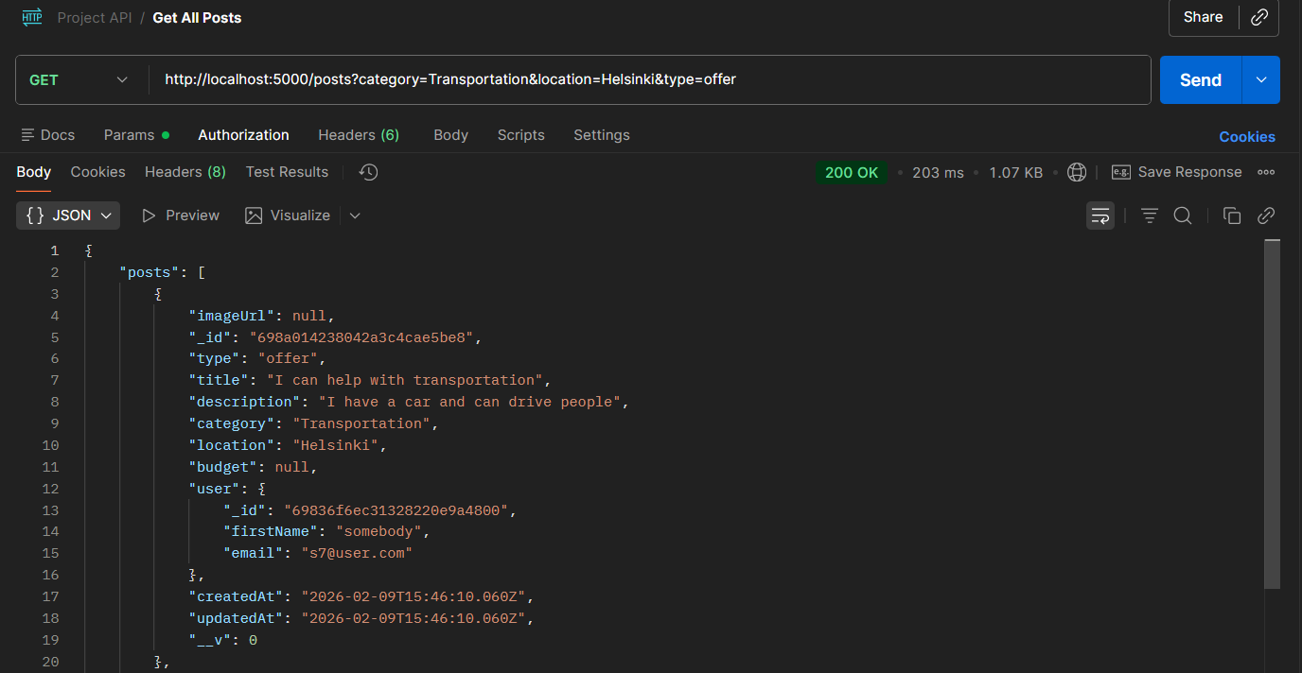
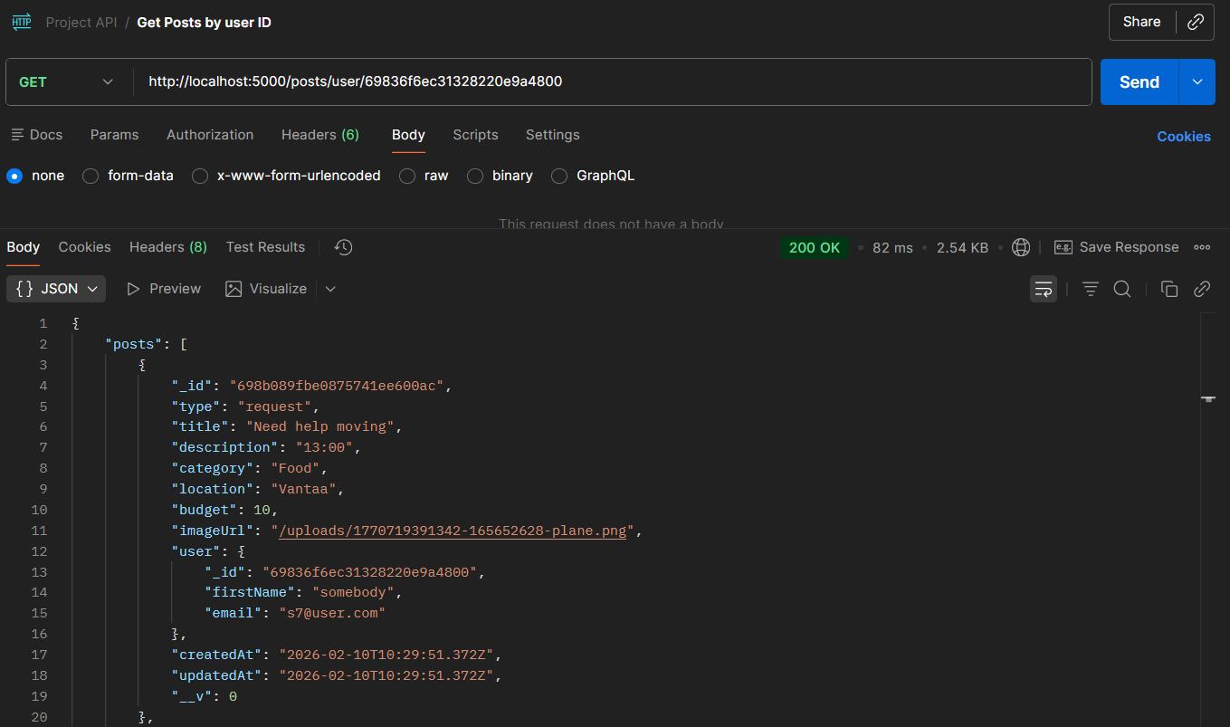
Backend-Progress
Testing with postman (include screenshot of collection )

Slide 14
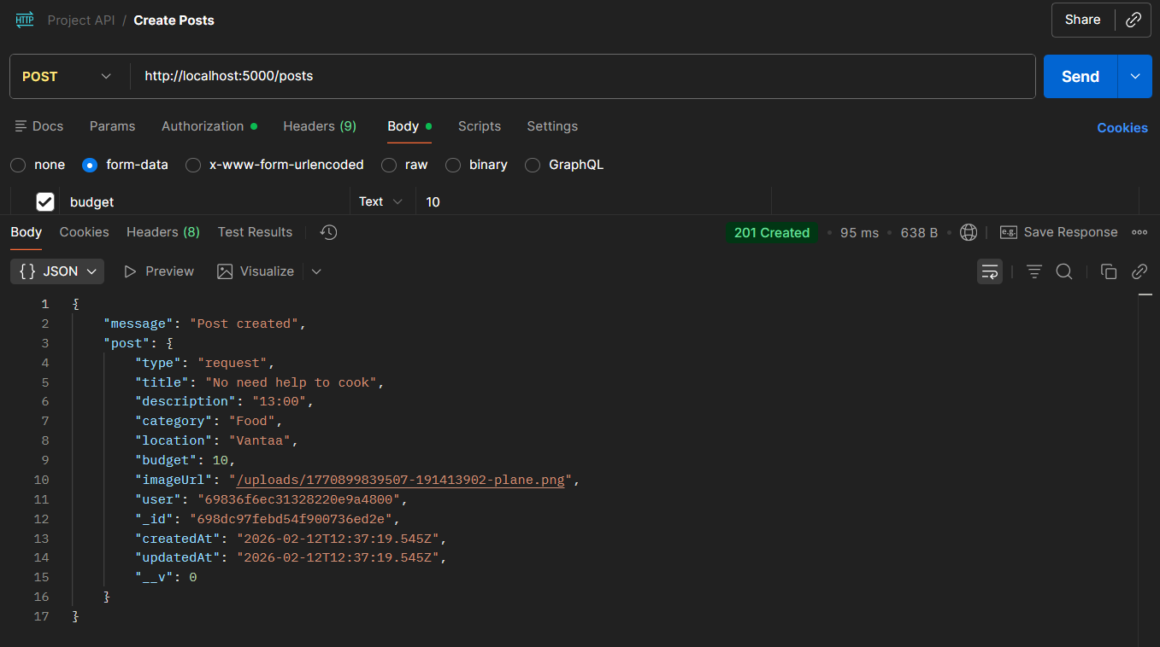
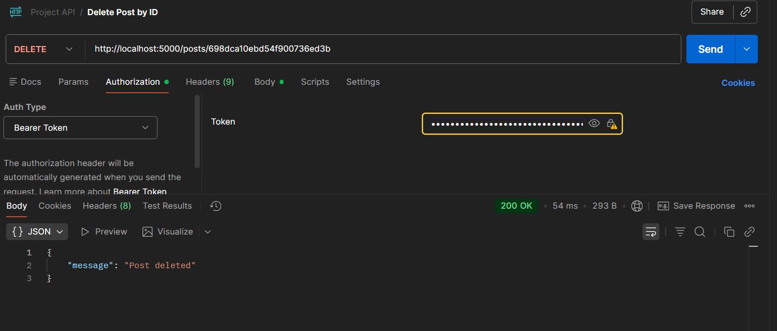
Backend-Progress
Testing with postman (include screenshot of collection )

Slide 15
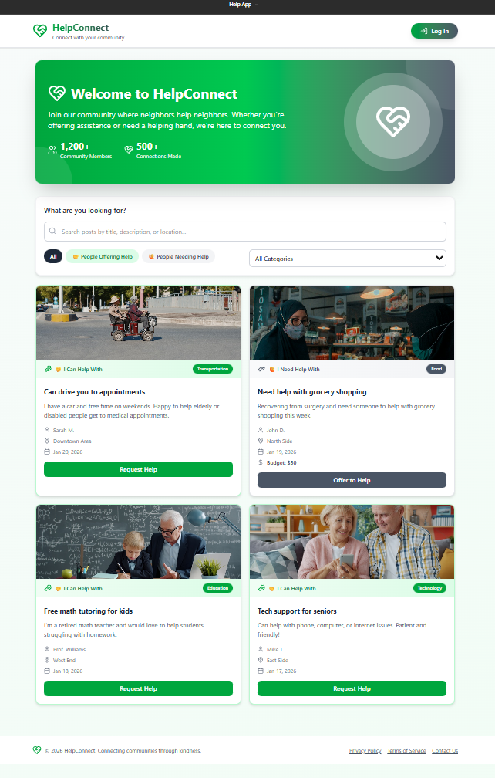
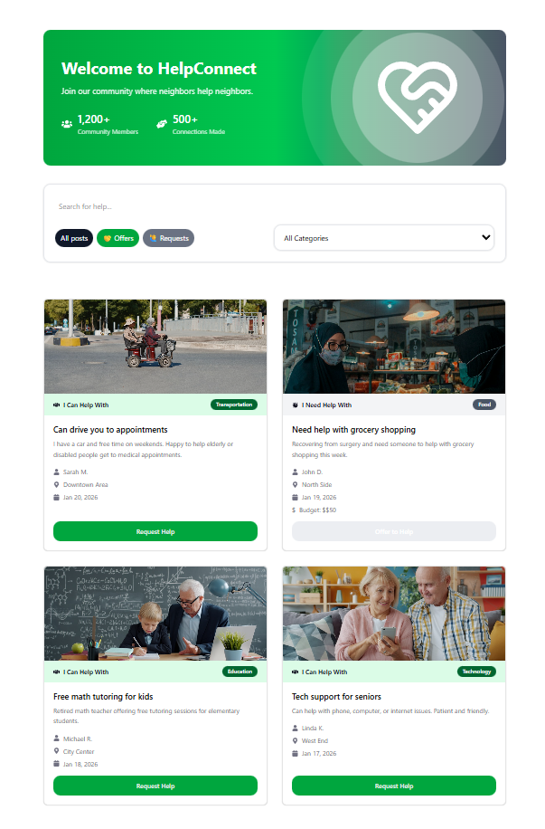
Alignment with Sprint 1 prototype
Figma
Web
SAME

Slide 16

The message section was intentionally relocated for the demo/testing flow. It will be moved to the Login screen afterward.
Only change
Figma
Web

Slide 17
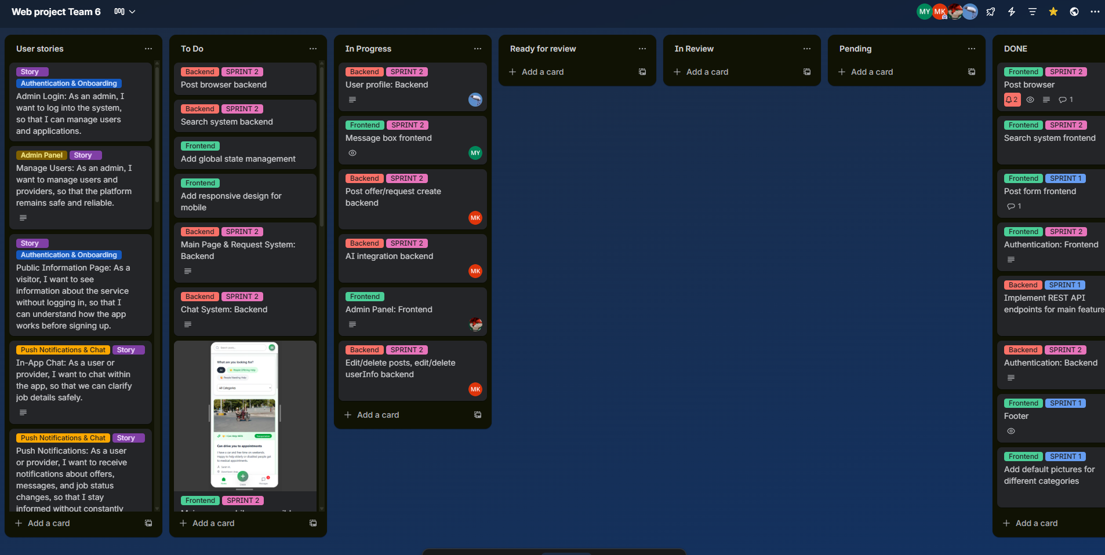
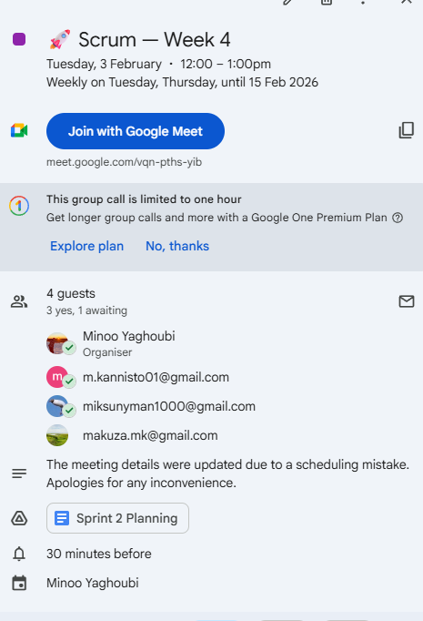
Sprint Ceremony
We hold Daily Scrum meetings every Tuesday and Thursday, and the whole team attends. We review our tasks, share progress and what we’ve completed, and raise any issues or challenges. We then continue with the planned work.

Slide 18
Remaining Tasks / Next Sprint
Plans:
Start implementing new user‑facing features such as messaging, notifications and rating system.
Strengthen the connection between frontend and backend so all new endpoints are fully integrated and visible in the UI.
Risks or blockers to address:
Frontend–backend integration may require additional coordination
Real‑time features like messaging or notifications introduce technical complexity.
Role‑based access for the admin panel needs careful planning to avoid security risks.

Slide 19
Team contribution
Member | Key Contribution
Maria | Authentication, Posts, Location API endpoints, MongoDB integration, user and post models, backend validation, AI endpoint, Postman testing, PR Review
Mikael | User profile backend
Markus | Product Owner. Login, registration, search box, admin panel. Reviewing pull requests and code.
Minoo | Scrum Master (Weeks 4–5): facilitated daily stand-ups, sprint planning. Frontend: built/updated Header, Footer, Hero, Posts, and Message components.

Slide 20
Summary and closing
The biggest achievement in Sprint 2 was staying on track with the plan and making steady progress. Huge thanks to both the backend and frontend teams for their strong effort. We still have a long road ahead, but this was an important step forward.

Slide 21
THANK YOU
Questions?

