Slide 1
Minor Project-1
Project Number - 90
Image processing Using web Assembly
Project Guide:
Mr. NavalJeet Singh Arora Sir
Project Team Members:
Mayank Singh Tomar (201b153)
Himanshu Tiwari (201b373)
Chirag Jain (201b087)

Slide 2
Index
Need of Image Processing
Need of WebAssembly
More About WebAssembly and Image Processing
Techs & Languages used in the Project
Package Managers used in the Project
Project Objectives
Project Working
Conceptual Architechture
Project Phases
Approx Result

Slide 3
Need of Image Processing
Image processing’s applications range from medicine to entertainment, passing by geological processing and remote sensing.
The processing of digital images can be divided into several classes: image enhancement, image restoration, image analysis, and image compression.
Currently, we process image using various libraries written in languages like python, JavaScript, C# and etc.
New technological breakthrough in the areas of digital computation and telecommunication has relevance for future applications of image processing.

Slide 4
Need of WebAsssembly
WebAssembly is totally new topic with daily new discoveries and huge scope for improvement and development.
It is compiles almost any type of low-level language including C/C++, Rust, JavaScript, python, etc. allowing us to easily import our projects to wasm based.
WebAssembly ensures that the task carried out is fast, efficient while making it secure over the duration.

Slide 5
More about WebAssembly and Image Processing
Web Assembly: WebAssembly (abbreviated Wasm) is a binary instruction format for a stack-based virtual machine. Wasm is designed as a portable compilation target for programming languages, enabling deployment on the web for client and server applications.
Image Processing: Image processing is a method to perform some operations on an image, in order to get an enhanced image or to extract some useful information from it.
We will use a low-level language like Rust for better and higher performance backend which provides all image processing functions.

Slide 6






Techs & Languages used in the project
JavaScript | Node.Js | React.jS | Cascading Style Sheets | Rust | wasm
• Base language used for structuring project. • Used for connecting backend to frontend | • Worked as initiator of the project. • Used for running packages. | • Used as main language in project’s Frontend. • Connects styling to the project. | • Used for styling frontend. • Enables clarification of content in frontend. | • Main language for the backend. • Compiles backend and provide connection between wasm and js. | • Root language for webassembly • Compiles whole backend in file sets

Slide 7



Package Managers used in the Project
Wasm-Pack | WebPack | Git & GitPod
• Main package that compiles backend. • Provides connection route between frontend and backend • Manages debugging and synchronization of whole project. | • Main Package that compiles Frontend. • Provides UI & UX of the project • Provides connection between frontend and backend via callbacks. | • Provides maintenance and easy team support for the project. •Helps in easy error finding and builds • Helps in structuring the project.

Slide 8
Project Objectives
The main objective of this project is to make a web app that works on the basic principle’s of image processing and returns a processed image.
The goal here is to achieve much faster, efficient and secure method of providing better quality images.
This Image processor will provide multiple options applicable on image, making it a wide range application.

Slide 9
Project Working
The project works in four stages :
Input Image at frontend
Compilation of image processing functions on backend
Applying functions on frontend
Returning processed Image

Slide 10
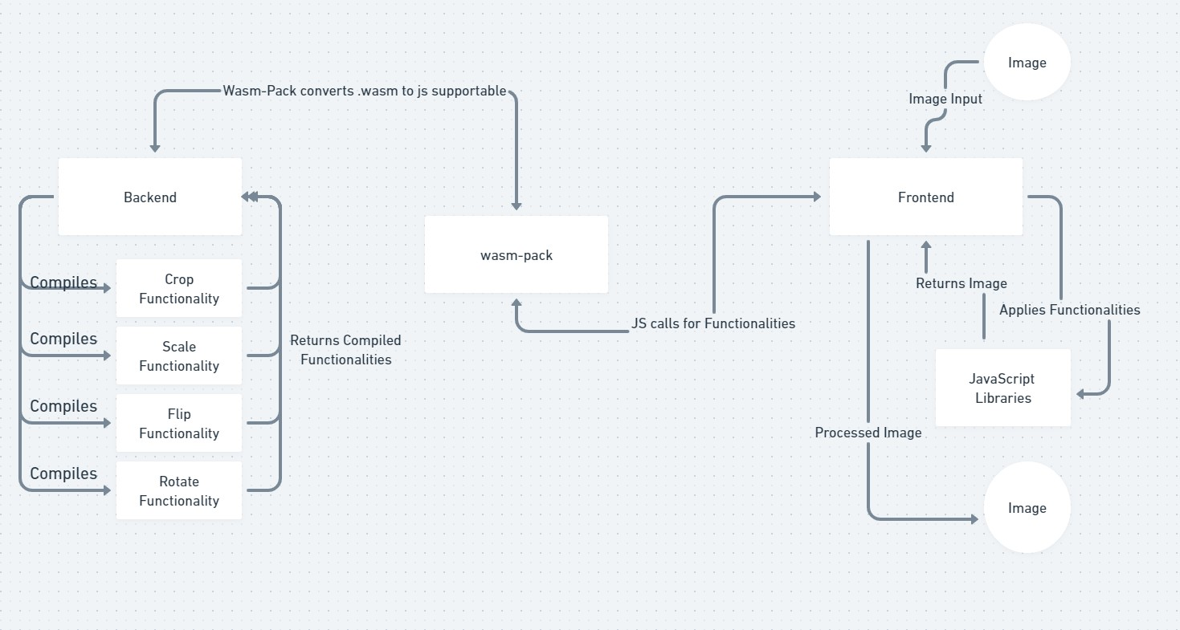
CONCEPTUAL ARCHITECTURE

Slide 11
Project Phases
Phase I: Adding Basic Structure :: Completed
Phase II: Adding Basic Functionalities :: Still In Progress
Phase III: Adding Additional Image Effects :: On Hold
Phase IV: Adding Color Filters To Image & Other Effects :: On Hold
Phase V: Hosting Whole Package :: On Hold

Slide 12
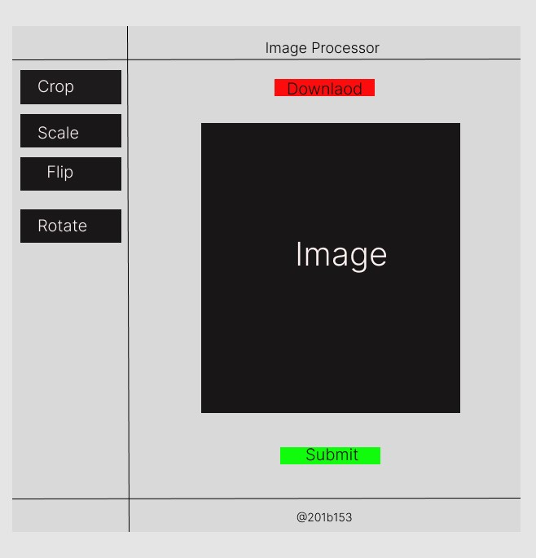
Approx Result

Slide 13
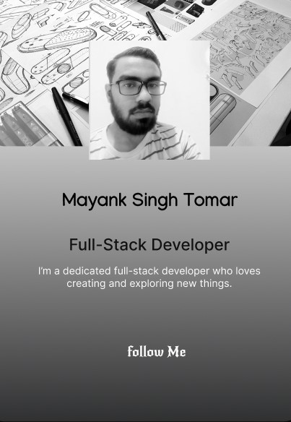
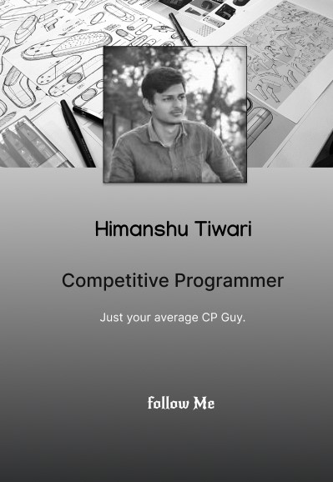
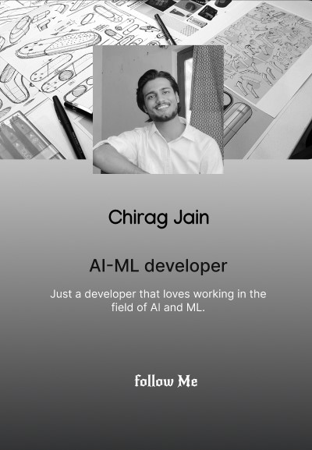

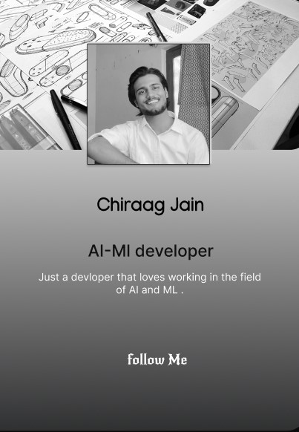
Project By
Mayank Singh Tomar (201b153)
Himanshu Tiwari
(201b373)
Chirag Jain
(201b087)

Slide 14
Thank You

