Slide 1
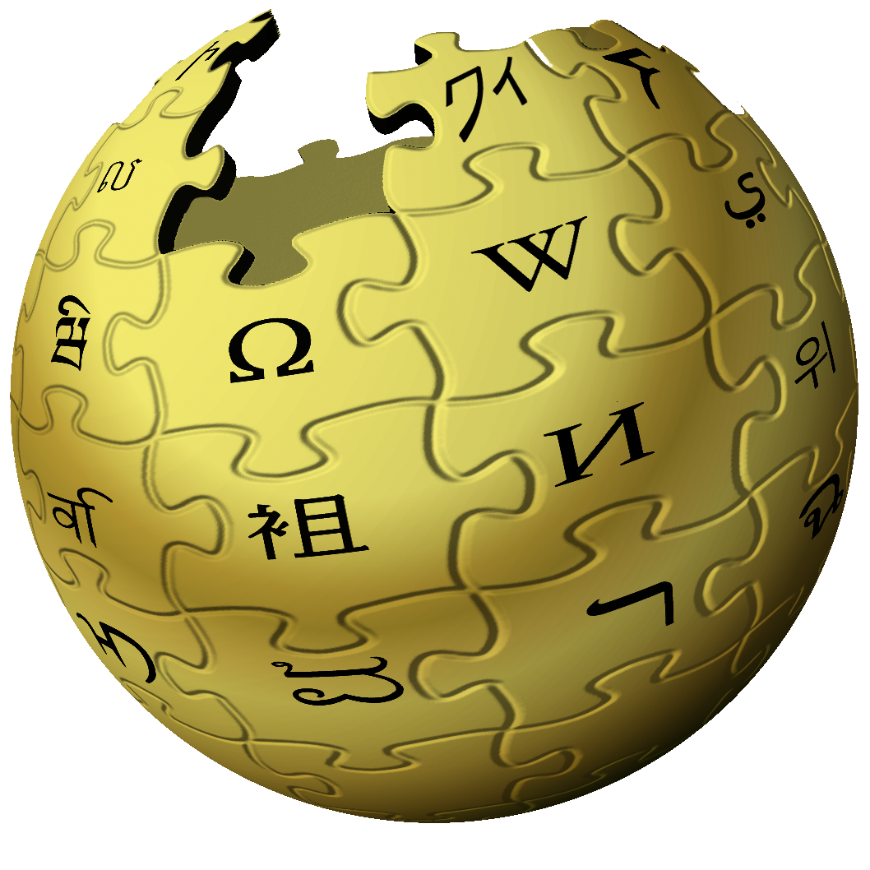
NAVICLEAR
TOOL TO NAVIGATE WIKIPEDIA FOR VISUALLY IMPAIRED

Slide 2

Group - 4
Team Mentor:
Under the guidance of:
Prof. Manish Kumar
Team Members:
19103001 Harsh Sambyal
19103002 Vageesh
19103005 Sukaran Kant
19103084 Aayush

Slide 3

PROBLEM STATEMENT
According to WHO, globally, at least 2.2 billion people have a near or distance vision impairment.
There are very scarce ways for the visually impaired individuals to have an appreciable access to the online forums where they can learn, nourish, and pursue their interests effortlessly with ease.
It makes it strenuous for them to easily access any portal of their choice because the problem of “How will they navigate and get to know where they should click to move to the required portal” always prevails because of their natural disability.

Slide 4
OUR CONTRIBUTION…
What already exists:
Source of information i.e. Wikipedia
Speech recognition systems
Existing Problems:
No navigating tool with the help of speech commands
What we have done:
Scrapped Wikipedia pages to extract useful information
Basic Navigation commands for interactive communication between system and visually impaired.

Slide 5
What is NAVICLEAR?
A Command line tool implementing various speech commands:
Next / previous heading
Next / previous paragraph
Next / previous image
Next / previous table
Next / previous link
Web page statistics
Uses only SPACE BAR key, rest of communication is vocally.

Slide 6
Additional Features…
Online help command using [query] Google command
Search meaning using [word] Dictionary command
Fetch news headlines using [category] news command

Slide 7




Technologies used...
Language : Python
Web Scrapping : Beautiful soup, Selenium
Deep learning : Tensorflow
APIs : google speech, news api, dictionary api

Slide 8
Models Used:
ASRTflite model
Silero models for speech to text and text to speech
Google speech recognition

Slide 9
USE CASE DIAGRAM

Slide 10
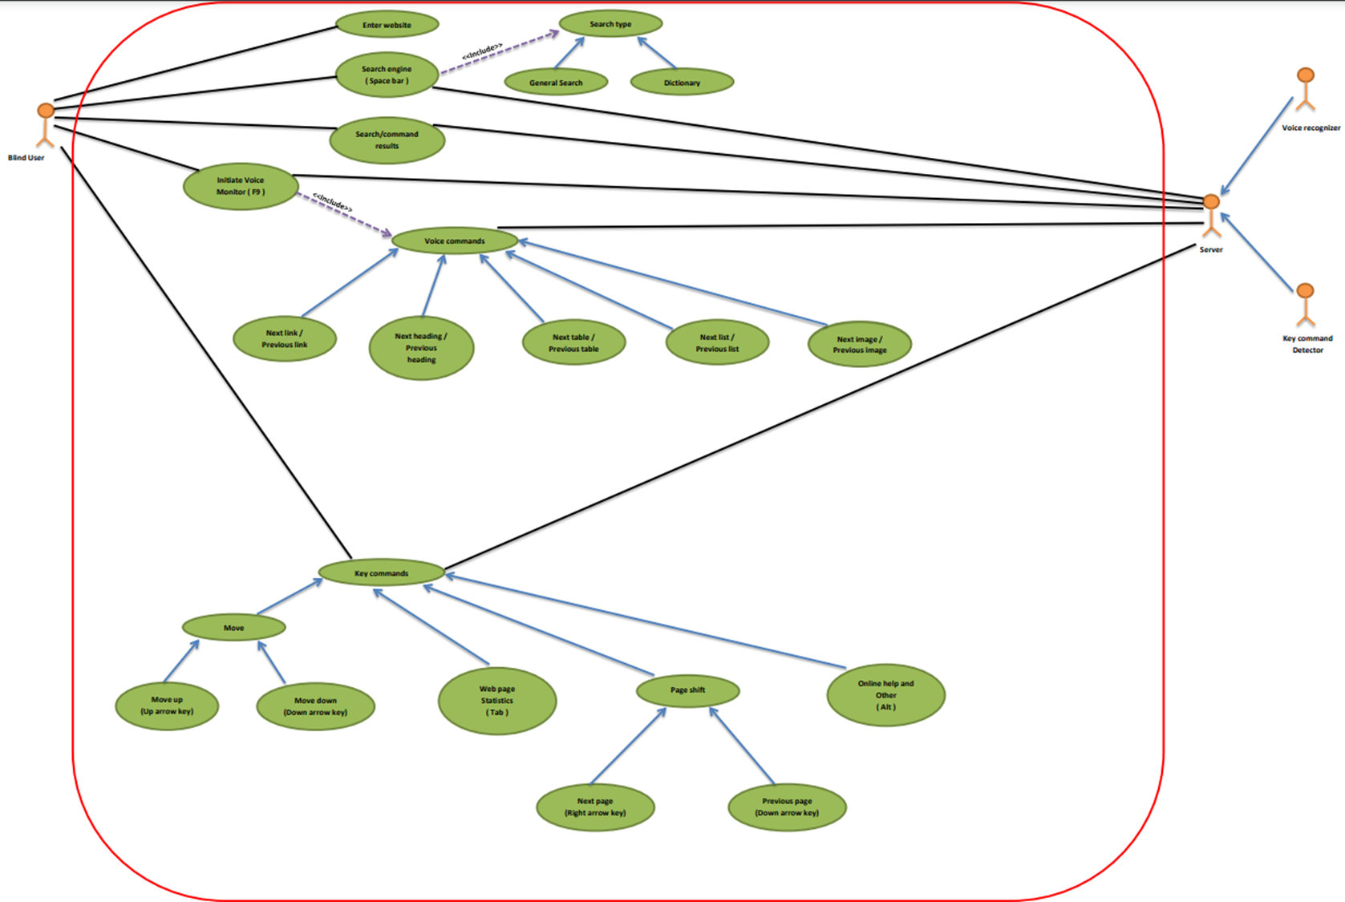

Slide 11
ACTIVITY DIAGRAM

Slide 12
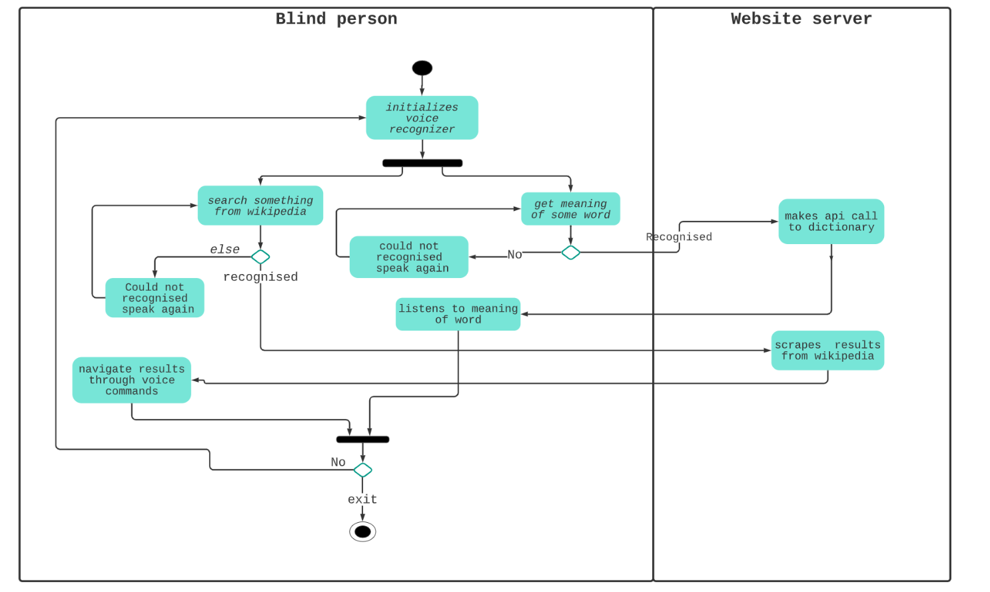

Slide 13
CLASS DIAGRAM

Slide 14
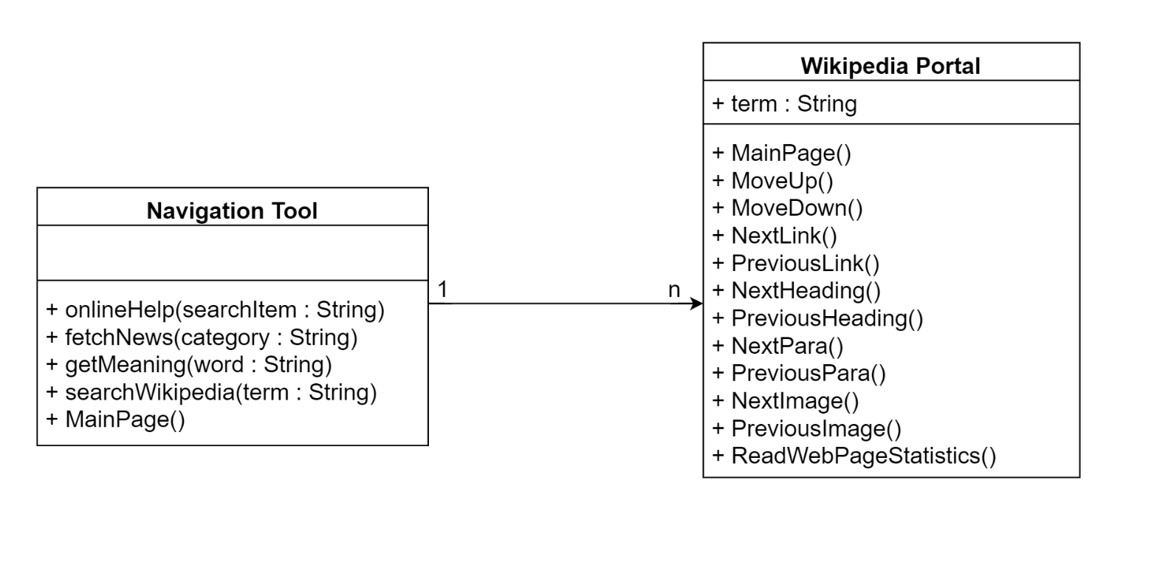

Slide 15
SEQUENCE DIAGRAM

Slide 16
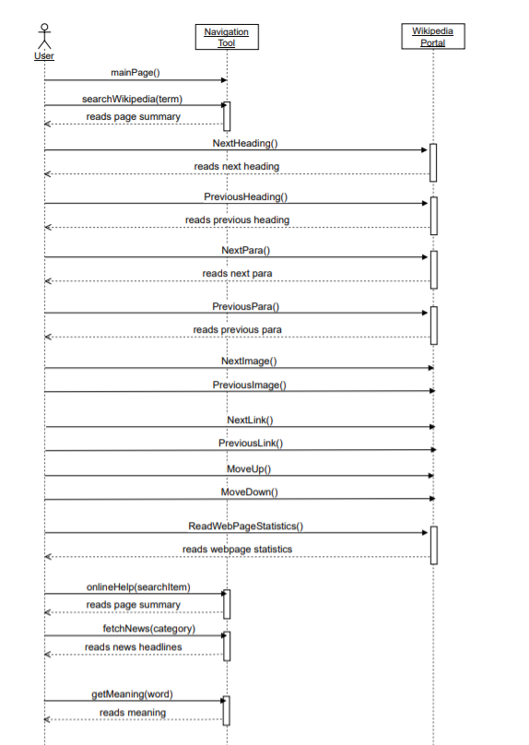

Slide 17
STATE DIAGRAM

Slide 18
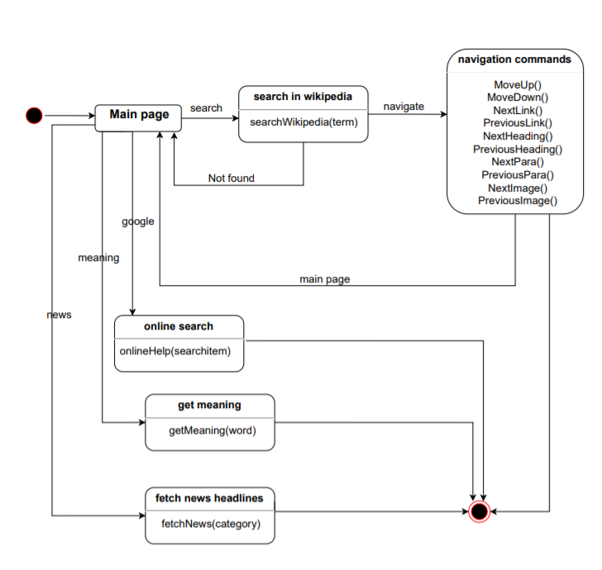

Slide 19
Future Scope:
Existing Challenge:
Microphone seldom gets stuck while listening.
FUTURE SCOPE:
Skip items if the user wants to do so.
Efficient solution to irregular error generation in the model.
Translating the text to regional languages.

Slide 20


