Slide 1
Sentiment Analysis of Gaming Subreddits
Jeremy Reynolds

Slide 2
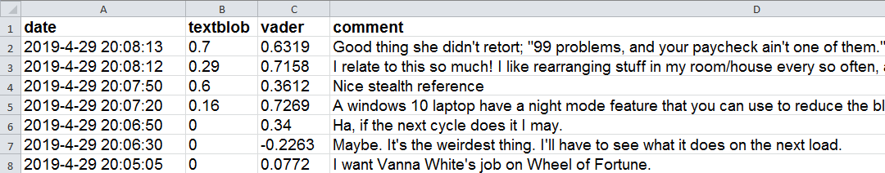
Data Collection
PRAW - Python Reddit API Wrapper
PSAW - Python Pushshift.io API Wrapper
Collected 13.8 million comments from 13 subreddits
Totalling 2.4GB of data

Slide 3

Sentiment Analysis
TextBlob - Sentiment Analysis
Trained using movie reviews.
VADER - Sentiment Analysis
Specifically attuned to sentiments expressed in social media.
Possibly more accurate for Reddit

Slide 4
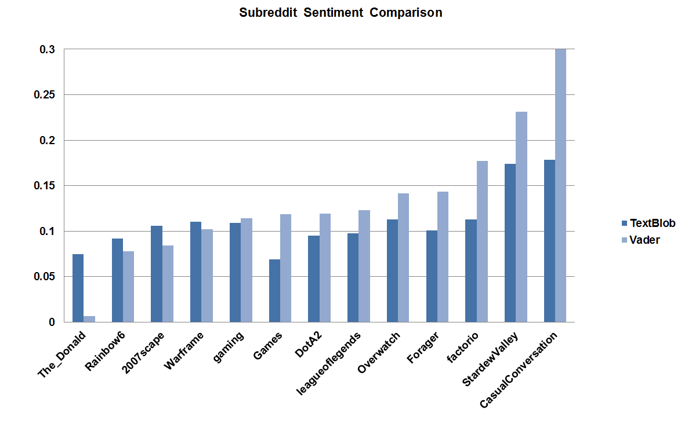

Slide 5
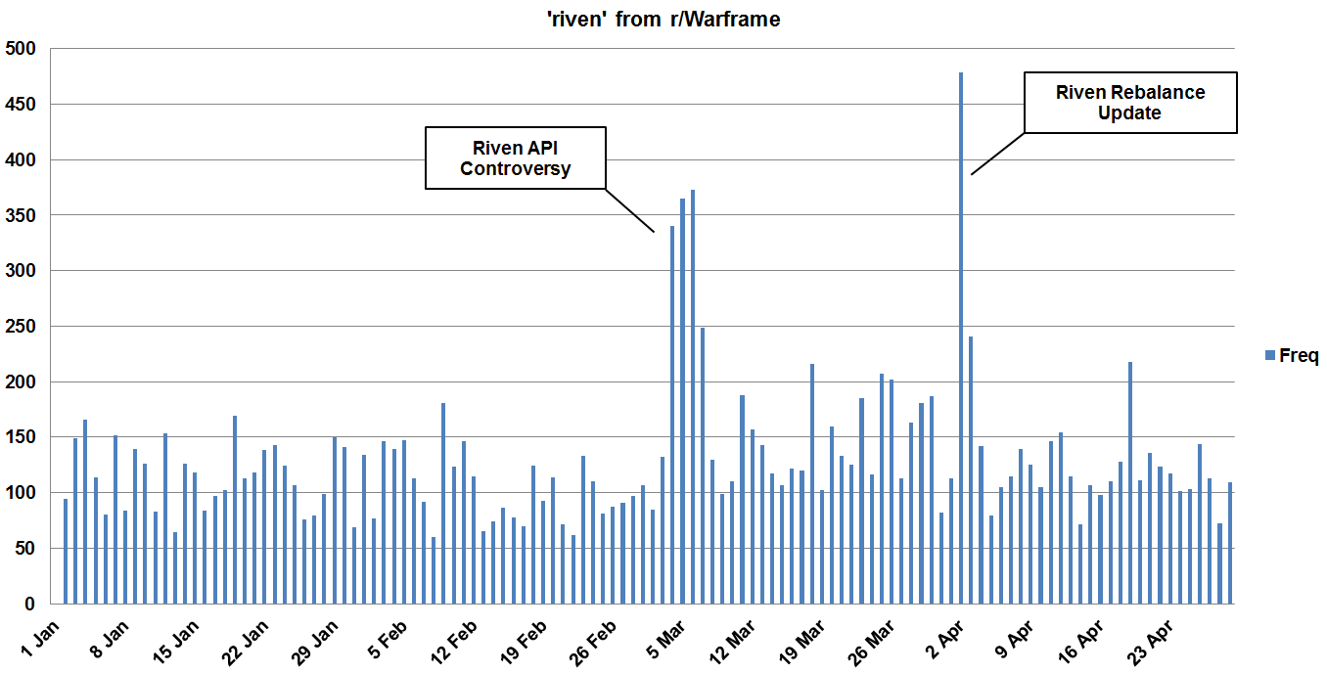

Slide 6
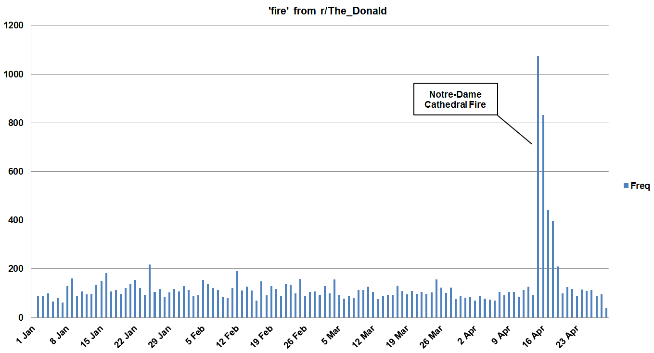

Slide 7
Challenges and Future Work
Reddit Pushshift.io API rate limits
Poor file IO logic when parsing/cleaning data
Change how I analyze sentiments
Use comments that are of longer length >100 characters
Use comments that have been upvoted >5 times

Slide 8
Sources and Technologies Used
Python 3 https://www.python.org/download/releases/3.0/
PRAW https://praw.readthedocs.io/en/latest/
PSAW https://github.com/dmarx/psaw
TextBlob https://textblob.readthedocs.io/en/dev/quickstart.html#sentiment-analysis
VADER https://github.com/cjhutto/vaderSentiment

Slide 9
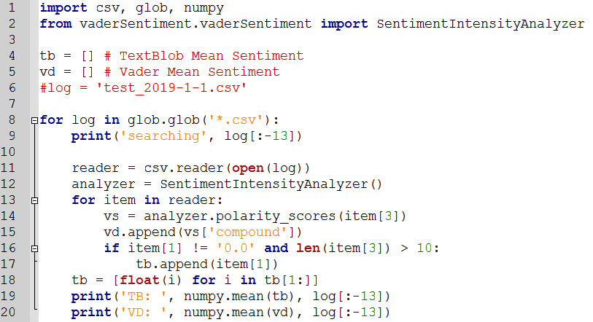
Sentiment.py

Slide 10
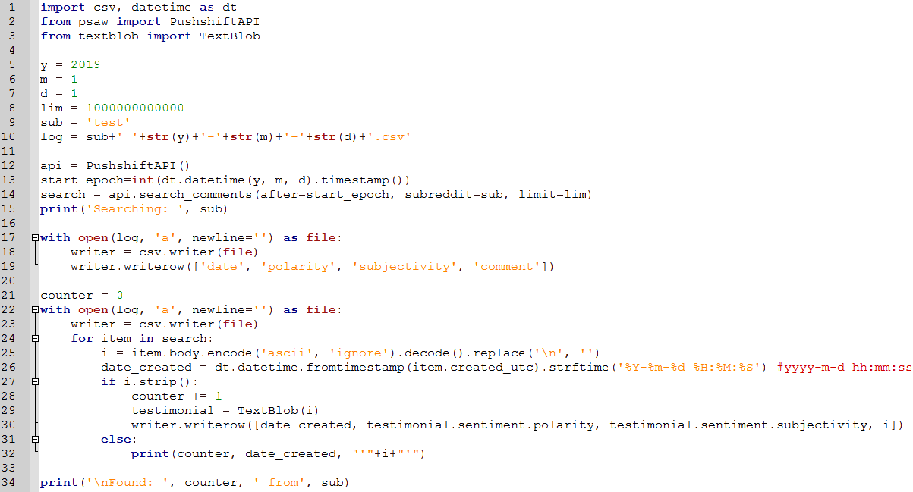
Scrape.py

Slide 11
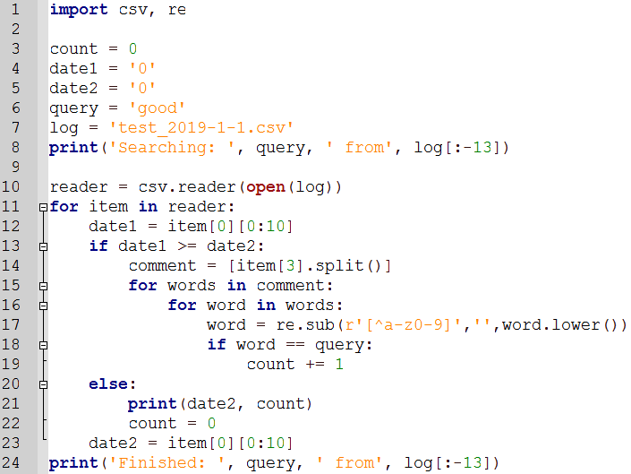
Frequency.py

Slide 12
Sentiment Analysis of Gaming Subreddits
Jeremy Reynolds

