Slide 1
Country’s Happiness
Using countries metrics of different features to determine their happiness

Slide 2
Questions To Explorer
What countries are the happiest?
What factors may contribute most to their score?
What regions seem to have the happiest countries?

Slide 3
Country Happiness
The dataset is a compilation of a countries metrics.
Factors include: Country, Dystopia, Family, Freedom, GDP, Generosity, HappinessRank, Health, Region, StandardError, Trust and more.
The main factor is HappinessScore, a value from 1 to 10 where 10 is the happiest surveyed by people in their respective countries.

Slide 4
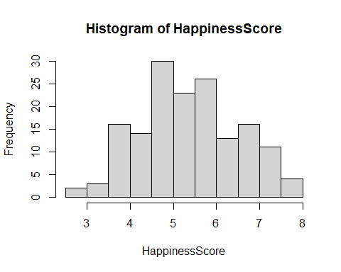

Happiness Score
The variable we are most concerned with is the happiness score. A value calculated from the responses of the population.

Slide 5
Possible improvements and Usage
To improve on the dataset we would need other possible features.
Remove countries that have inexplicable happiness scores, or outliers.

