Slide 1
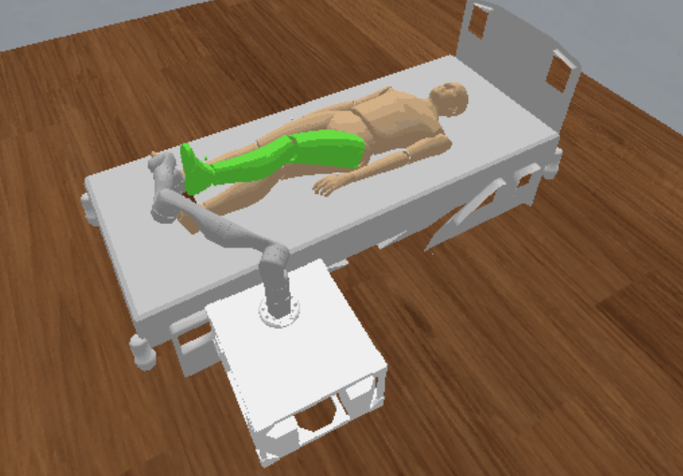
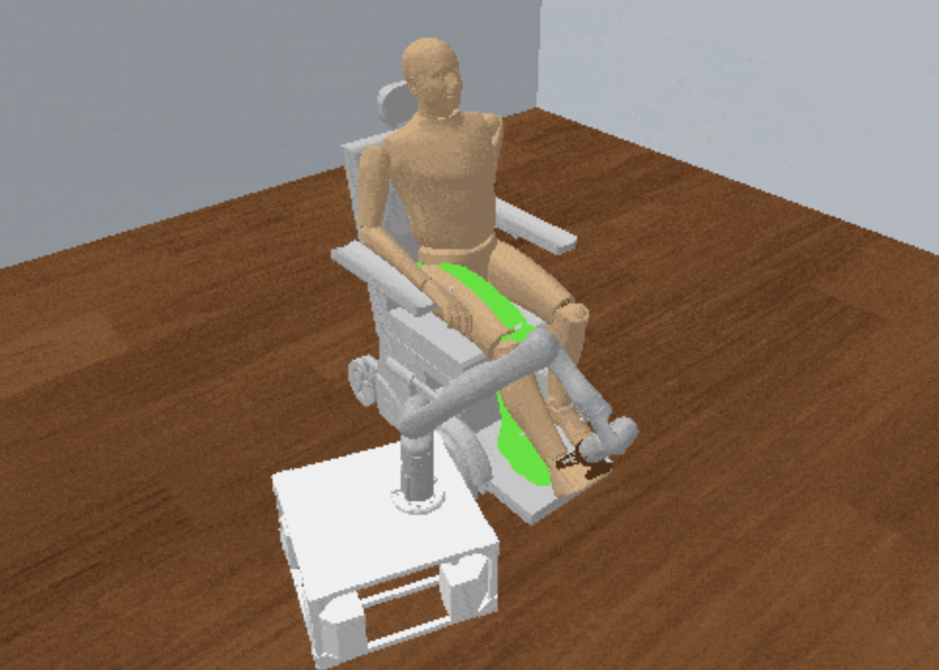
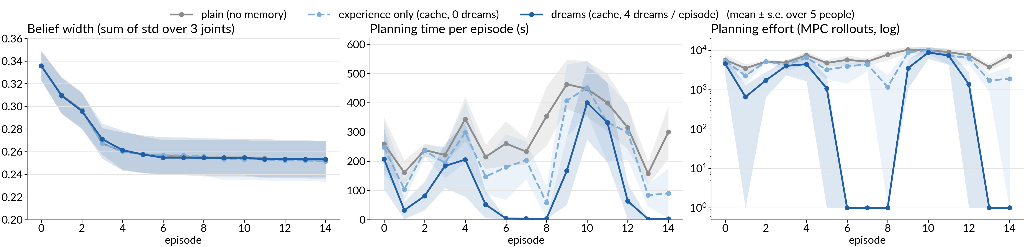
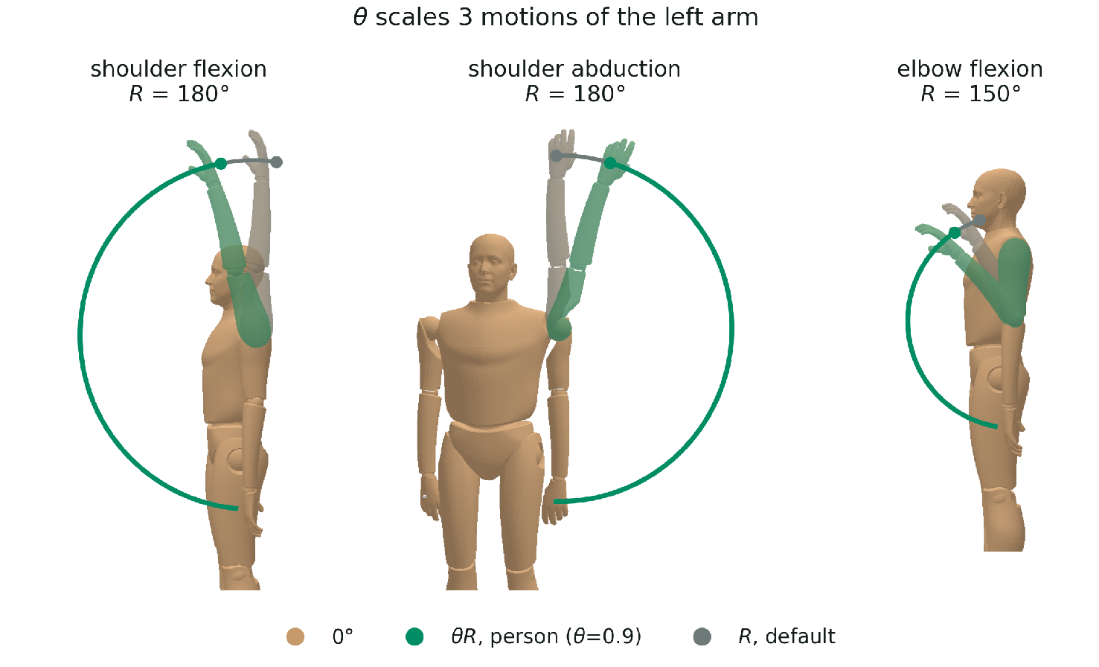
Learning to Accelerate Task and Motion Planning
for Forceful Human Limb Manipulation
logo
Minseo Kwon, Tom Silver
Princeton University
Motivation: Limb Manipulation
Approach
Caregiving and rehabilitation using a robot require moving a person's limb by direct, forceful contact.
Long-horizon: where to stand, where to grasp, how to move the limb ⇒ Task and Motion Planning (TAMP).
The human’s range of motion (RoM) differs across people
next episode
execution updates the belief
1) Information gathering
2) Human model learning
3) Dreaming (offline)
4) Planning & execution
Person pushes a joint to the believed limit
Look up M or learn from M for planning
query q_{t} → response r_{t}
prior
belief b_{t}
b(θ) ∝ p(r | q, θ) b(θ)
θ′ ~ b_{t} → imagined b̃_{t+1}
π_{t} = Plan(τ_{t}, b_{t}; M)
Problem Formulation
Zoom: n dreams per episode
used in the next episode
TAMP domain (PDDLStream): The plan-limb-motion stream is an MPC that searches over robot torques under the human and robot limits.
b̃¹_{t+1}
PDDLStream
plan₁
memory M
(goal, b̃_{t+1}) → plan
cache or
learned policy
⋮
b̃²_{t+1}
plan₂
Domain
Streams
belief b_{t}
b̃^{n}_{t+1}
plan_{n}
move-base
plan-base-motion
grasp
sample-grasp
plan-grasp-motion
move-limb
plan-limb-motion
Experimental setup
Task. τ = (q_{h}⁰, q_{r}⁰, q_{h}^{goal}) ~ P(τ): move the limb to a goal configuration.
Objective. Reach the goal quickly without violating the human RoM.
5 simulated people × 15 episodes · left arm (3 joints) · 4 dreams / episode · 600 s per plan
Tested on a left-arm manipulation environment in PyBullet sim and TidyBot
Evaluated: dreaming + planning & execution only (no information gathering or human model learning steps)
Research Question
Proof of concept
Learn the human's parameters θ
What is the human’s range of motion?
Learn the TAMP solver's parameters ψ
How can it plan fast for this person?
How can we learn to plan faster for the new user?
Human parameter θ: a person-specific range of motion
Dreams make planning a lookup: median 4992 → 1 MPC rollouts, 223 s → 4 s (plain → dreams).
Experience alone helps little: median 196 s; 38 vs. 69 memory hits out of 75 episodes.
The belief narrows the same in all conditions (0.34 → 0.25): memory speeds up planning, not learning.

