Slide 1

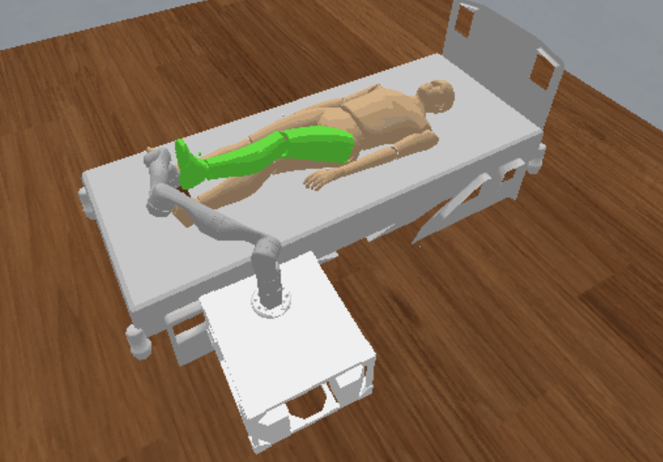
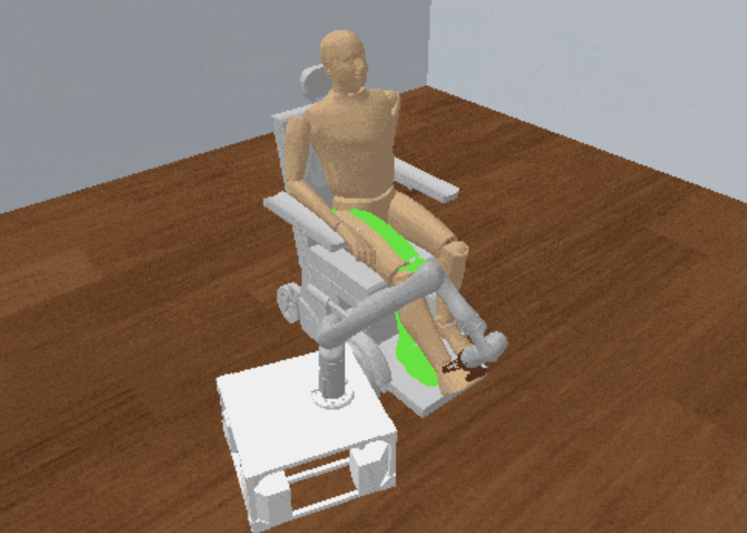
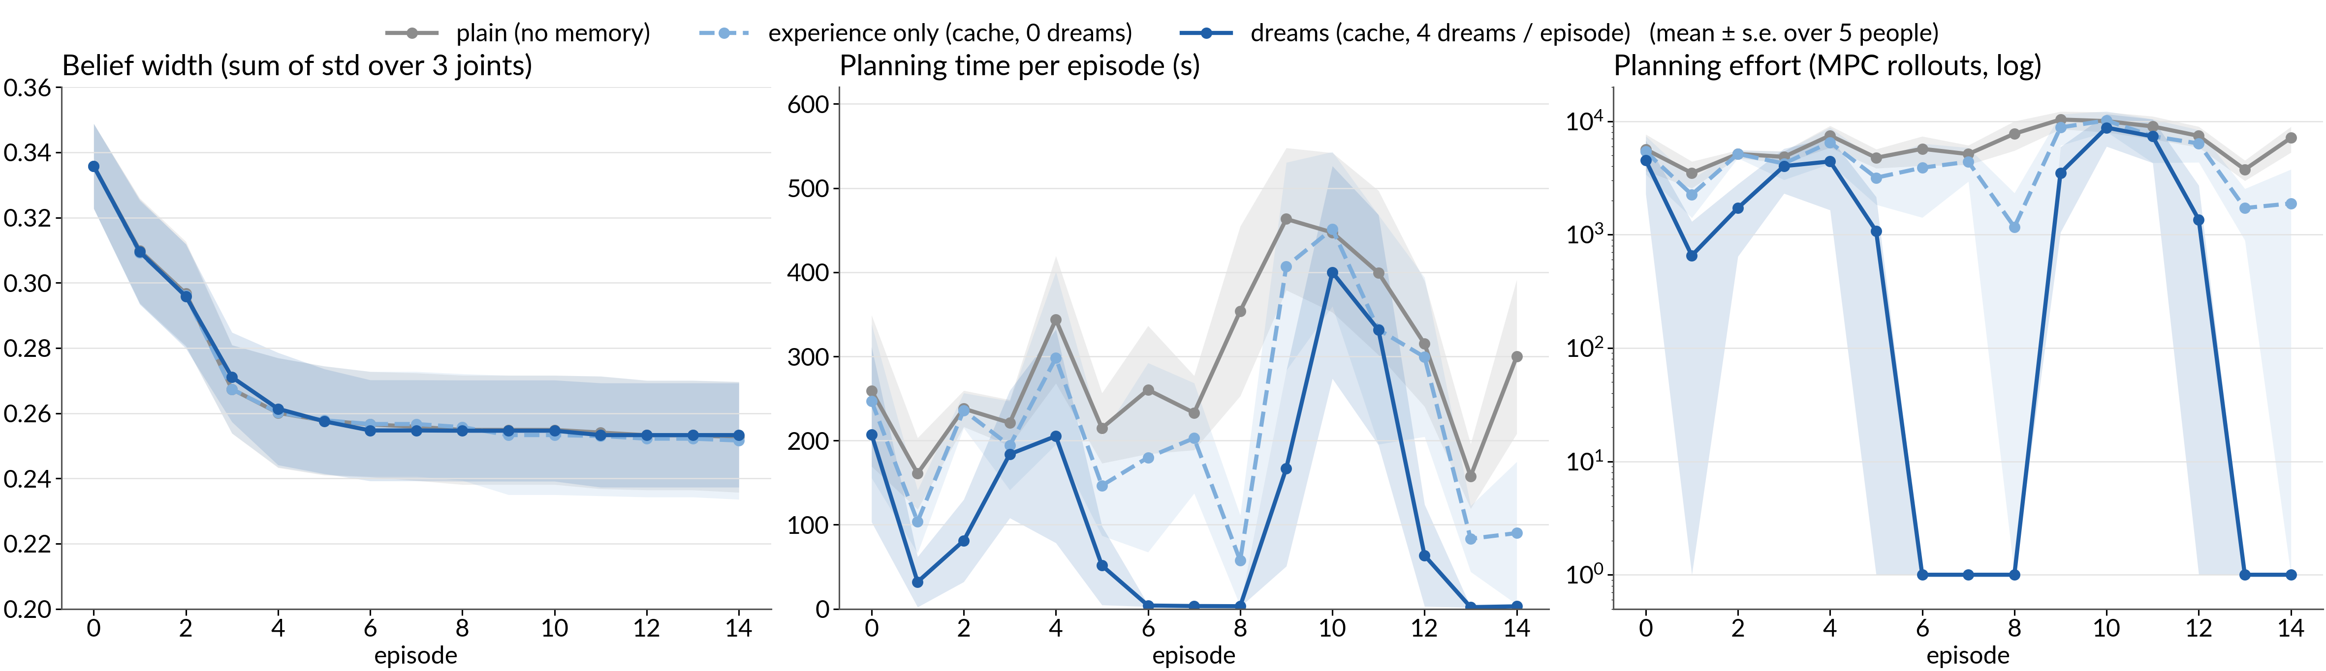
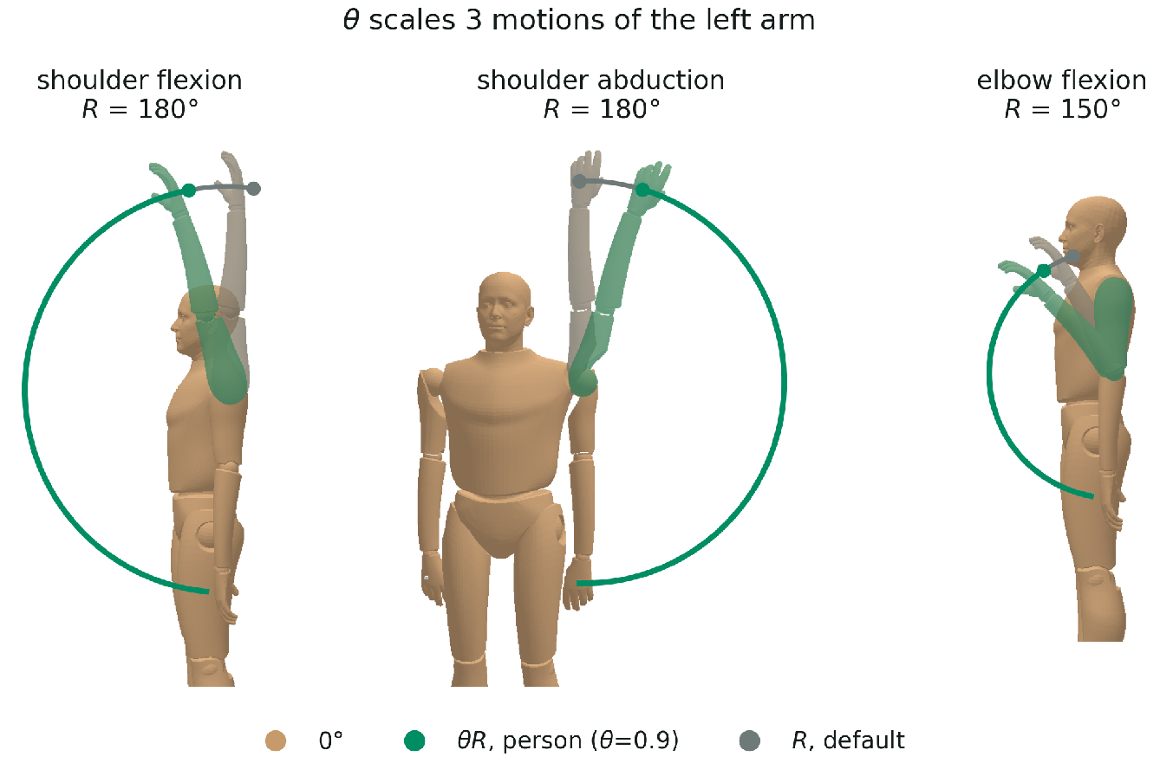
ABLE: Anticipating Belief Updates for Learning Efficient TAMP
Minseo Kwon, Tom Silver
Contact: mk1406@princeton.edu
Princeton University
Motivation: Limb Manipulation
Approach
Caregiving and rehabilitation using a robot require moving a person's limb by direct, forceful contact.
Long-horizon: where to stand, where to grasp, how to move the limb ⇒ Task and Motion Planning (TAMP).
The human’s range of motion (RoM) differs across people
next episode
execution updates the belief
1) Information gathering
2) Human model learning
3) Dreaming (offline)
4) Planning & execution
Person pushes a joint to the believed limit
Look up M or learn from M for planning
query q_{t} → response r_{t}
prior
belief b_{t}
b(θ) ∝ p(r | q, θ) b(θ)
θ′ ~ b_{t} → imagined b̃_{t+1}
π_{t} = Plan(τ_{t}, b_{t}; M)
Zoom: n dreams per episode
Problem Formulation
b̃¹_{t+1}
PDDLStream
plan₁
used in the next episode
TAMP domain (PDDLStream): The plan-limb-motion stream is an MPC that searches over robot torques under the human and robot limits.
memory M
(goal, b̃_{t+1}) → plan
⋮
b̃²_{t+1}
plan₂
cache or
learned policy
Domain
Streams
belief b_{t}
b̃^{n}_{t+1}
plan_{n}
move-base
plan-base-motion
grasp
sample-grasp
plan-grasp-motion
move-limb
plan-limb-motion
Experimental Setup
Task: τ = (q_{h}⁰, q_{r}⁰, q_{h}^{goal}) ~ P(τ) move the limb to a goal config
5 simulated people × 15 episodes · left arm (3 joints) · 4 dreams / episode · 600 s per plan
Tested on a left-arm manipulation environment in PyBullet sim and TidyBot
Research Question
Proof of Concept: Dreaming
Learn the human's parameters θ
What is the human’s range of motion?
Learn the TAMP solver's parameters ψ
How can it plan fast for this person?
How can we learn to plan faster for the new user?
Human Model
• Evaluated only the dreaming and execution steps, on a fixed set of 6 goals
Dreams make planning more efficient: with dreams, the robot reuses plans prepared while dreaming, while planning without memory or with experience-only memory stays slow.
Future work: since dreamed plans already speed up planning, learn a model from them instead of caching, so it generalizes to unseen goals and beliefs.

