Slide 1

Robotics Competition
Team 2
20175088 Boyoung Son
20175179 Minseok Choi

Slide 2
Contents
Overview
Methodology
Results
Appendix

Slide 3
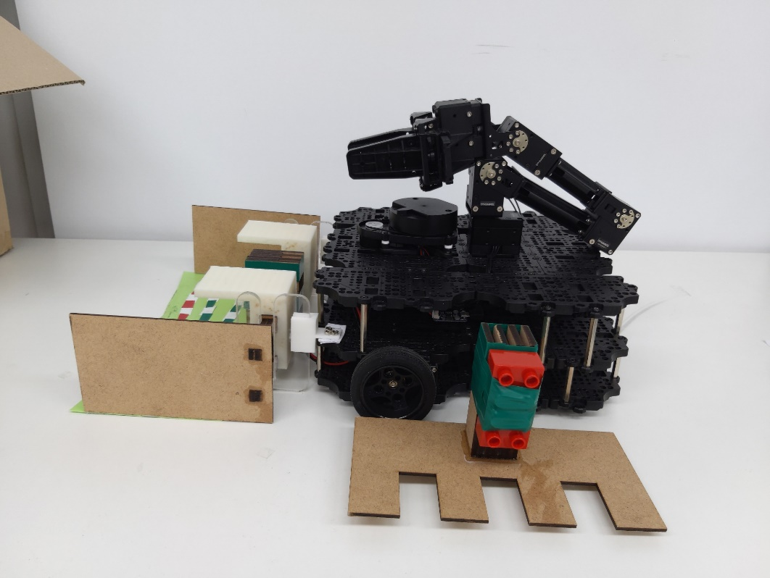
Overview
Turtlebot3
Manipulator (Openmanipulator-X)
Lidar (LDS-01)
Dustpan
Pickax

Slide 4
Methodology
Task 1 Navigate to zero position
Find initial position and heading by rviz
Navigate to zero position by using SLAM
Task 2 Move and sweep
Move straight line by 2 step acceleration
Sweep using manipulator and pickax

Slide 5
Methodology
Task 3 Navigate to trash bin
Navigate to trash bin by using SLAM
Task 4 Throw
Place pickax
Throw trash by using manipulator and dustpan

Slide 6
Results
Task 1 Navigate to initial position
https://youtu.be/T45aIqk8vIo

Slide 7
Results
Task 2 Move and sweep
https://youtu.be/AmbE85gnoFI

Slide 8
Results
Task 3 Navigate to trash bin
https://youtu.be/aNhXvE5mPPk

Slide 9
Results
Task 4 Throw
https://youtu.be/rJzVsj-BFaM

Slide 10
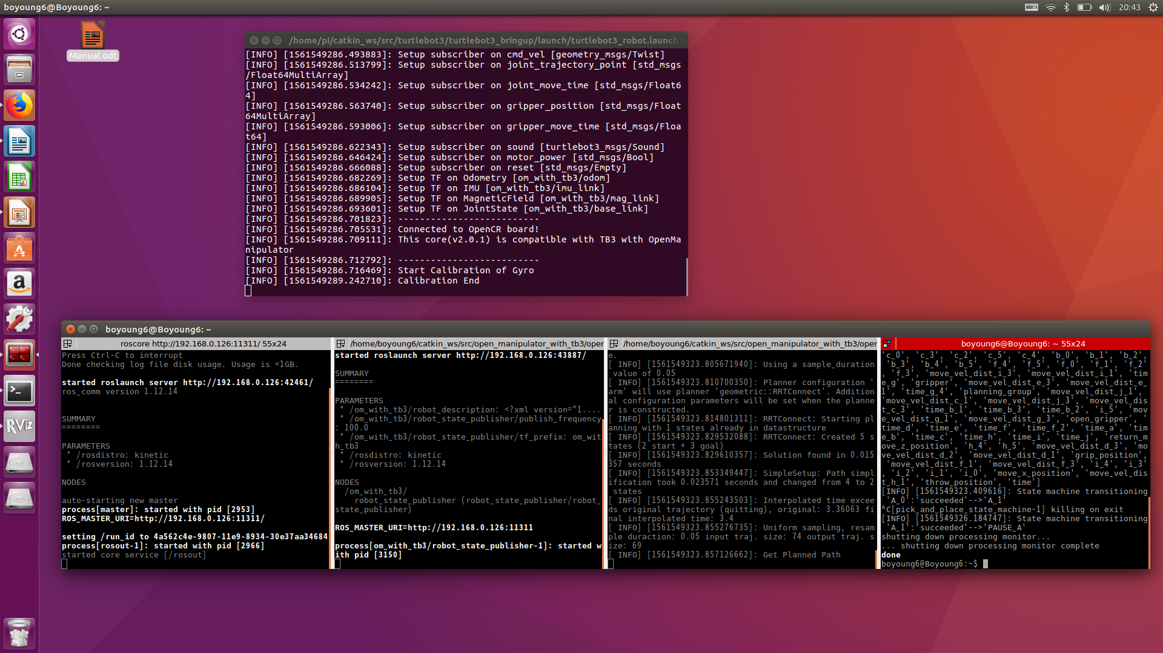
Appendix
1. Connect master PC and Turtlebot
2. Bring up Turtlebot

Slide 11
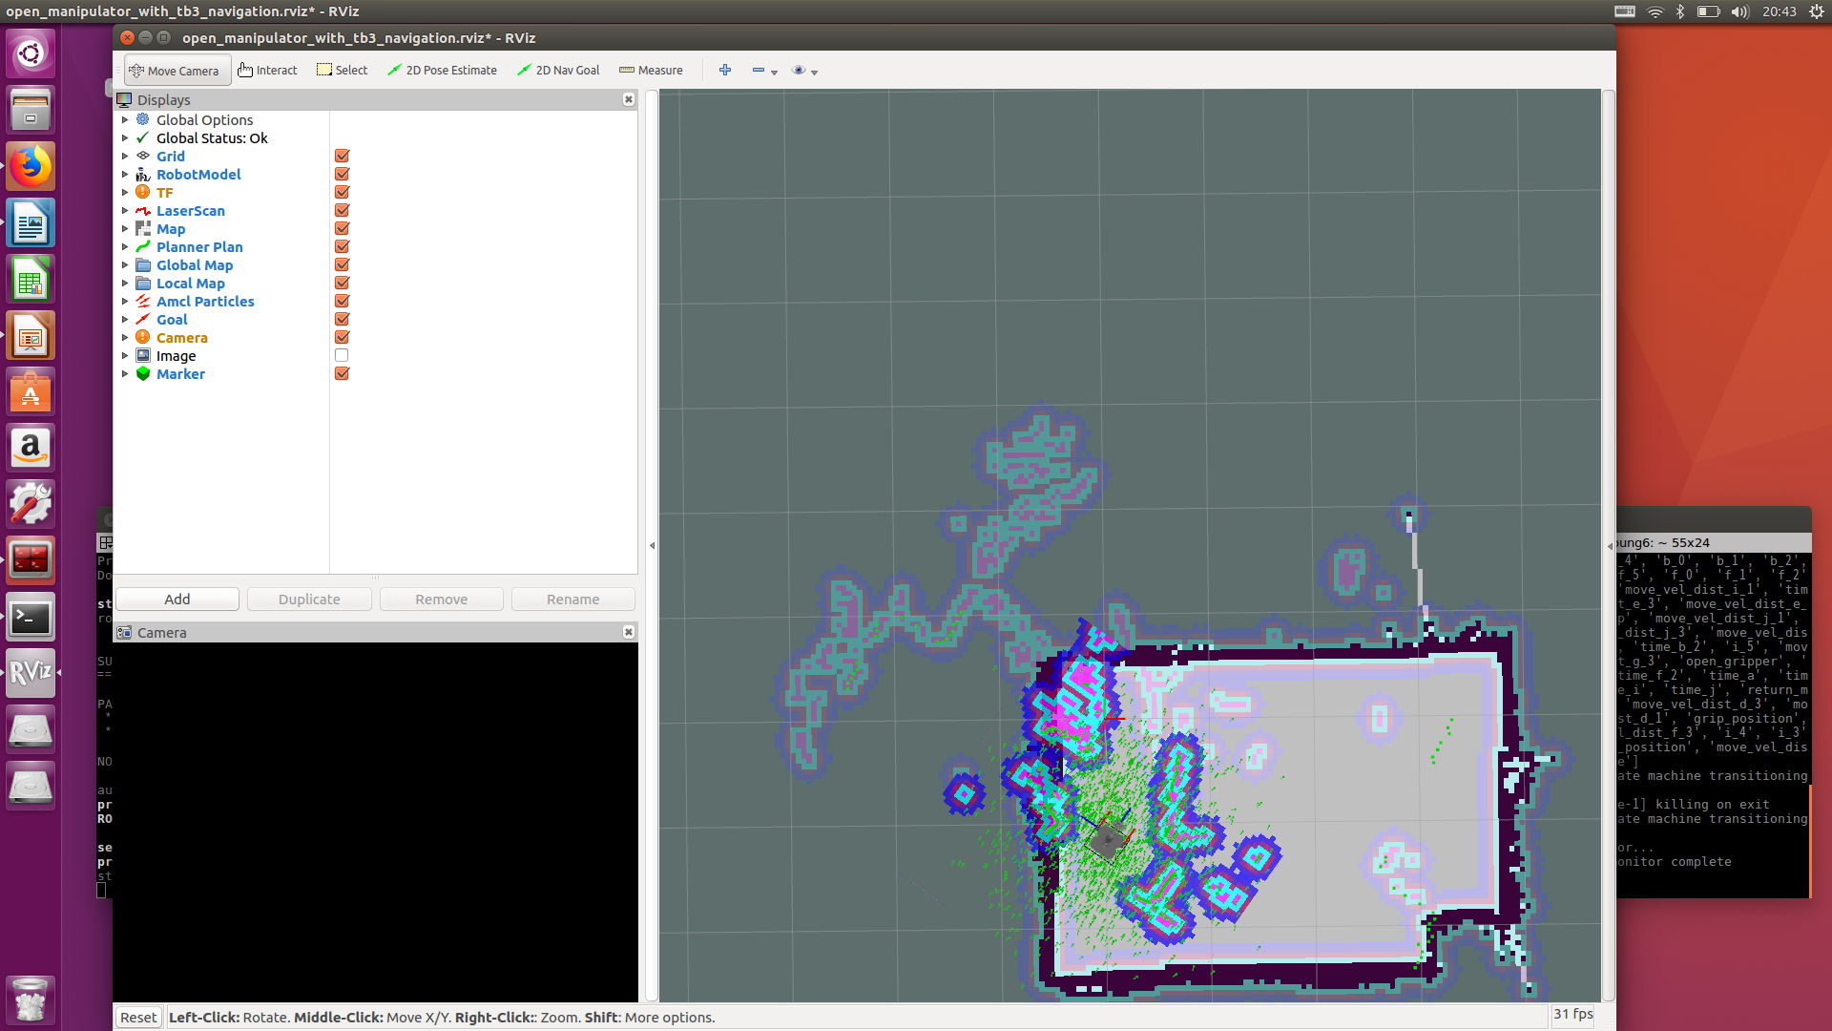
Appendix
3. Launch rviz and manipulator
4. Launch task controller

