Slide 1

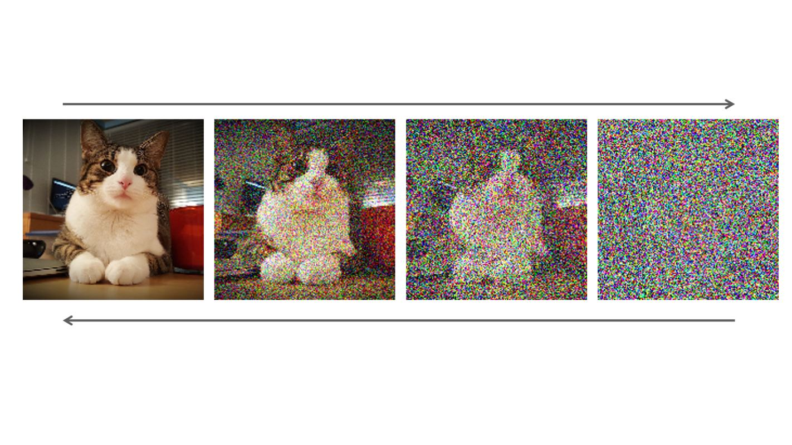
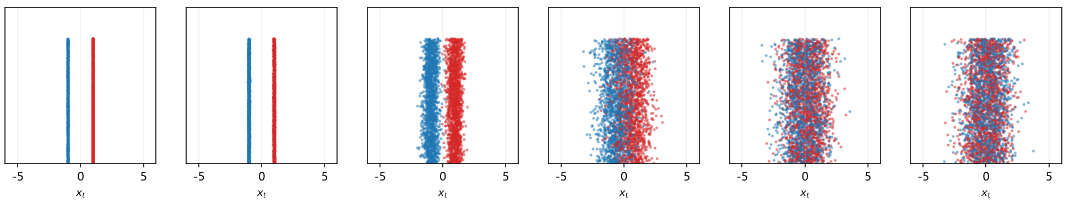
Deep Learning Model Presentation
Diffusion Models
Learning to generate images by reversing a gradual noising process
Presented by:
WU Peihang
24108869D
xₜ = √(ᾱₜ)·x₀ + √(1−ᾱₜ)·ε

Slide 2
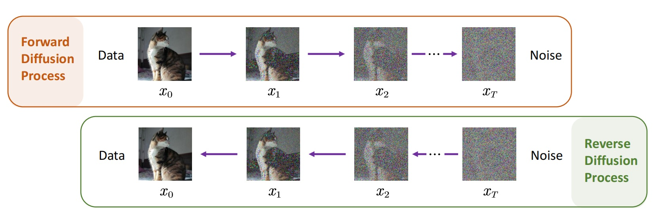
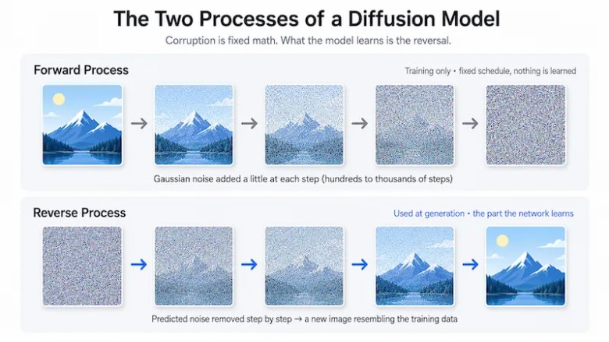
ROADMAP
Outline
1
Why diffusion? Generative modelling landscape
2
Forward process — the closed-form shortcut
3
Reverse process — the intractable posterior
4
Variational bound — deriving the training loss
5
Training and sampling algorithms
6
Design choices, results, and modern extensions
* The Denoising Diffusion Probabilistic Model is the variant discussed here.
2

Slide 3

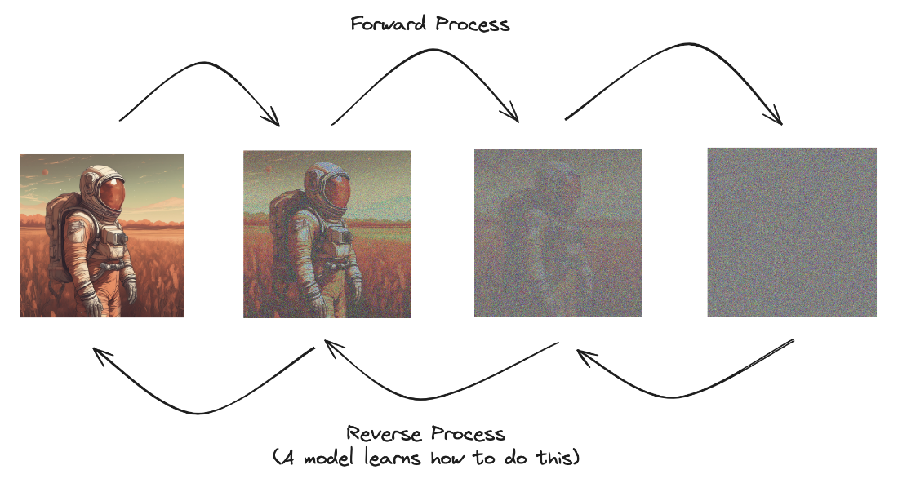
“Can Diffusion get reversed?”
INTRODUCTION
Background: what is a diffusion model?
Diffusion models are inspired by a familiar physical process: particles drift from high to low concentration until the system reaches equilibrium.
A diffusion model borrows this idea. It adds noise to an image step by step, then trains a network to reverse that process.
Once the network can turn noise back into an image, we can generate new samples from pure random noise — no existing image required.
Denoising Diffusion Probabilistic Models
3

Slide 4
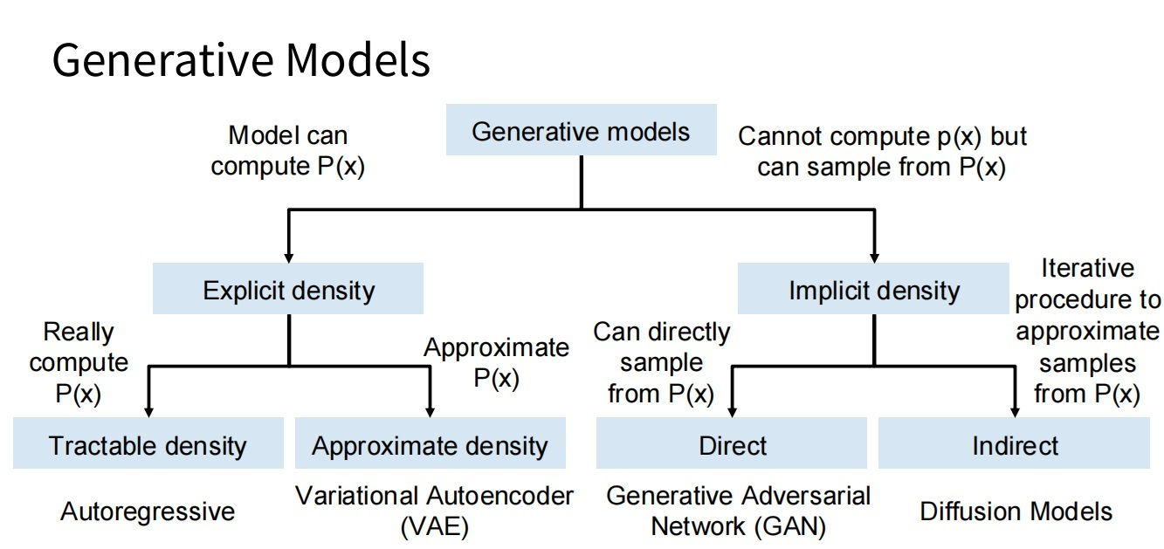
Where is the diffusion model?
An overview of the generative modelling landscape
Diffusion sits under Implicit density → Indirect sampling:
a generative model that samples through an indirect, iterative procedure.
Classification:
Implicit density
Indirect sampling
Figure adapted from Goodfellow, Tutorial on Generative Adversarial Networks, 2017
Denoising Diffusion Probabilistic Models
4

Slide 5
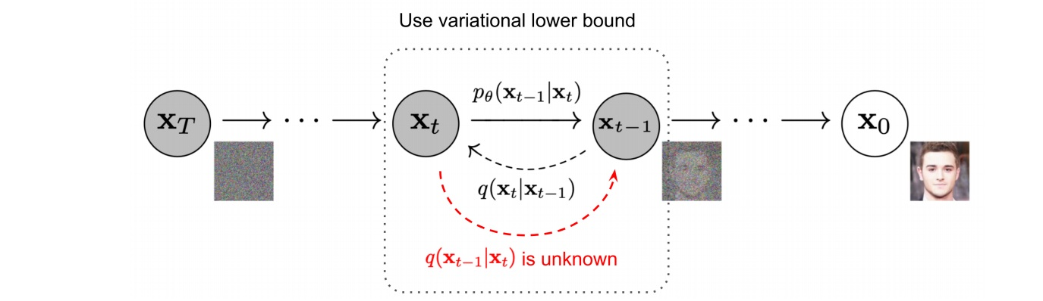
The forward and backward processes of Diffusion Model
Diffusion models are bi-directional, comprising the noise addition process and the denoising process
The noise addition process follows the Markov Chain, easier to find the relationship between time steps.
The denoising process is similar to “entropy reduction”, being more challenging to tackle.
Denoising Diffusion Probabilistic Models
5

Slide 6
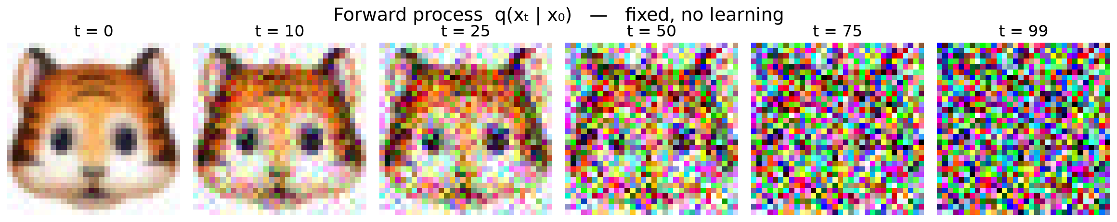
INTUITION
The core idea: destroy information, then learn to restore it
Measured on a real training image (tiger face, 32×32): q(xₜ|x₀) over t = 0 → 99. Noise is Gaussian at every step and the schedule is fixed — nothing is learned here.
FORWARD
fixed, no learning — gradually add Gaussian noise over T steps until the signal becomes pure noise
REVERSE
learned — train a network to undo one small noising step at a time
SAMPLE
inference — iteratively denoise from random noise to obtain a new image
Key point: each step is small, so both the forward and the learned reverse step can be modelled as Gaussians.
Denoising Diffusion Probabilistic Models
6

Slide 7
SETUP
Notation
x₀
clean data sample drawn from the data distribution q(x₀)
xₜ
noisy sample at time step t, t = 1 … T
βₜ ∈ (0, 1)
per-step noise variance (the noise schedule)
αₜ = 1 − βₜ
per-step signal retention factor
ᾱₜ = ∏ ᵢ₌₁ᵗ αᵢ
cumulative signal retention factor
ε ~ N(0, I)
standard Gaussian noise, same shape as x₀
βₜ increases with t ⇒ ᾱ_t decreases with t as t -> T
ᾱ_T ≈ 0 ⇒ x_T ≈ N(0, I)
Denoising Diffusion Probabilistic Models
7

Slide 8
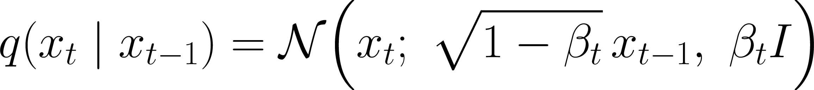
STEP 1
Forward process: a fixed Markov chain that adds noise
Each step keeps a shrinking fraction of the signal and injects a little Gaussian noise:
Reparametrized:
▪ The forward process has no learnable parameters — it is fully specified by the schedule {βₜ}.
▪ Because every step is Gaussian, the composition of steps stays Gaussian — which gives us a closed form (next slide).
Denoising Diffusion Probabilistic Models
8

Slide 9
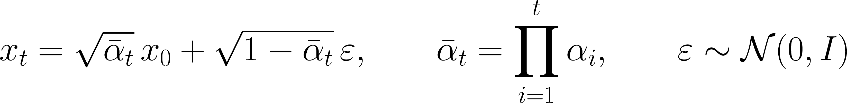
STEP 1 · DERIVATION
The closed-form shortcut: jump to any time step
Unrolling two steps and using the fact that the sum of independent Gaussians is Gaussian:
Substituting both sides and collecting the noise terms:
Repeating to x₀ gives the closed form used throughout DDPM:
Denoising Diffusion Probabilistic Models
9

Slide 10
STEP 1 · CONSEQUENCE
Why the closed form matters
▪ One sample for any t — no need to simulate t sequential steps during training.
▪ In practice we draw one random t per example per gradient step.
▪ xₜ is a deterministic function of (x₀, ε), so the model can be trained with a single random draw.
▪ It makes the entire training objective computable in O(1) per example.
Because xₜ is available in closed form, the loss needs only one network evaluation per example.
Denoising Diffusion Probabilistic Models
10

Slide 11
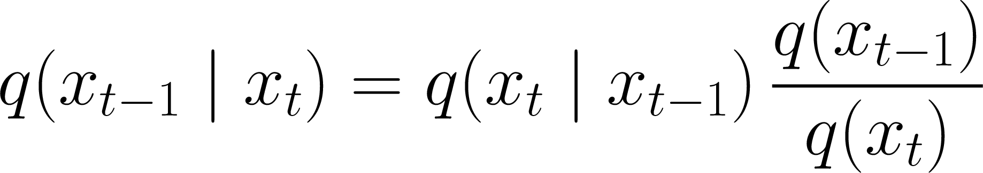
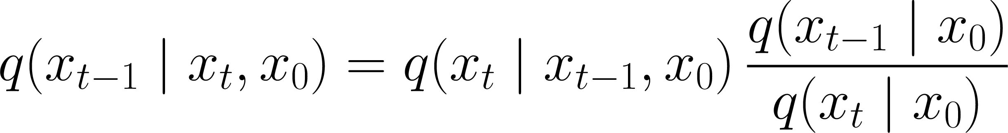
STEP 2
Reverse process: the posterior we actually need
We want the inverse of the forward kernel — but Bayes' rule requires the unknown marginals q(xₜ):
Standard fix: condition on x₀ as well. Then all three terms are known Gaussian densities, so the posterior is Gaussian:
This is the training target: an explicit Gaussian we can regress to.
Denoising Diffusion Probabilistic Models
11

Slide 12
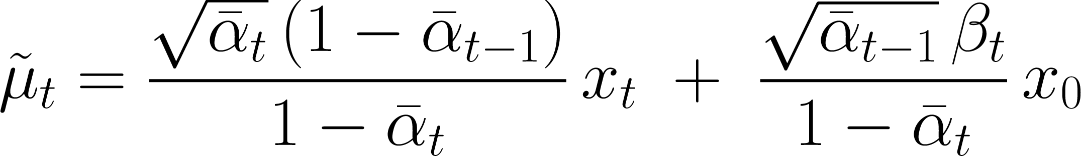
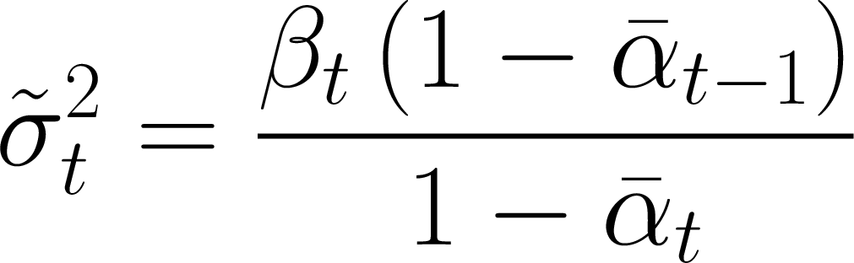
STEP 2 · RESULT
The posterior is Gaussian — with known mean and variance
Expanding the product of the three Gaussian densities and completing the square in xₜ₋₁:
The variance depends only on t — it is a known constant, not a quantity we must learn.
Denoising Diffusion Probabilistic Models
12

Slide 13
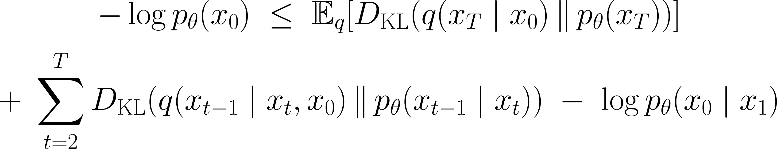
STEP 3
Variational bound: turning likelihood into a sum of KL terms
We maximise the data likelihood. Since it is intractable, we maximise its evidence lower bound:
Writing the joint distributions along the Markov chain and rearranging gives a sum of three groups of terms:
KL Divergence measures the “difference between two distributions”. Here we use KL terms to measure the difference between the noise predicted by model and the actual noise added to the image.
Denoising Diffusion Probabilistic Models
13

Slide 14
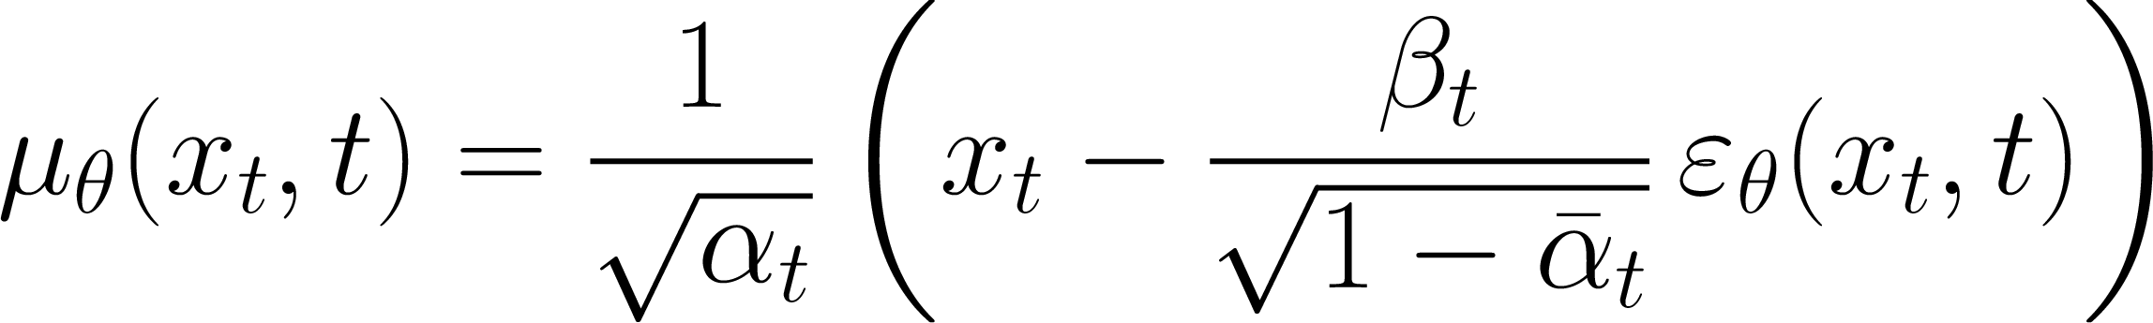
STEP 3 · RESULT
From KL divergence to a simple noise-regression loss
Both distributions in Lₜ₋₁ are Gaussian, so the KL has a closed form. With the variance fixed, only the means matter:
Substituting x₀ = (xₜ − √(1−ᾱₜ)·ε)/√(ᾱₜ) removes x₀ and leaves a prediction of the noise itself:
L2 loss shows the square of error between the added noise and the noise predicted by neural network.
Mean Squared Error(MSE) is the simplified training objective, depicting the accuracy for the model to predict noise.
Denoising Diffusion Probabilistic Models
14

Slide 15
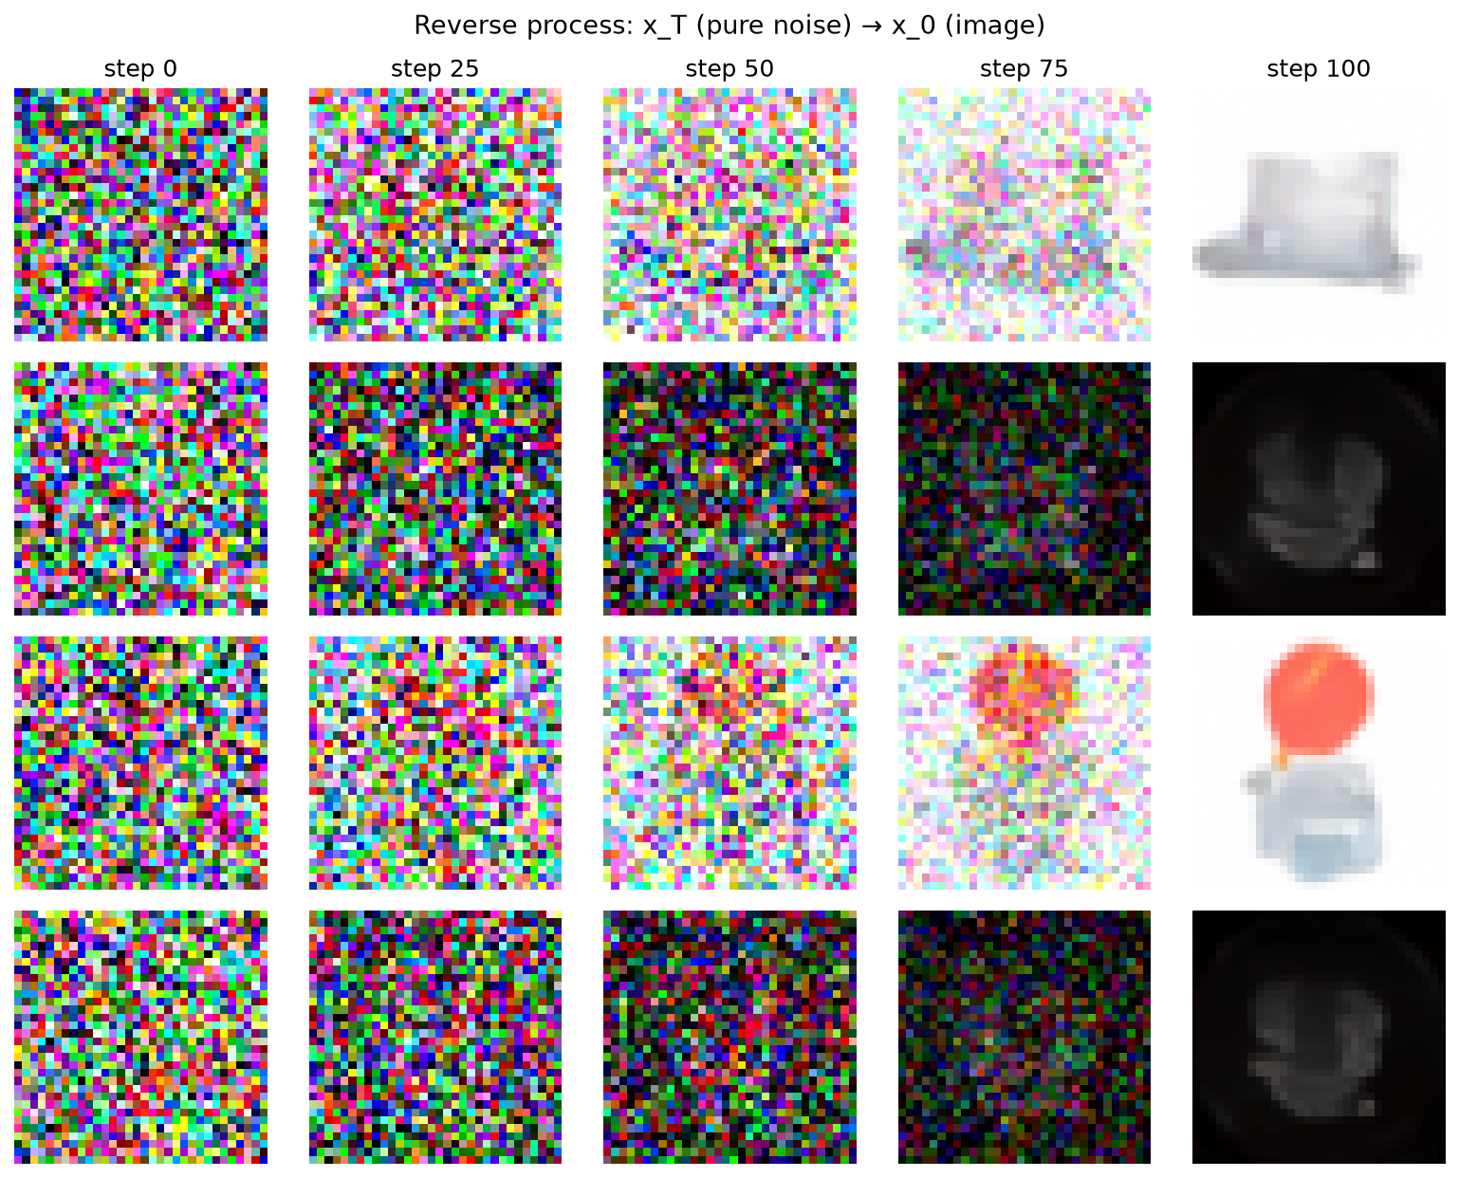
STEP 4 · ALGORITHM 1
Training algorithm
repeat
▪ predict eps from (x[t], t);
▪ one random t per example;
▪ closed form => one net call;
▪ eps and x0 are equivalent.
x0 ~ q(x0) # sample a clean image
t ~ Uniform({1, ..., T}) # pick a random time step
eps ~ N(0, I) # draw standard Gaussian noise
gradient-descent step on:
|| eps - eps_theta( sqrt(abar[t]) * x0
+ sqrt(1 - abar[t]) * eps, t ) ||^2
until converged
# cs231n/gaussian_diffusion.py -> p_losses()
t = torch.randint(0, T, (b,)) # one random t per example
noise = torch.randn_like(x_start)
x_t = q_sample(x_start, t, noise) # sqrt(abar)*x0 + sqrt(1-abar)*eps
target = noise if objective == 'pred_noise' else x_start
loss = ((model(x_t, t) - target) ** 2).mean()
Reverse process p(xₜ₋₁|xₜ): four independent runs from pure noise x_T down to x_0, using the pretrained weights.
Denoising Diffusion Probabilistic Models
15

Slide 16
STEP 4 · ALGORITHM 2
Sampling algorithm
x[T] ~ N(0, I)
▪ start from pure noise;
▪ one net call per step;
▪ T = 1000, so sampling is slow;
▪ sigma[t]*z keeps it stochastic.
for t = T, ..., 1 do
z = randn_like(x[t]) if t > 1 else 0
x[t-1] = (1/sqrt(alpha[t])) * ( x[t]
- (beta[t]/sqrt(1 - abar[t])) * eps_theta(x[t], t) )
+ sigma[t] * z
end for
return x[0]
# cs231n/gaussian_diffusion.py -> p_sample()
model_out = model(x_t, t)
x_start = predict_start_from_noise(x_t, t, model_out) # invert x_t
x_start.clamp_(-1.0, 1.0) # keep generation stable
mean, std = q_posterior(x_start, x_t, t)
return mean + (t != 0) * std * torch.randn_like(x_t)
Denoising Diffusion Probabilistic Models
16

Slide 17
STEP 5 · PRACTICE
Design choices that matter
Noise schedule βₜ
linear (original DDPM) · cosine (better SNR) · sigmoid (above 64×64)
Reverse variance σₜ²
analytic value · DDPM fixes σₜ² = βₜ · iDDPM learns a hybrid
Network εθ
U-Net with skips · residual blocks · self-attention at low resolution
Timestep conditioning
sinusoidal embedding of t, injected by scale-and-shift
Denoising Diffusion Probabilistic Models
17

Slide 18
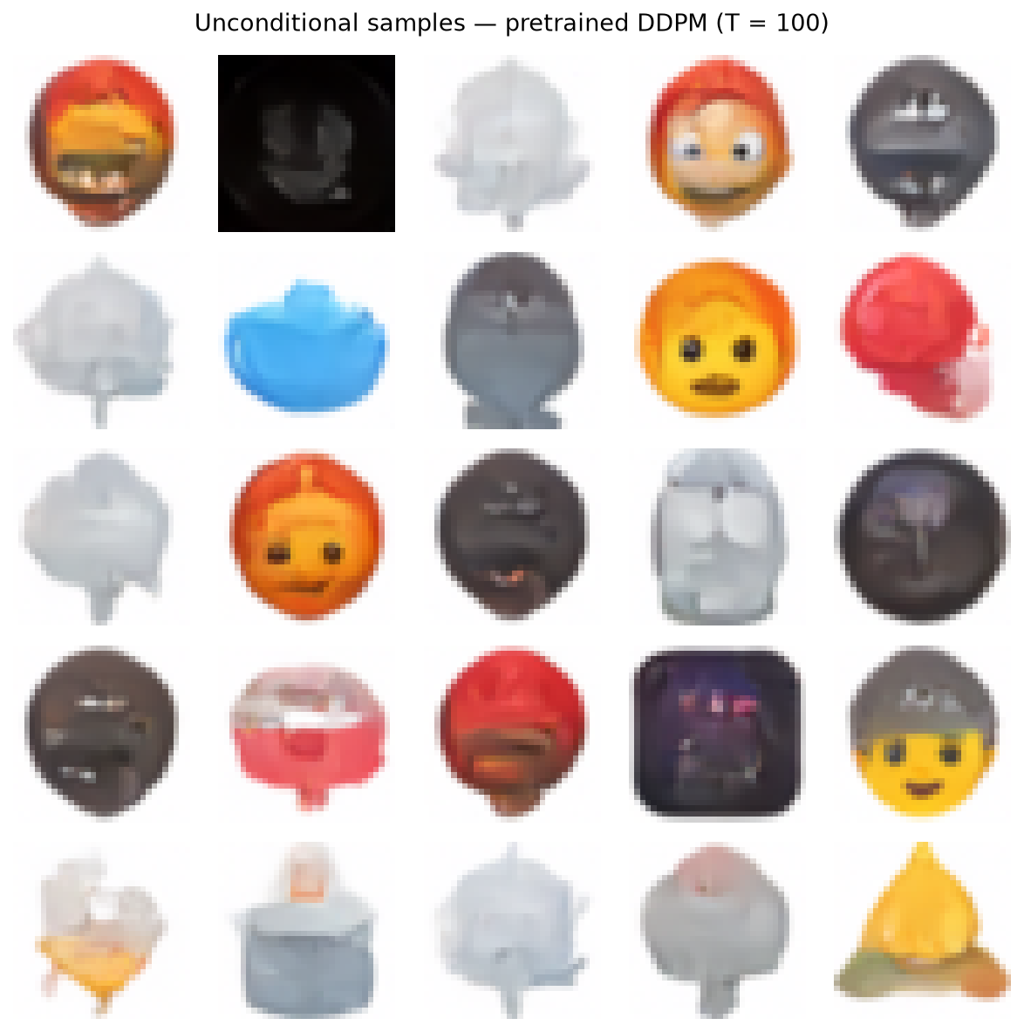
OUTCOME
Results and extensions
▪ DDPM reported state-of-the-art FID on CIFAR-10 and high-quality 256×256 ImageNet samples.
▪ FID 3.17 on CIFAR-10 (unconditional) — competitive with the best GANs of its time.
▪ Quality improves with model size and with the number of sampling steps.
Sampled from the pretrained model
Direct descendants
– DDIM — deterministic, far fewer sampling steps
– Score-based SDE — continuous-time unification
– Classifier-free guidance — conditional control
– Latent diffusion — diffuse in a compressed latent space
– Diffusion Transformers — replace U-Net with a Transformer
25 unconditional samples, T = 100.
Denoising Diffusion Probabilistic Models
18

Slide 19
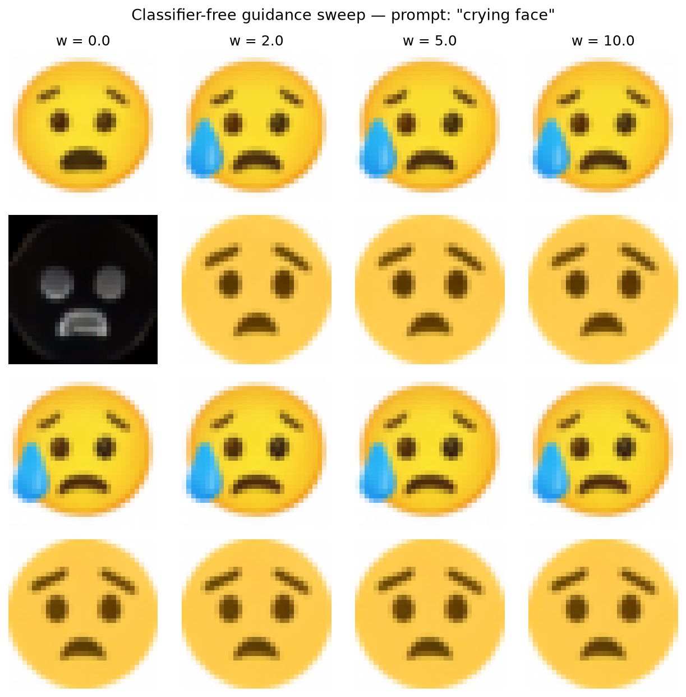
OUTCOME · PRACTICAL
Generation results
Classifier-free guidance — "crying face" generation
Unconditional samples
q_sample 5.1e-07 · predict_start_from_noise 2.8e-06 · predict_noise_from_start 1.1e-06
25 samples, T = 100
w = 0 / 2 / 5 / 10. Higher w → more faithful to the prompt, less diverse.
U-Net 12.4M params · reproduced from the released pretrained checkpoint (step 70,000)
Denoising Diffusion Probabilistic Models
19

Slide 20
Takeaways
1.
Diffusion replaces one hard generation problem with many easy denoising problems.
2.
The forward process is fixed; a Gaussian closed form gives xₜ directly from x₀.
3.
The true reverse posterior is intractable, so we condition on x₀ to obtain a Gaussian.
4.
The variational bound reduces to a simple noise-regression loss L = E[‖ε − εθ‖²].
5.
Training is stable and parallel; the price is slow, iterative sampling.
Denoising Diffusion Probabilistic Models
20

Slide 21
SOURCES
References
[1]
Ho, Jain & Abbeel. Denoising Diffusion Probabilistic Models.
NeurIPS 2020. arXiv:2006.11239
[6]
Nichol & Dhariwal. Improved Denoising Diffusion
Probabilistic Models. ICML 2021. arXiv:2102.09672
[2]
Sohl-Dickstein et al. Deep Unsupervised Learning using
Nonequilibrium Thermodynamics. ICML 2015. arXiv:1503.03585
[7]
Ho & Salimans. Classifier-Free Diffusion Guidance.
2022. arXiv:2207.12598
[3]
Song & Ermon. Generative Modeling by Estimating Gradients
of the Data Distribution. NeurIPS 2019. arXiv:1907.05600
[8]
Rombach et al. High-Resolution Image Synthesis with
Latent Diffusion Models. CVPR 2022. arXiv:2112.10752
[4]
Song, Meng & Ermon. Denoising Diffusion Implicit Models
(DDIM). ICLR 2021. arXiv:2010.02502
[9]
Peebles & Xie. Scalable Diffusion Models with
Transformers (DiT). ICCV 2023. arXiv:2212.09748
[5]
Song et al. Score-Based Generative Modeling through SDEs.
ICLR 2021. arXiv:2011.13456
[10]
Liu, Gong & Liu. Flow Straight and Fast: Learning to
Generate and Transfer Data with Rectified Flow.
2022. arXiv:2209.03003
All references verified against the official proceedings / arXiv listings.
Denoising Diffusion Probabilistic Models
21

Slide 22

Diffusion Models
Thank you for watching !
Questions are welcome.
Presented by:
WU Peihang
24108869D
Denoising Diffusion Probabilistic Models
22

