Slide 1
Multi-armed Bandit Problem
-Thompson Sampling-
컴퓨터공학과 KALINA BAYARTSETSEG
통계학과 김민수
통계학과 김연진

Slide 2
Reference
[1] O.Chapelle and L.Li. An Empirical Evaluation of Thompson Sampling (2011)
[2] S.Agrawal and N.Goyal. Analysis of Thompson Sampling for the Multi-armed Bandit Problem (2012)
[3] S.Agrawal and N.Goyal. Further Optimal Regret Bounds for Thompson Sampling (2013)
[4] Volodymyr Kuleshov and Doina Precup. Algorithms for the multi-armed bandit problem (2000)
[5] Peter Auer. Using Confidence Bounds for Exploitation-Exploration Trade-offs (2002)
[6] Peter Auer and Nicolo Cesa-Binanchi. Finite-time Analysis of the Multiarmed Bandit Problem (2002)

Slide 3
Contents
1. Multi-armed Bandit Problem
2. Algorithms for the Application of Multi-Armed Bandits
3. Thompson Sampling
4. Empirical Results

Slide 4
Multi-armed Bandit
Problem

Slide 5
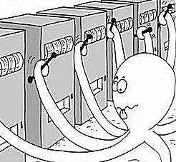
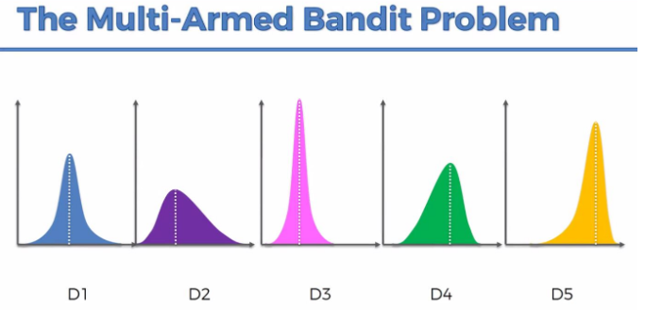
1. Multi-armed Bandit Problem
Assumption : Only one slot machine arm can be pulled at a time, and the rewards
from each slot machine are different.
reward : Random Variable from probabilistic distribution.
출처 : https://paperswithcode.com/task/multi-armed-bandits
출처:https://stats.stackexchange.com/questions/326449/multi-armed-bandit-problem
How to maximize reward?

Slide 6
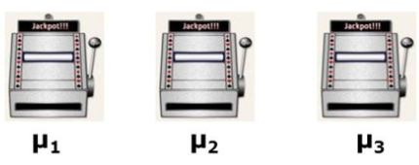
1. Multi-armed Bandit Problem
Problems
Different slot machines have different rewards.
Only one slot machine reward can be observed at a time.
출처:https://www.slideshare.net/sangwoomo7/multiarmed-bandit-and-applications
Select only one slot machine?
Select all slot machines the same number of times?

Slide 7
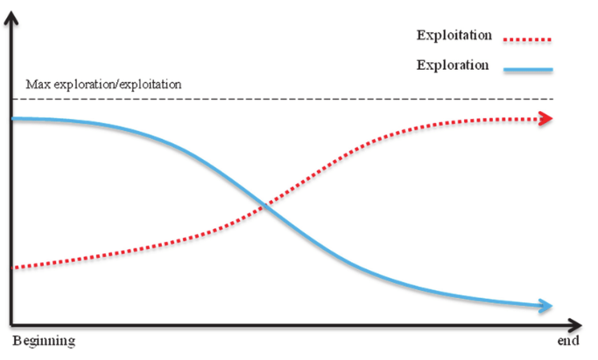
1. Multi-armed Bandit Problem
Exploitation and Exploration Trade-off
Exploitation : Choosing the best arm based on existing experience or observations.
Exploration : Choosing a new arm for more information.
출처 : https://www.researchgate.net/figure/Change-trend-of-exploration-and-exploitation-from-the-beginning-to-the-end_fig1_324704242

Slide 8

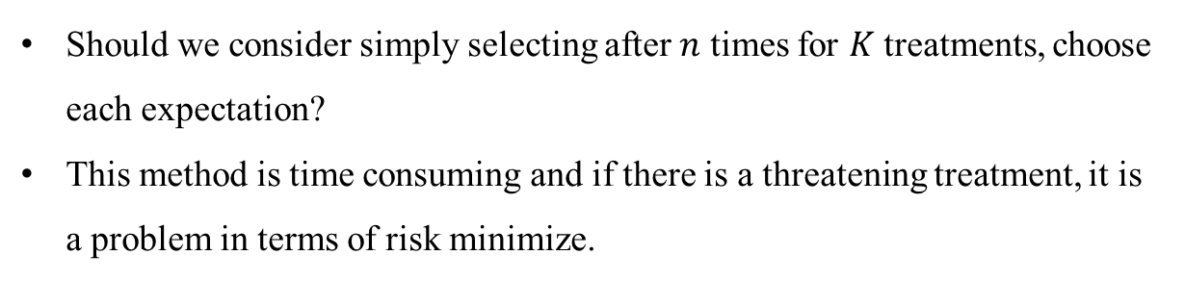

1. Multi-armed Bandit Problem
Applying Real World
What is the best Treatment?
Treatment 1
Treatment 2
$$…$$
Treatment$K$
Should we consider simply selecting after $n$ times for $K$ treatments, choose each expectation?
This method is time consuming and if there is a threatening treatment, it is a problem in terms of risk minimize.
Multi-armed bandit is used to solve this problem.

Slide 9
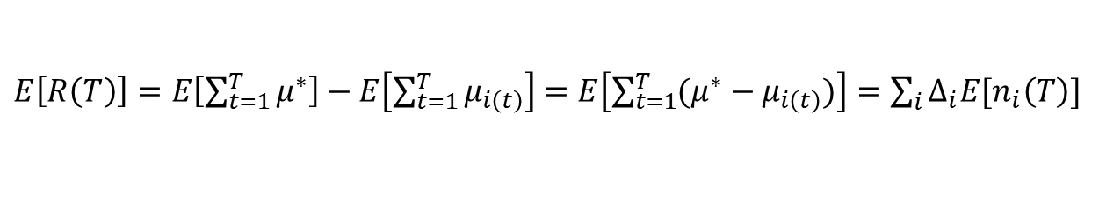
1. Multi-armed Bandit Problem
Multi-armed Bandit
Assumption : finite-armed and i.i.d for all arms (time-invariant)
Regret : Difference between optimal policy and my policy.
Total expected regret
$${arm}_{i} \sim Bernoulli\left(θ_{i}\right) i.i.d, μ_{i}=P\left[arm_{i}=1\right]=θ_{i}∗1+\left(1−θ_{i}\right)∗0$$
$$μ_{i} :expected reward for arm i, μ^{∗}=\max_{i}{μ_{i}}, Δ_{i}≔μ^{∗}−μ_{i},$$
$$n_{i}\left(T\right):the number of plays of {arm}_{i} during the first T turns.$$
$E\left[R\left(T\right)\right]=E\left[\sum_{t=1}^{T}{μ^{∗}}\right]−E\left[\sum_{t=1}^{T}{μ_{i\left(t\right)}}\right]=$ $E\left[\sum_{t=1}^{T}{(μ^{∗}−μ_{i\left(t\right)})}\right]=\sum_{i}{Δ_{i}E[n_{i}\left(T\right)]}$
Minimize regret = Maximize reward

Slide 10
Algorithms for the Application of Multi-Armed Bandits

Slide 11

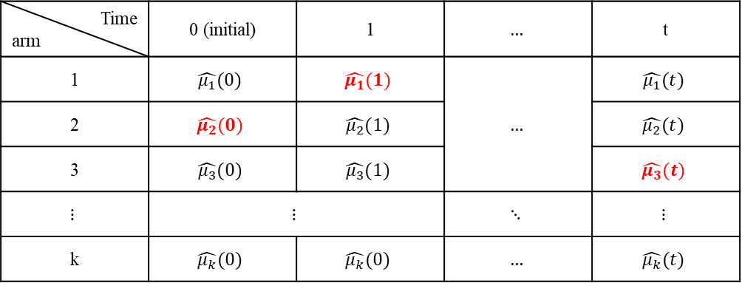
2. Algorithms for the Application of Multi-Armed Bandits
$ε−$ greedy ($ε is fixed)$
: very simple, and sequential decision problems.
$selects the arm with the biggest empirical mean with probability 1−ε.$
$selects a random arm with probability ε.$
Time arm | 0 (initial) | 1 | $$…$$ | t
1 | $$\hat{μ_{1}}(0)$$ | $$\hat{μ_{1}}(1)$$ | $$…$$ | $$\hat{μ_{1}}(t)$$
2 | $$\hat{μ_{2}}(0)$$ | $$\hat{μ_{2}}(1)$$ |  | $$\hat{μ_{2}}(t)$$
3 | $$\hat{μ_{3}}(0)$$ | $$\hat{μ_{3}}(1)$$ |  | $$\hat{μ_{3}}(t)$$
$$⋮$$ | $$⋮$$ |  | $$⋱$$ | $$⋮$$
k | $$\hat{μ_{k}}(0)$$ | $$\hat{μ_{k}}(0)$$ | $$…$$ | $$\hat{μ_{k}}(t)$$
Even if t continues to grow so that we know the optimal arm, continue exploration with probability $ε.$

Slide 12

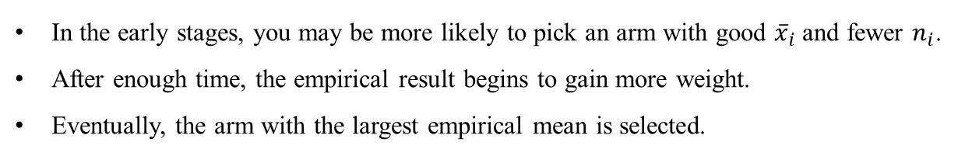


2. Algorithms for the Application of Multi-Armed Bandits
UCB(Upper Confidence Bound)
$${\overline{x}}_{i} : i−th arm^{′}s empirical mean$$
$$t :at time t$$
$$n_{i} :at time t, count play$$
: select maximum upper bound
Think about Confidence interval :
$${\overline{x}}_{i}−σ_{i}≤μ_{i}≤{\overline{x}}_{i}+σ_{i}$$
$$=\underset{i}{argmax}{{\overline{x}}_{i}+\sqrt{\frac{2lnt}{n_{i}}}}$$
Upper Bound :
$$\underset{i}{argmax}{{\overline{x}}_{i}+σ_{i}}$$
In the early stages, you may be more likely to pick an arm with good ${\overline{x}}_{i}$ and fewer $n_{i}$.
After enough time, the empirical result begins to gain more weight.
Eventually, the arm with the largest empirical mean is selected.
Problem : The empirical mean for all arms is essential, you must explore all arms first.

Slide 13
Thompson Sampling

Slide 14
3. Thompson Sampling
Bernoulli bandit problem / Stochastic multi-armed bandit problem
Among many algorithms available for the stochastic bandit problem, some popular ones include Upper Confidence Bound(UCB) family, The algorithm by Gittins, Thompson Sampling(TS) that is a member of the family of randomized probability matching algorithms.
It has been suggested that despite being easy to implement and being competitive to the state of the art methods, the reason TS is not very popular in literature could be its lack of strong theoretical analysis.

Slide 15
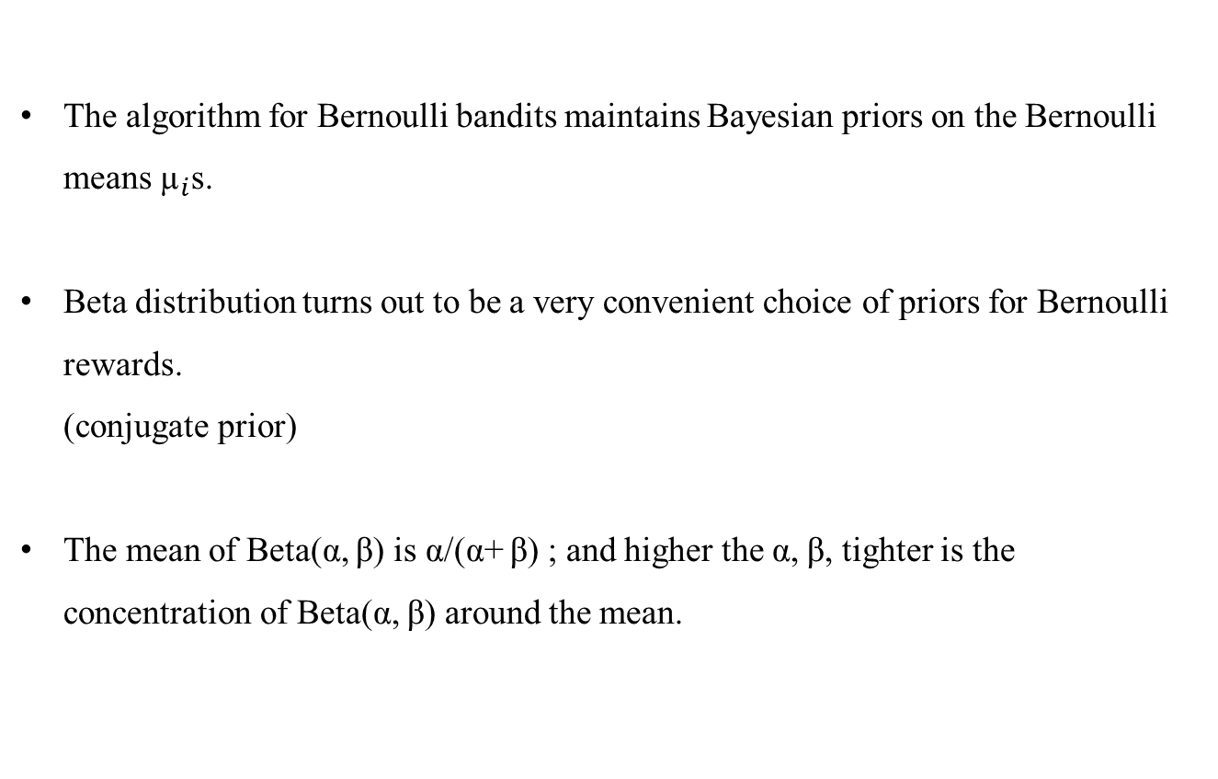
3. Thompson Sampling
Thompson Sampling algorithm for the Bernoulli bandit problem
The algorithm for Bernoulli bandits maintains Bayesian priors on the Bernoulli means ${\text{µ}}_{i}$s.
Beta distribution turns out to be a very convenient choice of priors for Bernoulli rewards.
(conjugate prior)
The mean of Beta(α, β) is α/(α+ β) ; and higher the α, β, tighter is the concentration of Beta(α, β) around the mean.

Slide 16
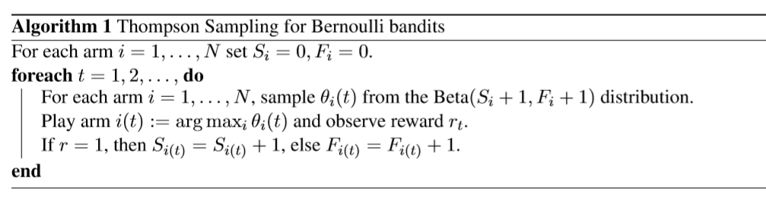
3. Thompson Sampling
Thompson Sampling algorithm for the Bernoulli bandit problem

Slide 17
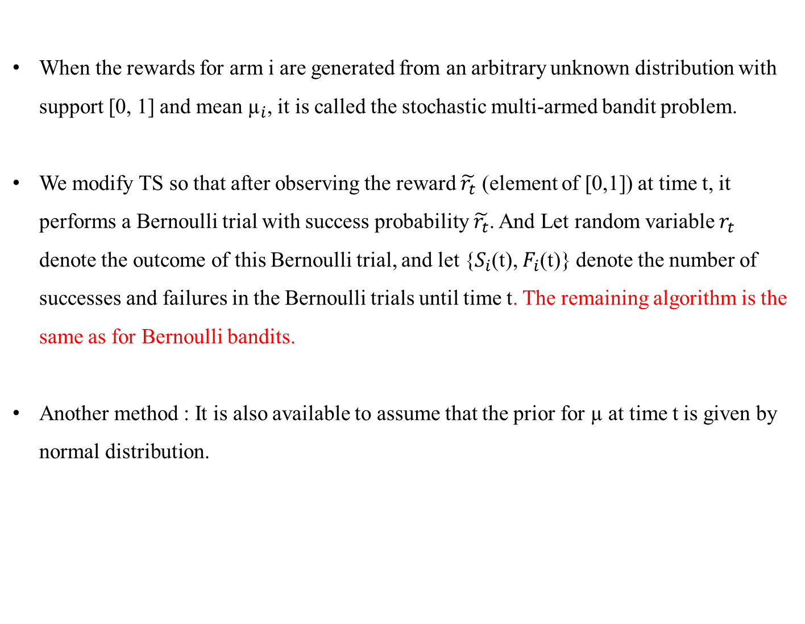
3. Thompson Sampling
Thompson Sampling algorithm for the stochastic multi-armed bandit problem
When the rewards for arm i are generated from an arbitrary unknown distribution with support [0, 1] and mean ${\text{µ}}_{i}$, it is called the stochastic multi-armed bandit problem.
We modify TS so that after observing the reward $\tilde{r_{t}}$ (element of [0,1]) at time t, it performs a Bernoulli trial with success probability $\tilde{r_{t}}$. And Let random variable $r_{t}$ denote the outcome of this Bernoulli trial, and let {$S_{i}$(t), $F_{i}$(t)} denote the number of successes and failures in the Bernoulli trials until time t. The remaining algorithm is the same as for Bernoulli bandits.
Another method : It is also available to assume that the prior for $\text{µ}$ at time t is given by normal distribution.

Slide 18

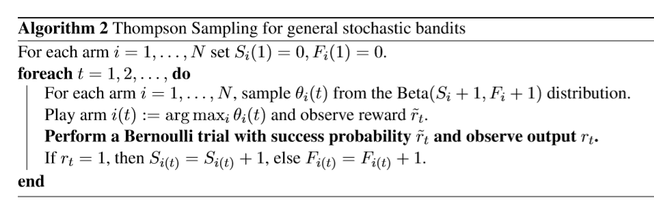

3. Thompson Sampling
Thompson Sampling algorithm for the stochastic multi-armed bandit problem
We observe that the probability of observing a success (i.e., $r_{t}$ = 1) in the Bernoulli trial after playing an arm i in the new generalized algorithm is equal to the mean reward ${\text{µ}}_{i}.$
Let $f_{i}$ denote the (unknown) pdf of reward distribution for arm i. Then, on playing arm i,

Slide 19
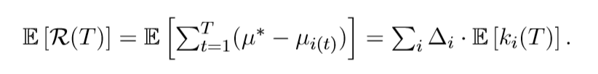

3. Thompson Sampling
Thompson Sampling – The theoretical theorems
What is the measure of good model ?
The model that have big expected reward and small expected regret may be a good model.
denote the number of times arm i has been played up to step t

Slide 20
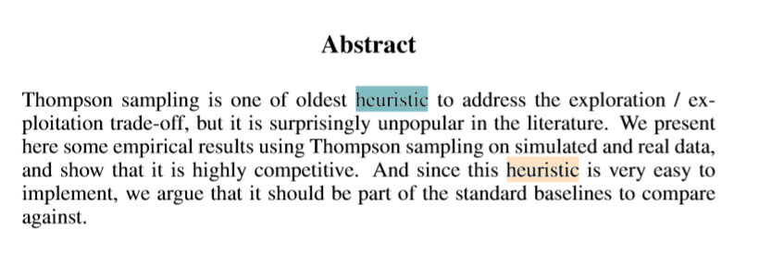
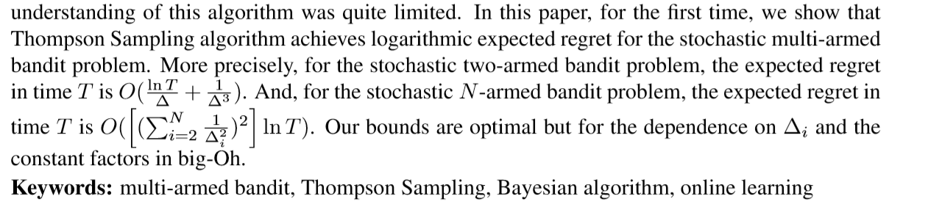
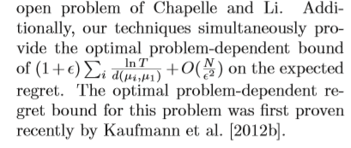
3. Thompson Sampling
Thompson Sampling – The theoretical theorems
An empirical Evaluation of Thompson Samping(2011)
Analysis of Thompson Sampling for the Multi-armed Bandit Problem(2012)
Further Optimal Regret Bounds for Thompson Sampling(2013)

Slide 21
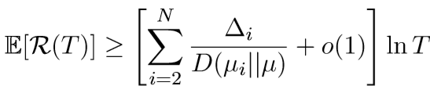
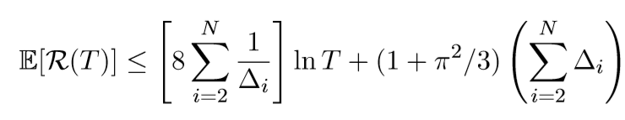
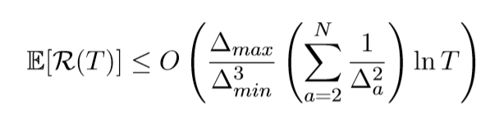
3. Thompson Sampling
Thompson Sampling – The theoretical theorems
Lai and Robbins(1985) proved the following lower bound on regret of any bandit algorithm :
Auer et al. (2002) gave the UCB1 algorithm, which is efficient and achieves the following bound :
Agrawal and Goyal(2012) gave the TS algorithm, which is efficient and achieves the following bound :

Slide 22
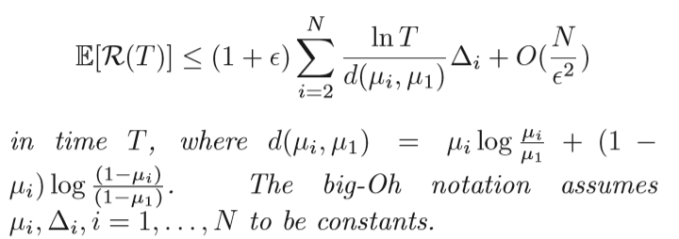

3. Thompson Sampling
Thompson Sampling – The theoretical theorems
Lai and Robbins(1985) proved the following lower bound on regret of any bandit algorithm :
Agrawal and Goyal(2013) gave the TS algorithm, which is efficient and achieves the following bound (For the N-armed stochastic bandit problem) :

Slide 23
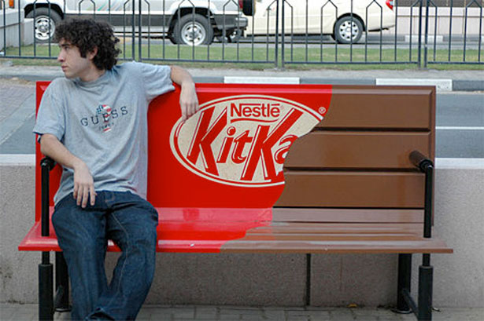
3. Thompson Sampling
Real data Analysis
https://blog.naver.com/cutycuty02/140084223813
We now consider an online advertising application. Given a user visiting a publisher page, the problem is to select the best advertisement for that user.
A key element in this matching problem is the click-through rate(CTR) estimation : what is the probability that a given ad will be clicked given some context (user, page visited)
There is of course a fundamental exploration / exploitation dilemma here : in order to learn the CTR of an ad, it needs to be displayed, leading to a potential loss of short-term revenue.

Slide 24

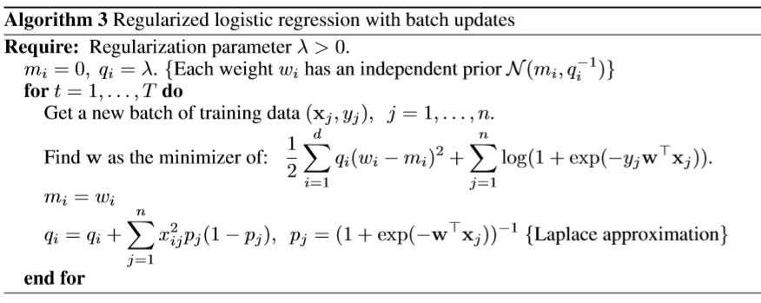
3. Thompson Sampling
Real data Analysis
In this paper, we consider standard regularized logistic regression for predicting CTR.
There are several features representing the user, page, ad, as well as conjunctions of these features.
In our model, the posterior distribution on the weights is approximated by a Gaussian distribution with diagonal covariance matrix. (Laplace Approximation)

Slide 25
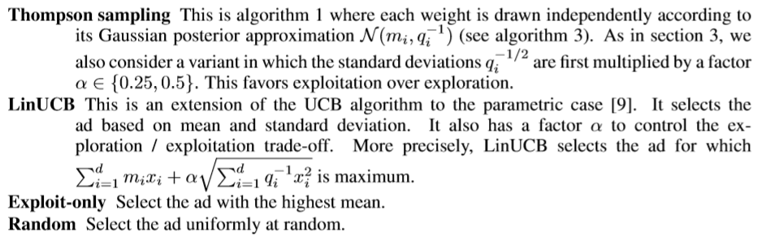
3. Thompson Sampling
Real data Analysis
The model is updated every hour as described in algorithm 3.
A feature vector is constructed for every (context, ad) pair and the policy decides which ad to show.
The total number of clicks received during this one hour period is the reward.
Several explore / exploit strategies are compared :

Slide 26
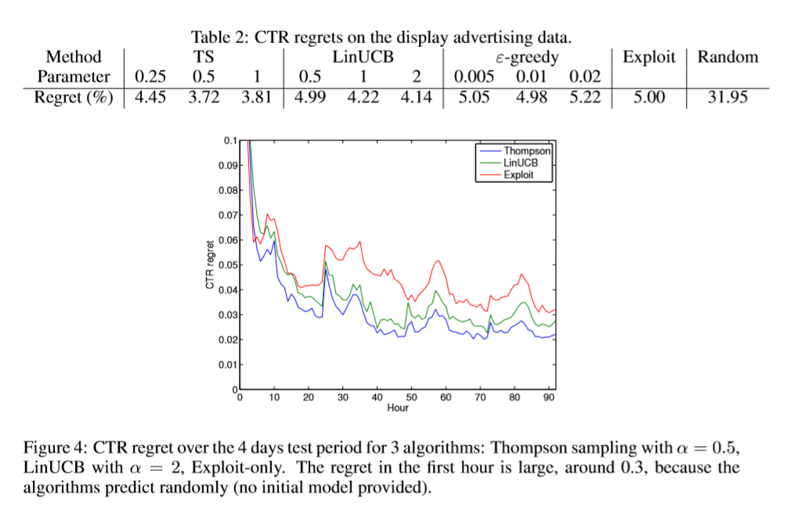
3. Thompson Sampling
Real data Analysis

Slide 27
Empirical Results

Slide 28

4. Empirical Results
Comparison between UCB and TS for the Bernoulli bandit problem
There are various variants of the UCB algorithm, but they all have in common that the confidence parameter should increase over time.
Specifically, we chose the arm for which the following upper confidence bound is maximum :
where m is the number of times the arm has been selected and k its total reward.
This is a tight upper confidence bound derived from Chernoff’s bound.

Slide 29

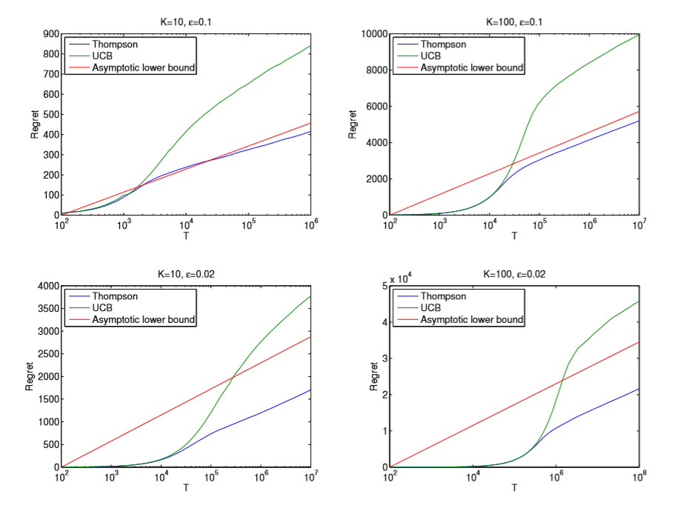
4. Empirical Results
Comparison between UCB and TS for the Bernoulli bandit problem

Slide 30
4. Empirical Results
Posterior reshaping in TS
Sharpening the posterior would have the effect of increasing exploitation while widening it would favor exploration.
In our simulations, the posterior is a Beta distribution with parameters a and b, and we have tried to change it to parameters a/α, b/α.
Doing so does not change the posterior mean, but multiply its variance by a factor close to α^2.
Values of α smaller than 1 decrease the amount of exploration and often result in lower regret. But the price to pay is a higher variance. (in sum runs, the regret is very large.)
The average regret is asymptotically not as good as with α=1, but tends to be better in the non-asymptotic regime.

Slide 31
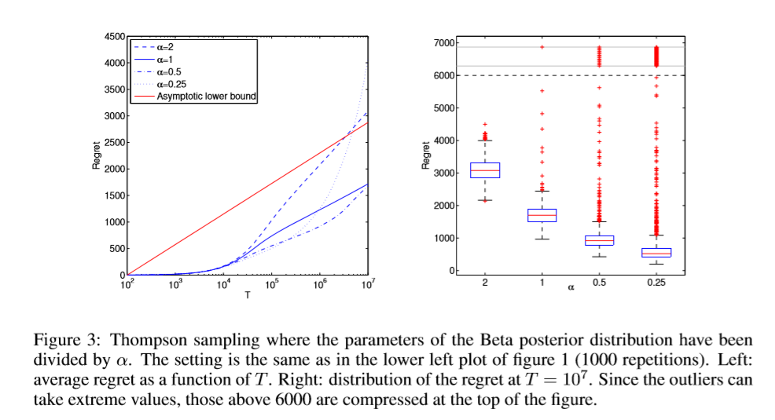
4. Empirical Results
Posterior reshaping in TS

Slide 32
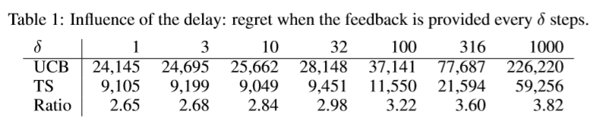
4. Empirical Results
Impact of delay
In a real world system, the feedback is typically not processed immediately because of various runtime constraints.
Instead it usually arrives in batches over a certain period of time.
We now try to quantify the impact of this delay by doing some simulations that mimic the problem of real situation.
The true reward probability of a given item is drawn according to a Beta(4,4) distribution. The feedback is received only every δ time units.
<The average regret over 100 repetitions at T=${10}^{6}$ : TS is more robust than UCB when the delay is long.>

Slide 33
Conclusion
Thompson sampling
can be applied to a broad array of online decision problems
a simple and effective method for addressing the exploration/exploitation trade-off.
effective at minimizing the exploration costs required to converge on an optimal action. (Minimize regret)
sampling actions according to the posterior probability they are optimal

