Slide 1

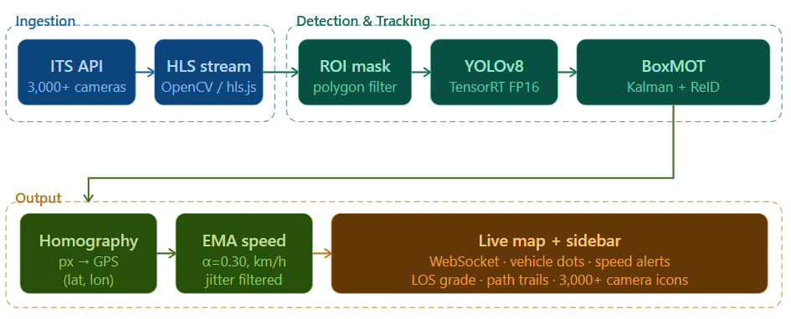
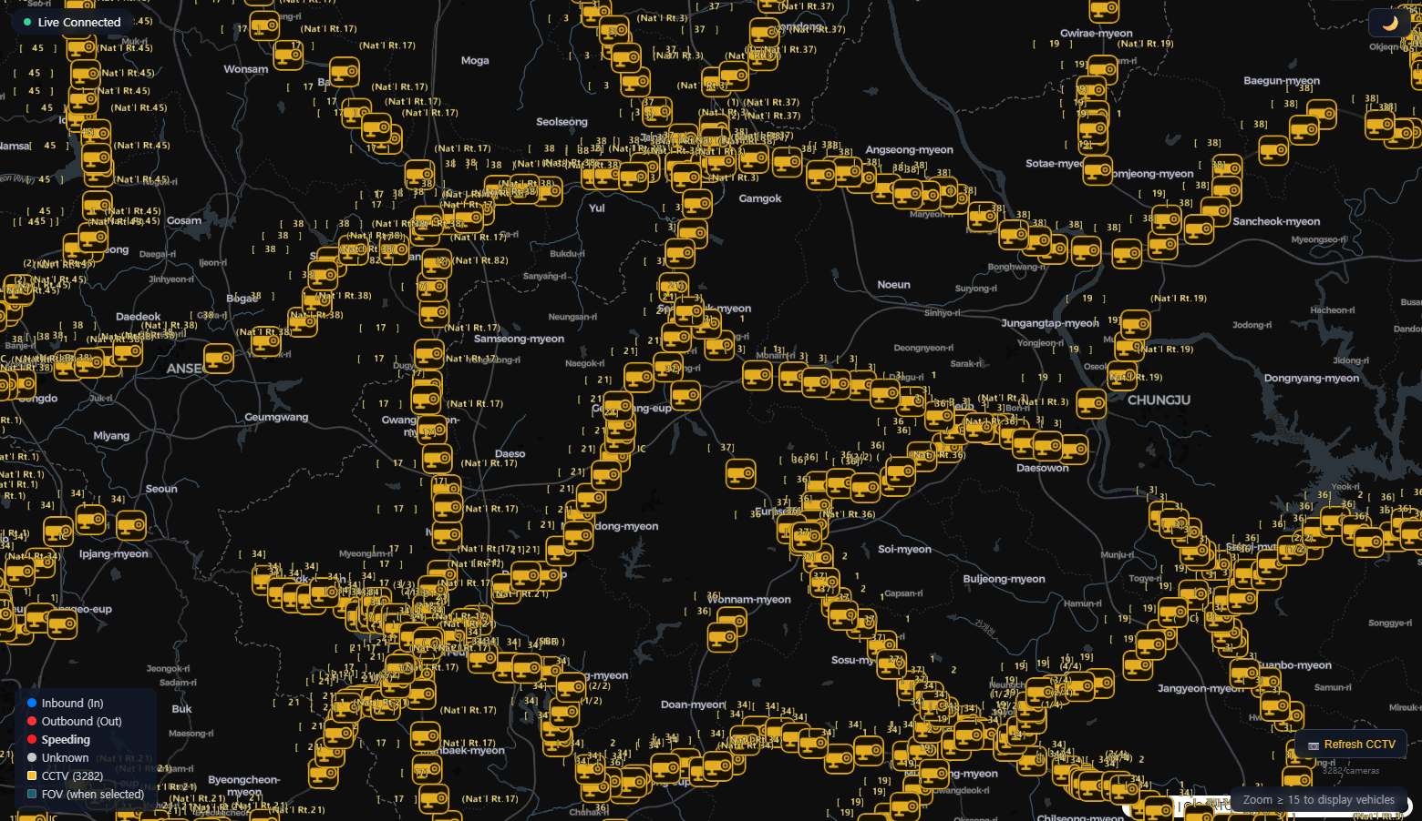
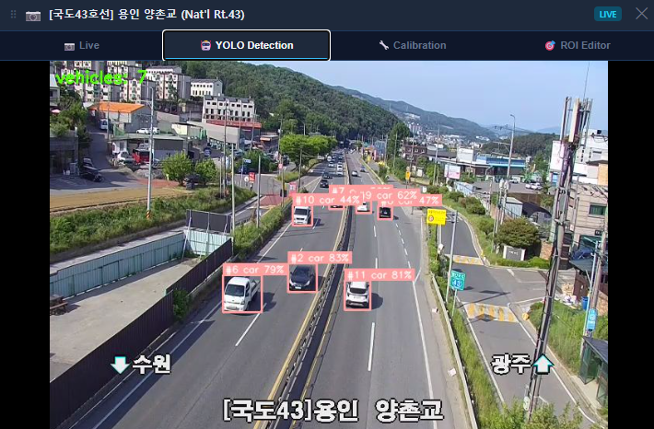
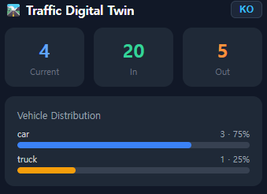
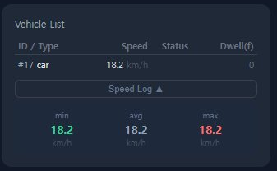
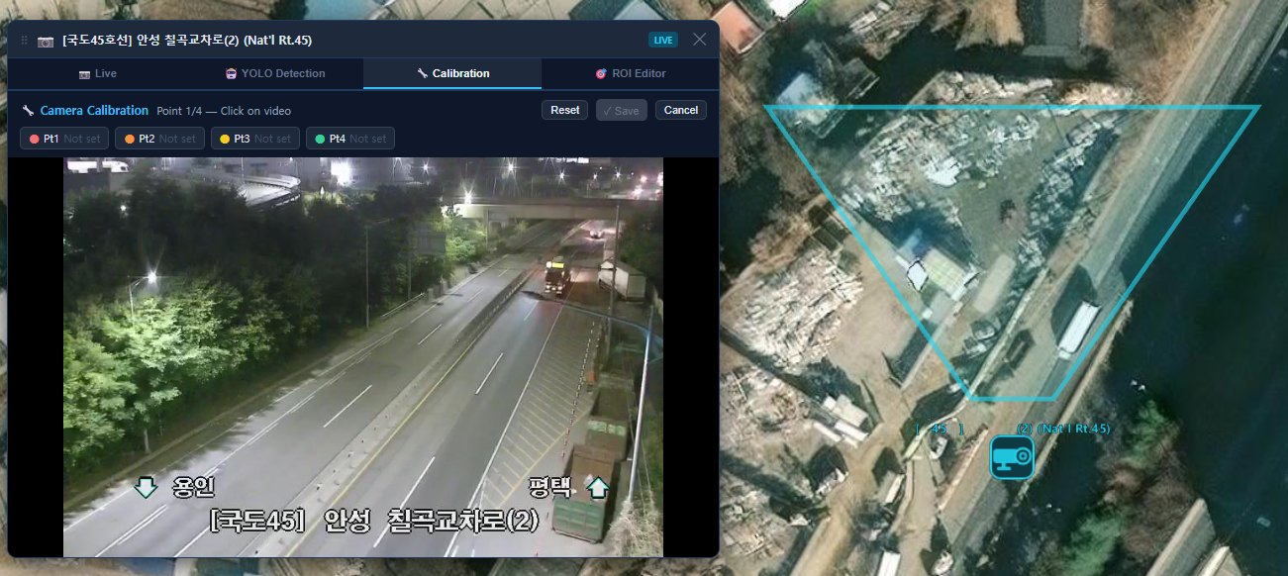
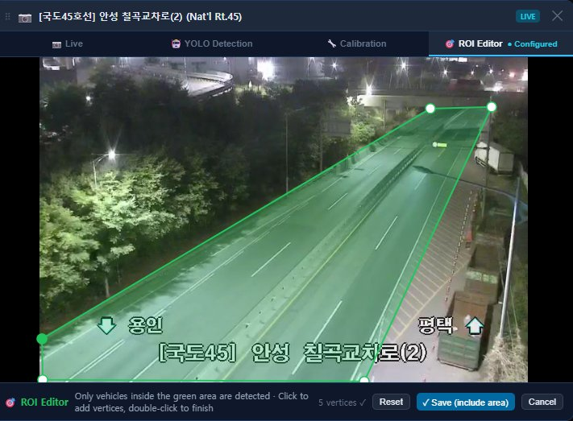
Traffic Digital Twin
Real-time Vehicle Detection & Traffic Analytics from Live CCTV Streams
Minsoo Ahn, Dahyun Kwon · CSE 327, Spring 2026 · SUNY Korea University
This pipeline ingests HLS camera streams, detects and tracks vehicles using YOLOv8 and BoxMOT, converts pixel positions to GPS coordinates, estimates smoothed speeds, and visualizes real-time traffic status on a live map.
INTRODUCTION
DEMO
Korea's 3,000+ highway CCTV cameras generate 24/7 footage — yet real-time traffic state remains inaccessible. Traffic Digital Twin delivers GPS-accurate vehicle tracking with no additional hardware.
📷 YOLOv8 + BoxMOT tracking — car, motorcycle, bus, truck
🗺️ Pixel → GPS homography (~130m × 70m FOV per camera)
⚙️EMA speed (α=0.30) · LOS grading A–F · bottleneck detection
✏️Browser ROI editor and camera calibration — no server restart
3,000+
live cameras
0
Extra Hardware
4pt
GPS calibration
TECH STACK
① CCTV Map View
Backend
Frontend
WebSocket
FastAPI
React 18
hls.js
Python 3.11
TensorRT FP16
deck.gl
Recharts
YOLOv8
OpenCV
MapLibre
BoxMOT
PyTorch 2.6
② YOLO Detection
RESULTS & LIMITAION
Live Sidebar
— counts, vehicle list, speed log, LOS, alerts
Known Limitation
⚠️Homography valid only inside calibrated quad
⚠️Manual ROI required per camera
⚠️Reduced accuracy in night / low-light scenes
⚠️Speed threshold fixed at 120 km/h in config
37fps
~27ms pipeline
YOLOv8x FP16
50fps
~20ms pipeline
YOLOv8s FP16
30–50%
faster with FP16 vs FP32
<1% accuracy loss · both exceed 30fps threshold
Calibration
— satellite FOV
⑤ ROI Editor — green polygon

