Slide 1
Campuswire QA
Suejung Kang, Minsoo Kim

Slide 2
Current Campuswire Search
Search
Use word-matching to find the posts.
Limit
Can’t find posts with similar words.
Can’t answer the question in sentence.

Slide 3
Search Module using Question&Answering
Improving search module with question and answering
Represent queries and posts as sentence embedding
Find similar vectors(= Find similar questions with user’s one)

Slide 4
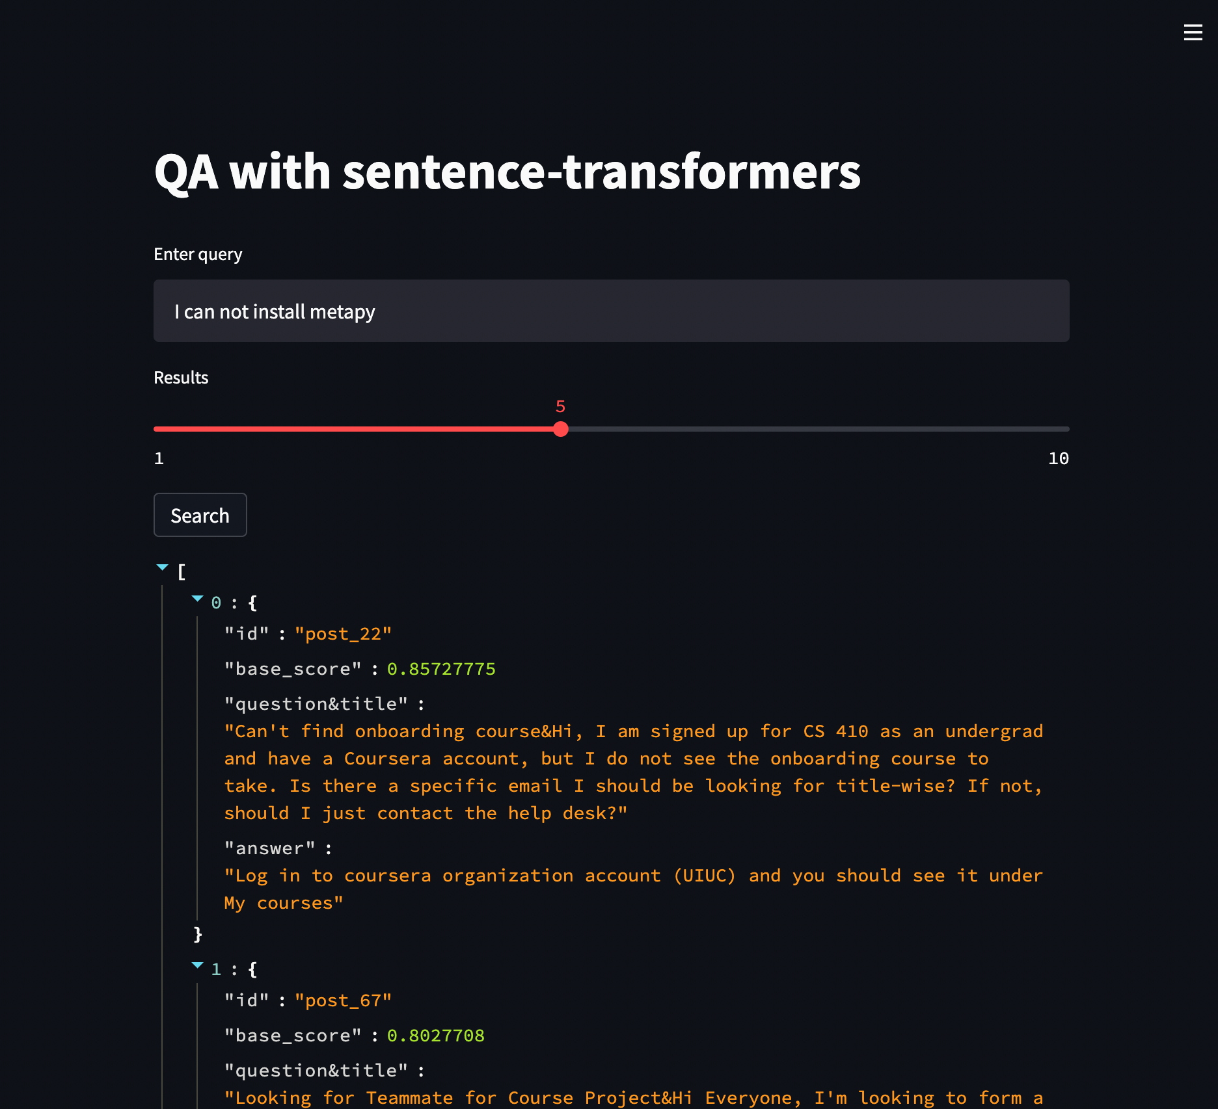
Usage
Demo : https://uiuc-cs410-demo.ngrok.io/

Slide 5
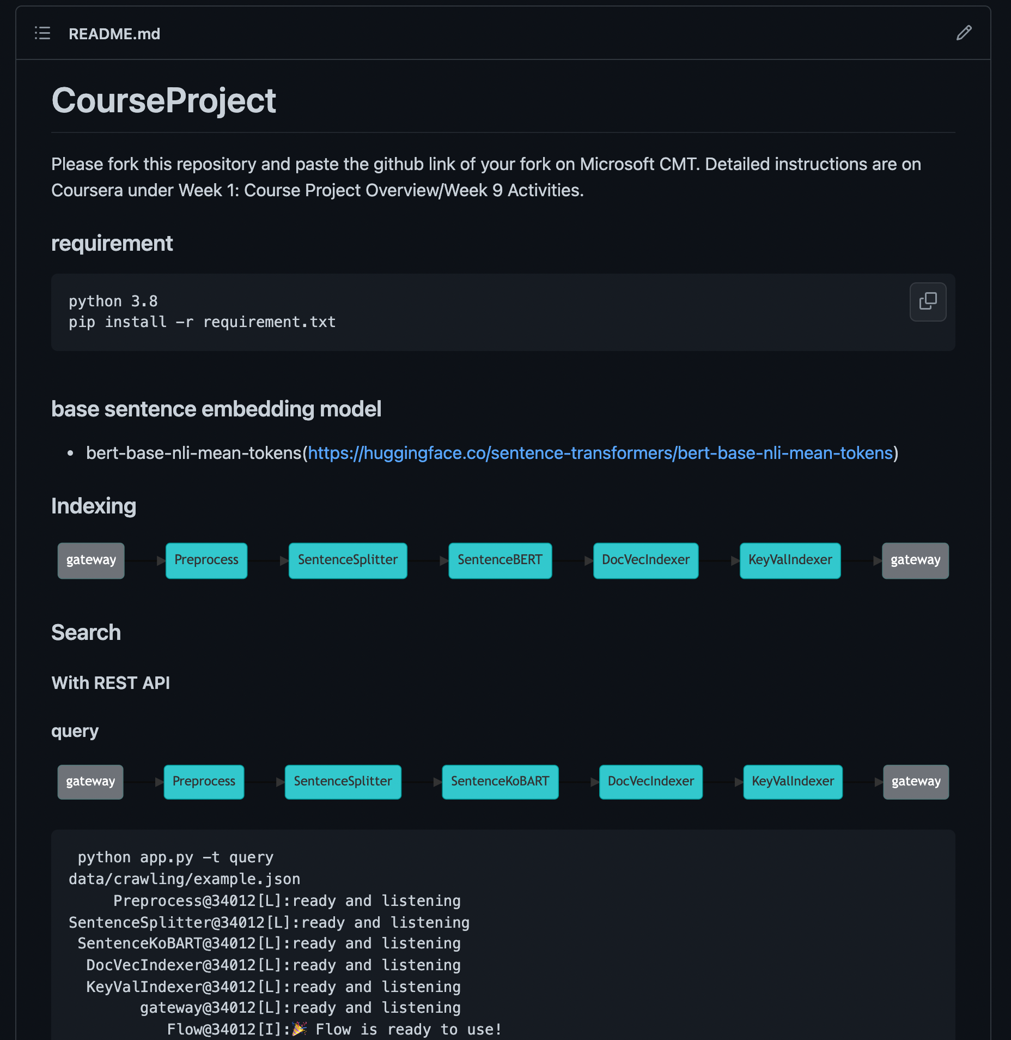
Setup
Github : https://github.com/MinsooKim15/CS410_QuestionAnswering

Slide 6
End of document

