Slide 1
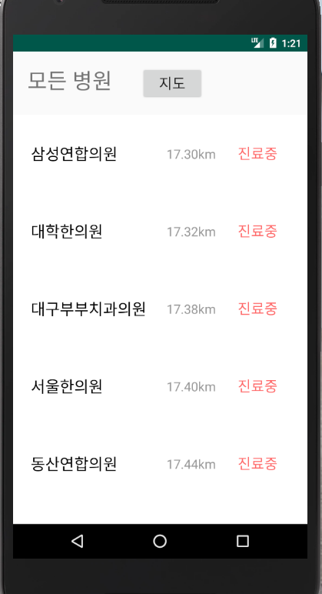









Slide 2
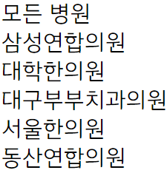

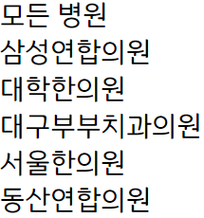


Slide 3
뺀건데 혹시나?

Slide 4


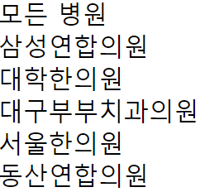

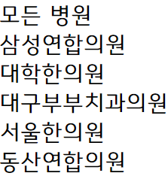

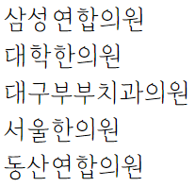



Slide 5
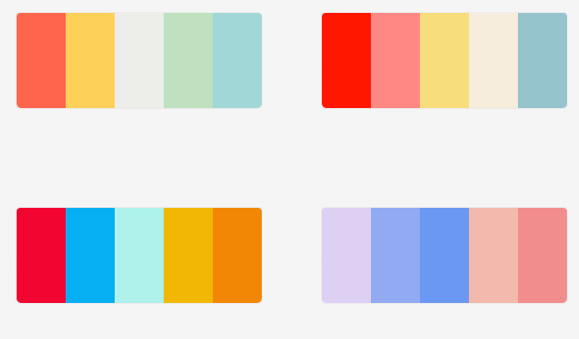


영업중
https://color.adobe.com/ko/mythemes

Slide 6
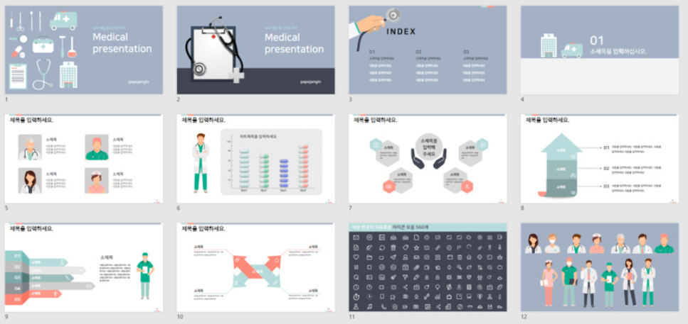
https://smartstore.naver.com/papojangin/products/2373098790

Slide 7


https://slidesgo.com/theme/childrens-hospital
https://slidesgo.com/theme/community-medical-center

Slide 8

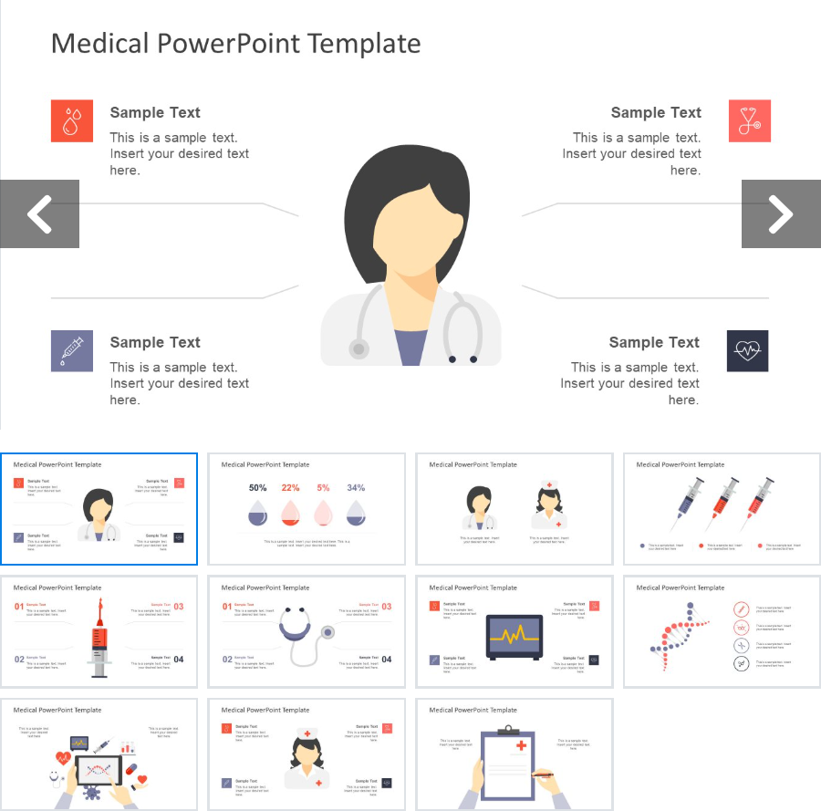
https://blog.naver.com/jee6959/221127186619
https://slidemodel.com/templates/medical-powerpoint-template/

Slide 9



https://blog.naver.com/seiru523/220567692909
https://blog.naver.com/seiru523/220363745041
https://blog.naver.com/seiru523/220271750297

Slide 10


https://blog.naver.com/seiru523/220263253804
https://blog.naver.com/seiru523/220249374820

