Slide 1









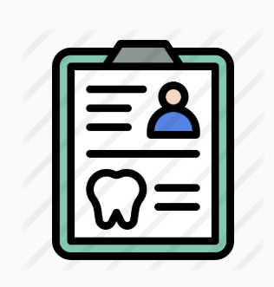


컬러 / 흑백
정형외과
한의원
안과
피부과
산부인과
신경외과

Slide 2
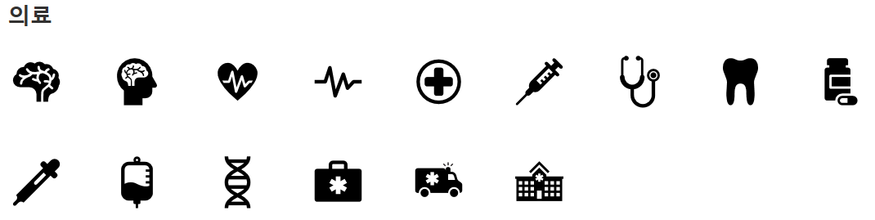
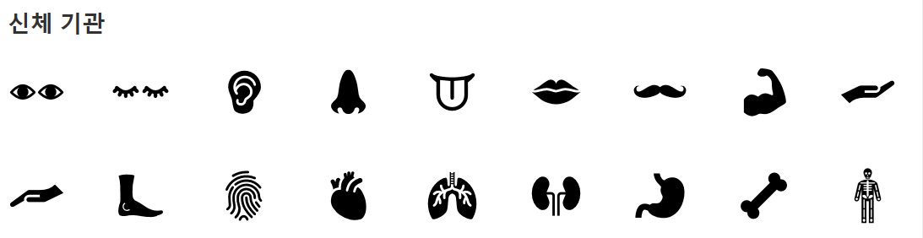

Slide 3
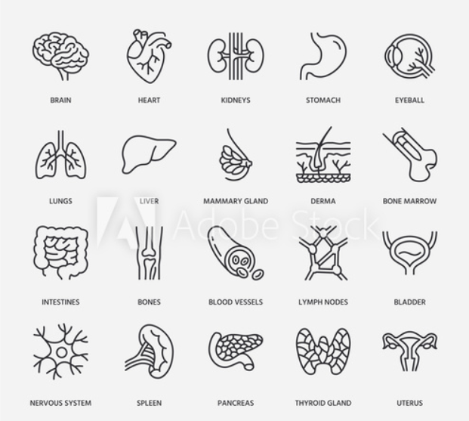
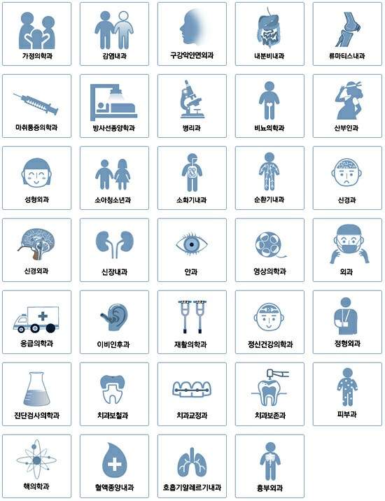

Slide 4
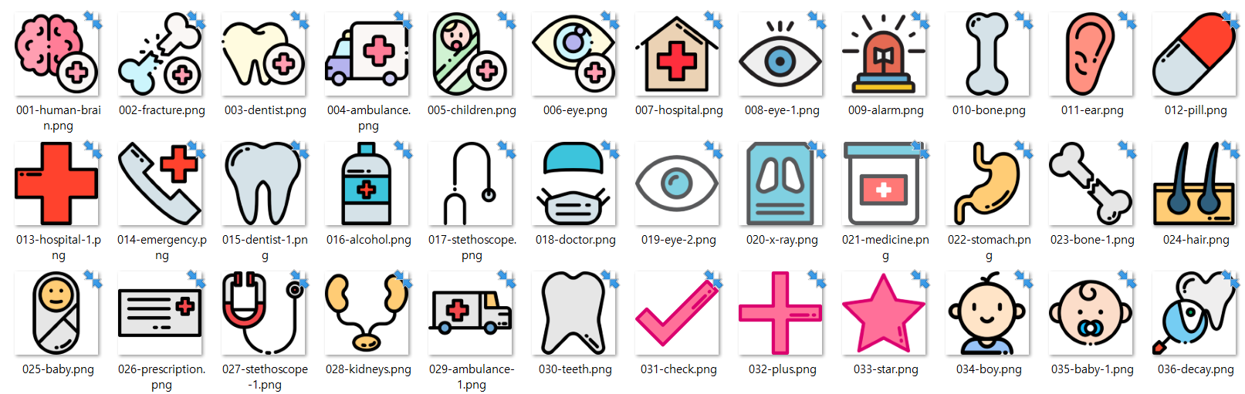
한의원 없음 / 이비인후과 피부과 산부인과 애매

Slide 5
아이콘 팩
https://www.flaticon.com/packs/hospital-11 조금 어둡
https://www.flaticon.com/packs/medical-129/2 선만하면 괜찮지만 채색은 파랑
https://www.flaticon.com/packs/human-body-1
https://www.flaticon.com/packs/medical-set-2
https://www.flaticon.com/packs/medical-43
https://www.flaticon.com/packs/health-3
https://www.flaticon.com/packs/medical-25
https://www.flaticon.com/packs/medical-32

Slide 6




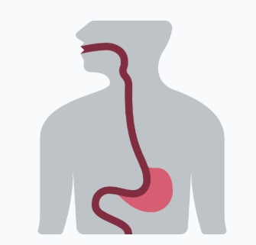








내과
https://www.flaticon.com/search?search-type=icons&word=digestive+organ&license=&color=&stroke=&current_section=&author_id=&pack_id=&family_id=&style_id=&category_id=
정형외과
https://www.flaticon.com/search?word=bone

Slide 7
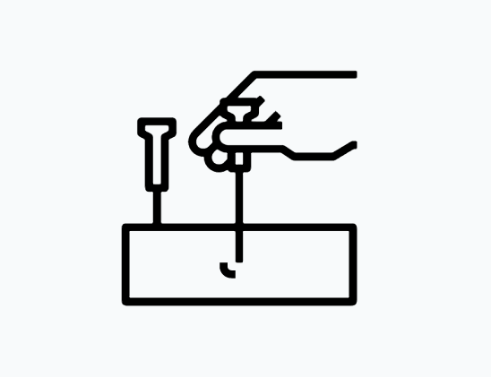







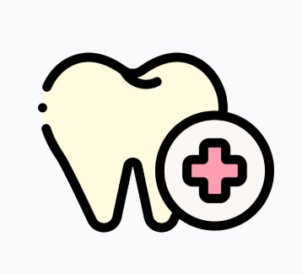


한의원
Chinese medicine
https://www.flaticon.com/search?word=Chinese%20medicine
https://www.flaticon.com/premium-icon/medical-record_3016850?term=tooth&page=1&position=27
https://www.flaticon.com/search?word=dental
치과

Slide 8
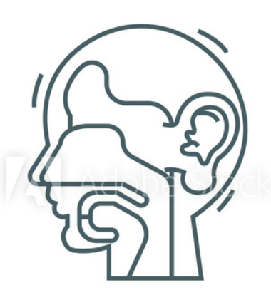
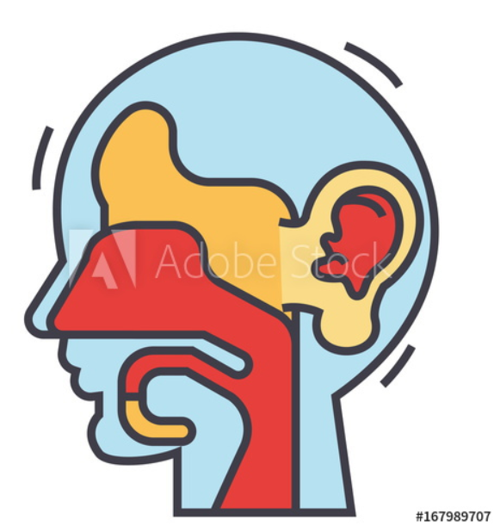


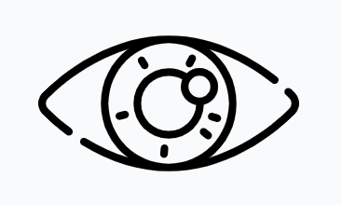
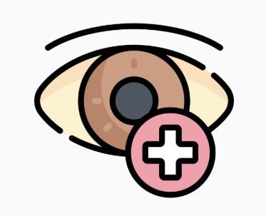
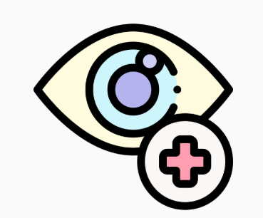
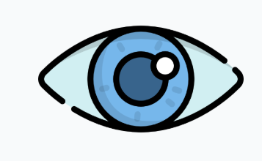
이비인후과
특정부위 or 눈코입 합쳐서 아이콘?
https://stock.adobe.com/images/id/167989707?as_campaign=Flaticon&as_content=api&as_audience=404&tduid=844fd18c484bc56d96bf98fe6f70e0ea&as_channel=affiliate&as_campclass=redirect&as_source=arvato&asset_id=261389661
안과
https://www.flaticon.com/search?word=eye

Slide 9
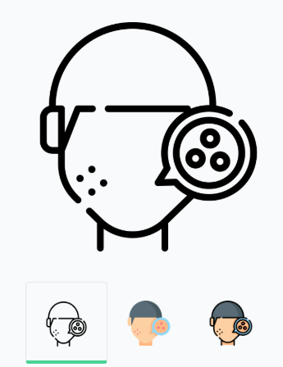
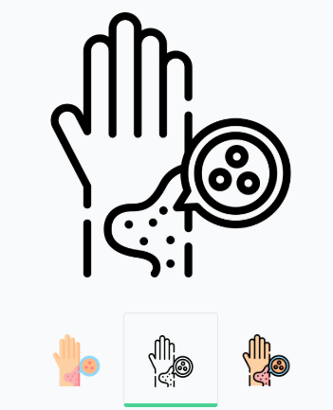


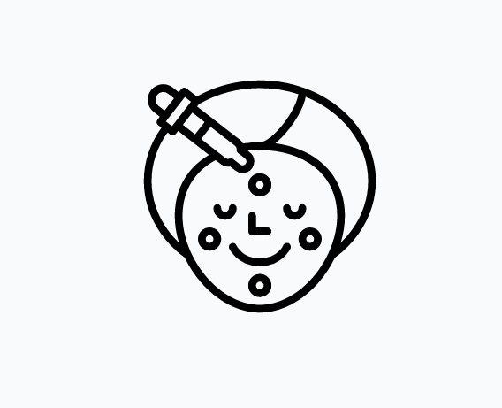
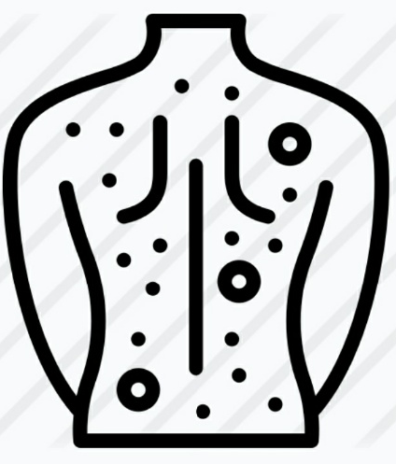




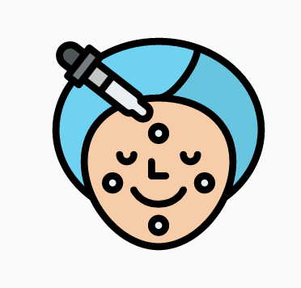
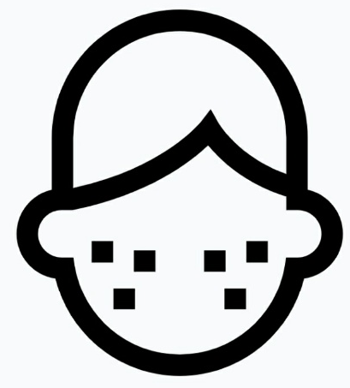





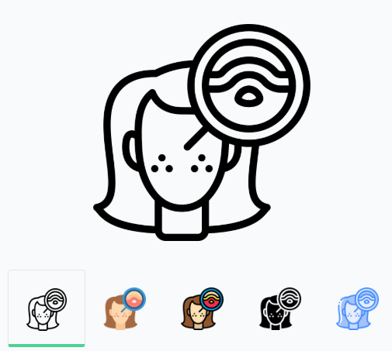

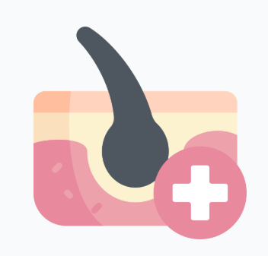
https://www.flaticon.com/packs/allergies-29
피부과
https://www.flaticon.com/search?search-type=icons&word=skin+medical&license=&color=&stroke=&current_section=&author_id=&pack_id=&family_id=&style_id=&category_id=
https://www.flaticon.com/search?search-type=icons&word=dermatology&license=&color=&stroke=&current_section=&author_id=&pack_id=&family_id=&style_id=&category_id=

Slide 10
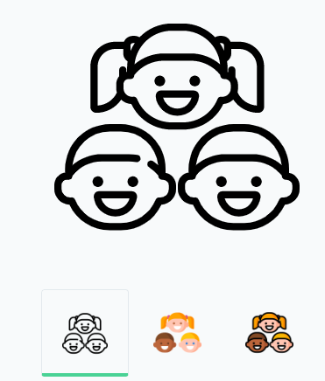
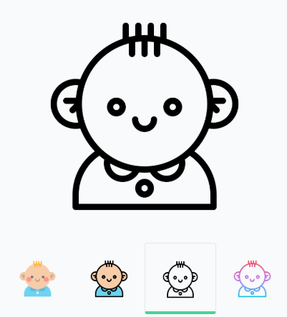


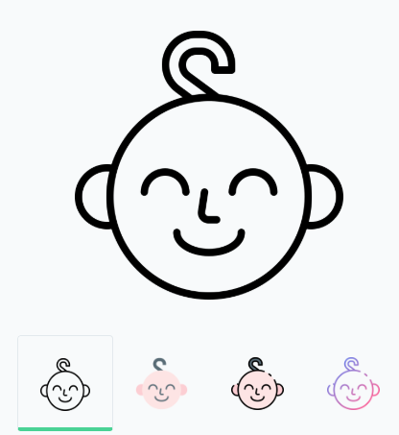

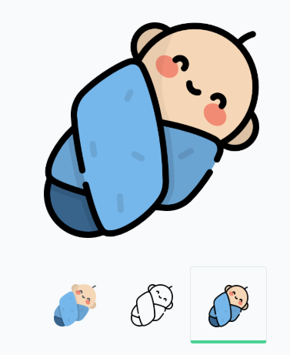
https://www.flaticon.com/free-icon/boy_1761446
소아청소년과
https://www.flaticon.com/search?word=kids
https://www.flaticon.com/search?word=kid%20face
https://www.flaticon.com/free-icon/baby_822123

Slide 11





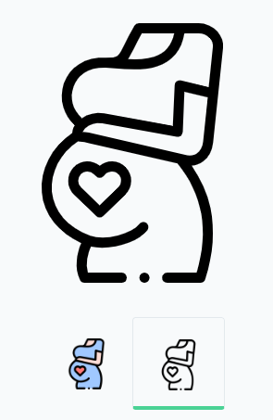
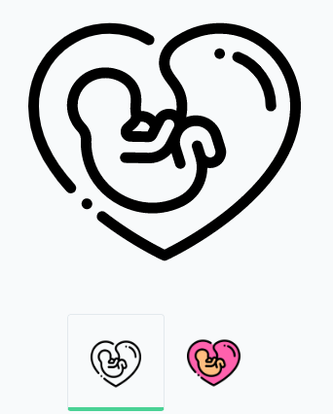


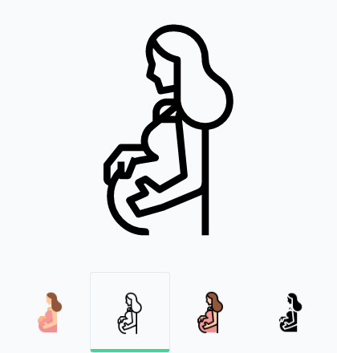
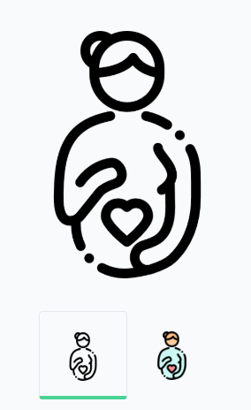
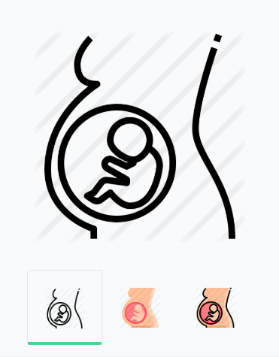
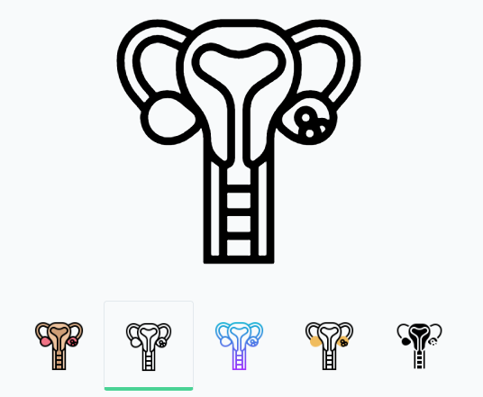
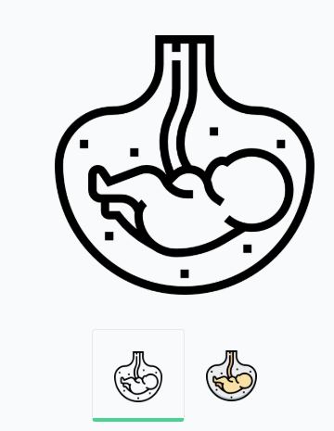
신경외과
뇌
산부인과
임신, 자궁
https://www.flaticon.com/free-icon/fetus_946322

