Slide 1






Minsu.Kim()
Home About me Stack Projects Contact
f
in
Minsu Kim
Software
Developer
About-me.()

Slide 2
Minsu.Kim()
Home About me Stack Projects Contact
in
About me
Computer science student majoring in Software Development
Have a passion for building things to help others
Looking for junior software development opportunities
Hobbies include
Stack()
Home()

Slide 3






Minsu.Kim()
Home About me Stack Projects Contact
in
Stack
Projects()
About-me()

Slide 4
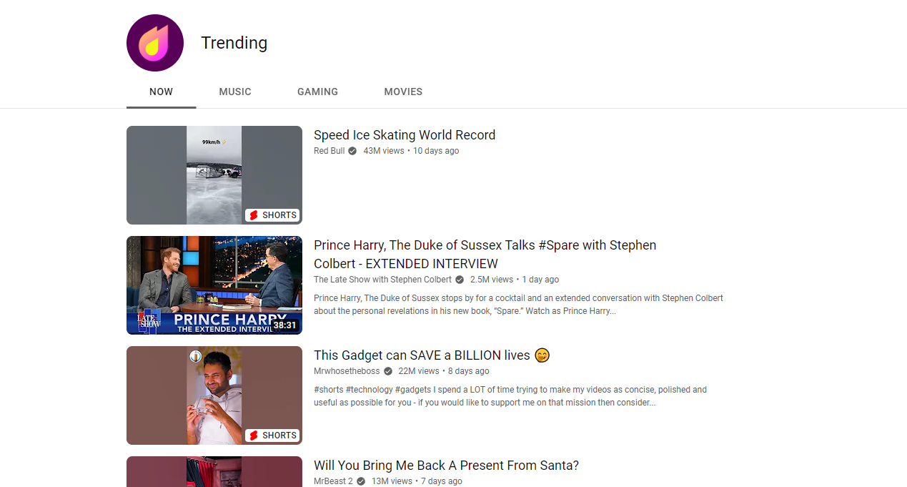
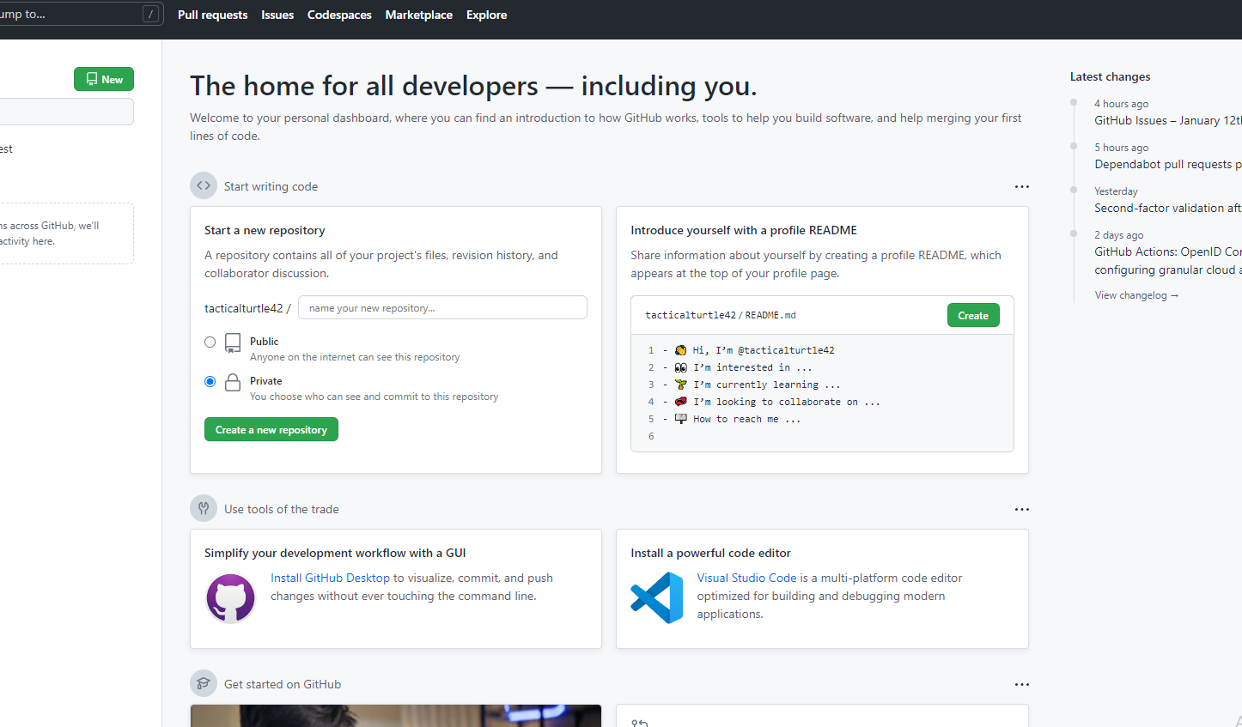
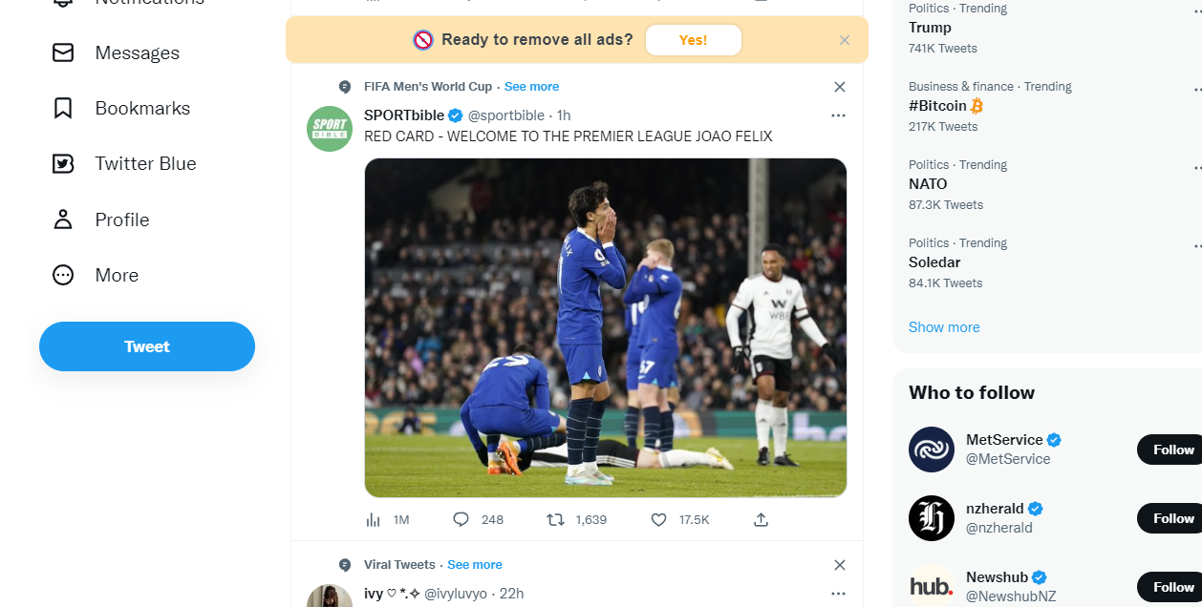
Minsu.Kim()
Home About me Stack Projects Contact
in
Projects
Contact()
Stack()

Slide 5
Minsu.Kim()
Home About me Stack Projects Contact
in
Contact
Name
Phone Number
Email
Message
Projects

