Slide 1
CMSE 381 · Section 001
Student Exam Score Prediction
Predicting Student Exam Scores Using Machine Learning
Mint Menakanit · Brian Kim
April 24, 2026

Slide 2
01 BACKGROUND
Background and Motivation
Dataset: 6,607 students, 19 predictors, 1 target (Exam Score)
Predictors cover study habits, attendance, family background, and school environment
Preprocessing: missing values filled by mode, categorical variables encoded, features standardized with StandardScaler
Research Questions
1. Can we accurately predict student exam scores from 19 predictors, and which ones matter most?
2. Can we classify students into Low, Medium, and High performance groups based on these predictors?
3. Do Lasso and Ridge regression outperform OLS and effectively produce automatic feature selection?
4. Can we compress the predictor space into fewer principal components without losing predictive power, and what do those components represent?

Slide 3
02 METHODOLOGY
Methods Overview
Classification
OLS Regression
Logistic Regression (baseline) vs Random Forest + GridSearchCV
10-fold Stratified CV · 80/20 train-test split
Multiple linear regression on all 19 predictors
10-fold CV for R² and RMSE · Coefficient interpretation
Ridge & Lasso
PCA + PCR
CV-selected alpha via RidgeCV / LassoCV
Lasso provides automatic feature selection
Scree plot + cumulative variance analysis
CV over 1–19 components · PC1 loading interpretation

Slide 4
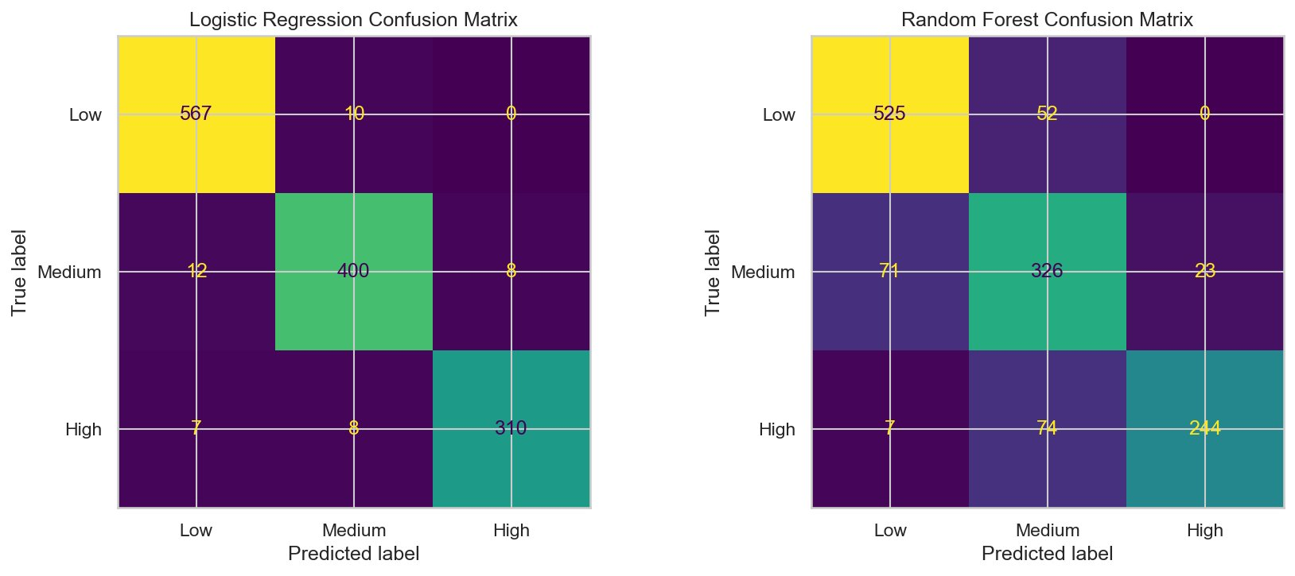
03 CLASSIFICATION
Logistic Regression
Outperforms Random Forest by ~14 percentage points in test accuracy
Model | CV Acc | Test Acc | Macro F1
Logistic Regression | 96.7% | 96.6% | 0.965
Random Forest | 83.1% | 82.8% | 0.821
CV accuracy ≈ test accuracy (96.7%) → generalizes well
Low group recall = 98% → strong at identifying at-risk students
Logistic Regression outperforms the more complex Random Forest

Slide 5
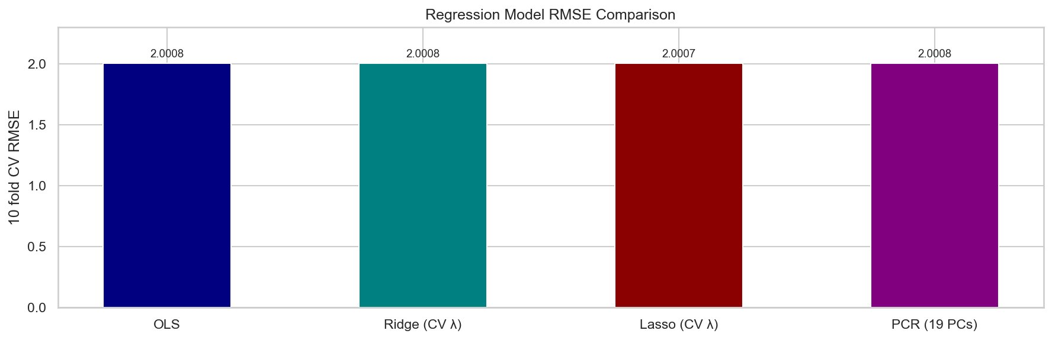
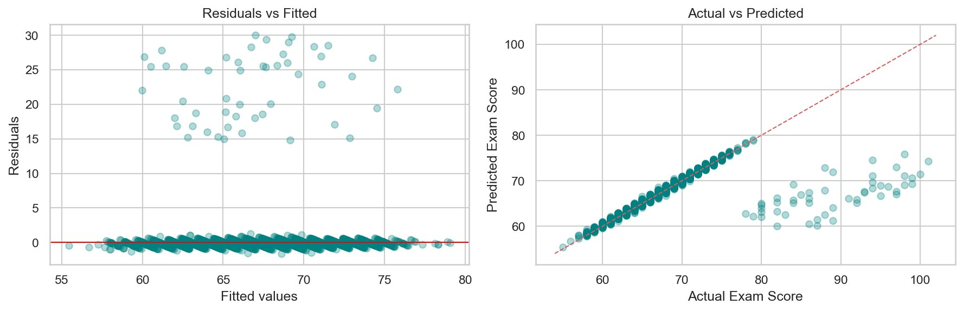
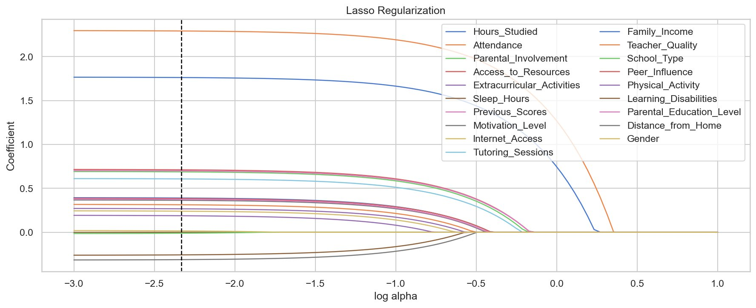
04 REGRESSION
Model Comparison: OLS, Ridge, Lasso, PCR
All 4 models: CV R2 ~ 0.732, RMSE ~ 2.00 | Attendance +2.3 pts/SD Hours Studied +1.7 pts/SD | Lasso zeroed only Sleep_Hours

Slide 6
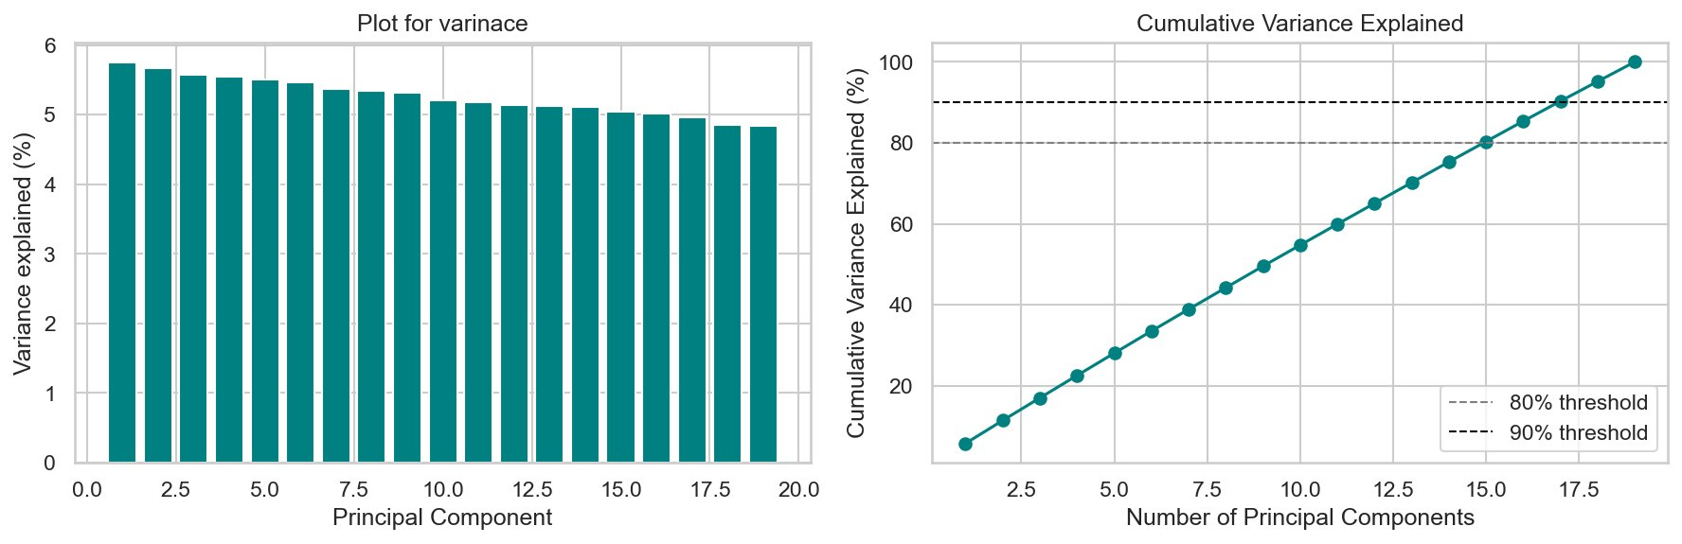
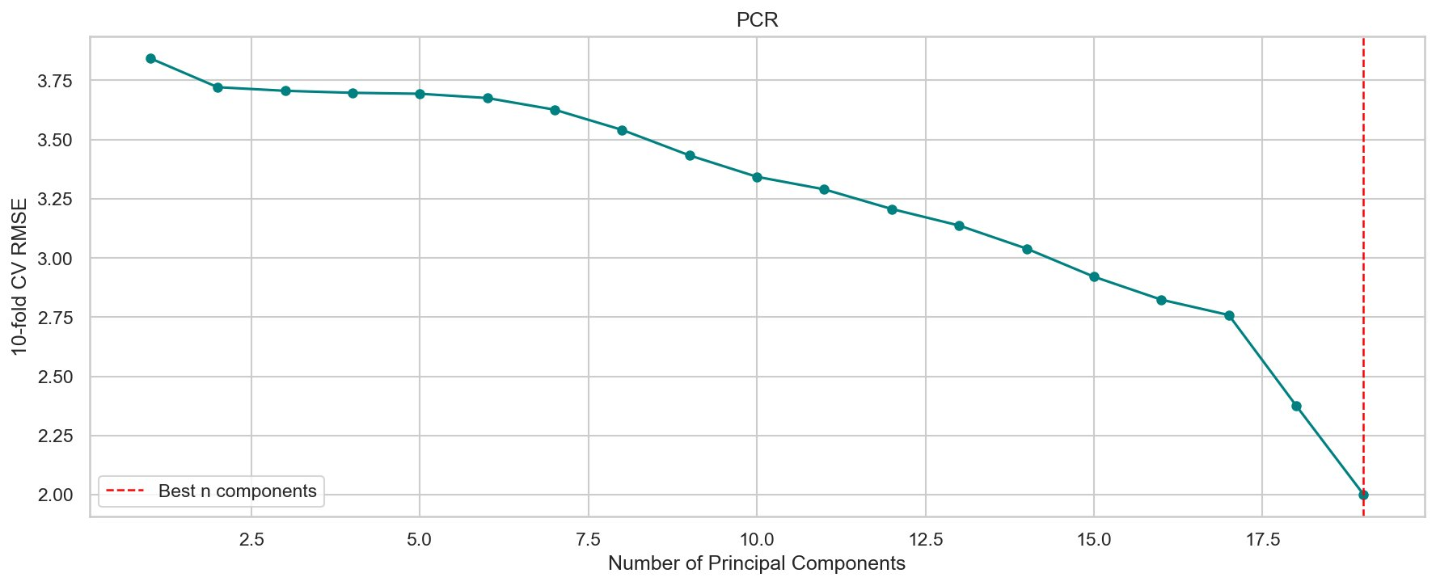
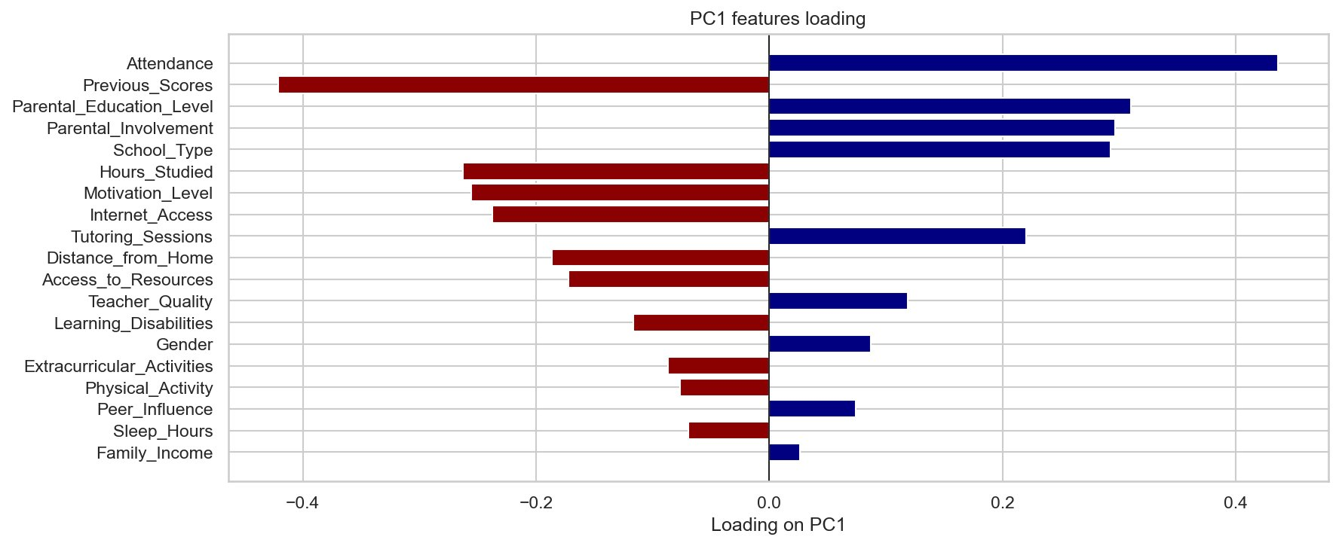
05 PCA + PCR
Features from PCA and PCR
No single PC dominates — all components contribute roughly equally
CV selected all 19 PCs → no compression benefit for prediction
PC1 = student engagement axis: Attendance, Study Hours, Motivation, Tutoring
High PC1 score → more engaged student → higher exam score

Slide 7
06 CONCLUSION
Summary
✓ 96.6% classification accuracy — Logistic Regression outperformed Random Forest by ~14%
✓ R² = 0.732, RMSE ≈ 2 pts across all regression models — regularization gave no gain
✓ Attendance & Hours Studied are the strongest predictors across all methods
✓ PCA: 19 predictors are not redundant; PC1 captures the student engagement dimension
Next steps: SVMs, interaction terms, gradient boosting

