Slide 1
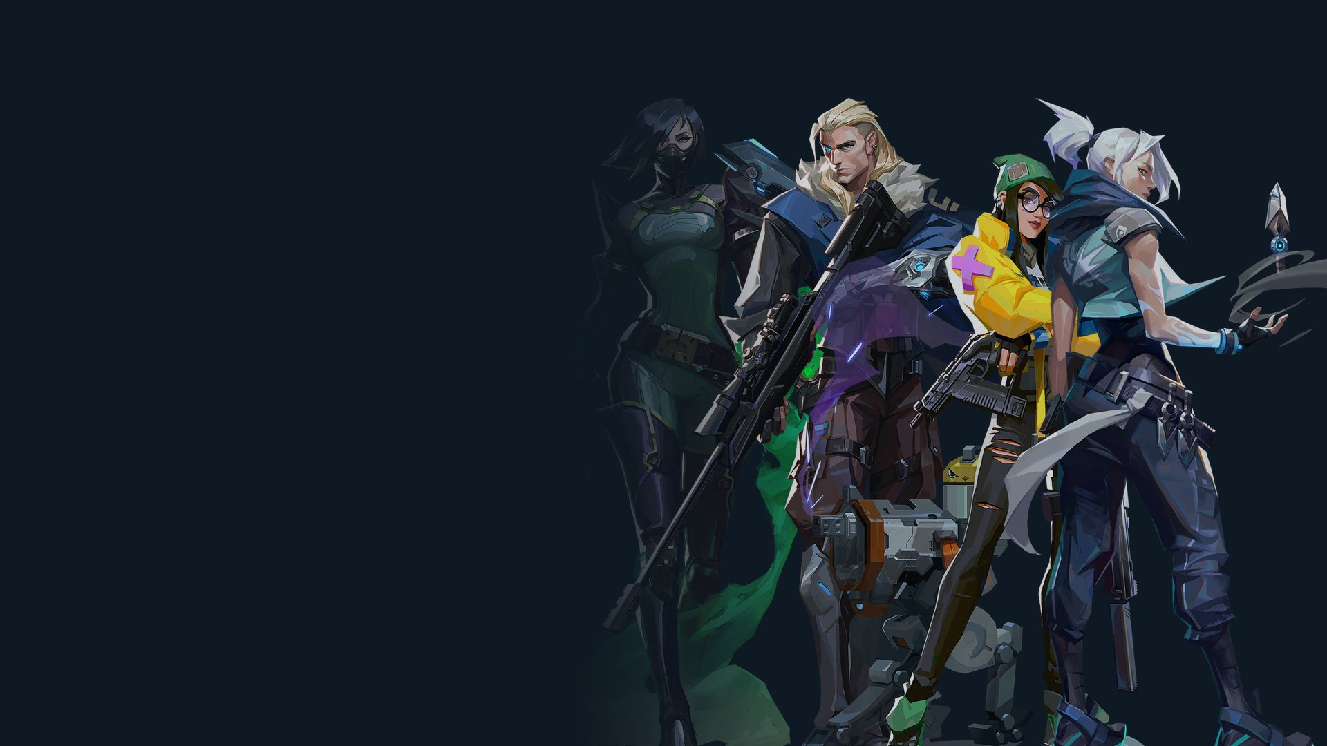
A VALORANT DATA PROJECT
Meta Data
What would the pros pick?
Harun Tontus · Friday 25 September 2026
Notes:
~20s. Hi, I'm Harun, and this is my project, Meta Data. "Meta" is gamers' word for what the best
players are playing right now: the most optimal line-up or tactic. This project is based on
VALORANT, which I'll explain in a second.

Slide 2
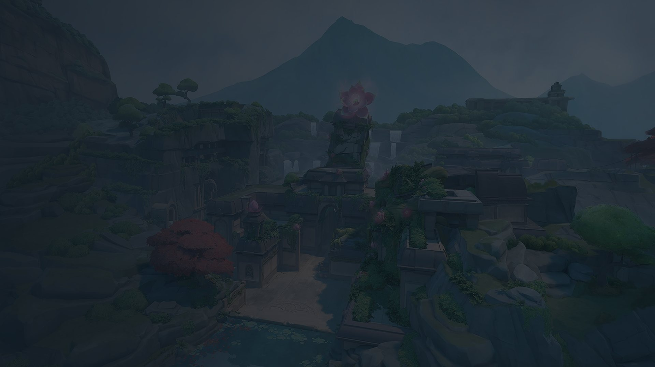





VALORANT for anyone who hasn't played
MAP: LOTUS
A PRO MATCH, BEST OF THREE
Fade
Omen
Raze
Viper
Vyse
Map 1
chosen by team A
Map 2
chosen by team B
A real pro line-up on Lotus
Map 3
the one left over, if needed
Map
Agent
Line-up
The arena. Seven are in play at a time, and the set changes over the years.
A character with its own abilities. No two teammates pick the same one.
A team's five agents. Roles make them follow patterns.
Notes:
~35s. For anyone who hasn't played, VALORANT is a 5v5 tactical shooter. Each player picks an agent, a
character with its own abilities. No two teammates can pick the same one, though the other team
can. A team's five agents are its line-up, like this one on Lotus, the map in the background.
Seven maps are in play at a time, and that set changes over the years. A pro match is usually
best of three: each team chooses a map, and the third is the one left over.

Slide 3
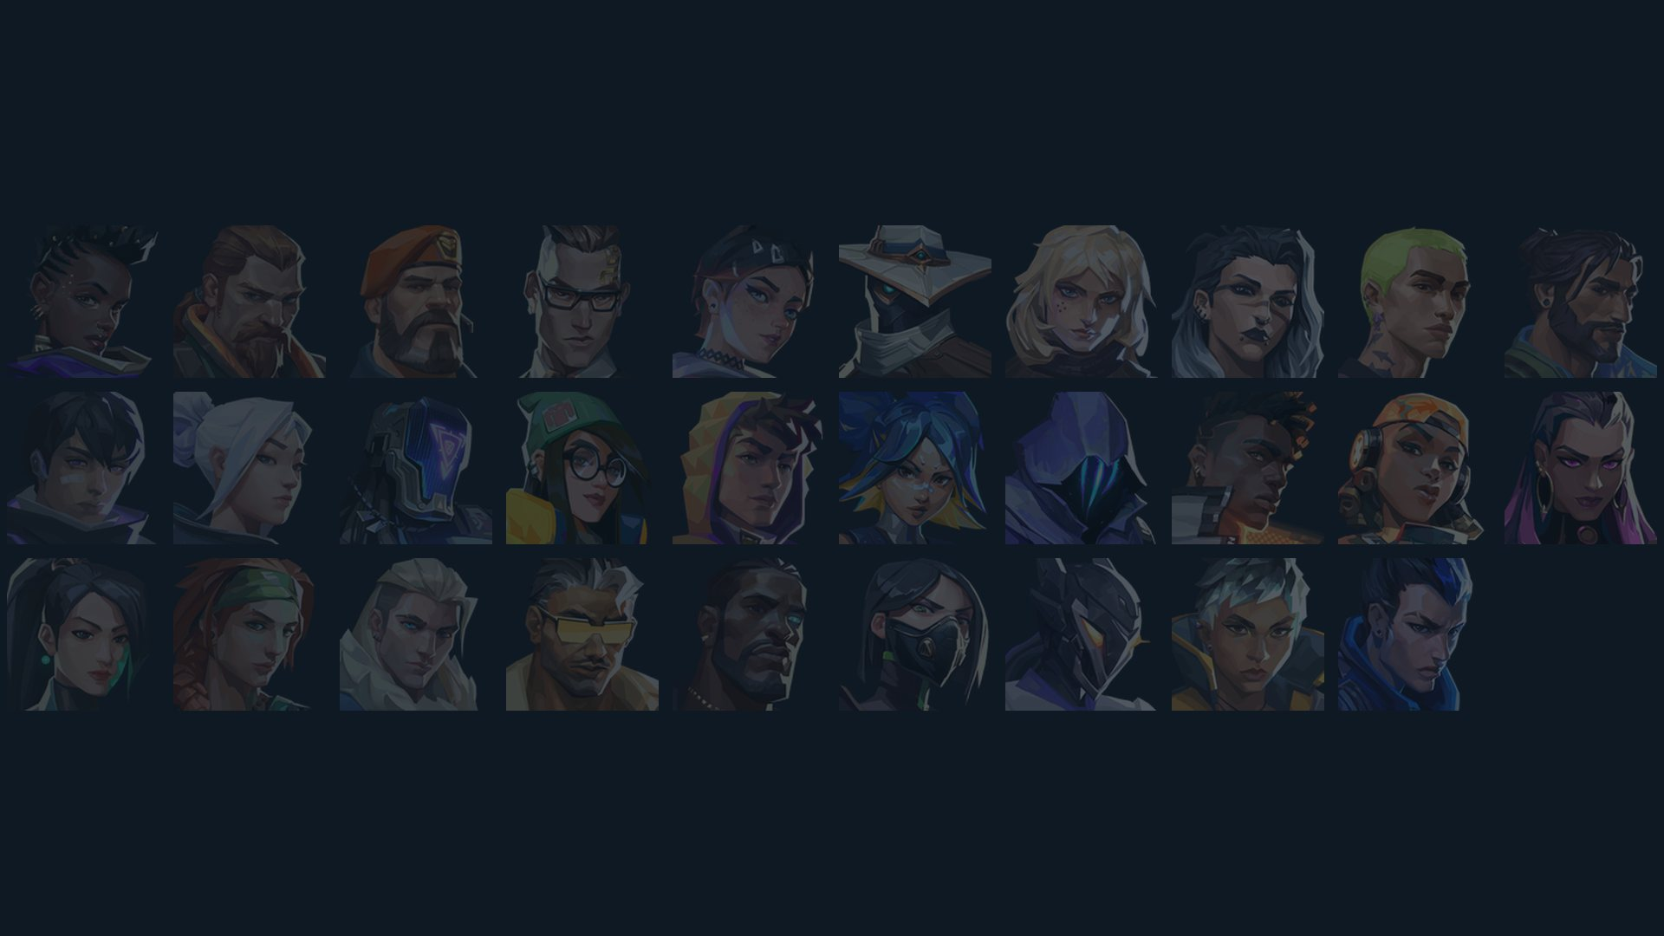
Players try to optimise for the best line-up
ME
THE GAP
WHO IT'S FOR
Four years of competitive play, achieving one of the highest ranks. Viewer of the pro tour.
Stats sites show past pick and win rates. They don't test which agents work better together.
Players picking a line-up, and fans curious what the pros would do.
Notes:
~35s. So, why did I build this? Players are always trying to find the best line-up. I played VALORANT
competitively for about four years and got to one of the highest ranks, and I still follow the
pro tour. There are loads of stats sites that show past pick rates and win rates, but none of them
test which agents actually work best together. It's for players picking a line-up: whether you're
queuing with four friends, or playing solo and the other four have already locked in.

Slide 4
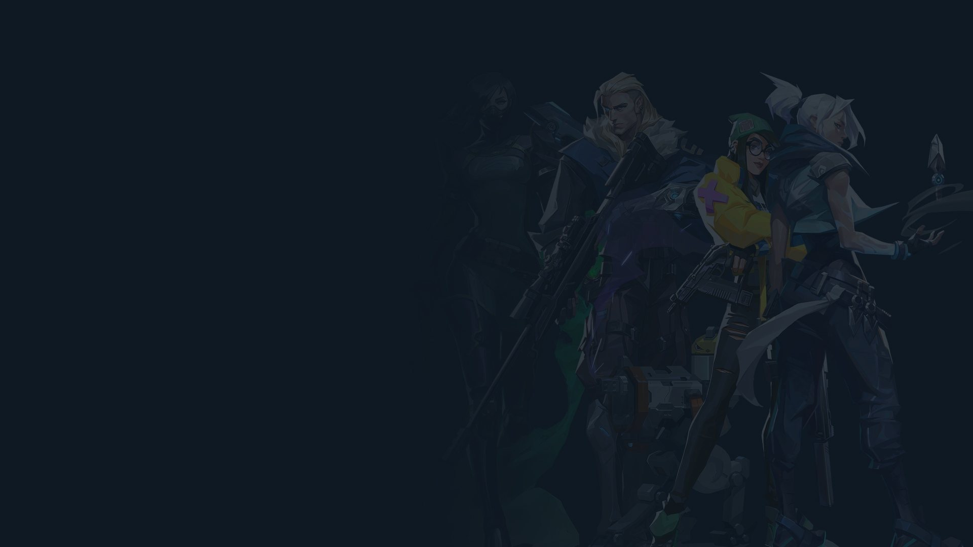
Three questions
01
02
03
What would the pros pick?
Do agent picks predict who wins?
Do some line-ups over-perform?
A map and four agents in, the fifth out.
Using only what's known before the game.
Is a combination better than its parts?
Notes:
~20s. So, the project sets out to answer three questions. One: what would the pros pick? You give it a
map and up to four agents, and it suggests the next one. Two: do agent picks predict who wins,
using only what's known before the game? And three: do some line-ups do better than their agents
would on their own?

Slide 5
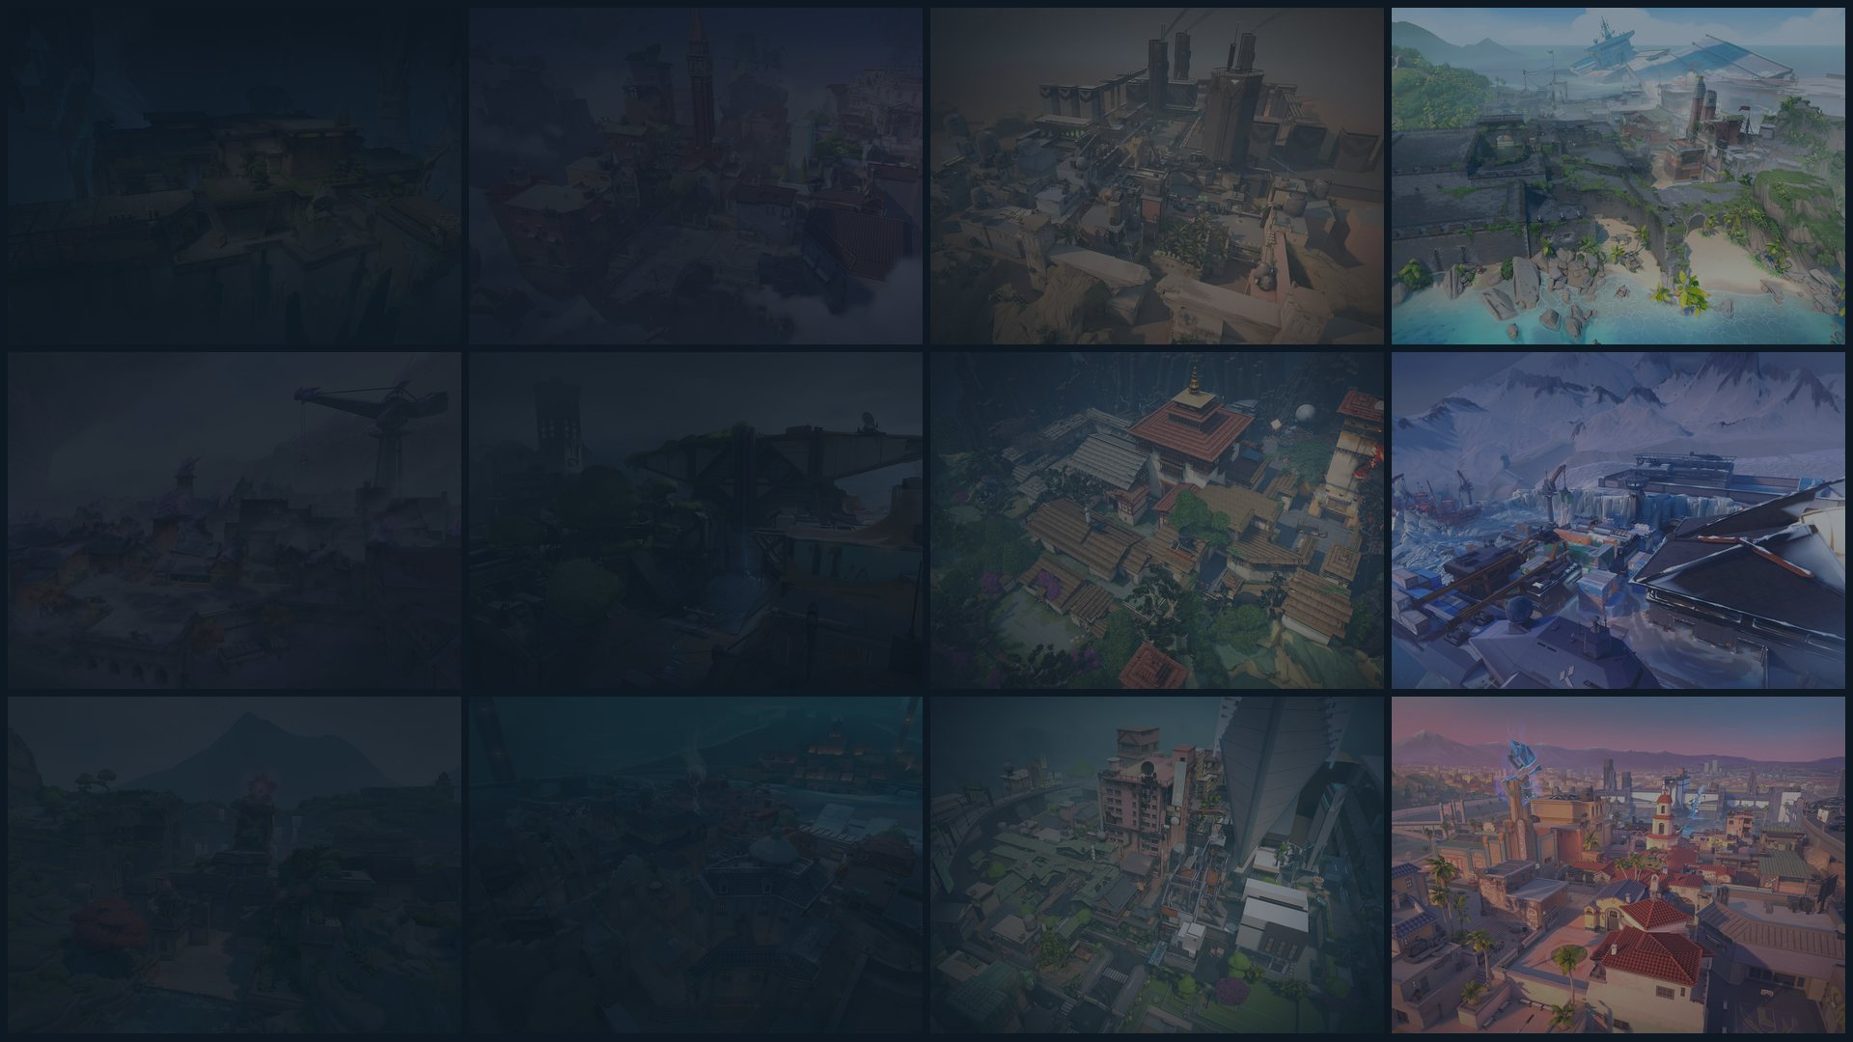
01
How it works
From two seasons of pro games to a working app.
Notes:
~3s. So, how does it work?

Slide 6
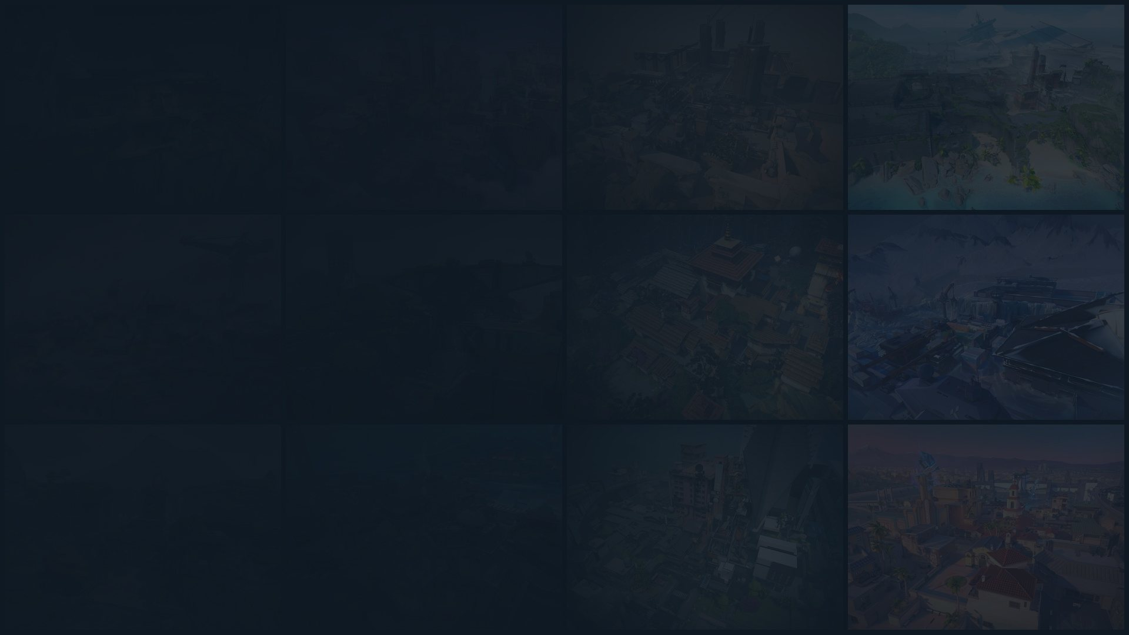
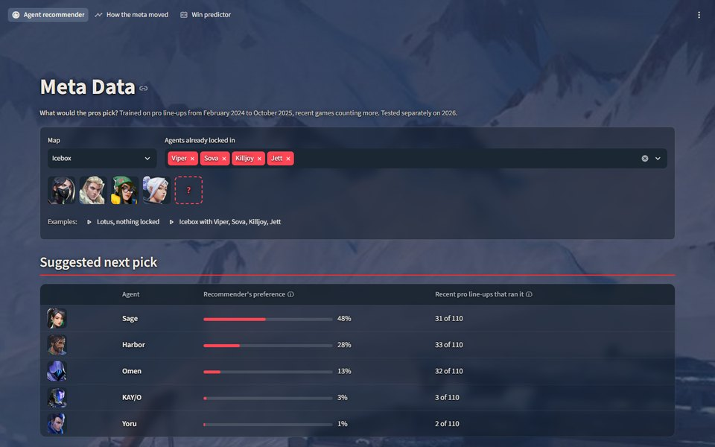
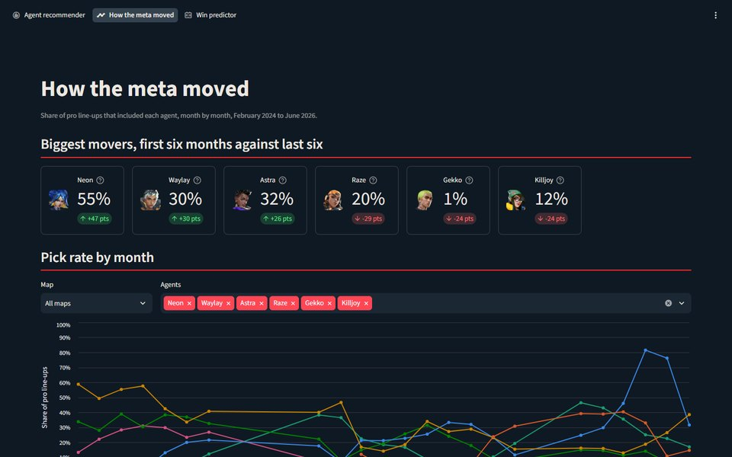
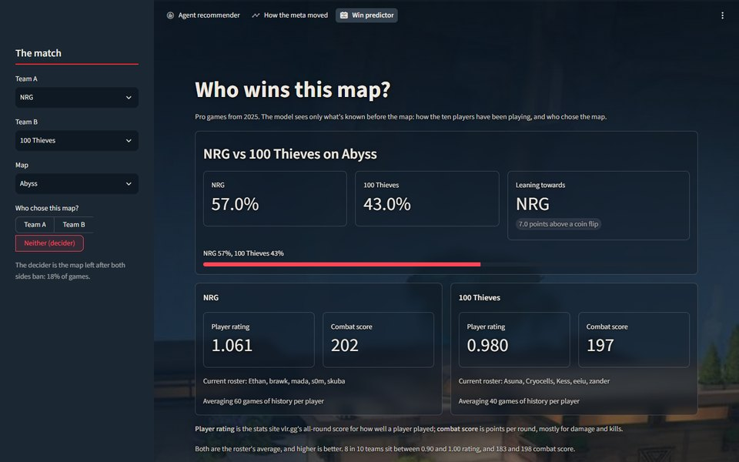
From pro games to an app, in six steps
1
2
3
4
5
6
Collect
Clean
Frame
Learn
Test
Show
2,376 pro games over two seasons
Fixed 3 errors that fail silently
Hide one agent: which completes the line-up?
Gradient boosting: which agents go together
Week by week, earlier games only
A three-page Streamlit app
BUILT WITH
Python, pandas, scikit-learn, Streamlit
Data: Kaggle, from vlr.gg
Agent recommender
How the meta moved
Win predictor
Notes:
~60s. I'll focus on how the recommender works. I collected 2,376 pro games over two seasons. A game
here is one map, so that's from about 930 pro matches. Then I cleaned the data. Some errors didn't
show up as errors: one team was filed under a different name in one file, so I matched teams by
their IDs instead.
To train it, I take real pro line-ups, hide one agent, and the model learns which agent completes
the line-up. It uses gradient boosting, a standard machine-learning method, to learn which agents
go together on each map. It's tested week by week: each week, it only learns from the games
before that week, and it's scored on games it hasn't seen. And it's all accessed through a
Streamlit app with three pages, which I'll demo shortly.

Slide 7
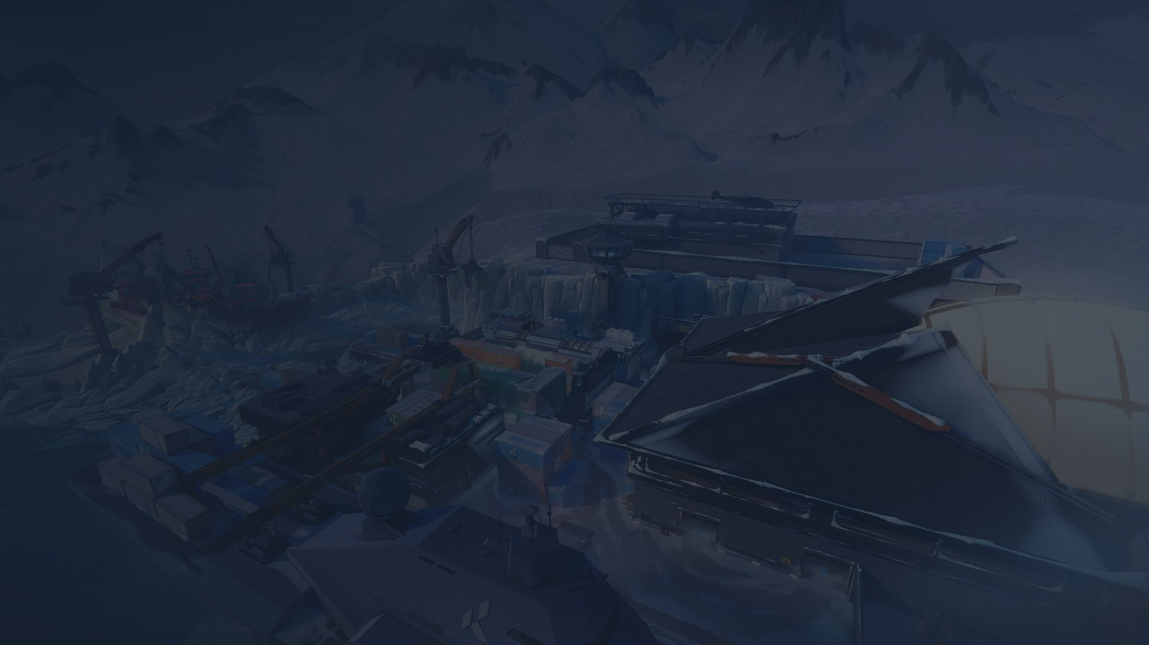





The task
MAP: ICEBOX
ITS TOP 3 SUGGESTIONS
Viper
Sova
Killjoy
Jett
?
Sage
48%
Four agents locked in. What's the fifth?
Harbor
28%
Omen
13%
HOW IT'S SCORED
Hide one agent from a real pro line-up. Is it in the top 3?
The bar to beat: the most-played rule, whatever pros played most here lately.
Notes:
~35s. Here's an example, on Icebox. Four agents are already locked in: Viper, Sova, Killjoy and Jett,
so it's the solo scenario, and I need to pick the fifth. The model gives its top three: Sage,
Harbor and Omen, with Sage at 48%. That's how strongly it favours each one, not a chance of
winning. To score it, I hide one agent from a real pro line-up and check if it comes back in the
top three. And the bar to beat isn't random guessing. It's a simple rule: pick whatever pros have
played most on that map lately.

Slide 8
The result
91.3%
PROS' PICK IN THE TOP 3, FOUR AGENTS LOCKED IN
Random guess
≈13%
rest of 2025
Most-played rule, 2025
77.3%
87.4%
Recommender, 2025
91.3%
Most-played rule, 2026
72.1%
2026: new season, new agents
Recommender, 2026
87.4%
+14 and +15 points over the most-played rule, even allowing for luck
Notes:
~35s. And the result: on the rest of 2025, the agent the pros actually picked was in its top three
91.3% of the time. On 2026, a new season, it was 87.4%. But the simple "most played lately" rule
already gets 77% and 72%, so the real result is the lead: about 14 to 15 points, and it held on a
new season. 2026 is a bit lower because of new agents and map changes. When something new comes
in, it learns it, but it struggles at the start.

Slide 9
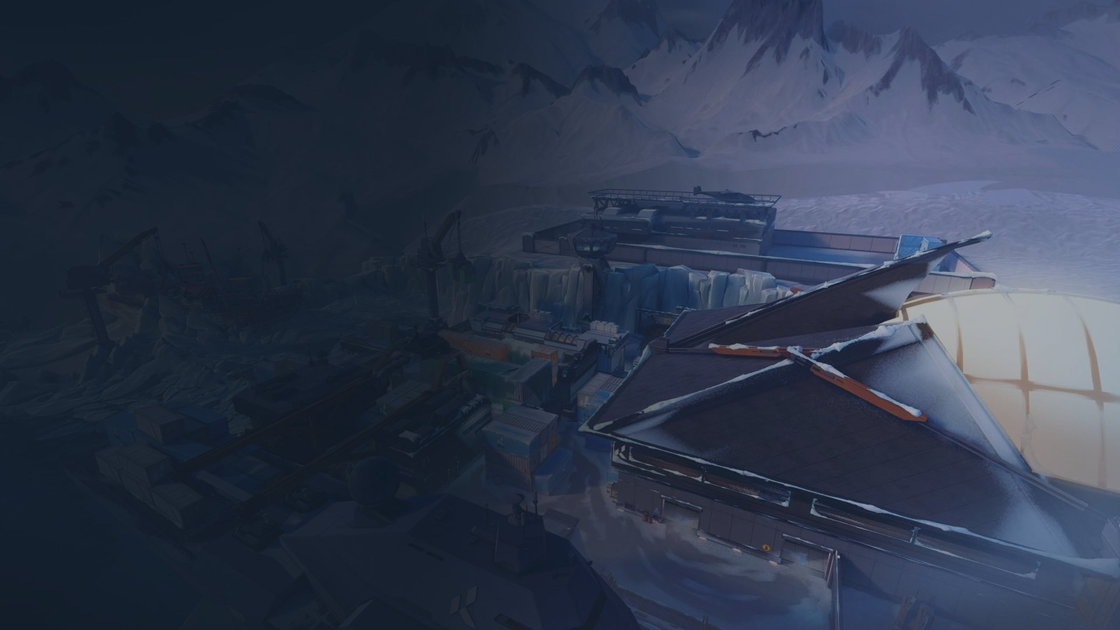
02
Live demo
Three pages: what the pros would pick, how the meta moved, and who wins a map.
Notes:
~3s. Now I'll move on to the live demo. Give me a moment.

Slide 10
What to watch for
Agent recommender
How the meta moved
Win predictor
Select a map and agents for recommendations
Pick rates month by month, per agent
Testing whether agent picks change who wins
Notes:
~3:25. [10 seconds on the slide] There are three pages: the recommender, how the meta moved, and a win
predictor. [switch to the app; if it won't start, talk through this slide's three pictures]
Agent recommender (about 1:45). [click "Lotus, nothing locked"] First, Lotus with no agents
selected. With nothing locked in, it shows the most common line-ups on Lotus lately: here, Fade,
Omen, Raze, Viper and Vyse, how many times it's been played, its record, and which teams played
it most. And individually, Omen's in 98% of line-ups, Fade 90, Raze 73. So pros almost always run
those three. I've played this map a lot, I usually play Raze, and I can tell you that's accurate.
[click "Icebox with Viper, Sova, Killjoy, Jett"] Now the example from the slides: Icebox with
Viper, Sova, Killjoy and Jett. Because we've given it four, it suggests the fifth: Sage at 48%,
Harbor 28, Omen 13.
[scroll to "Why this pick"] And here's why. Of the pro line-ups on Icebox in the last 180 days
with those four agents, 31 also ran Sage. [scroll to the record] That exact line-up was played 50
times across 2024 and 2025, with a 29–21 record. [point at "Played most by" and the yellow box]
But look who played it. This is question three: I checked whether any line-up wins more than its
agents deserve, and there was no sign of it. The standouts were just strong teams, which is why
every record has this warning.
How the meta moved (about 30s). [open the page] This page is why I give more weight to recent
games. Take Neon. [all maps] You can see when Neon came in, a gradual rise, then a huge spike. That
was likely a patch that made Neon stronger, or weakened another agent, or a map rotation that
suited Neon. So recent games are what the game actually looks like now.
Win predictor (about 1:20). [open the page] This page is question two: do the agents a team
picks tell you who'll win? You pick two teams and a map, and it gives each team a chance. Here,
NRG against 100 Thieves: 57% to NRG.
That number comes from a model that only looks at the players: how well each team's five players
have been playing lately. [scroll to "Now change the agents"] Down here there's a second model that
only looks at the agents each team picked, and nothing about the players.
[in NRG's line-up, remove Omen and add Sage] Watch what happens when I change one agent. The agent
model jumps from 34% to 54%, from a single pick. The player model stays at 57%, because it doesn't
look at agents at all.
So which one do you trust? I tested both on games they'd never seen. [point at the line under the
two boxes] The agent model was right 50.8% of the time, basically a coin flip, and no better than
just guessing whoever picked the map wins. The player model did a bit better, 54.5%, but pro games
are close, so nothing predicts them well. The agent model reacts a lot, but its swings don't mean
anything: from what I found, the agents a team picks don't tell you who'll win.
[back to the slides]

Slide 11
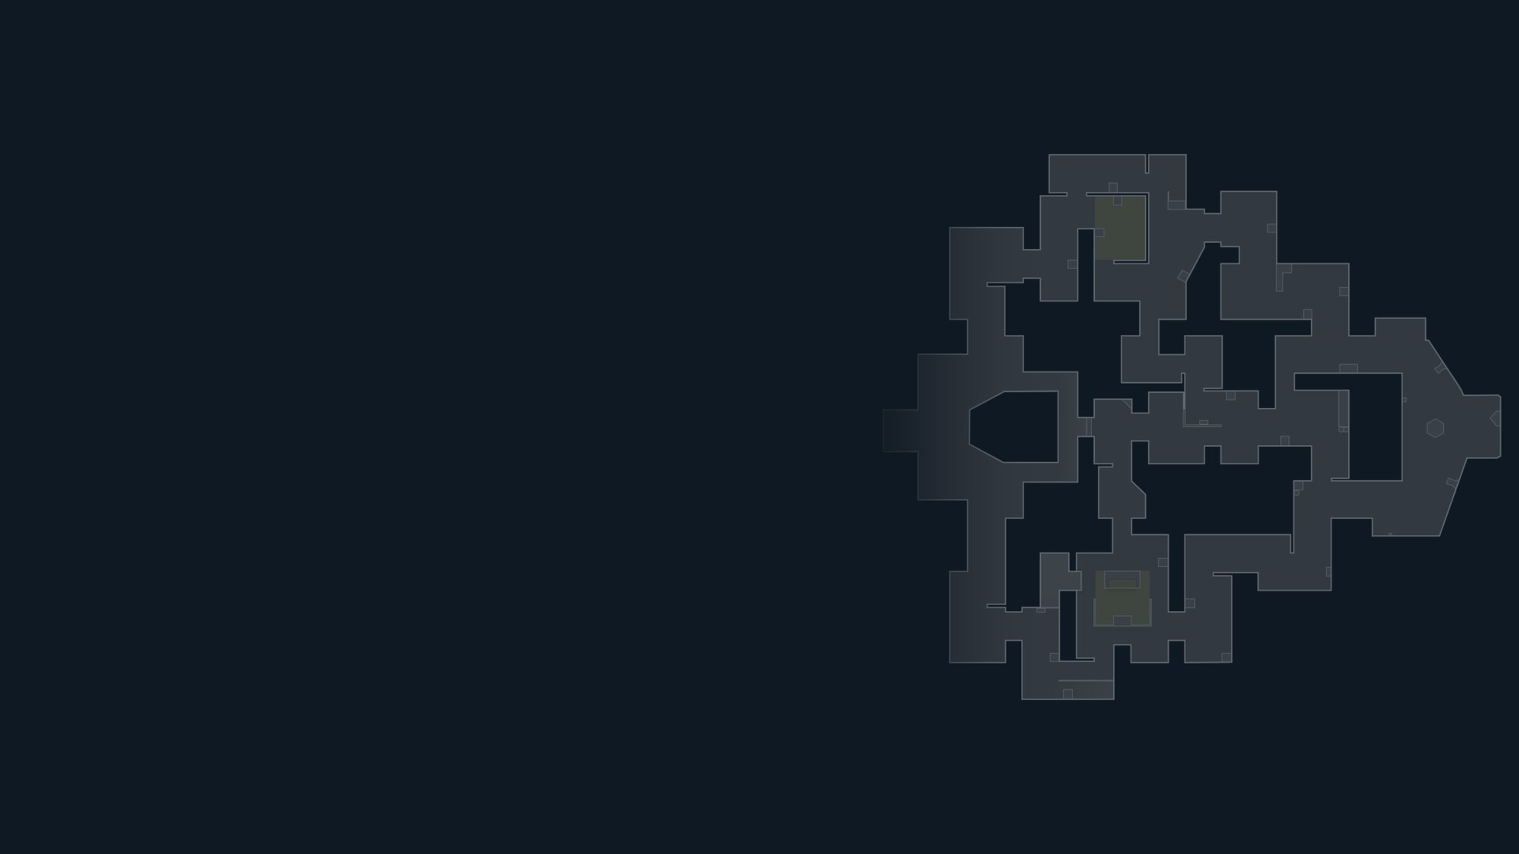
03
What I learnt
What surprised me, and what I'd improve next.
Notes:
~3s. So, what have I learnt from this project?

Slide 12

Four lessons I learnt
Split by time, not at random
The simple rule is hard to beat
A random split lets the model peek at the future meta.
'What pros played lately' already gets 77%.
Winners are far harder to predict
Years of data can shrink to months
Best win model: 54.5%. 'Map picker wins': 52.9%.
The game keeps changing: a year-old game counts under 1%.
Notes:
~45s. First, split by time, not at random. Because the meta keeps changing, a random split would let
the model learn from future games, so it learns from earlier weeks and is tested on later ones.
Second, simple rules can be really hard to beat: "what pros played lately" already gets 77%.
Third, predicting who wins a match is far harder than I thought. My best win model got 54.5%,
against 52.9% for just saying whoever picked the map wins. And fourth, years of data can shrink to
months. I thought I had years of data, but once you weight games by how recent they are, a
year-old game counts for under 1%.

Slide 13
What I'd improve
LIMITS TODAY
NEXT
Shows what pros pick, not what wins
Weaker with fewer agents locked in
Weaker on brand-new maps and agents
Keep it updated with new pro games
Test it on ranked games
An LLM in the app that suggests tactics for the chosen map and agents
Notes:
~40s. And what would I improve? The limits first. It shows what pros pick, not what wins; my guess is
pro teams mostly pick strong agents they're comfortable with, so the picks don't separate them.
It's weaker with fewer agents locked in, and at first on brand-new maps and agents.
Next, I'd keep it updated with new pro games, because new agents and patches keep changing what's
strong. I'd test it on ranked games, to compare everyday players with pros. And an LLM in the app
that suggests tactics: give it a map and five agents, and it tells you where each player should go
and how to use their abilities.

Slide 14
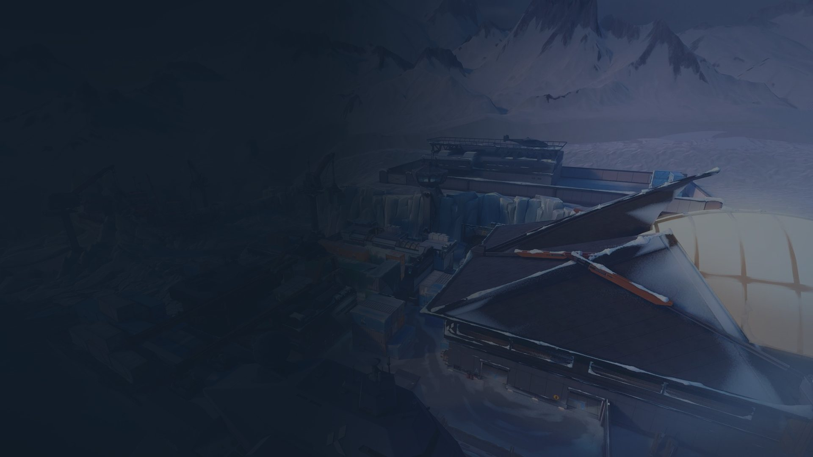
Conclusion
With four agents locked in, the pros' pick is in its top three nearly nine times in ten, even on a new season.
?
Notes:
~10s. So, to conclude: with four agents locked in, the pros' pick is in its top three nearly nine times
in ten, even on a new season.

Slide 15
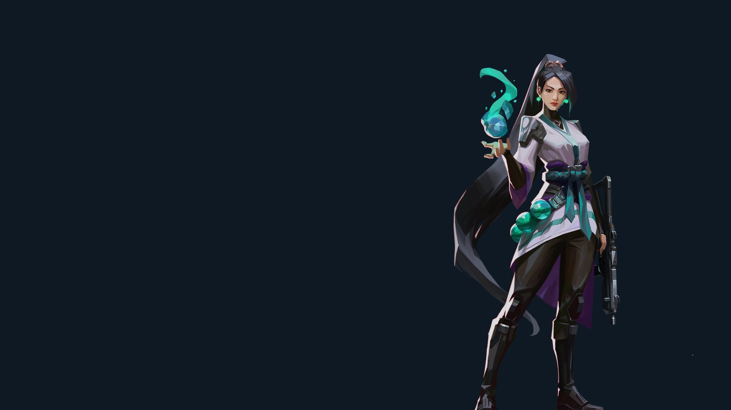
Thanks for listening
Any questions?
Harun Tontus
Made under Riot Games' "Legal Jibber Jabber" policy using assets owned by Riot Games. Riot Games does not endorse or sponsor this project.
Notes:
~5s. That's all. Thank you very much for listening, and I'm happy to take any questions.
IF YOU'RE ASKED
- "Isn't 91% suspiciously high?" It predicts picks, not wins, and pros are predictable: the
simple rule already gets 77%. The number that matters is the 14-point lead, and it held at 15
on 2026.
- "Why is Sage above Harbor when more line-ups ran Harbor?" The counts on that page treat
the last 180 days equally. The model counts recent games more: a game 45 days old counts half.
- "Should a team just follow its suggestions?" No. It tells you what pros play, not what wins.
- "How do you know you didn't tune it on the test?" Each test plan was saved in git, with a
timestamp, before it ran, and each test was run once. Nothing changed after seeing a result.
- "Why gradient boosting?" I compared five methods in development. The best two were level,
and a rule I'd set in advance picked gradient boosting. The tests are what count.
- "How does it learn to complete a line-up?" Every real line-up is used with each agent
hidden in turn, against every smaller set of the other four, so it also learns what to suggest
with fewer agents locked in.
- "How sure are you agents don't predict the winner?" The agent model was worse than saying
50/50 on every game in development, and no better on unseen games (log loss 0.760 and 0.704,
where 50/50 scores 0.693; lower is better).
- "What does predict the winner?" Player form, how well the ten players have been playing:
nearly six points ahead in development, 1.6 on the test, with a range from −3.2 to +6.4. So it
isn't proven.
- "Could synergy be there and you missed it?" Yes. Spotting a five-point edge needs about 784
games of one line-up, and the most-used had 86.
- "So agents don't matter?" Probably not that. Opposing teams share about three of their five
agents on a typical map, so the picks rarely separate them. That's my reading; I didn't test it.
- "What was wrong with the data?" Three errors that don't show up as errors: every performance
counted several times over, NRG filed as "Mega Minors" in one file, and a player-stats file that
already contained the game being predicted.
- "Why only two seasons?" The game keeps changing, so a year-old game counts under 1% anyway.
2021 to 2023 also have no dates, but those could have been scraped from vlr.gg like 2026's.
- "How weak is it on new things?" A brand-new map scored 80% against 93% elsewhere, and new
agents 43%, from only 77 questions.
- "How would you check the LLM's tactics?" I couldn't yet: my data has no round-by-round play.
It would need round-level data, or pro players rating its suggestions.
- "Why isn't the app retrained on 2026?" I held it back to keep the demo stable, and Icebox,
the demo map, left the pool in 2026.
- "Other projects report over 90% for predicting winners." Those use stats from the game
itself, like kills and damage, which you only know once it's over.

