Slide 1







STACK OVERFLOW DEVELOPER SURVEY(2019)- Data Analysis
MINTU VIPIN JOY
12 APRIL 2024

Slide 2



OUTLINE
Executive Summary
Introduction
Methodology
Results
Visualization – Charts
Dashboard
Discussion
Findings & Implications
Conclusion
Appendix

Slide 3

EXECUTIVE SUMMARY
Data Cleaning, EDA
Current Technology Usage Trend
Language
Database
Platform
Web Frame
Future Technology Usage Trend
Language
Database
Platform
Web Frame
Demographic Survey
Gender
Country
Age
Education Level

Slide 4

INTRODUCTION
DataSet - The 2019 Stack Overflow Developer Survey
Responders - 90,000 developers
Analysing - Programming Languages, Databases, Platform, Web frame
Demographics – Gender, Country, Age, Education level
Target Audience
IT Professionals
Anyone interested in IT
Students
Significance of predicting the trend

Slide 5

METHODOLOGY
Collect survey data & explore its content
Web Scraping
APIs.
Request library.
Data Preprocessing & Exploratory data analysis
Python
Data Visualization
Highlight distribution of data, relationships, the composition and
comparison of data- python
Dashboard
IBM Cognos Analytics

Slide 6
RESULTS

Slide 7
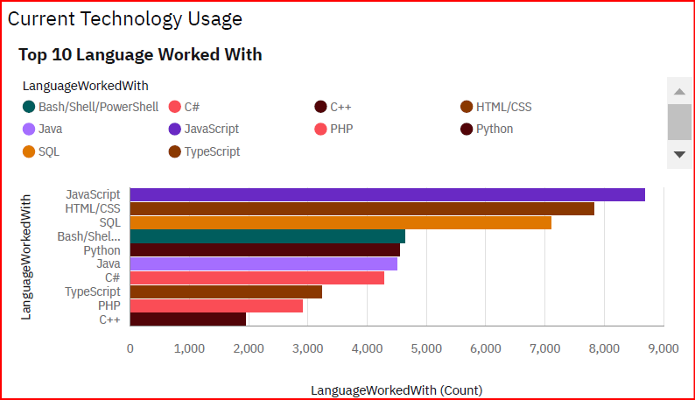
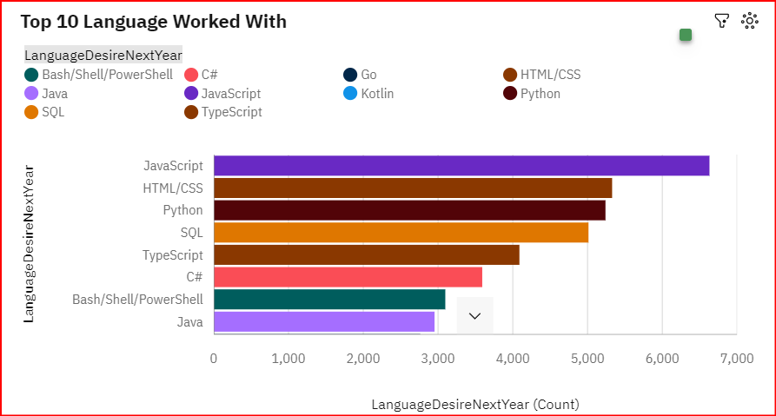
PROGRAMMING LANGUAGE TRENDS
Current Year
Next Year

Slide 8
PROGRAMMING LANGUAGE TRENDS - FINDINGS & IMPLICATIONS
Findings
JavaScript is top trending in the world
Python is more popular
HTML/CSS and SQL still has great portion in language usage trend
Implications
Web developments and Web developers are still in high demands
Python is the new trending language,
especially popular in AI fields
JavaScript and TypeScript are crucial to learn for developers

Slide 9
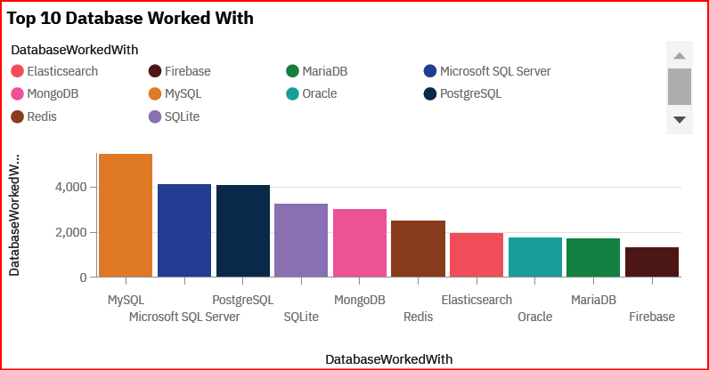
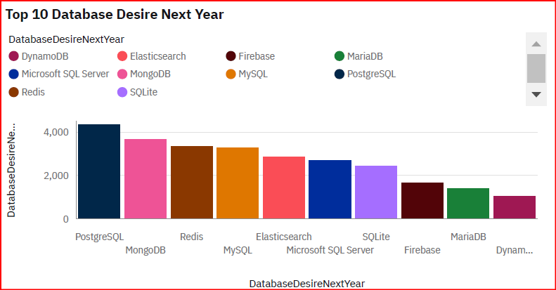
DATABASE TRENDS
Current Year
Next Year

Slide 10
DATABASE TRENDS - FINDINGS & IMPLICATIONS
Findings
MySQL as most used database
Lack of interest in Microsoft SQL Server and SQLite
Increasing interest in PostgreSQL and MongoDB
Implications
Microsoft SQL Server and SQLite losing ground in the market
PostgreSQL and MongoDB establishment in the market
Open source databases are preferred

Slide 11

DASHBOARD
Dashboard

Slide 12
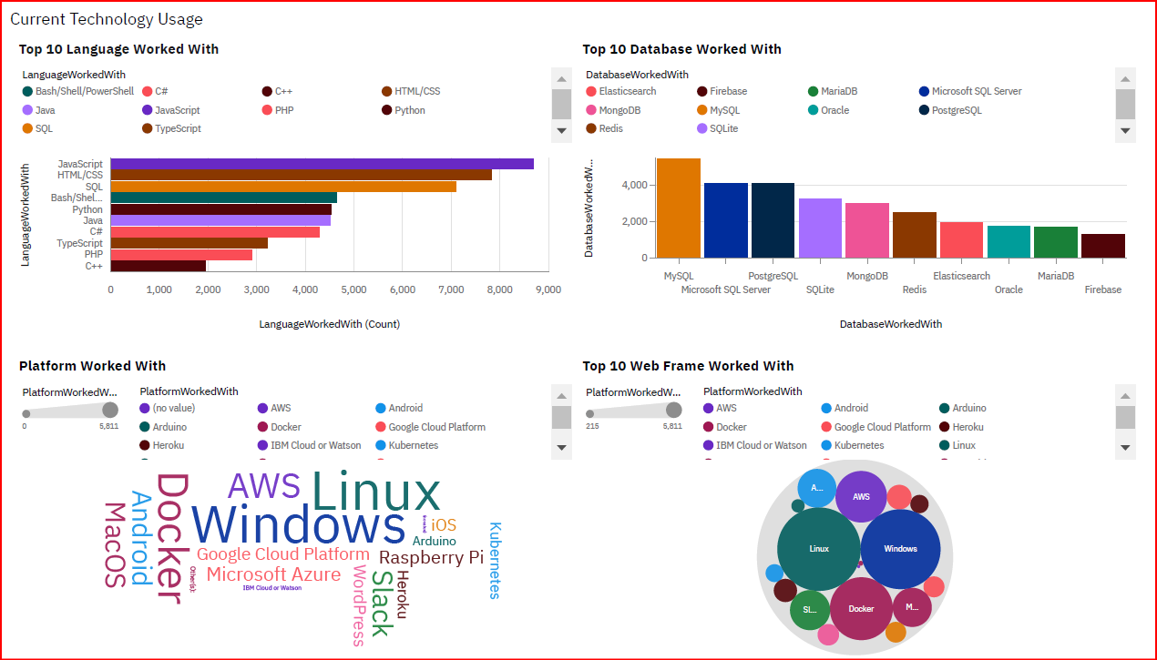
DASHBOARD TAB 1

Slide 13
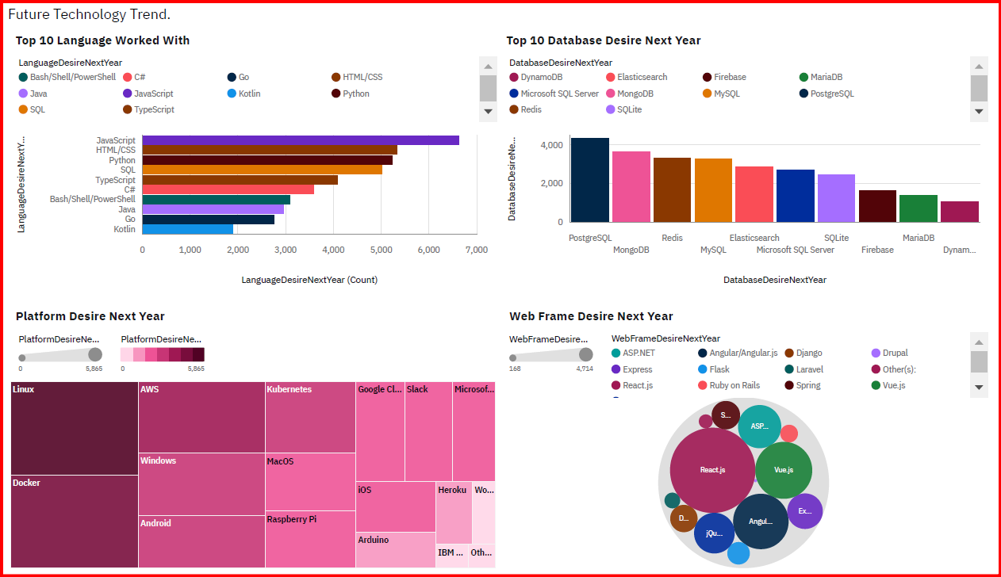
DASHBOARD TAB 2

Slide 14
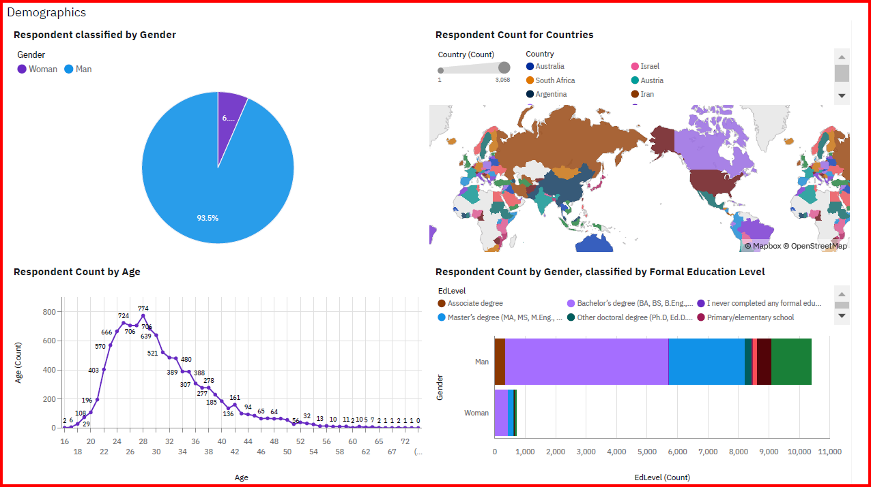
DASHBOARD TAB 3

Slide 15
DISCUSSION
Current & Future Technology Usage Trend
Gender, Age, Country and Education Discrimination in IT Industry

Slide 16
OVERALL FINDINGS & IMPLICATIONS
Findings
JavaScript widely used and TypeScript getting popular
Developers mostly located in developed countries
There are extreme gender and age
discrimination
Implications
JavaScript and TypeScript web
frames gaining fans
Young developers without postgrad studies on its majority
Gender gap and age gap will affect job hiring

Slide 17

CONCLUSION
Current & Future Technology Usage Trend
Programming Language, Database, Platform and Web frame
Gender, age, country, and education significantly influence workforce diversity, skills development, and market dynamics in the IT industry

Slide 18

APPENDIX
IBM Cognos Analytics
IBM Cognos Analytics is a comprehensive business intelligence and analytics platform that enables organizations to make data-driven decisions. It offers powerful reporting, dashboarding, and data visualization capabilities to uncover insights from diverse data sources

Slide 19
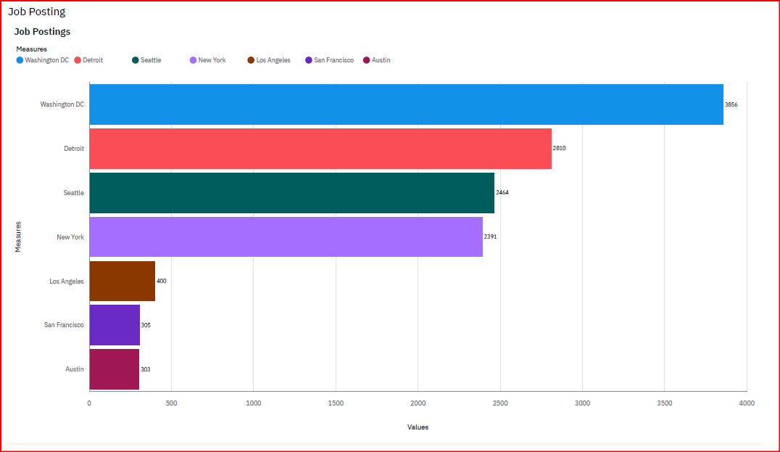
JOB POSTINGS

Slide 20
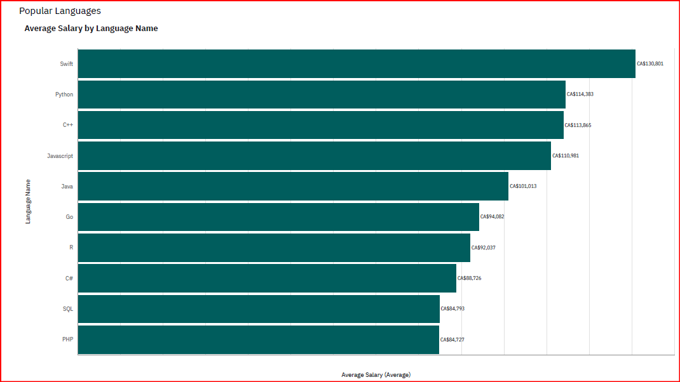
POPULAR LANGUAGES

Slide 21
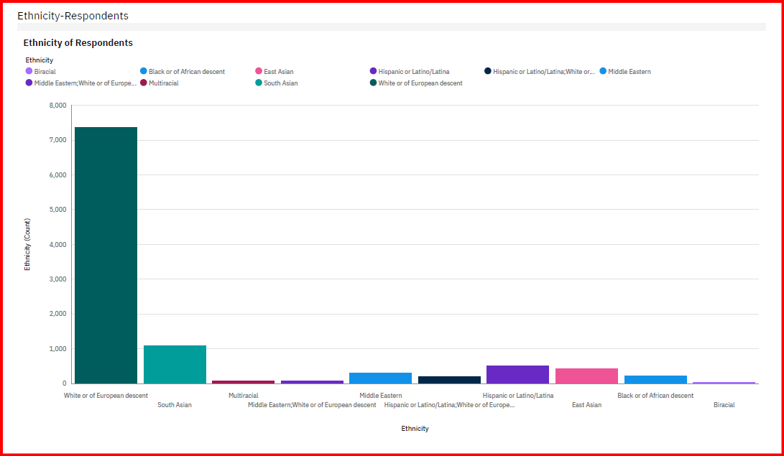
Ethnicity of Respondents

Slide 22
Thank you

