Slide 1
Title Slide
Forecasting Ambient Temperature with RNNs
Linear vs Sequence Models
Mintesnot Kassa, Fordham University

Slide 2
Problem Motivation
- Need accurate short-horizon forecasts
- Applications: HVAC, energy, scheduling
- Temperature shows strong cycles

Slide 3
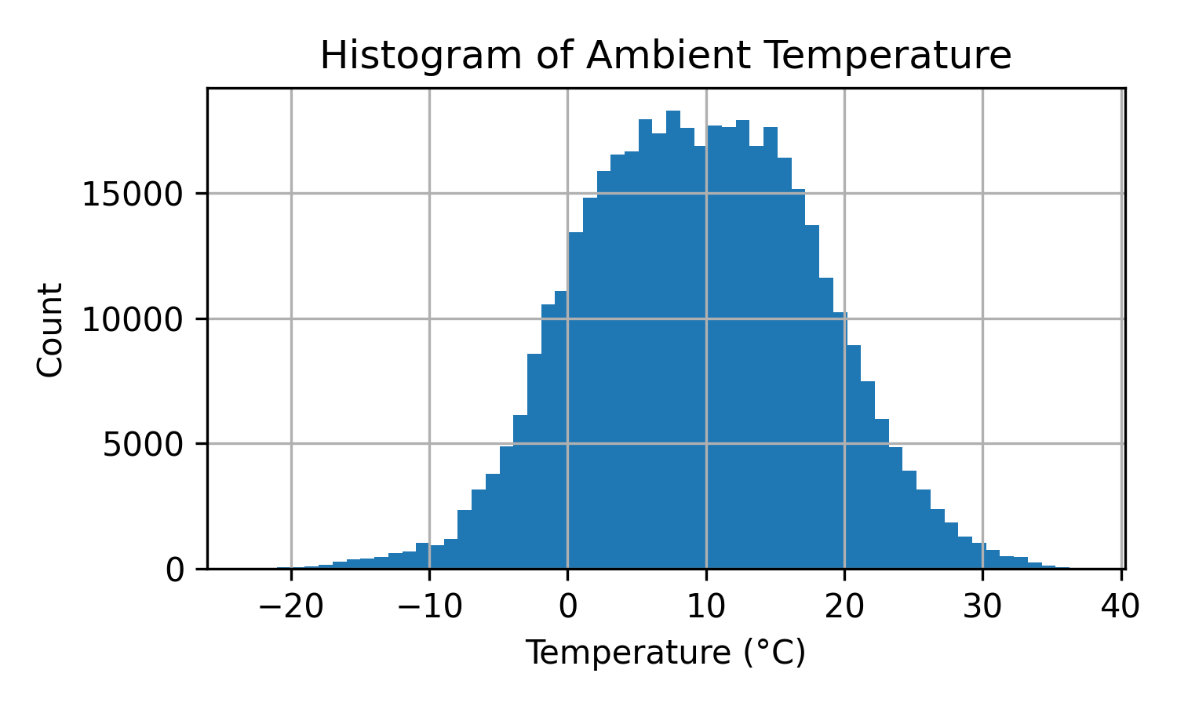
Dataset Overview
- Jena Climate Dataset (2009–2016)
- 10-minute resolution
- Multivariate weather variables

Slide 4
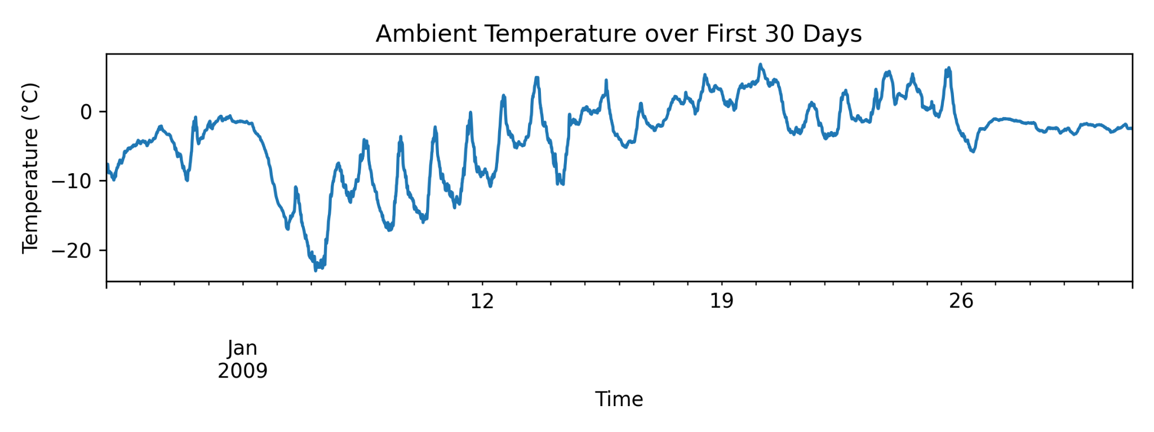
First 30 Days Visualization
Strong diurnal structure and weather variability.

Slide 5
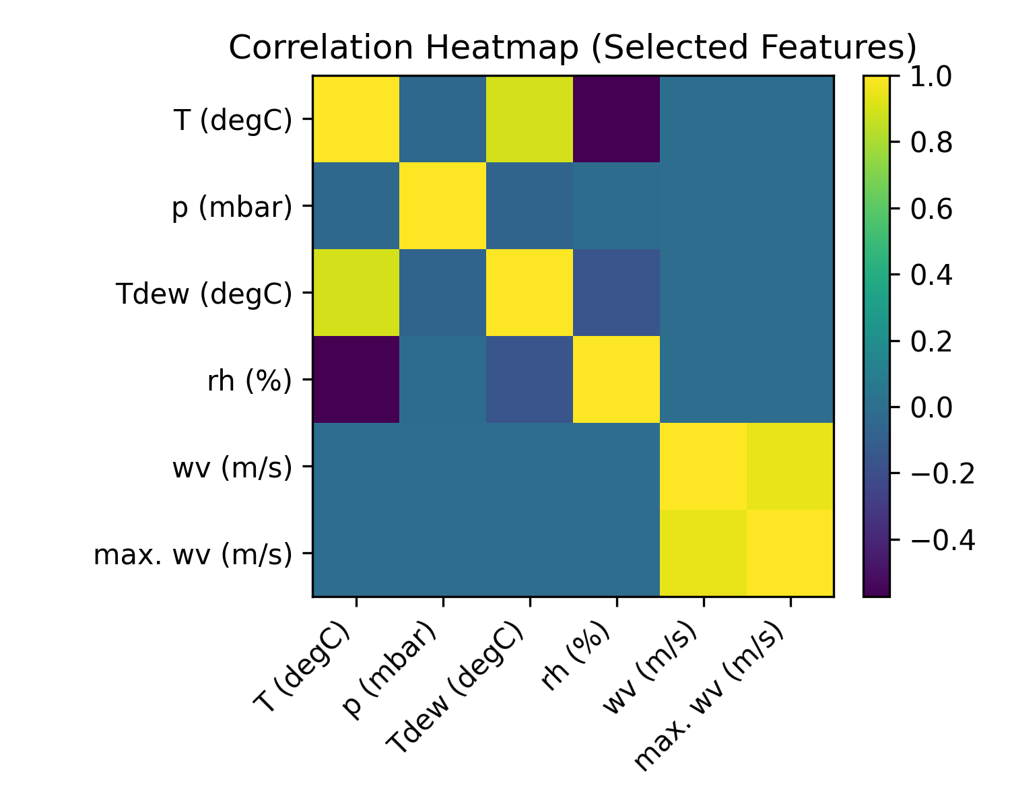
Correlation Analysis
Correlations among key meteorological features.

Slide 6
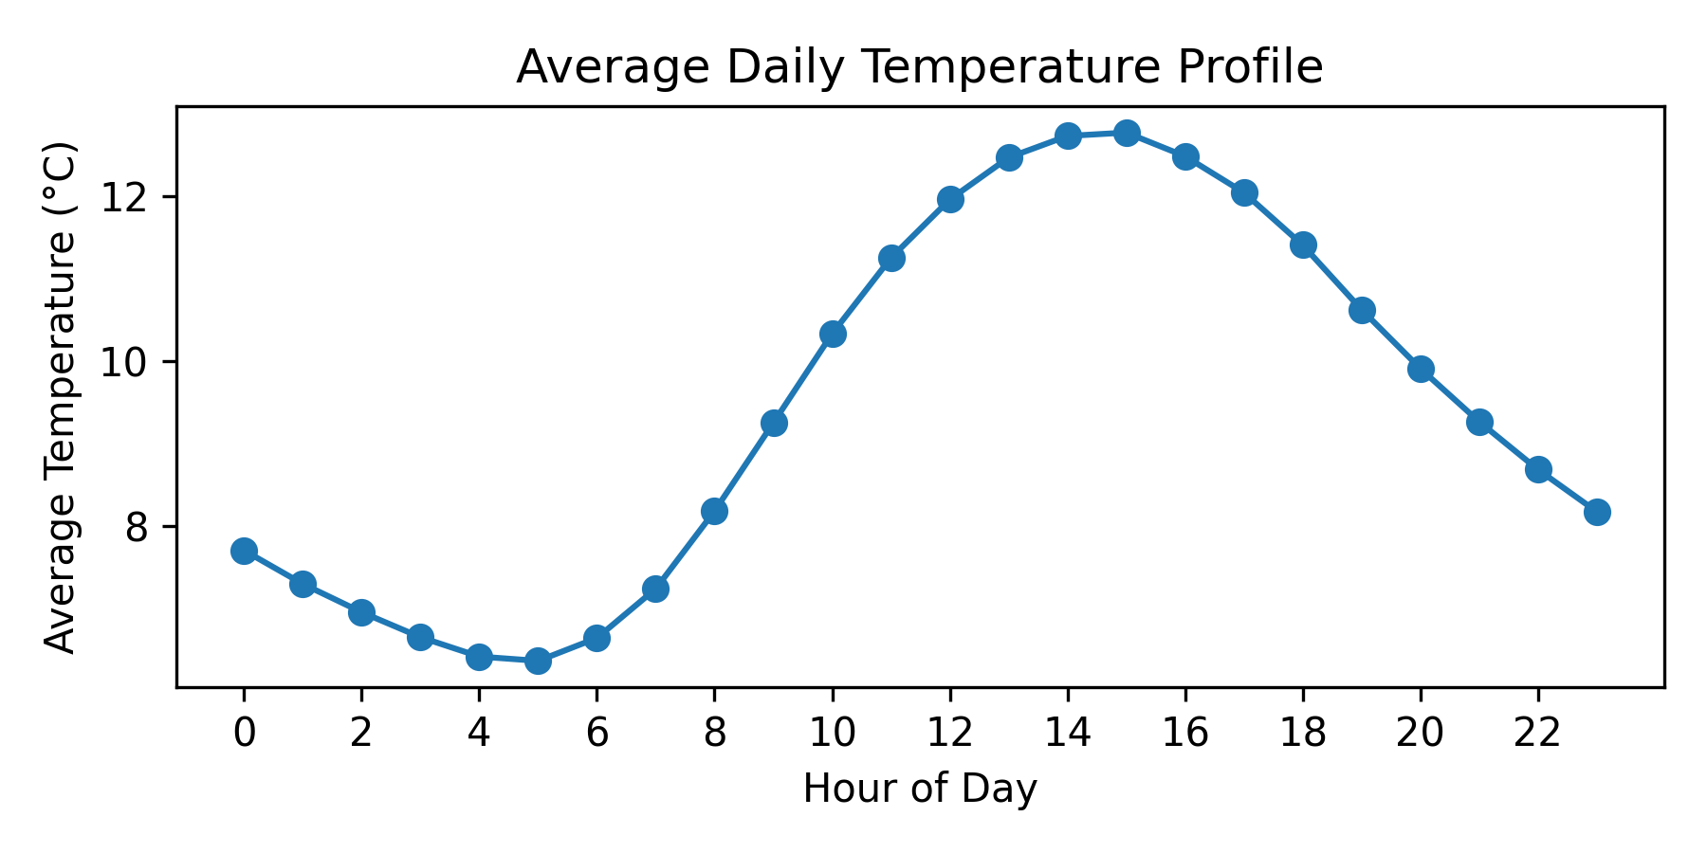
Daily Temperature Profile
Shows average diurnal cycle across dataset.

Slide 7
Windowing & Problem Setup
- History windows of 1,2,4,8 hours
- Forecast horizons: 1h, 2h, 6h
- Standardization applied

Slide 8
Models Compared
- Persistence, Linear, Ridge
- LSTM & GRU
- Adam optimizer, early stopping

Slide 9
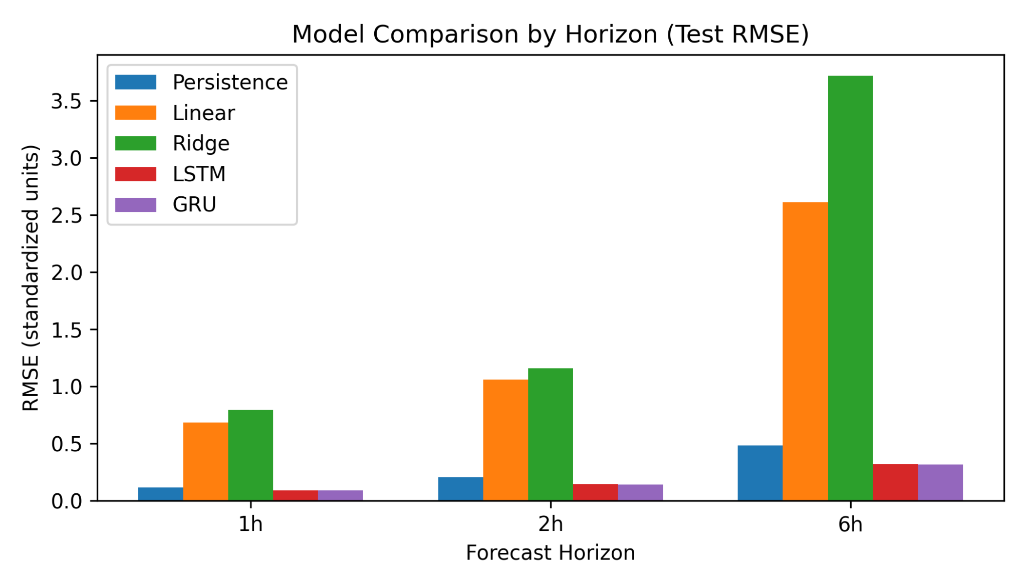
RMSE Comparison by Horizon
RNNs outperform at longer horizons, baselines strong at 1h.

Slide 10
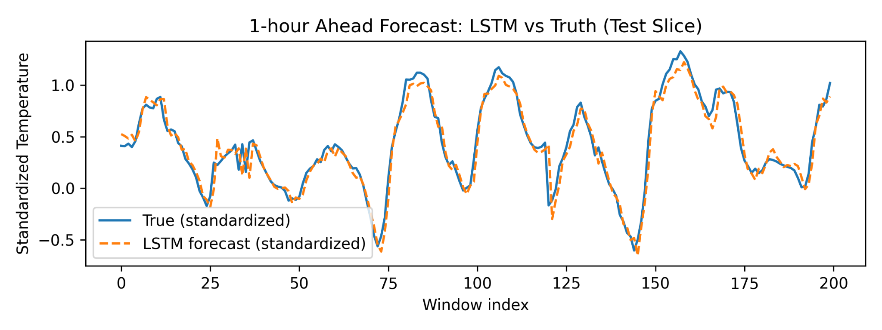
Forecast Example
LSTM prediction vs true temperatures on test slice.

Slide 11
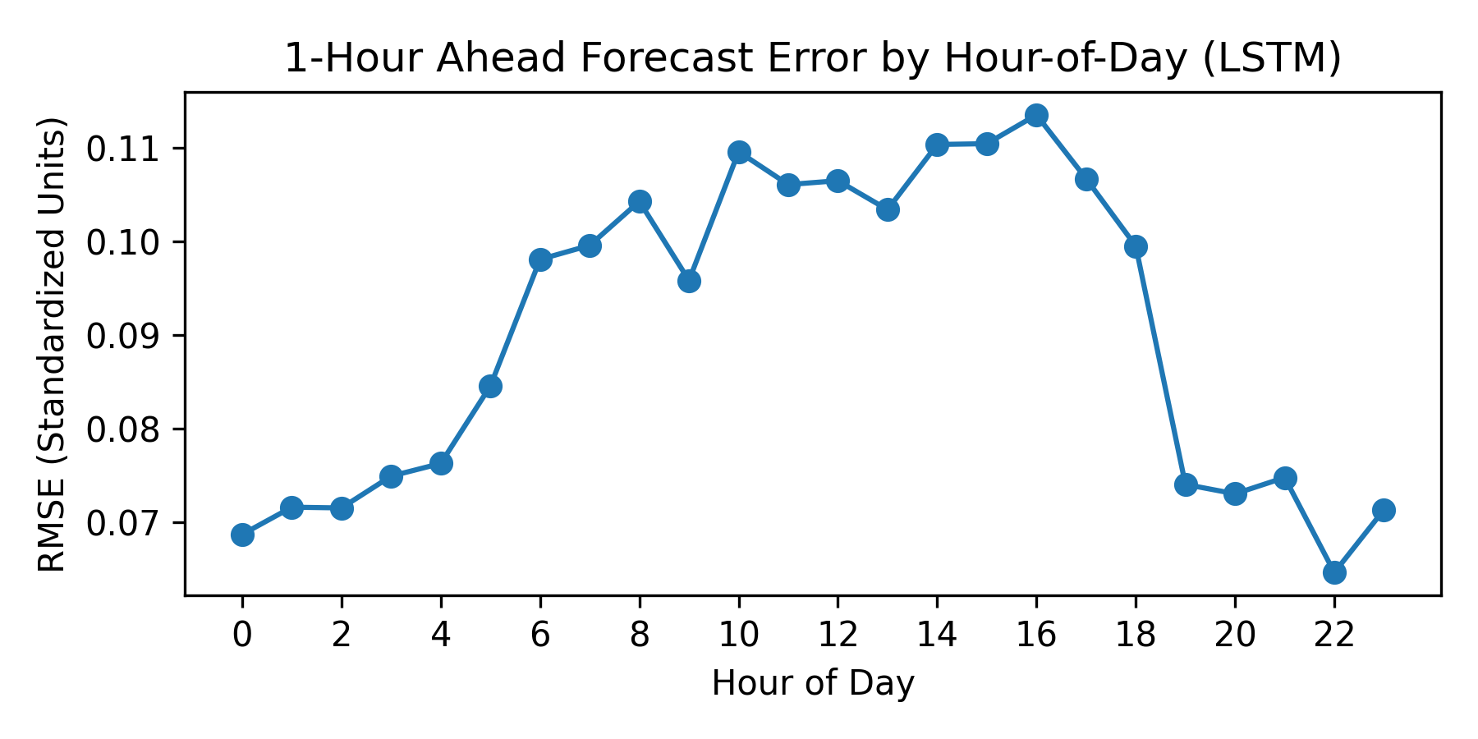
Error by Hour of Day
Higher error at dawn/dusk; smoother at midday.

Slide 12
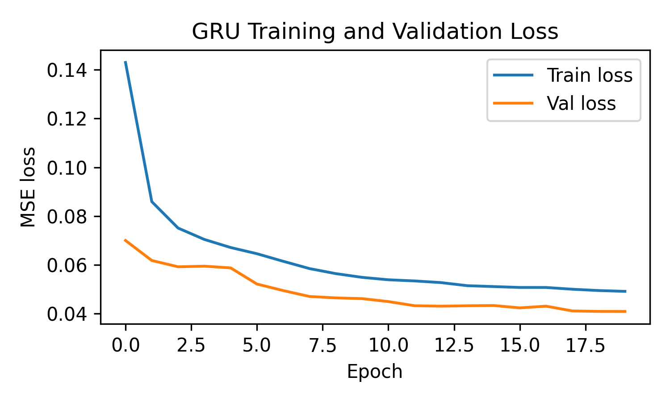
GRU Training Curve
Validation loss stabilizes after ~10 epochs.

Slide 13
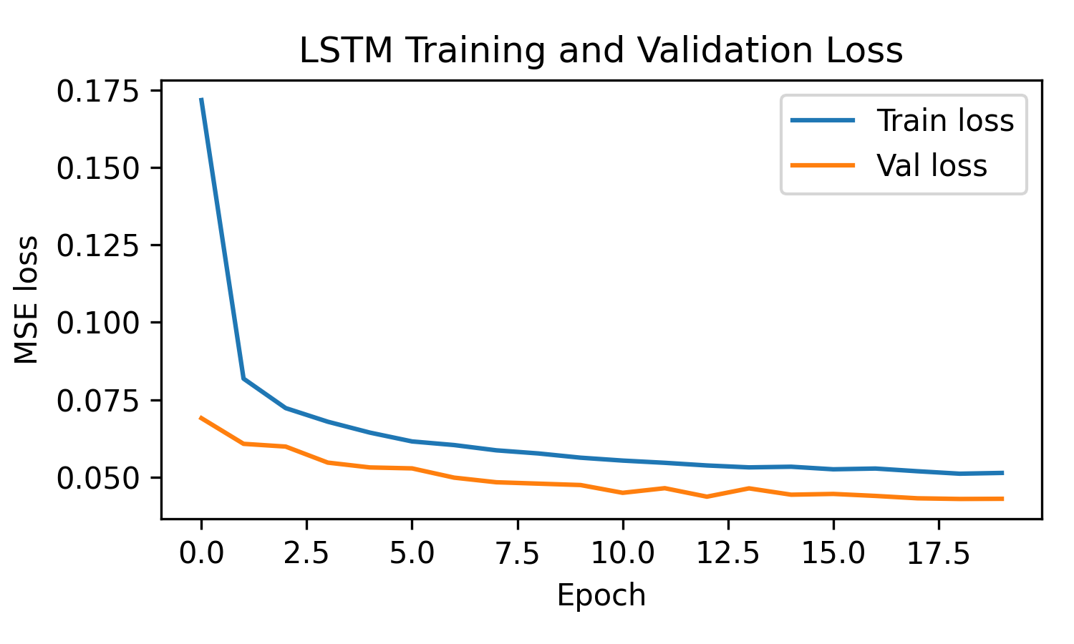
LSTM Training Curve
Shows similar convergence properties with slight variance.

Slide 14
Key Observations
- 1h: persistence nearly optimal
- 6h: RNNs clearly better
- Ridge reduces overfitting

Slide 15
Conclusion & Future Work
- Extend to TCN/Transformers
- Add seasonal variables
- Probabilistic forecasting

