Slide 1
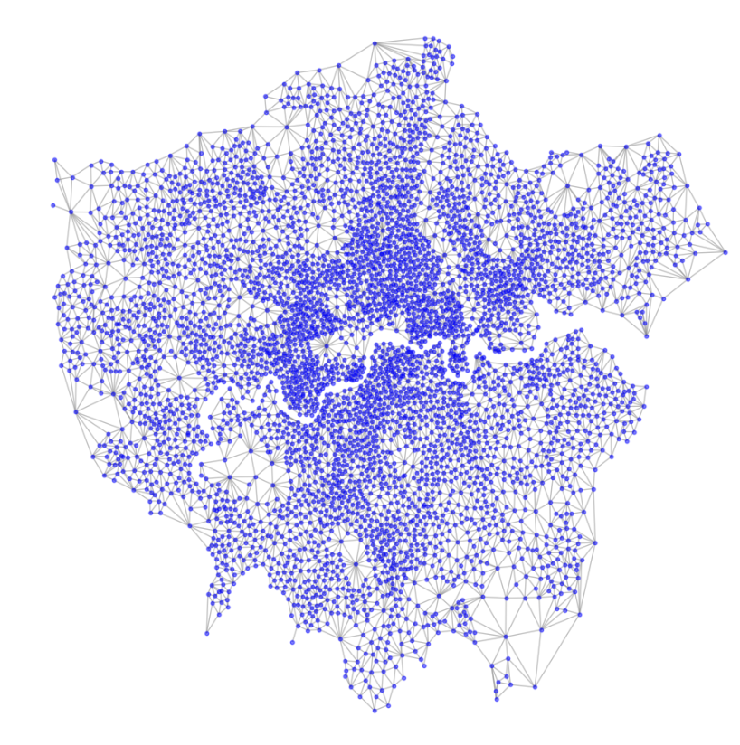
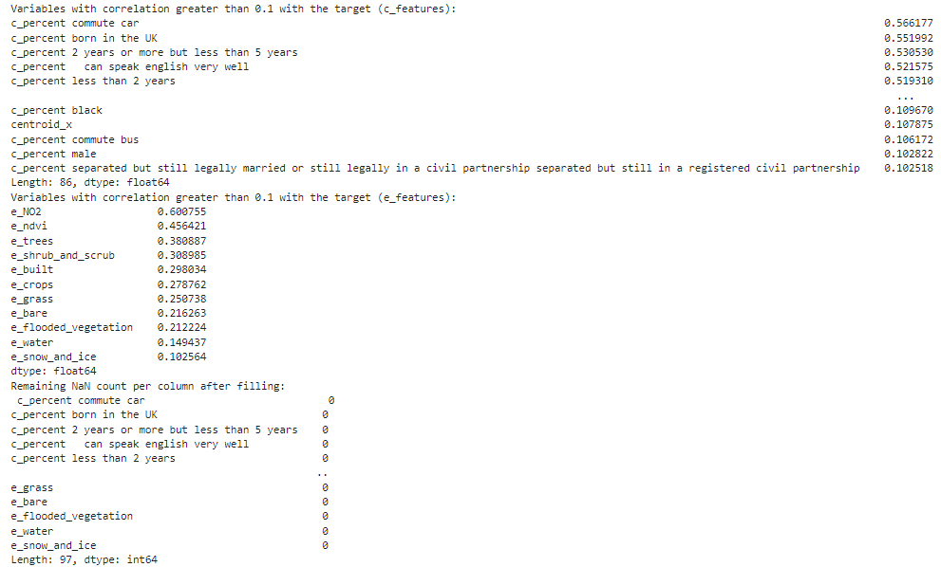
Week4 done
1. New network building method
Adjacency determination
-- Count all neighbors
New network significantly improves model performance
Currently only one layer of adjacency
which can be expanded further.
2. Variable relevance filtering
+ Processing of environment variables
Only variables with a correlation greater than 0.1 are extracted
Socioeconomic variables: 86
Processed environment variables: 11
Total independent variables: 97

Slide 2
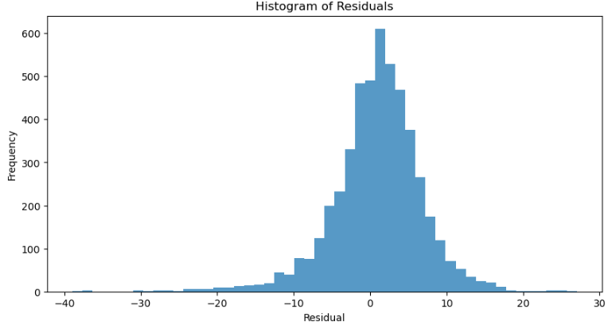
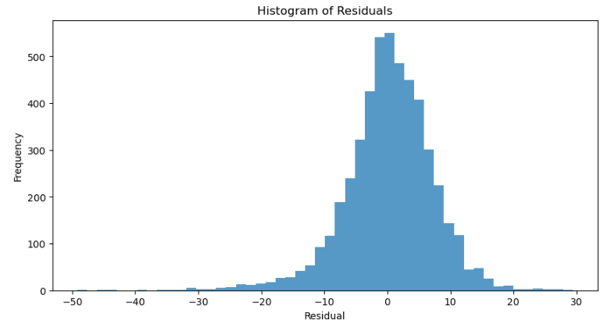
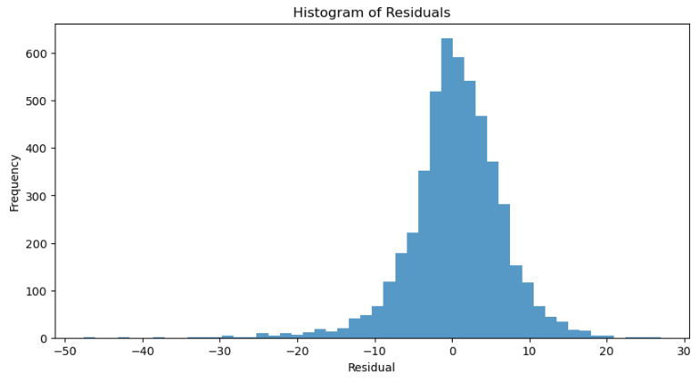
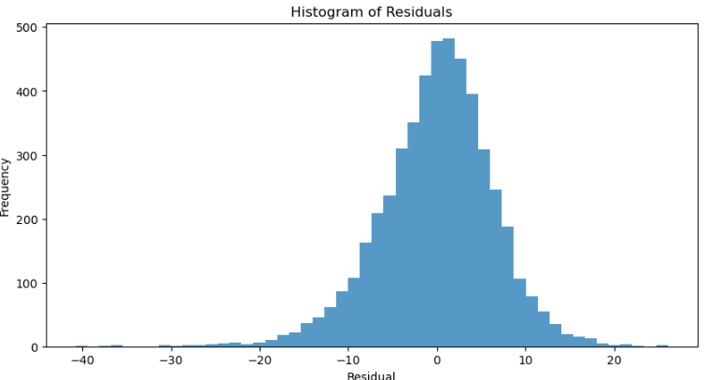
3. Multi-model results (in progress)
Metric | GAT | GCN | GIN | GraphSAGE
MSE | 37.1599 | 49.4870 | 37.0260 | 41.7905
RMSE | 6.0959 | 7.0347 | 6.0849 | 6.4646
MAE | 4.4602 | 5.2108 | 4.4394 | 4.9105
R² | 0.7747 | 0.6999 | 0.7755 | 0.7466
PARAMS | Best params: {'lr': 0.01, 'weight_decay': 0.0005, 'hidden1': 128, 'hidden2': 64, 'dropout': 0.3, 'num_epochs': 200}, Best loss: 59.0546 | Best params: {'lr': 0.01, 'weight_decay': 0.0005, 'hidden1': 128, 'hidden2': 32, 'dropout': 0.3, 'num_epochs': 200}, Best loss: 55.6451 | Best params: {'lr': 0.01, 'weight_decay': 0.005, 'hidden1': 32, 'hidden2': 64, 'dropout': 0.3, 'num_epochs': 200}, Best loss: 53.9741 | Best params: {'lr': 0.01, 'weight_decay': 0.005, 'hidden1': 32, 'hidden2': 64, 'dropout': 0.3, 'num_epochs': 200}, Best loss: 58.9711

Slide 3
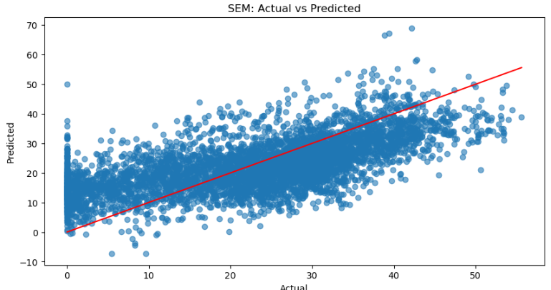
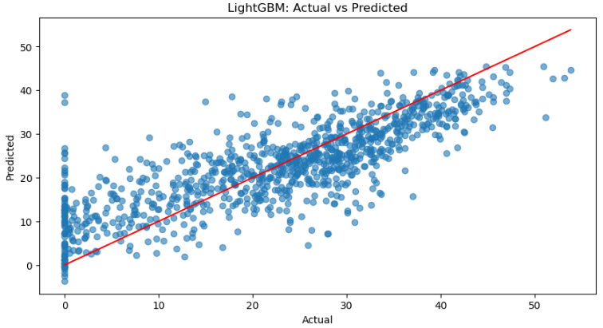
4. Baseline Models
Metric | SEM | LightGBM | GWR(working) | SLM(working)
MSE | 95.6151 | 56.5933
RMSE | 9.7783 | 7.5229
MAE | 7.9630 | 5.7204
R² | 0.4202 | 0.6523

Slide 4
Next
1. Further complete the model testing and summarize
GNN models still need further optimization.
SLM has outliers that make the model almost unusable and needs further study.
GWR is not in the proposal, but I want to see the results. There is currently a problem of insufficient computing power.
2. Try other dependent variables
Currently only focusing on anxiety disorders.
3. Plot the appropriate model results. Explore the vacuum boundary

