Slide 1
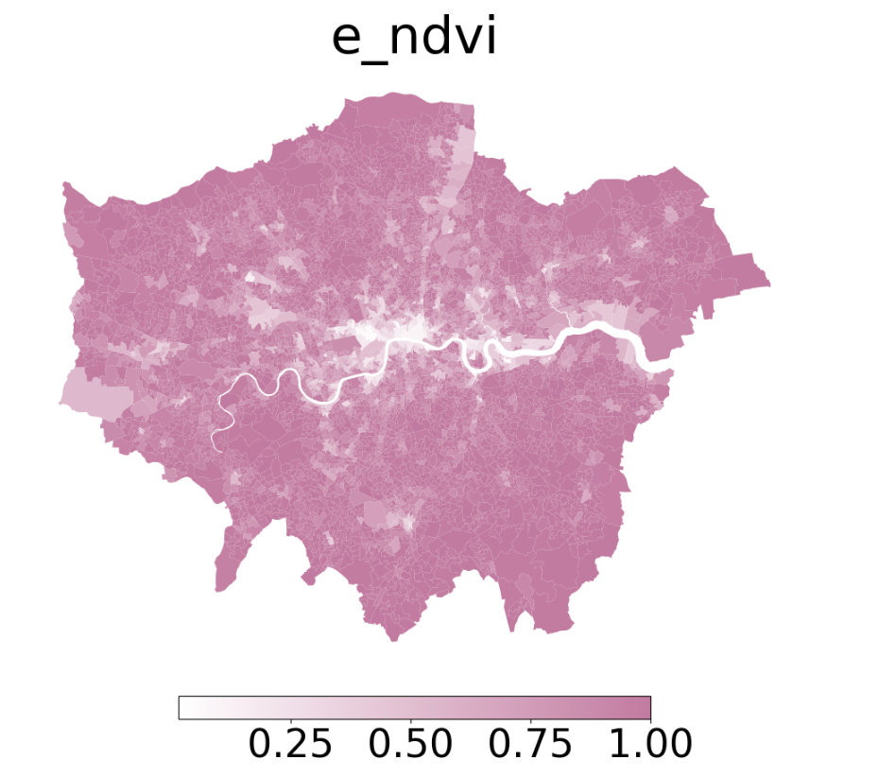
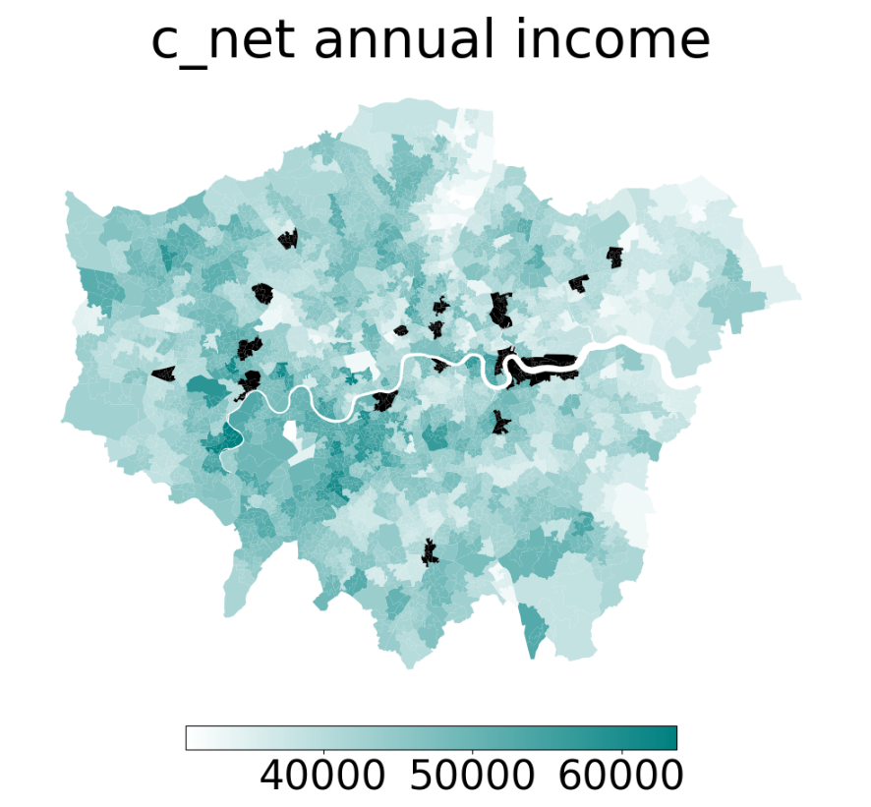
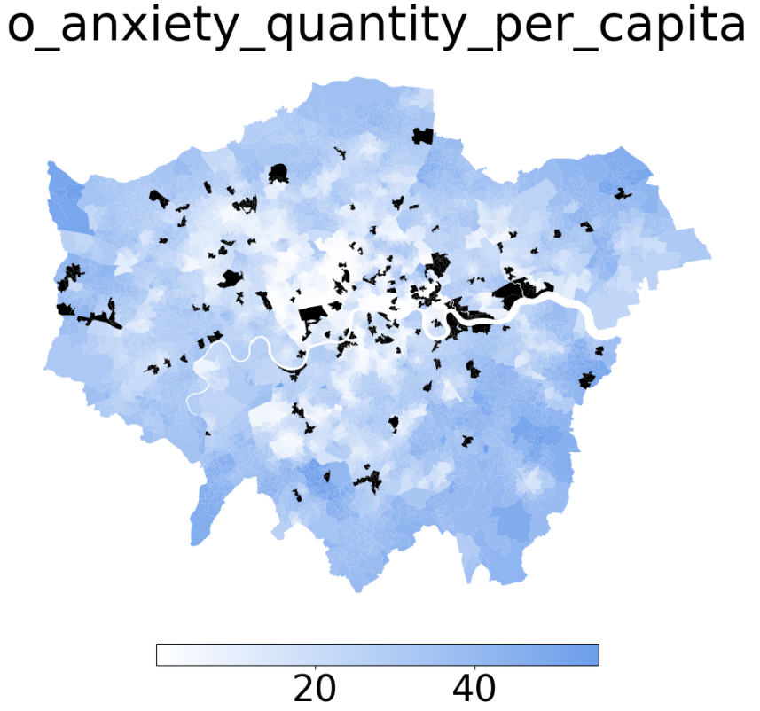
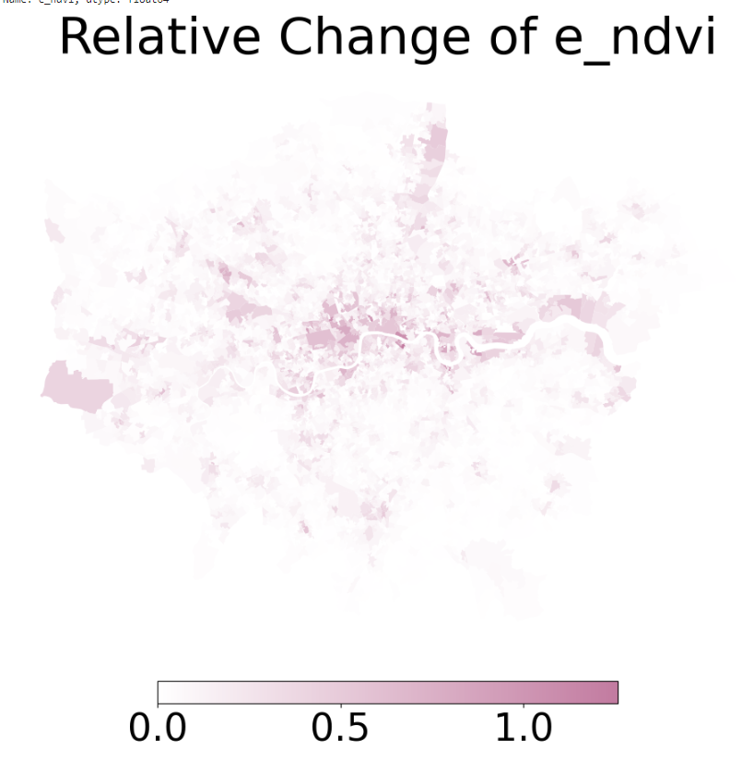
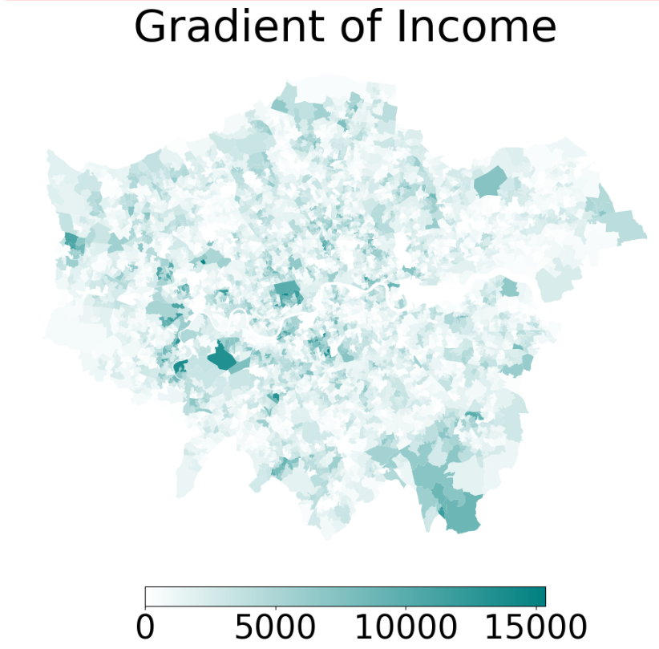
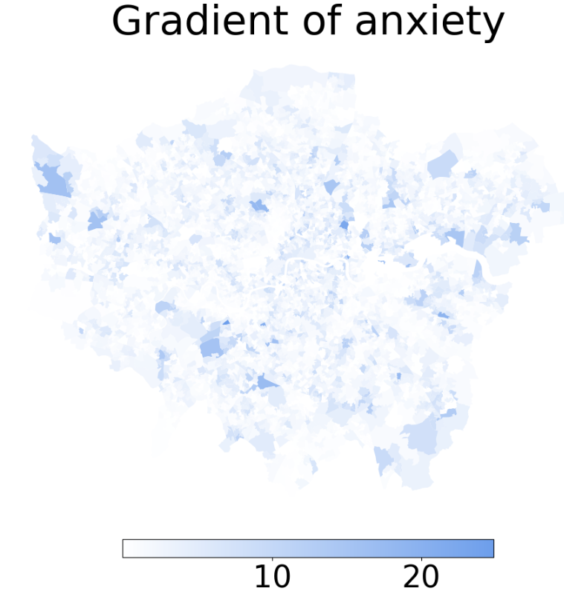
Week5 Done
1. Plotting gradients to explore the border vacuum

Slide 2
Week5 Done
2. Variable selection tests
VIF values for fixed features:
Commonly used "control" Variable VIF
c_age_median 174.6072421
c_percent white 17.6227232
c_percent male 146.2038513
c_net annual income 95.2651924
c_percent 2. Professional occupations 21.6431705
e_ndvi 35.981782
It is not possible to use fixed variables and iteratively calculate VIF to select independent variables
Iterating all social-economic variables – still not reasonable enough
Variable VIF
0 c_percent asian 8.521565
1 c_percent black 5.348247
2 c_percent buddhist 3.067861
3 c_percent muslim 8.489626
4 c_percent no central heating 7.249610
5 c_percent communal heating 1.747646
6 c_percent commute on foot 7.167117
7 c_percent commute metro rail 6.406851
8 c_percent commute bicycle 5.290857
9 c_percent commute train 5.403677
10 c_percent student moved to address 2.789924
11 c_percent outside UK moved to address 4.579646
12 c_percent occupancy rating bedrooms+2 5.906992
13 c_percent occupancy rating bedrooms -2 6.509869
14 c_percent 5. Skilled trades occupations 9.320388
15 c_pop_density 5.198822
16 c_percent Aged 85 years and over 4.747272
17 c_percent married or in a registered civil par... 2.918438
18 c_percent married or in a registered civil par... 7.717885
19 c_percent married or in a registered civil par... 6.935149
20 c_percent separated but still legally married ... 1.182923
21 c_percent divorced or civil partnership dissol... 1.559882
22 c_percent cannot speak english 4.477672
23 c_percent households deprived in four dimensions 2.423713

Slide 3
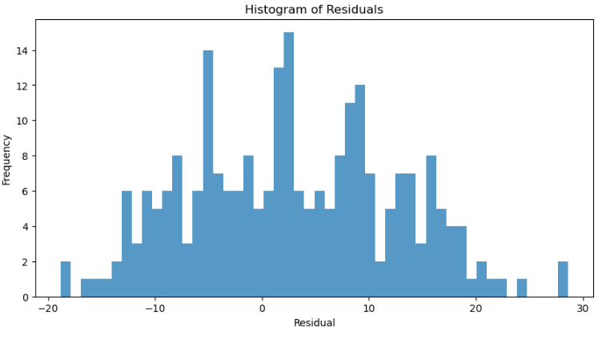
Week5 Done
3. Model generalization test
The model is not very general
Almost a random distribution
It may be related to variable selection
and further attempts are needed
4. Try to achieve Daniele's approach
For adjacent nodes i,j.
The difference between the target variables (which can be IMD or prescription results) between i and j is used as the attribute of edge b_ij.
Train GNN and predict the edge attributes between nodes through adjacent nodes.
Node variables for prediction
1.The proportion of all land use types
2. construction area
3. slope?
4. what’s more?

Slide 4
By the Week 5
Completed
Preprocessing of the dataset
Adjacent Network
Architecture of various GNN models
Baseline models
Plotting distribution and results
Outlook
variable selection(VIF, Expertise)
optimal model and parameters(GAT&GIN model is currently the better)
Model generalization test
Exploring the border vacuum:
i.Establish edges based on the existing network
ii. Take the confidence of the existence of the vacuum boundary as the edge attribute
iii. Add appropriate environment variables to the node
iv. Predict edge attributes by node

