Slide 1
Week6 Done
Variable selection
Variable VIF
0 c_percent Aged 10 to 14 years 33.804457
1 c_percent Aged 15 to 19 years 15.740946
2 c_percent Aged 20 to 24 years 29.972500
3 c_percent Aged 25 to 29 years 22.826171
4 c_percent mixed 18.046342
5 c_percent 2. Professional occupations 47.457447
6 c_pop_density 6.231285
7 e_water 5.383448
8 e_trees 5.353664
9 e_grass 5.390388
10 e_bare 19.428156
11 c_percent asian 19.745475
12 c_percent black 17.196204
13 c_percent white 49.316295
14 c_percent buddhist 3.204071
15 c_percent muslim 11.691214
16 c_percent no central heating 8.330519
17 c_percent communal heating 1.815892
18 c_percent TFW less than 2km 33.118072
19 c_percent 49 or more hours worked 22.570283
20 c_percent commute on foot 30.800237
21 c_percent commute metro rail 10.045420
22 c_percent commute bus 18.317356
23 c_percent commute bicycle 6.371253
24 c_percent student moved to address 5.602587
25 c_percent occupancy rating bedrooms -2 7.972093
26 c_percent occupancy rating bedrooms -1 36.050365
27 c_percent occupancy rating rooms -1 26.467091
28 c_percent 10 years or more 48.512881
29 c_percent 2 years or more but less than 5 years 19.937812
30 c_percent 5 years or more but less than 10 years 25.247330
31 c_percent married or in a registered civil par.. 3.090496
32 c_percent married or in a registered civil par... 7.868680
33 c_percent married or in a registered civil par... 7.048819
34 c_percent separated but still legally married ... 1.189716
35 c_percent divorced or civil partnership dissol... 1.582907
36 c_percent cannot speak english well 22.450593
37 c_percent cannot speak english 6.997153
c_percent households deprived in four dimensions 2.974711
c_percent Aged 30 to 34 years 52.606991
c_percent Aged 35 to 39 years 62.327100
c_percent Aged 40 to 44 years 62.851638
Red ones represent fixed variables
Blue ones will lead to a surge in VIF, but for anxiety disorders, these ages may be relevant.
Other variables are the best combination of low VIF

Slide 2
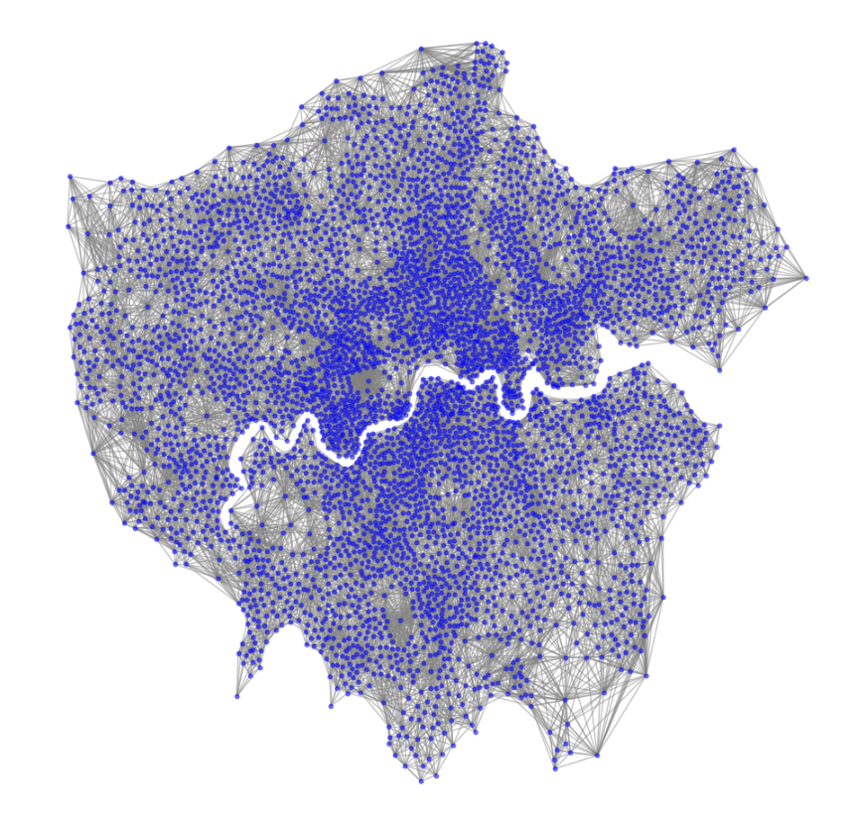
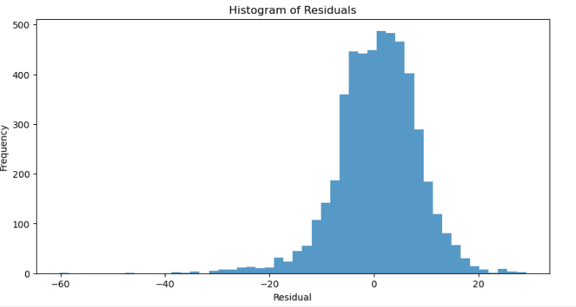
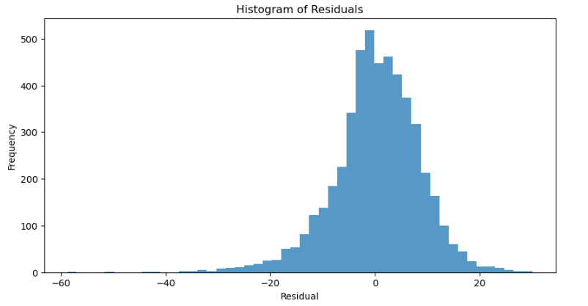
Week6 Done
2. Two-layer neighbor network
With GIN, it performs better than the previous network.
The simplest GIN model test | RMSE | MAE | R2
New Network | 7.6966 | 5.8995 | 0.6408
Original Network | 8.3367 | 6.2843 | 0.5786
New
Original

Slide 3
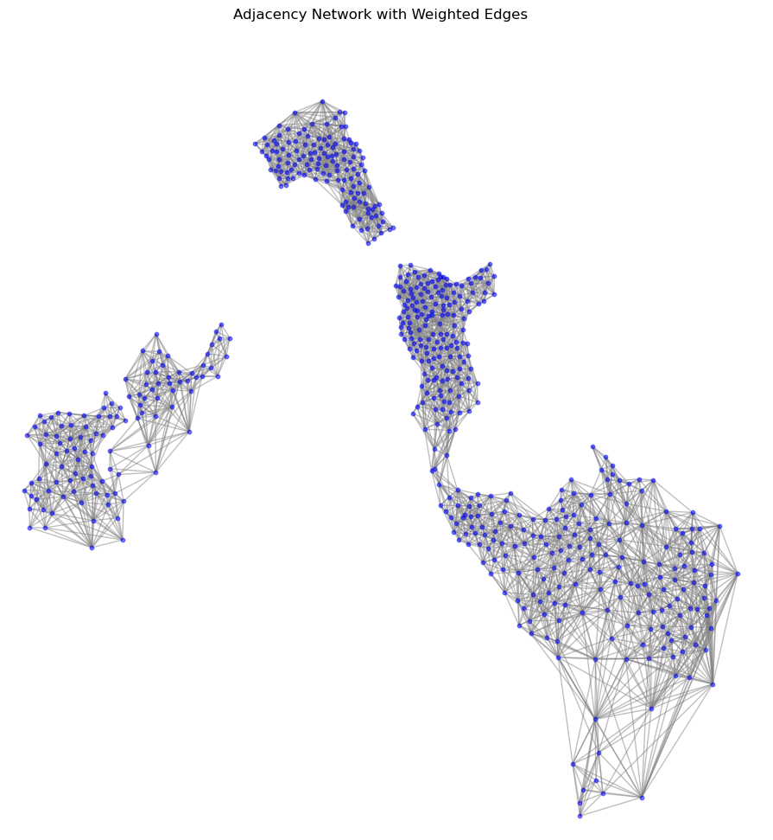
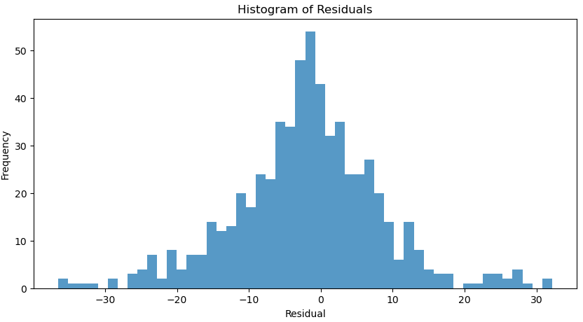
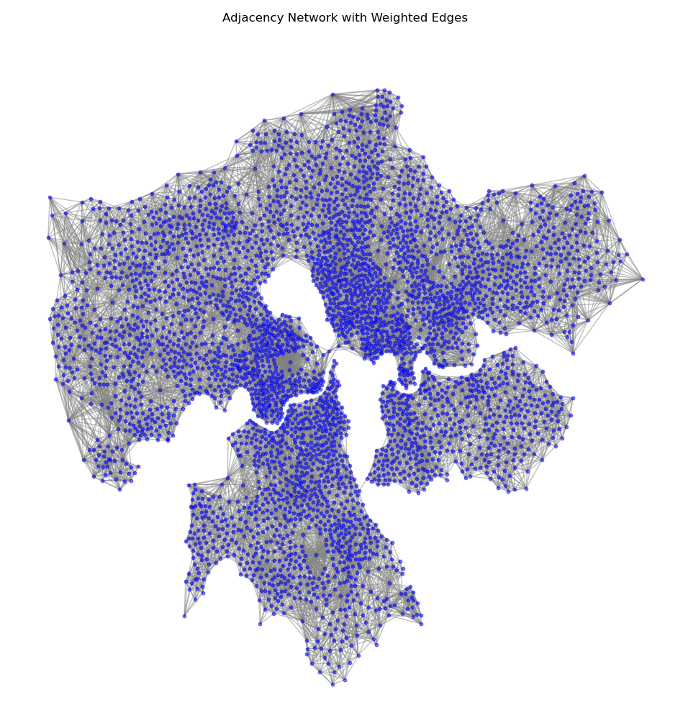
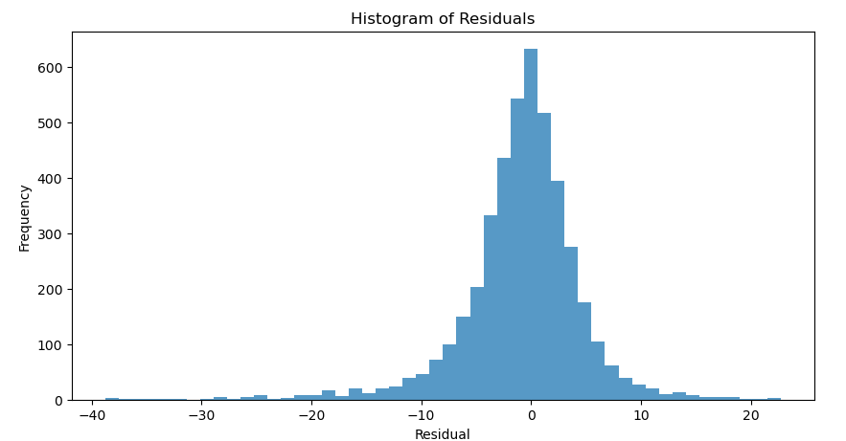
Week6 Done
3. Model generalization test
Improvements from last week：
Increase the number of samples from 170 to 650
Consider neighbors of split region boundary points
Measures to prevent overfitting
Random Search - Early Stopping GIN | RMSE | MAE | R2
Subset of the training set | 5.5228 | 3.7009 | 0.8078
Testing set | 10.3577 | 7.6818 | 0.4870
Trying to further prevent the overfitting problem?
Or maybe there are some sub-patterns distribution.
Try more areas to check.

Slide 4
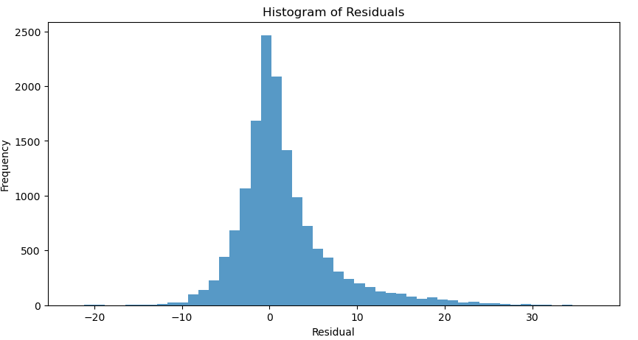
Week6 Done
4. Border Vacuum
Current node features:
'e_ndvi', 'e_water', 'e_trees', 'e_grass', 'e_bare','e_built','e_shrub_and_scrub’,
'e_crops','e_flooded_vegetation’
How to improve?
Edge visualization is a problem :
Current idea -- value of the edge difference is used as the probability that there is a border vacuum between two nodes?
Random Search GIN | RMSE | MAE | R2
Edge_Diff Prediction | 5.6656 | 3.6751 | 0.3369

Slide 5
Next
Variable selection and network construction determined
-- Framework to predict all prescription outcomes
2. Which node variables are related to border vacuum?
3. Border vacuum visualization problem
4. Still a little confused about how to identify border vacuum.

