Slide 1
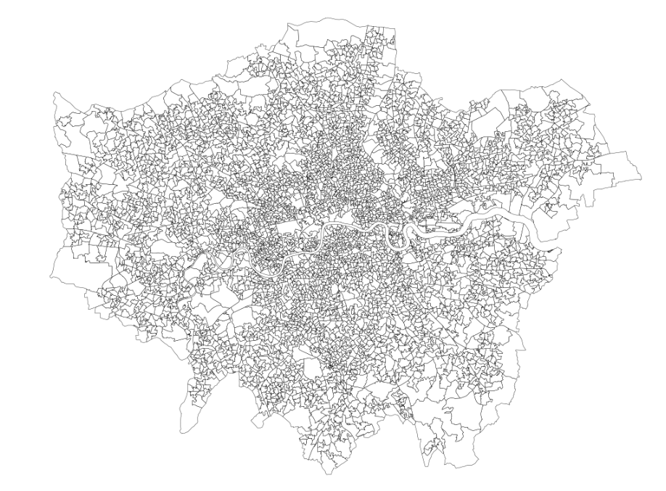
Week2 done
GIS operations
Including clipping, spatial joining, boundary correction, extraction of London-wide LSOAs via UK LSOAs boundaries of 2022.
shape(4994, 167)
Get Familiar with the dataset
Get familiar with variable distribution
Compare data structure with the description in the MEDSAT paper -- The dataset meets the description
Plot maps for checking

Slide 2
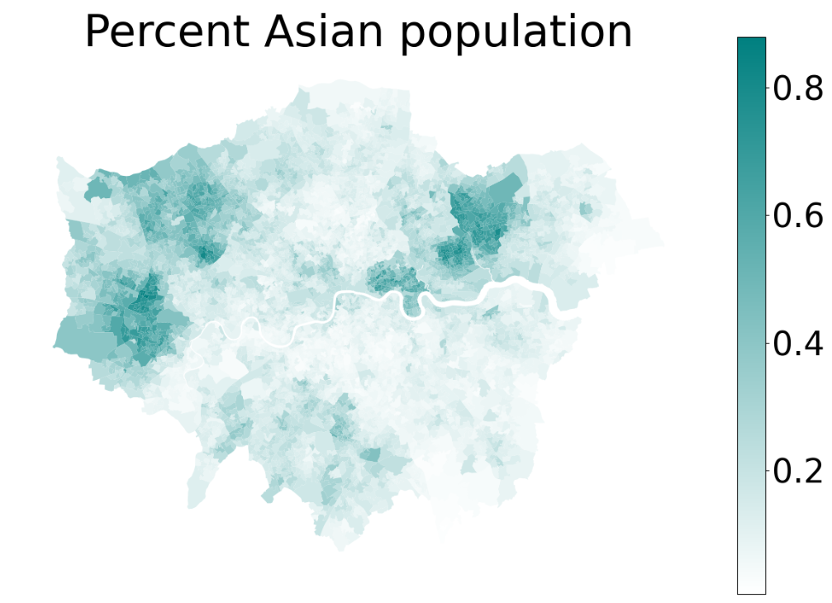
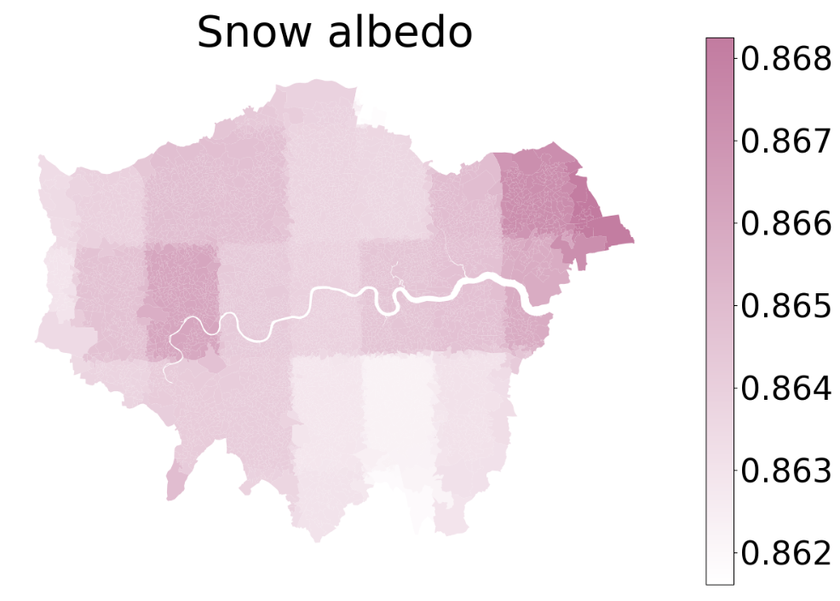
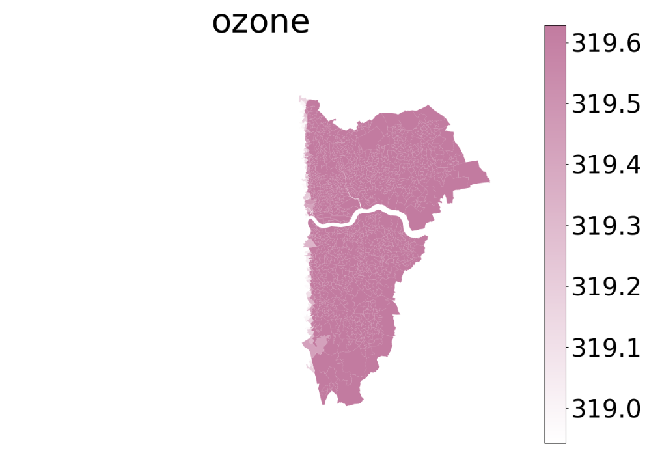
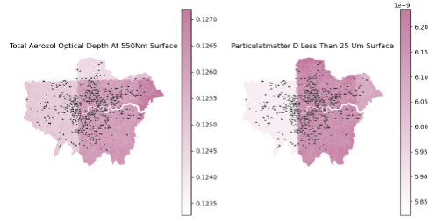
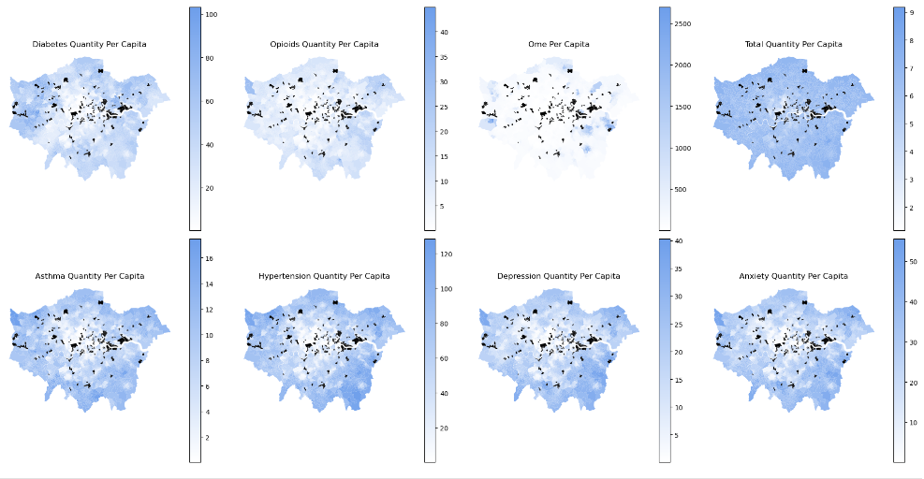
Week2 Questions
Data resolution and missing issues
Type A. All Socioeconomic – great Type B.RS(environmental factor) Type C. RS - A lot of missing content
small amount of missing income data - some Lower resolution in London range Discard fields? Only “OZONE” 1 filed so, lots of duplicate values ​​- still usable (still indicate regional differences?)
Type D. RS - Coarse resolution with missing values Type D. Missing LSOAs (335 / 4997)
Missing values ​​can be filled with swath value 1. Discard these LSOAs -- Relatively small proportion
Coarse resolution – may still discard fields like this does not affect the exploration of residual distribution (i.e. vacuum boundary)
2. Mean filling

Slide 3
Next
Keep learning GNN model methods
https://www.youtube.com/watch?v=0YLZXjMHA8&list=PLV8yxwGOxvvoNkzPfCx2i8an--Tkt7O8Z&index=3
https://seunghan96.github.io/gnn/PyG_review1/
https://colab.research.google.com/drive/16GBgwYR2ECiXVxA1BoLxYshKczNMeEAQ?usp=sharing
https://gist.github.com/rohithteja/677f71357cc73f1a2d9294736908d8e2
Build the simplest GCN model to view the result
Data structure organization
Null value preprocessing – KNN fill
Simple cross-validation, hyperparameter optimization

Slide 4
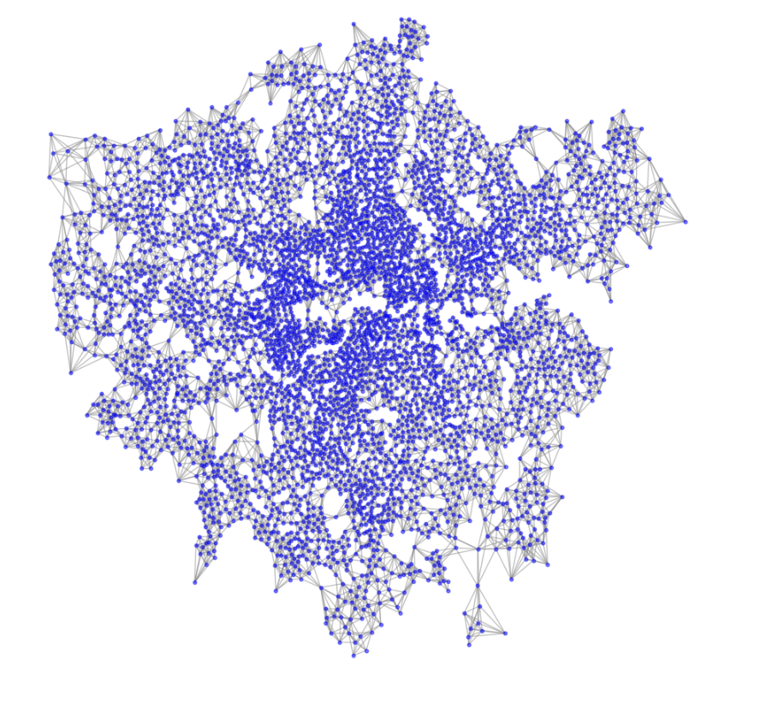
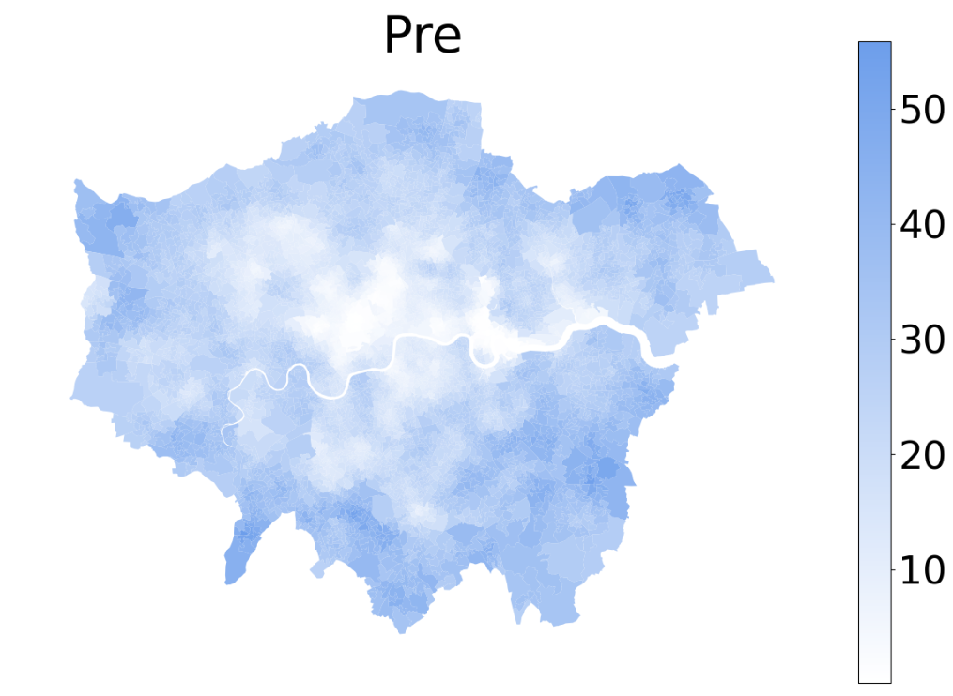
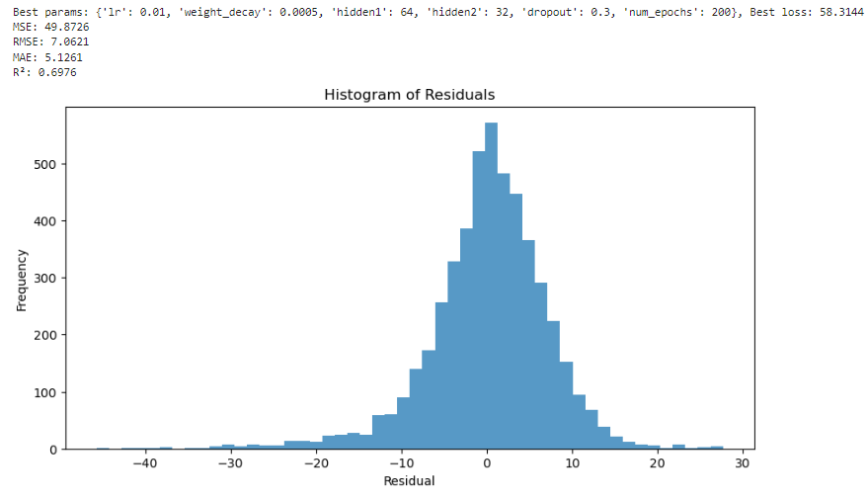
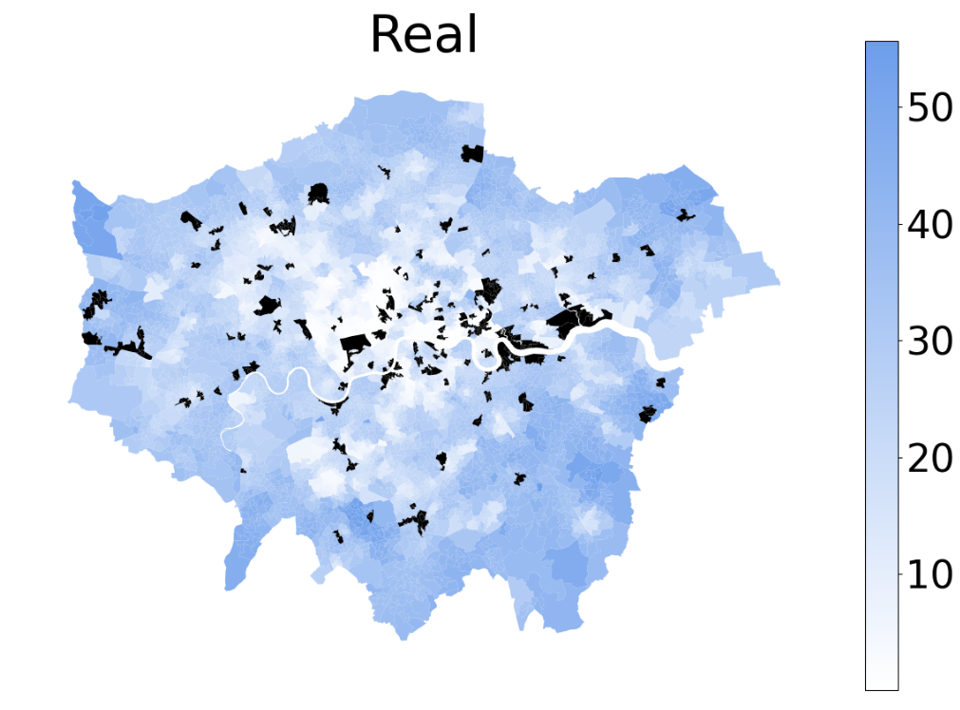
Week3 Completed
The GCN model was used for prediction
All socioeconomic variables were used as independent variables.
Predictions for anxiety disorders
KNN(K = 3)

Slide 5
Week3 Questions
Currently, Environment variables are not introduced
Because of the poor results
Further optimize the network model
Optimized feature engineering(Dimensionality reduction, aggregation…)
GAT (Graph Attention Network)
Combined with road network weights
Consider how to incorporate environmental variables (remote sensing data)
Extracting land use、built environment characteristics
ML models to explore and solve vacuum boundary problems？

Slide 6
Next
Build a slightly more complex model to try to improve the prediction accuracy.
Implement the SLM and LightGBM from MEDSAT
and compare the results.
Analyze the importance of each variable?
Extracting land cover and other variables from MSS images.
Consider how to incorporate this environmental variables.

