Slide 1
Time-Series Approach for Forecasting the Number of Hospital Daily Discharged Inpatients
Zhu, Ting, et al. "Time Series Approaches for Forecasting the Number of Hospital Daily Discharged Inpatients." IEEE journal of biomedical and health informatics (2015).
Minzhe Zhang
3/30

Slide 2
Outline
Introduction of the Study
Models
Seasonal Regression ARIMA (SRARIMA)
Multiplicative Seasonal ARIMA (MRARIMA)
Combinatorial Model of MSARIMA and Weighted Markov Chain
Models Assessment
Discussion
Notes:
The author proposed three models for this study, they are …,

Slide 3

Introduction
Place: West China Hospital (WCH)
Situation: overcrowding and bed management
4800 licensed bed, over 6000 patients in waiting list
bed quota depends on the expected available bed next day
expected capacity (patient discharged)
occupied
For patients in waiting list
For emergent request
Notes:
The situation is the WCH like many other top hospital in China is facing the problem of being overcrowded and need more effective health care resource allocation, especially bed management.
Each day, majority of bed is occupied, but there is some expected capacity to be available next day because of patient discharged.

Slide 4
Question
Uncertainty
high possibility that planned patients cannot be discharged (changes in the illness state, postponed MRI/CT, etc.)
Overestimate of bed capacity leads to cost-related overflow and emergency admission delay
Question
Is there a way to anticipate today how much bed capacity we will have tomorrow?
Notes:
There is some uncertainty in terms of the expected capacity. Because there is

Slide 5
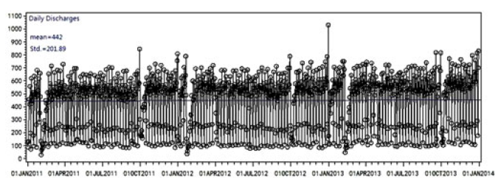
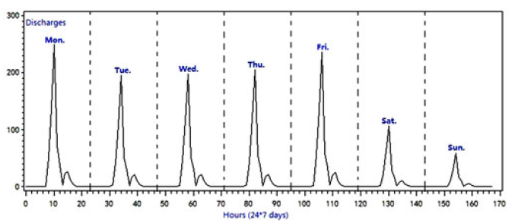
Data
Jan 1st, 2011 – Dec 31th, 2013; total S = 1096 days, 484 222 records.
First 877 observations (80% of S) for training
Remaining 219 observations (20% of S) for testing
Notes:
1. In the preliminary analysis, we can clearly see seasonal patterns in the plot.
2. Weekday has more discharged patients than weekend, and among weekdays, Monday and Friday has higher numbers of patients discharged

Slide 6

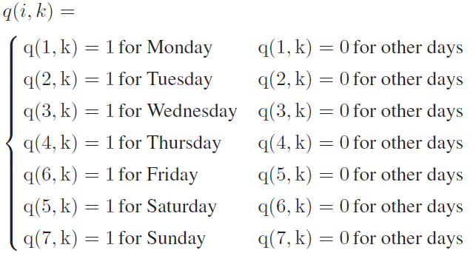


Seasonal Regression ARIMA (SRARIMA)
Seasonal effect forecast
Assume day-of-the-week effect
Regression residuals
Fit the residuals to ARIMA (p, d, q)
k: day index
q_{i,k}: dummy variable for seasonal effect
From BIC criteria, ARIMA (1, 0, 1) model was fitted.
Notes:
It takes three steps. First it regress the daily discharged value on the day index along with the dummy variables to model the seasonal effect.
If we assume it is the day-of-the-week effect, we have 7 dummy variables for the effect of Monday to Sunday respectively. And alpha is the coffecicient of the day index.
Next we calculate the residuals between the real observed value and predicted value, and fit conventional ARIMA model to the residuals.
And as claimed by the author, from BIC

Slide 7
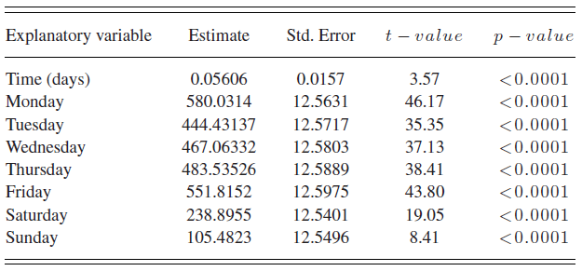
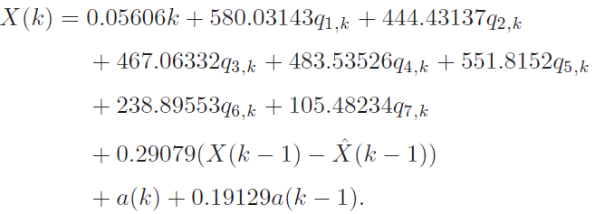
Seasonal Regression ARIMA (SRARIMA)
Notes:
This is the final fitted model. We see all coefficient have small p-value. And consistent with what we see before, Monday and Friday have high coefficient, and Saturday and Sunday has small coefficients.

Slide 8
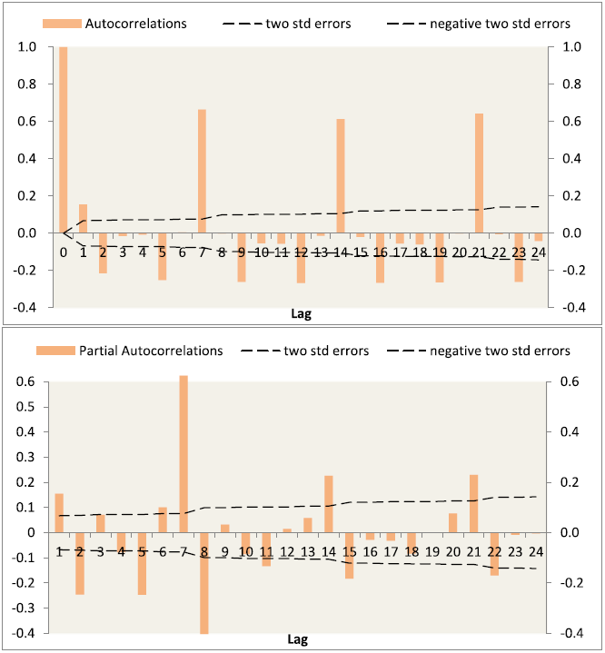
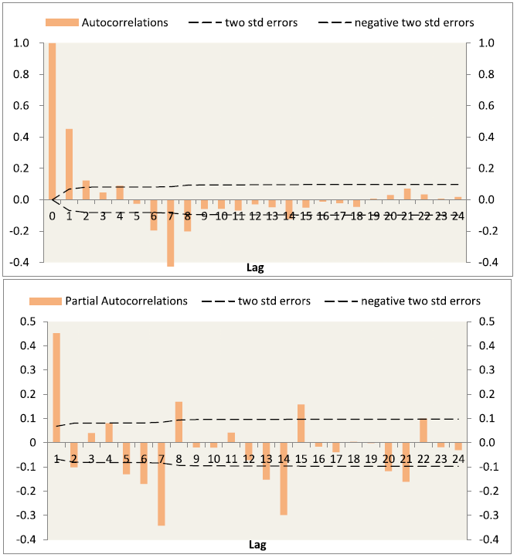
Seasonal Regression ARIMA (SRARIMA)
Autocorrelation coefficients of the original time series
Autocorrelation coefficients of the differencing time series
Notes:
These are the autocorrelation coefficient plot of the original time series and differencing time series. On the left hand right, we see clear seasonal pattern. But on the right hand side, even after differencing, the seasonal effect is not complete removed, which indicate there is still higher order correlation exist among the different seasons.

Slide 9




Multiplicative Seasonal ARIMA (MSARIMA)
Modelling
Trend differencing with order d and seasonal differencing with step length S.
If short-term correlations exist, fit ARMA (p, q).
If cyclic effect exist, and short-term correlations exist among cyclic effects, fit ARMA (P, Q).
non-seasonal model
seasonal model
(S = 7)
: correlations among different points in a same cycle.
: correlations among same points of different cycle.
Notes:
Then the author build another model to address this problem, it is called the multiplicative seasonal ARIMA.
It is combined by a non-seasonal ARIMA model and a seasonal ARIMA model to estimate the seasonal effect with multiplicative correlations between them

Slide 10

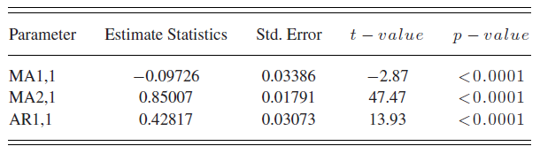
Multiplicative Seasonal ARIMA (MSARIMA)
ARIMA (1, 0, 4) × (0, 1, 1)₇
Notes:
This the final result. The author claimed, they tried many different models, and this is the best one.

Slide 11
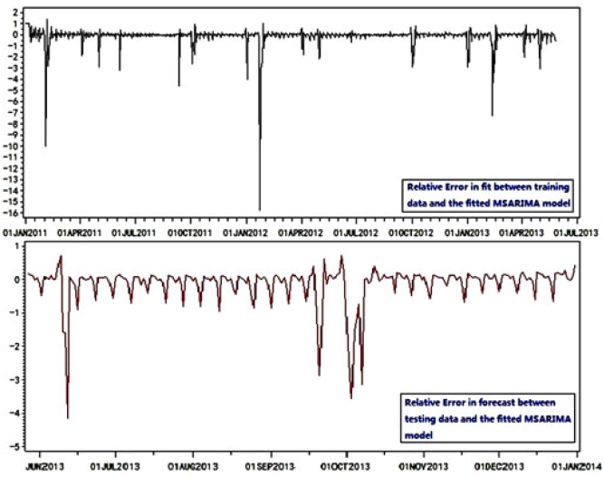
Multiplicative Seasonal ARIMA (MSARIMA)
Notes:
This is the residual plot of the model. We still see some kind of unexplained season effect, in the training set, and this effect is more clear in the test set.

Slide 12
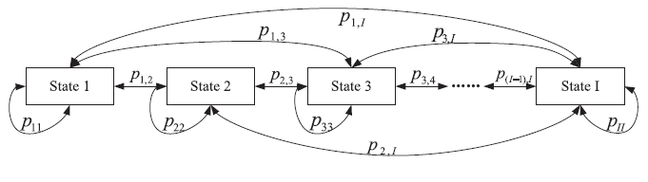
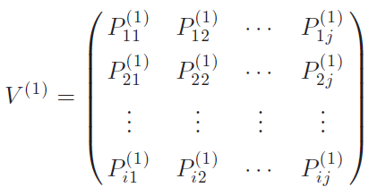
Markov Chain Model
Markov chain is a approach to model stochastic processes with discrete time and state
Notes:
So to further solve this, the author think Markov Chain may help. … .In this graph, the system has I different states. And the this matrix describe the probability of the state transition among different state. The P11 means if the system is now in state 1, the next time point

Slide 13



Combinatorial Model of MSARIMA and Weighted Markov Chain
Suppose a Time Series
Fitting Function
Calculate Performance Measures
Notes:
How to incorporate the Markov chain into the previous model. The first three step are … . And we have done this when we build the multiplicative reasoanl ARIMA.

Slide 14
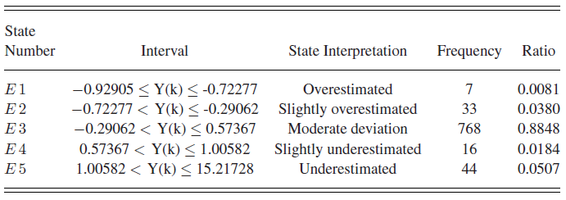
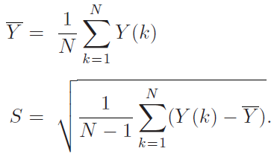
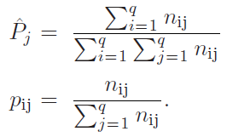



Combinatorial Model of MSARIMA and Weighted Markov Chain
State Confirming and Categorization
(−∞, Y − S], (Y − S, Y − 0.5S], (Y − 0.5S, Y + 0.5S], (Y + 0.5S, Y + S], (Y + S,∞)
Markovian Property Statistical Hypothesis Testing
> α = 0.05
435.078 > 26.296
Notes:
The 4th step is …. Because what we get before is a continual measure of the forecast accuracy in each time point, and we need to translate those into the categorical state for markov chain. The author divide the deviation range into five groups to indicate overestimate, slightly overestimate, moderate deviation, slightly underestimate and underestimate five state.
After that, they did the hypothesis testing to test the process is indeed follow a Markov chain. And they claim yes.

Slide 15
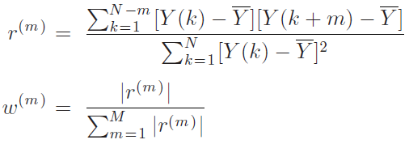
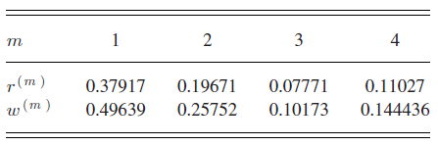
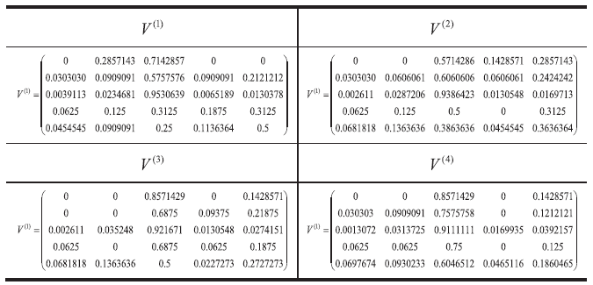
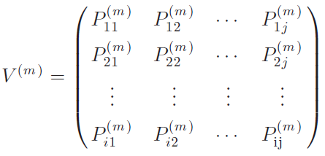

Combinatorial Model of MSARIMA and Weighted Markov Chain
Weights of Markov Chain
State-Transition Probability Matrix
Notes:
The next step is to weight the Markov chain. Because the previous multiplicative seasonal ARIMA look 4 lag behind, the weights of each lag should proportional to their corresponding correlation coefficient. And all the weights should sum up to 1.
The we calculate the state transition probability matrix for each of the lag. Because we look 4 lag, we have 4 matrix. For examples, the matrix describe the state transition probability between current time x and time x – 4.

Slide 16
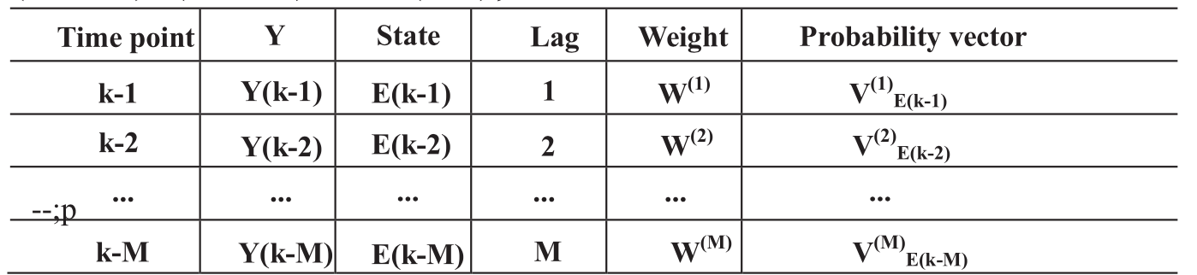
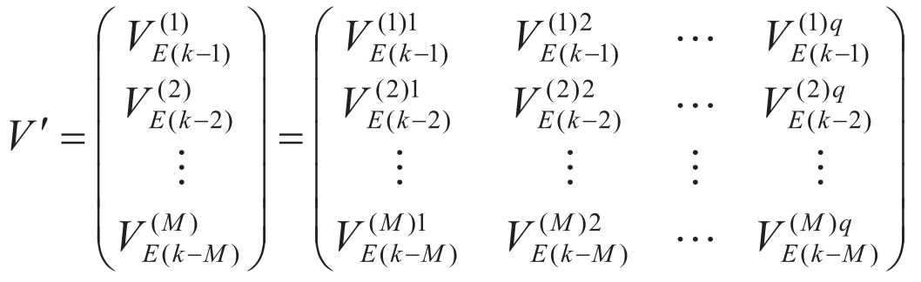
Combinatorial Model of MSARIMA and Weighted Markov Chain
Forecast Calculation
8.1. determine probability vector of predicted time k
8.2. determine new probability matrix for predicting the state of time k
Notes:
To Forecast the current state, we utilize the state of 1 day, 2, 3, 4 day before, and extract their corresponding probability vector of state transitation.
And combine them by row to determine new probability matrix for predicting the state of time k.

Slide 17
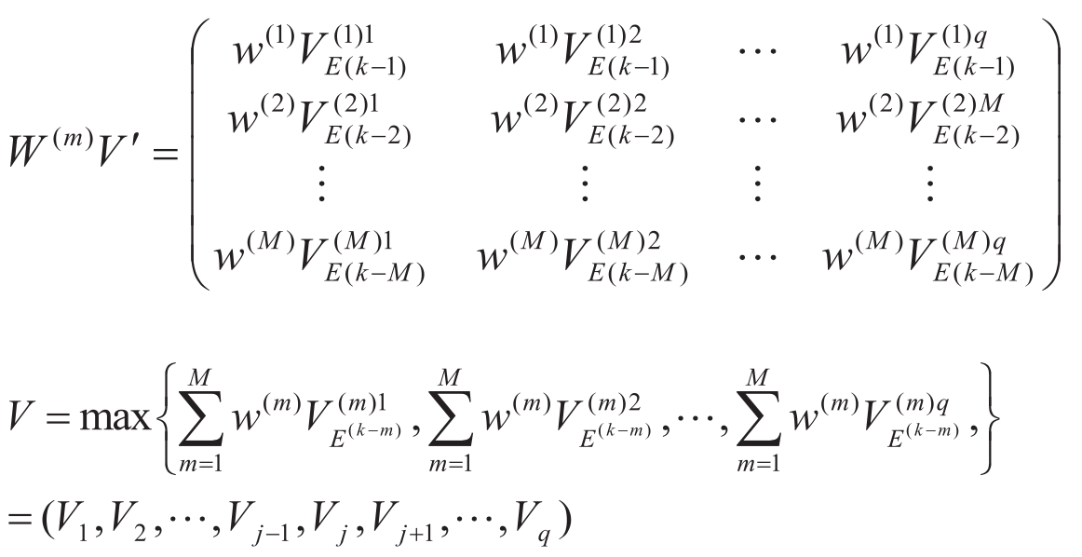

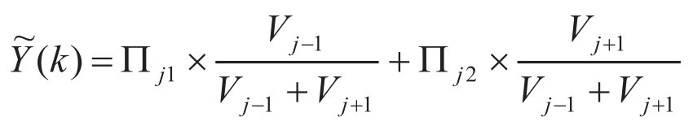

Combinatorial Model of MSARIMA and Weighted Markov Chain
Forecast Calculation
8.3. calculate the maximum weighted probability vector
8.4. calculate the corresponding corrected relative error
Final adjusted forecast

Slide 18
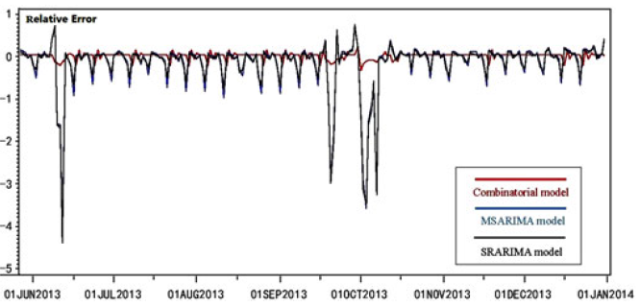
Models Assessment

Slide 19

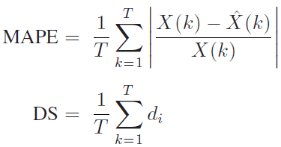
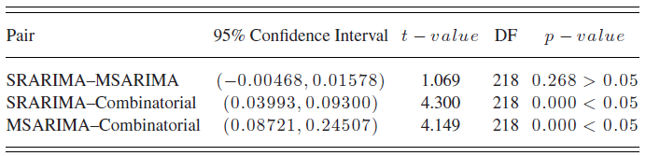
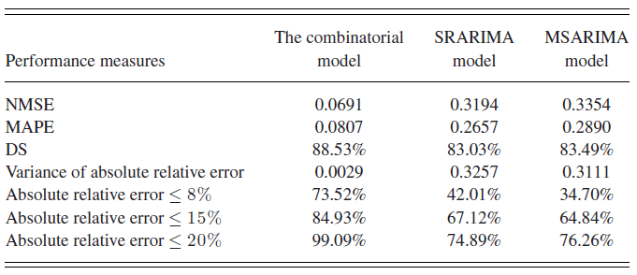
Models Assessment

Slide 20
Discussion
Predicting daily discharges is possible, with a large amount of variance explained by the trend and day-of-the-week effect.
Optimizing effect of implementing a planned discharged remained to be verified and validated. Future study comparing the predicted value and actual value should be considered.
Currently only one day ahead model. Future research could add in the data of left bed each day to model several days ahead.

Slide 21
Thanks!

