Slide 1
Essential Gene
Minzhe

Slide 2
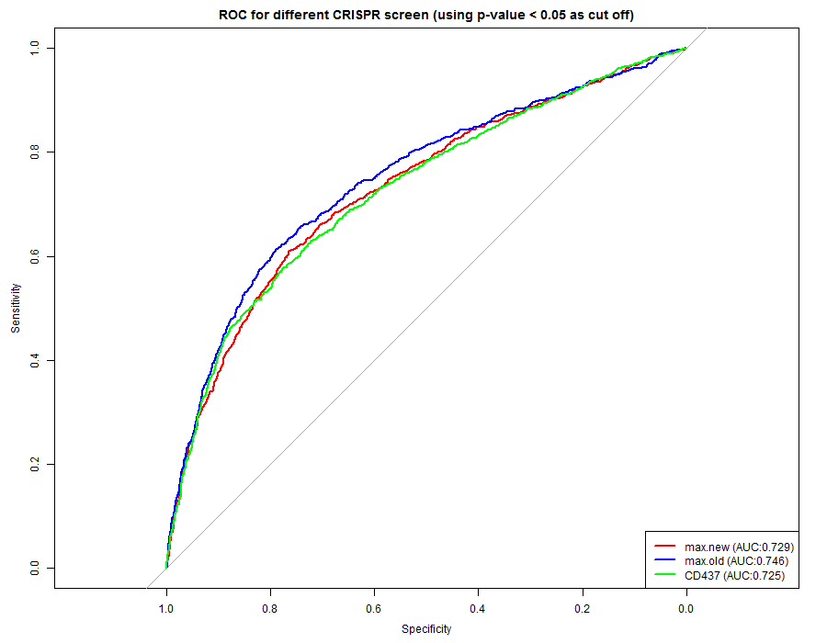
ROC curve

Slide 3
How ROC curve plotted
To plot ROC curve, we would need the true classification (whether a gene is essential or not) and the prediction. Here we don’t know the truth, so I set those genes in the science’s paper with p-value smaller than 0.05 and negative CS score to be the essential genes. Our p-values are used as the predictor.
The prediction by our screen is not bad with AUC around 0.72 (0.5 if random guess), suggesting some common essential genes found. And also three CRISPR screen data have pretty good overlap.

Slide 4
Why use p-value
I discussed with my colleague who is also working with CRISPR data. He suggest use p-value rather than the real gene score (gamma or CS in the paper).
Those score will vary across different platform and algorithm, while p-value is more honest, telling you how confident you could say the score is not 0 (essentiality for growth).

Slide 5
Why use p-value
This is confirmed by the ROC. Though the gamma value is different, three curve overlap well by p-value.
Also, if we plot ROC based on max old data being the truth value, Max new data stand suggesting strong correlation.
CD437 also has good correlation with max old data.

Slide 6
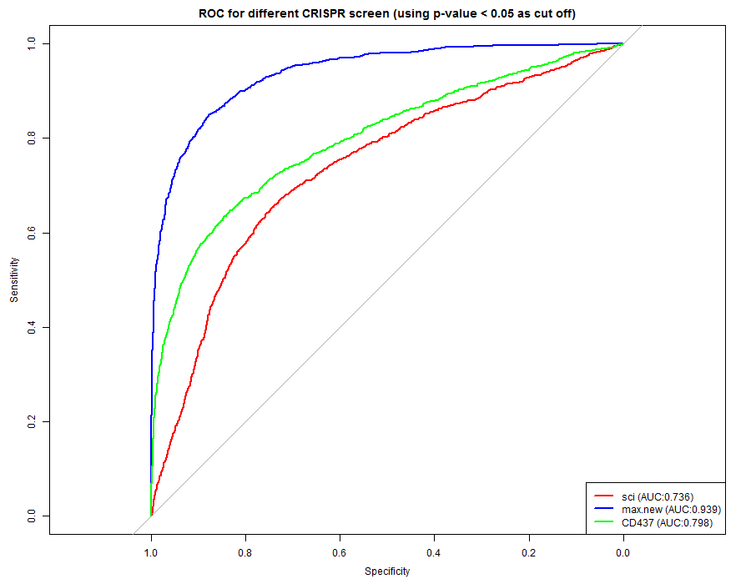
ROC with different truth value
Set the max old data to be the true value

Slide 7
Basic statistics of the dataset
Sumary | Science K562 | Max new | Max old | CD437
Total genes | 18166 | 31594 | 31977 | 31954
Real genes (delete control) | 18166 | 15977 | 15977 | 15977
Negative hits | 1663 | 1969 | 1987 | 2370

Slide 8
Top common hits
Top common hits among the four data set are selected based on p-value smaller than 0.001 ans negative score. (see attachment)

