Slide 2
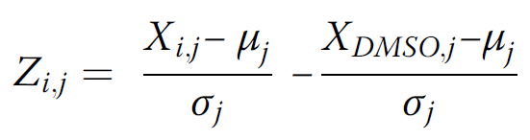

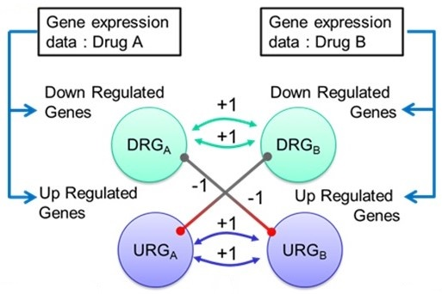
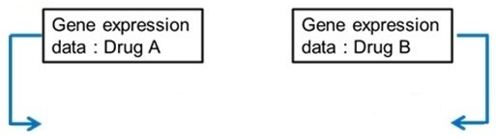
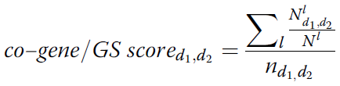
IUPUI_CCBB
Gene set-based method
Differential gene selection (ANOVA)
Drug A ↔ DMSO
Drug B ↔ DMSO
Gene enrichment (delta-z score)
Selecting core gene set
Selecting enriched gene set
(adjusted p-value < 0.05)
Co-enriched
gene set
Enriched
gene sets
Enriched
gene sets
Synergistic score pAB
Rank all possible drug pairs {p₁, p₂, … , p_{m}}
Rank all possible drug pairs by co-gene/GS score

