Slide 2
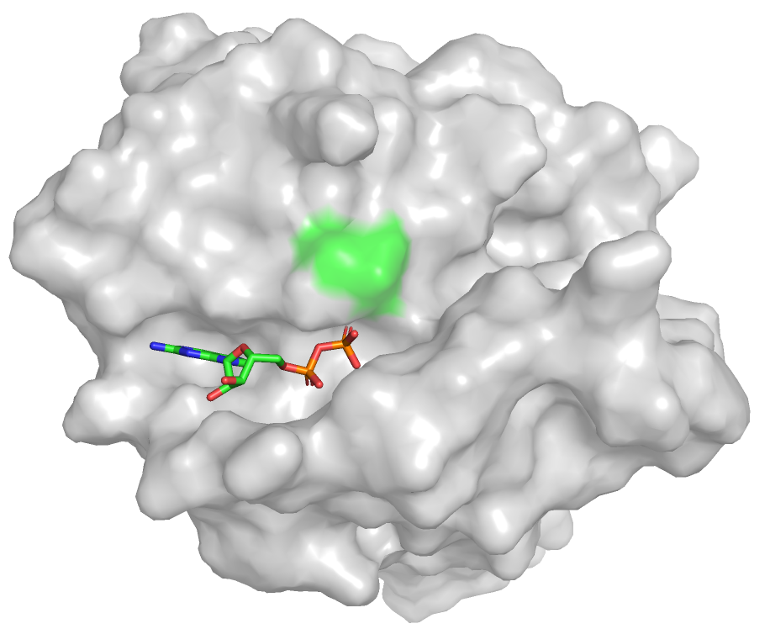
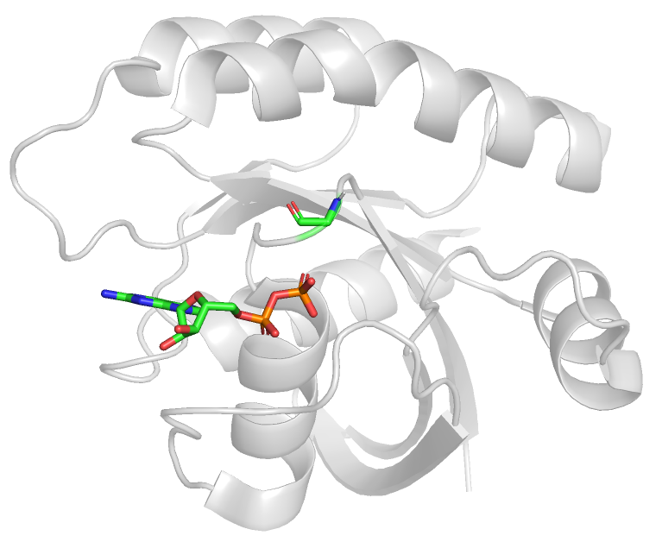
G12
GDP

Slide 3
Cell line | Selumetinib | Trametinib
A549 | 3.35 | 2.95
H2122 | 3.05 | 2.40
SKLU1 | 3.80 | 1.75
H2030 | 2.05 | 1.05
H1792 | 3.45 | 1.45
H23 | 3.30 | 1.80
H358 | 3.15 | 1.85
Ambrogio, C., Köhler, J., Zhou, Z. W., Wang, H., Paranal, R., Li, J., ... & Gondi, S. (2018). KRAS dimerization impacts MEK inhibitor sensitivity and oncogenic activity of mutant KRAS. Cell, 172(4), 857-868.

