Slide 1
Bioinformatics Tool to Detect RBP Bound CircRNA in CLIP-Seq Datasets
Minzhe Zhang

Slide 2
Outline
Background
CircRNA
CircRNA detection
Motivation
Pipeline
Preliminary results
Future plan

Slide 3
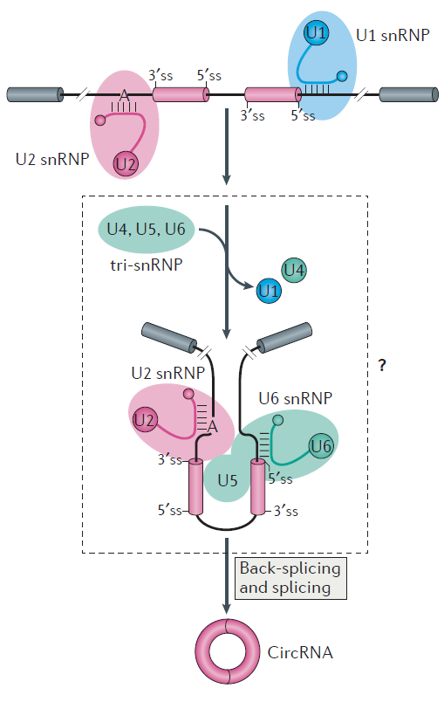
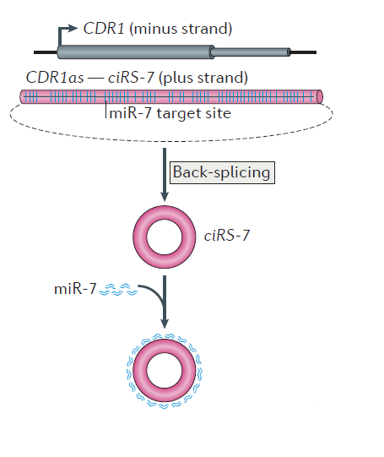
CircRNA
Formation
Back-splicing circularization, downstream 3’ splice site and upstream 5’ splice site is joined
Function
ciRS-7 serves as miRNA sponges

Slide 4
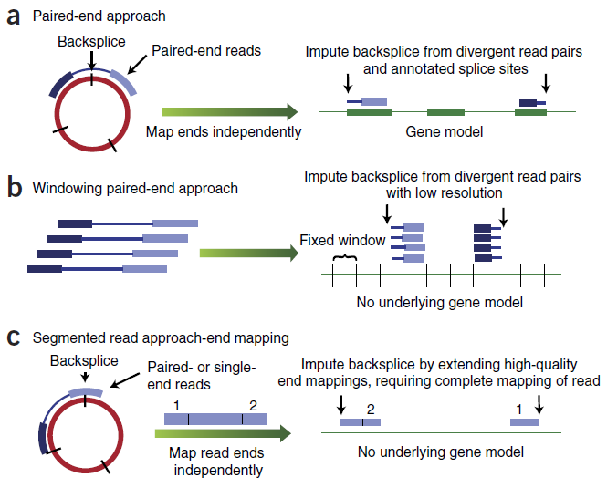
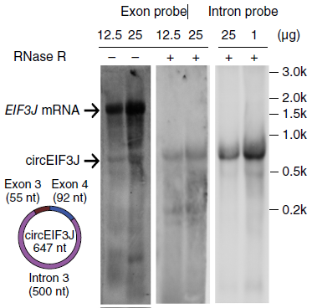
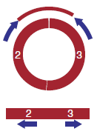
CircRNA detection
Sequencing based methods
Biochemical methods
Impute backsplice from divergent reads
(pair-ends)
Impute backsplice from single reads mapped to two ends
(single or pair ends)
Divergent qPCR primer
RNase R digestion

Slide 5
Motivation
Functionally important to know the RBP-circRNA interaction
Large scale profiling of RBP-circRNA interaction using CLIP-Seq data
Current algorithm to detect circRNA
all focused on RNA-Seq, cannot be directly applied to CLIP-Seq data
CLIP-Seq has shorter length reads compared to RNA-Seq
CLIP-Seq data is exclusively single-end
CLIP-Seq data has limited library complexity
Goal: To develop an pipeline to profile circRNA in CLIP-Seq data
Tool | Language | Aligner | Ref
Mapsplice | Python | Bowtie1 | Wang et al., 2010
find_circ | Python | Bowtie2 | Memczak et al., 2013
circRNA_finder | Perl | STAR | Westholm et al, 2014
CIRCexplorer | Python | Bowtie1 and 2 | Zhang et al, 2014
CIRI | Perl | Bwa | Gao et al, 2015

Slide 6
Workflow
Download public CLIP-Seq datasets
Build alignment library
Collect identified circRNA
CLIP-Seq reads
Linear transcript
Linearization of circRNA sequence
Removing PCR duplicates
Build alignment library from combined genome
Competitive alignment
Alignment to circRNA
Alignment to linear transcript

Slide 7
Competitive alignment
CLIP-Seq reads
Mapped to linear transcript
Mapped to linearized circRNA
Mapped to non-junction part
Mapped to across junction
Filtering rules
The overhangs from the junction too short?
Too many mismatches in either overhang?
Pass both
Fail either one
Alignment to linear transcript
Valid alignments to circRNA
Not a valid alignment

Slide 8
Filtering
To reduce false positive discovery, only keep circRNA:
that have ≥ 2 CLIP-Seq reads mapped across junction.
with at least 20 nucleotides covered at one junction–spanning reads.
with number of unique mapping start position and end position greater than 1/3 of the total number of reads mapped across this junction.

Slide 9
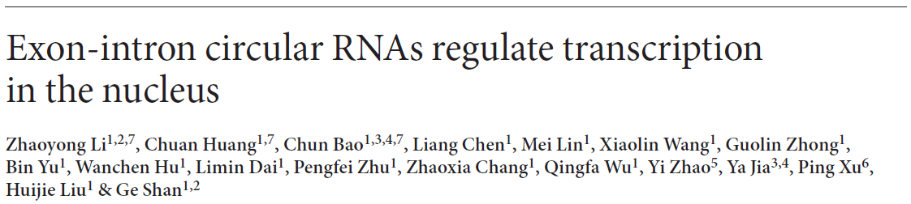
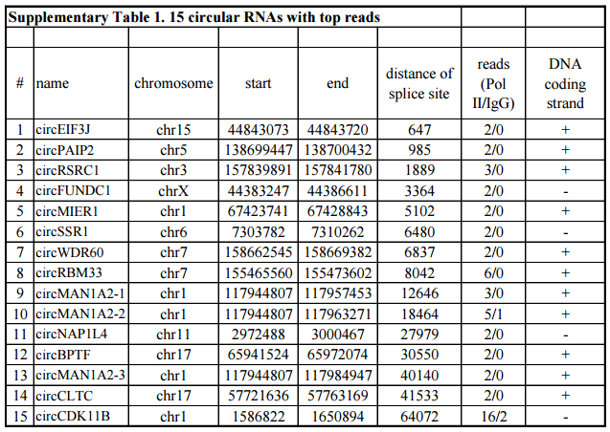
Preliminary validation
circRNA name | Chromosome | Start | End | Strand | # supporting reads
circEIF3J | chr15 | 44843074 | 44843720 | + | 2
circPAIP2 | chr5 | 138699448 | 138700432 | + | 2
circRSRC1 | chr3 | 157839892 | 157841780 | + | 3
circFUNDC1 | chrX | 44383248 | 44386611 | - | 3
circMIER1 | chr1 | 67423742 | 67428843 | + | 3
circSSR1 | chr6 | 7303783 | 7310262 | - | 2
circWDR60 | chr7 | 158662546 | 158669382 | + | 3
circRBM33 | chr7 | 155465561 | 155473602 | + | 12
circMAN1A2-1 | chr1 | 117944808 | 117957453 | + | 2
circMAN1A2-2 | chr1 | 117944808 | 117963271 | + | 9
circNAP1L4 | chr11 | 2972489 | 3000467 | - | 4
circBPTF | chr17 | 65941525 | 65972074 | + | 2
circMAN1A2-3 | chr1 | 117944808 | 117984947 | + | 2
circCLTC | chr17 | 57721637 | 57763169 | + | 0
circCDK11B | chr1 | 1586823 | 1650894 | - | 49
15 experimentally validated circRNA bound by Pol II
Our pipeline re-identified 14 of these 15 circRNA

Slide 10
Future plan
Apply our pipeline to public CLIP-Seq datasets to profile RBP-bound circRNAs
Conduct motif search to determine if RBPs bind to circRNA through specific sequence motif recognition
Cluster RBPs based on the similarity of circRNA they binds to find if clustered RBPs share some similar properties.
Functional study to see if the parental genes for circRNA bound by each RBPs are enriched in some certain biological process.

