Slide 1
[ISPR][Final Project report] CNN for 3D brain MRI classification
By Lanpei Li
lilanpei@gmail.com

Slide 2
Introduction
Data set : subset of ADNI (Alzheimer’s Disease Neuroimaging Initiative ) structural MRI data that has been pre-processed with alignment and skull-stripping marked as “Spatially Normalized, Masked and N3 corrected T1 images”.
Model architecture: VoxCNN (voxels convolutional neural network) : four volumetric convolutional blocks for extracting features (with a number of filters increasing from layer to layer), two deconvolutional layers with batch-norm and dropout for regularization and an output with SoftMax nonlinearity for classification

Slide 3
Data set summary
The dataset has 227 images of four classes:
50 of Alzheimer’s Disease (AD) patients,
39 of Late Mild Cognitive Impairment (LMCI),
77 of Early Mild Cognitive Impairment (EMCI),
61 of Normal Cohort (NC)
There are six binary (one-versus-one) classification tasks for these four classes.
All of the images are stored as voxel intensity values in 3D tensor of shape (110, 110, 110).

Slide 4
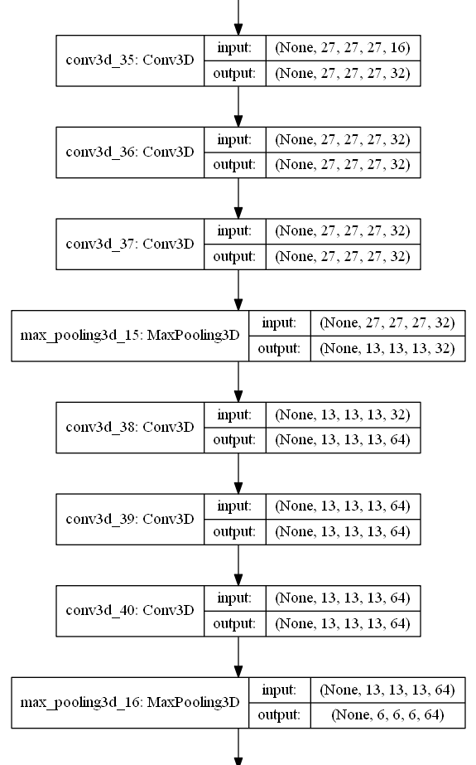
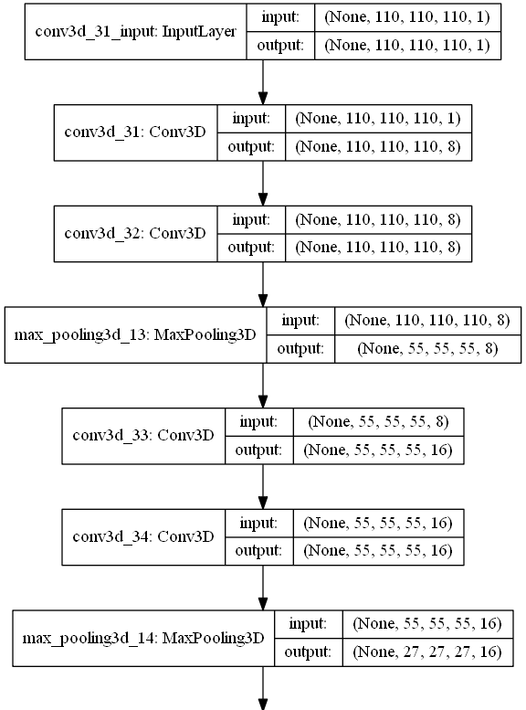
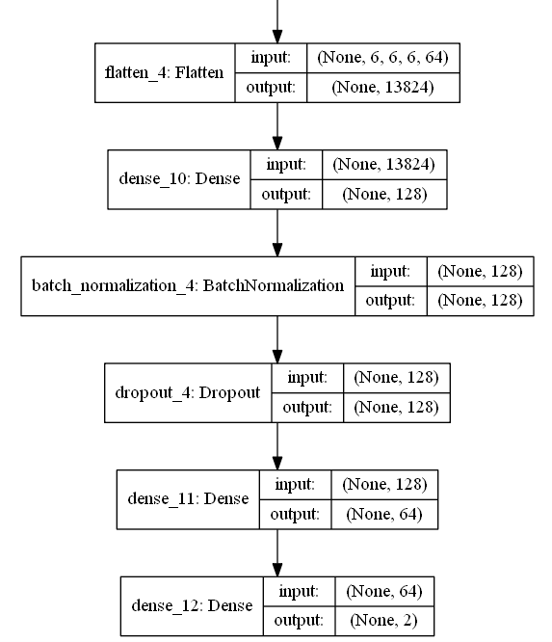
VoxCNN model architecture

Slide 5
VoxCNN model summary & Parameters
_________________________________________________________________ Layer (type) Output Shape Param # ================================================================= conv3d_1 (Conv3D) (None, 110, 110, 110, 8) 224 _________________________________________________________________ conv3d_2 (Conv3D) (None, 110, 110, 110, 8) 1736 _________________________________________________________________ max_pooling3d_1 (MaxPooling3 (None, 55, 55, 55, 8) 0 _________________________________________________________________ conv3d_3 (Conv3D) (None, 55, 55, 55, 16) 3472 _________________________________________________________________ conv3d_4 (Conv3D) (None, 55, 55, 55, 16) 6928 _________________________________________________________________ max_pooling3d_2 (MaxPooling3 (None, 27, 27, 27, 16) 0 _________________________________________________________________ conv3d_5 (Conv3D) (None, 27, 27, 27, 32) 13856 _________________________________________________________________ conv3d_6 (Conv3D) (None, 27, 27, 27, 32) 27680 _________________________________________________________________ conv3d_7 (Conv3D) (None, 27, 27, 27, 32) 27680 _________________________________________________________________ max_pooling3d_3 (MaxPooling3 (None, 13, 13, 13, 32) 0 _________________________________________________________________ conv3d_8 (Conv3D) (None, 13, 13, 13, 64) 55360 _________________________________________________________________ conv3d_9 (Conv3D) (None, 13, 13, 13, 64) 110656 _________________________________________________________________ conv3d_10 (Conv3D) (None, 13, 13, 13, 64) 110656 _________________________________________________________________ max_pooling3d_4 (MaxPooling3 (None, 6, 6, 6, 64) 0 _________________________________________________________________ flatten_1 (Flatten) (None, 13824) 0 _________________________________________________________________ dense_1 (Dense) (None, 128) 1769600 _________________________________________________________________ batch_normalization_1 (Batch (None, 128) 512 _________________________________________________________________ dropout_1 (Dropout) (None, 128) 0 _________________________________________________________________ dense_2 (Dense) (None, 64) 8256 _________________________________________________________________ dense_3 (Dense) (None, 2) 130 ================================================================= Total params: 2,136,746 Trainable params: 2,136,490 Non-trainable params: 256
Training parameters :
Optimizer: AdaM
Learning rate : 27*1e-6
Batch size : 5
No. of epochs : 150
Cross validation parameters :
No. of folds : 5

Slide 6
Implementation
Programming language: python 2.7.12
Deep learning framework: keras 2.1 (TensorFlow backend)
NIFTI1 data loading: nibabel package
Data normalization: local/ global min-max normalization and local/ global standardization. (consider time complexity, local min-max normalization is used by default)
Validation: Balanced 5-fold cross-validation ( from sklearn.model_selection)
Batch generating: Guarantee samples of each class in every batch by oversample from the class that has less number of samples

Slide 7
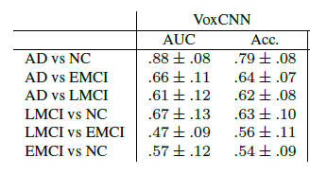
Compare results 1
Results from paper :
Results from my implementation :
ROC_AUC : [mean] ± [std]
AD vs NC : [0.87538462] ± [0.06169398] AD vs EMCI : [0.65433333] ± [0.05580634] AD vs LMCI : [0.76464286] ± [0.06621509] LMCI vs NC : [0.66934524] ± [0.05654292] LMCI vs EMCI : [0.51897321] ± [0.15433192] EMCI vs NC : [0.49821581] ± [0.0859987]
evaluation acc : [mean] ± [std]
AD vs NC : [0.74743083] ± [0.1340696] AD vs EMCI : [0.62246155] ± [0.11438376] AD vs LMCI : [0.5398693] ± [0.08587749] LMCI vs NC : [0.53092732] ± [0.10495938] LMCI vs EMCI : [0.66389989] ± [0.01105777] EMCI vs NC : [0.5365353] ± [0.04308016]

Slide 8
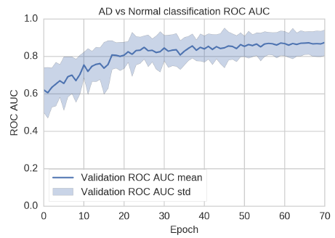
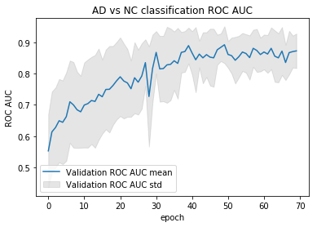
Compare results 2
Results from paper :
Results from my implementation :
ROC AUC plot for AD vs Normal classification of ResNet.
ROC AUC plot for AD vs Normal classification of VoxCNN.

Slide 9
Conclusion 1
The experiment form my implementation is close to the results shown on the paper, the difference may from:
Number of samples : only find 39 of LMCI samples from ADNI, instead of 43 which the paper used.
Training parameters : there is not so many information from the paper, only given optimizer, learning rate, batch-size and No. of epochs, so other parameters I just used the default value.
Data normalization: which the author of the paper not specified, min-max normalization is used by default in my implementation.

Slide 10
Conclusion 2
Batch generating: “guarantees samples of each class in every batch” from the paper but without showing details, here I used a strategy that oversample from the class that has less number of samples to achieve this kinds of “balanced batch”.
Fit the ADNI data to VoxCNN model without complex pre-processing or model stacking can achieves relatively good results, but in my case the training is unstable using the given parameters.

Slide 11
The future of work
Memory friendly implementation (delays the data loading until the data is needed)
Tune stable parameters for VoxCNN model
Implement other model on ADNI dataset (e.g. ResNet)

Slide 12
Resources
Code : https://github.com/lilanpei/ADNI
Input data set : https://drive.google.com/open?id=1a3a7e-aiCKENwKsAzVf2AOfQWq7y-yOR
Output log : https://drive.google.com/open?id=1u3iTdCJqyZqMkFZCi_neXH9tBslGbAVg

Slide 13
Reference 1
Residual and Plain Convolutional Neural Networks for 3D Brain MRI Classification : https://arxiv.org/abs/1701.06643
Nibabel : http://nipy.org/nibabel/gettingstarted.html
Nvidia-docker: https://devblogs.nvidia.com/nvidia-docker-gpu-server-application-deployment-made-easy/
ADNI: https://ida.loni.usc.edu/login.jsp
Keras: https://keras.io/layers/convolutional/
About KFold splitting: https://scikit-learn.org/stable/modules/classes.html#module-sklearn.model_selection

Slide 14
Reference 2
About KFold splitting: https://scikit-learn.org/stable/modules/classes.html#module-sklearn.model_selection
About 3D Image Normalization and standardization:https://forums.fast.ai/t/images-normalization/4058
About utilities: https://github.com/alleboudy/CodeSnippets/blob/master/LeboudyDLProjectOrganization/utilities.py
About setGPU: https://github.com/bamos/setGPU

Slide 15
Thank you !

