Slide 1
A Multi-Strategy Study of Medical QA
MedQA
From TF-IDF Baseline to PubMedBERT Fine-tuning and RAG
Course: COMP6713 Natural Language Processing Team: Alearner Members: Yuyi Zhu · Ian Zhao · Songning Liu · Wanxin Ma · Muyi Yang Date: April 2026
Medical Question Answering
Talk length: 5–7 minutes + Q&A

Slide 2
Problem & Motivation
Why Medical QA is Hard
Medical QA requires the system to understand questions in a clinical or research context, retrieve evidence from medical literature, and produce accurate, traceable answers.
Compared to open-domain QA, the medical setting demands much higher
factuality, interpretability, and controllability.
01
Terminology & Synonyms
Heavy ambiguity across abbreviations, brand names, INNs, and UMLS concepts.
02
Answer Format Variety
Each dataset expects a different answer shape (yes/no/maybe, factoid noun phrase, free text); one model must adapt to multiple output formats.
03
Groundedness Requirement
Answers must be grounded in authoritative literature rather than model parametric knowledge to avoid hallucination.

Slide 3
Datasets & Annotation
Three Public Corpora + UMLS
PubMedQA
BioASQ
MedQA-USMLE
1k labelled+ 61k unlabelled
≈ 3,000
≈ 12,000
Yes/No/Maybe with long-answer paragraphs; ideal for type classification.
Factoid noun-phrase answers (1–8 words); cross-validated accuracy > 0.85.
USMLE board exam multiple-choice; tests reasoning ceiling.
Project Highlights
Unified SQuAD-style corpus covering yes/no/maybe, factoid, and free-text answer types, with UMLS concept tags.
End-to-end implementation of TF-IDF baseline, PubMedBERT fine-tuning, and RAG, all evaluated side by side.
RAG with BGE-M3 + BGE-reranker-v2-m3 two-stage retrieval and answer-type-conditioned prompting.
Five-class error typology + per-source breakdown for interpretable analysis.
Data Governance & Agreement
PubMedQA double-annotation Cohen κ = 0.78; BioASQ multi-annotator consensus κ > 0.85.
All corpora unified to SQuAD v2 schema (with is_impossible + CLS fallback).
scispaCy + en_core_sci_lg extracts UMLS CUIs for query-expansion experiments and interpretability.
Train/val/test split is question- and PMID-deduplicated to prevent leakage.

Slide 4
System Overview
Three Backends, One Evaluation Harness
TF-IDF + Rules
Unified Evaluation Harness
Sparse vector · simple, reproducible
scripts/eval/run_eval.py
EM · Token-F1 · BERTScore
ROUGE-L · Yes/No accuracy
Recall@k · MRR (RAG only)
Answer length / confidence calibration
Per-source split (PubMedQA / BioASQ / MedQA)
PubMedBERT Fine-tuning
Extractive QA · span prediction
RAG (Qwen2.5-14B)
Generative · long answers + citations

Slide 5
Baseline: TF-IDF + Rules
Sparse Retrieval Baseline
scikit-learn TfidfVectorizer (max_features=50,000, ngram_range=(1,2), sublinear_tf=True).
Retrieves over the gold-context passages only; no separate index.
Query: original question text; no UMLS expansion in the baseline.
Answer: top-1 sentence by cosine similarity to the query.
No specialised yes/no head; the top-1 sentence is returned verbatim.
Baseline Results (combined dev set)
Metric
Value
Note
EM
0.000
Sentence extract ≠ short gold
Token-F1
0.022
Near-zero token overlap
BERTScore-F1
0.779
Topical but not exact
Yes/No Acc
0.000
0/8 on PubMedQA; no yesno head
→ Acts as the lower bound for downstream models.

Slide 6
Method 1: PubMedBERT Fine-tuning
Span Extraction with Domain Pre-trained BERT
Fine-tuned Performance
Backbone: microsoft/BiomedNLP-PubMedBERT-base-uncased-abstract.
Task head: linear start / end logits; CLS index serves as fallback for unlocated spans.
Loss: L = 0.5 · (FocalLS(start) + FocalLS(end)), focal_gamma γ = 2.0, label_smoothing ε = 0.1.
Training: 3 epochs, AdamW lr = 2×10⁻⁵, warmup_ratio 0.06, max_len 512, stride 128, batch 16, fp16.
MCQ records (MedQA-USMLE) are filtered; ≈ 40 % of PubMedQA spans default to [CLS] via deterministic matching.
0.350
EM
0.387
Token-F1
0.848
BERTScore
0.375
Yes/No Acc
Method 2: RAG 5-Stage Pipeline
Retrieval-Augmented Generation
1. Expand
2. Retrieve
3. Rerank
4. Generate
5. Format
scispaCy NER +
UMLS canonical name
BGE-M3 dense @ChromaDB
Top-10 candidates
BGE-reranker-v2-m3
Top-10 → Top-3
Qwen2.5-14B-Instruct
4-bit NF4 (9 GB VRAM)
Answer-type-conditioned
output (yesno / factoid / free)
Key Tech Stack
Vector store: ChromaDB · cosine distance · sentence granularity · persisted at ./chroma_db.
Embedding: BGE-M3 (multilingual + long-doc support), 1024-dim.
Reranker: BGE-reranker-v2-m3 cross-encoder, rescoring the top-10 and keeping top-3.
Generator: Qwen2.5-14B-Instruct, bitsandbytes 4-bit NF4 (28 GB → 9 GB VRAM).
Prompt: 3 templates (yesno / factoid / free) switched by `answer_type` in llm_qa.py.

Slide 7
Key Improvements
Finding: Negative Result
Extension 1: UMLS Query Expansion
MRR (rerank@5): 0.137 → 0.136
Why:
UMLS synonyms dilute the query embedding in BGE-M3;
BGE-M3 already captures much medical vocabulary;
Kept in code behind a flag; conditional triggering on entity confidence is future work.
Use scispaCy NER + UMLS linker on the original query to obtain candidate CUIs.
For each CUI take the preferred name + top-3 most frequent synonyms.
Concatenate as expanded query: original ⊕ "OR" ⊕ synonym set.
Run an A/B comparison on BGE-M3 recall (on/off).
Extension 2: Two-Stage Retrieval
BGE-M3 Dense
Reranker
Pick Top-3 paragraphs
Top-10 candidates cosine similarity.
+41% Recall
BGE-reranker-v2-m3 cross-encoder scoring.
+64% MRR
Feed into Qwen2.5-14B generator.
Form 10 to 3 Candidate convergence
The reranker computes cross-attention on the top-10, keeping latency around 3–4× the dense stage alone.
The second stage sharply reduces noise in the LLM input, indirectly mitigating hallucination.
Extension 3: Answer-Type Conditioned Prompting
Prompt Template Differences
Effect
Yes/No
"Restrict output to {yes, no, maybe}; max_new_tokens = 4."
EM (PubMedQA): 0 → 0.25
Eliminates format mismatch in yes/no & factoid QA
Improves alignment with dataset answer types
Factoid
"Extract a 1–8-word noun phrase from the context; max_new_tokens = 32."
Free
"Generate a concise answer (≤ 2 sentences); default max_new_tokens."
Switching
logic
The template is switched per-record by `answer_type` in `llm_qa.py` (yesno / factoid / free).

Slide 8
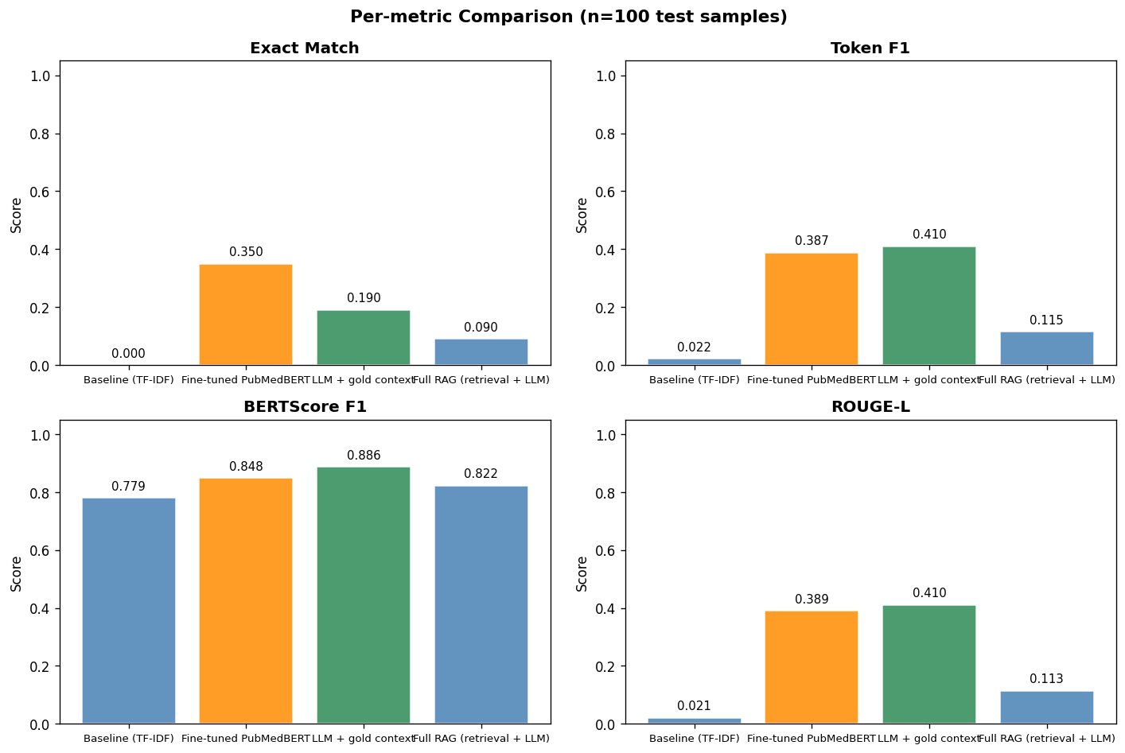
Quantitative Results
Quantitative Results · 4 Metrics × 4 Backends · n = 200
Key Take-aways
PubMedBERT still leads on EM/F1 — extractive answers align tightly with gold spans. RAG (full) has lower EM (0.115) but BERTScore reflects strong semantic similarity. RAG + gold ctx reaches F1=0.410 / BERTScore=0.886, proving the bottleneck is retrieval.

Slide 9
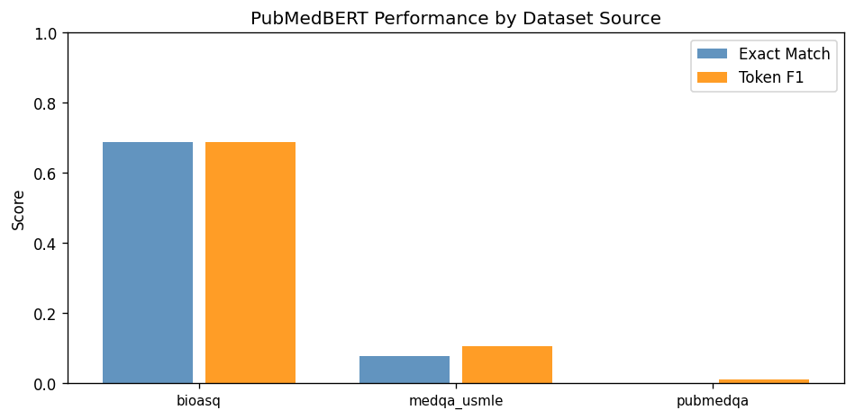
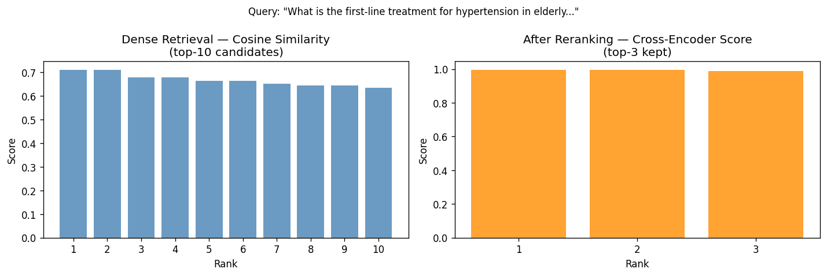
Per-Source Analysis & Retrieval Bottleneck
Per-Source Breakdown · Retrieval is the Bottleneck
BERTScore-F1 by data source
Dense vs. Rerank Recall@K
PubMedQA shows the smallest gap; BioASQ and MedQA reveal RAG's advantage more clearly.
Recall@1 = 0.155; Recall@3 = Recall@5 = Recall@10 = 0.210 — the dense retriever plateaus quickly and caps downstream F1.
Adding the reranker boosts Recall@1 by 41% and MRR by 64%.

Slide 10
RAG Component Ablation
Configuration
F1
BERT-F1
Recall@1
MRR
Take-aways
Dense single-stage
0.101
0.818
0.083
0.083
Reranker is the single biggest win. Prompt engineering lifts BERTScore but cannot fix Recall. Gold ctx → F1=0.41 confirms retrieval is the ceiling.
+ Reranker
0.103
0.821
0.155
0.137
+ Answer-type prompt
0.115
0.886
0.155
0.178
+ Gold context (ceiling)
0.410
0.886
1.000
1.000
Qualitative Error Analysis (TF-IDF baseline, n = 197 errors)
WRONG_RETRIEVAL
HALLUCINATION
PARTIAL_ANSWER
TERMINOLOGY_MISMATCH
OTHER
3.5%
52%
17%
2%
25%
Gold answer tokens absent from the retrieved context (< 20 % overlap).
Long prediction with near-zero overlap to gold — baseline returns full MCQ option list.
F1 between 0 and 0.5 with partial overlap against gold.
Short prediction (≤ 5 tokens) with zero token-F1 — synonym / abbreviation mismatch.
Residual failures not matching the four categories above.
Action Items
HALLUCINATION dominates TF-IDF (52 %): the baseline emits full option strings instead of the short gold answer.
PubMedBERT's error profile is different: TERMINOLOGY_MISMATCH covers 84 % (e.g. cholecalciferol vs. 1,25-dihydroxycholecalciferol).
WRONG_RETRIEVAL is the smallest category in the heuristic because context is always the gold passage in run_eval.py.
Data source: data/processed/baseline_errors.json and bert_errors.json.

Slide 11
Conclusions & Future Work
Conclusions & Future Work
What we did right
Future Work
3-way comparison, unified evaluation, error typology, reproducible scripts.
Hybrid retrieval: weighted fusion of BGE-M3 + BM25 for long-tail term recall.
Sentence-level chunking + citation-level evidence extraction to lift Recall@1.
SFT / DPO adaptation of the generator with explicit "abstain" training samples.
LLM-as-Judge (Qwen2.5-72B) on the evaluation side for cross-validation.
Safety-aware calibration for clinical use — uncertainty proportional to risk.
Headline numbers
PubMedBERT EM = 0.350; RAG full F1 = 0.115; RAG + gold F1 = 0.410 / BERT = 0.886.
Engineering trade
4-bit NF4 squeezes a 14B model into 9 GB VRAM — single-card deployable.

Slide 12
Q & A
Thank you for listening
Happy to take questions on methodology / evaluation / engineering / clinical fit
Repository: comp6713-medqa

